Slide 1

James Bond
Data analysis presented by: Katherine Howison & Melissa Benson

Slide 2
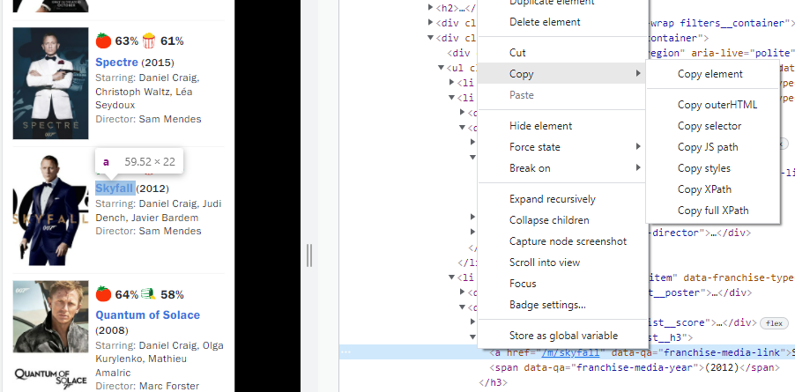
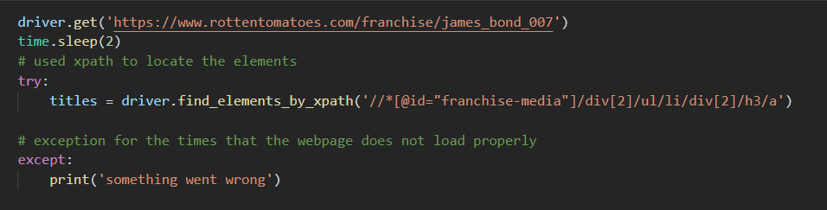
webscraping
Find element by xpath
A slightly different approach to the one we used in class

Slide 3

Python code
I had difficulty reading in some of the data to the d3 chart. I overcame these problems in two ways (this looks really simple, but it took me a few hours to work this out and overcome the data reading problems)
D
strings
A
T
integers
A
C
L
E
A
N
I
N
G

Slide 4
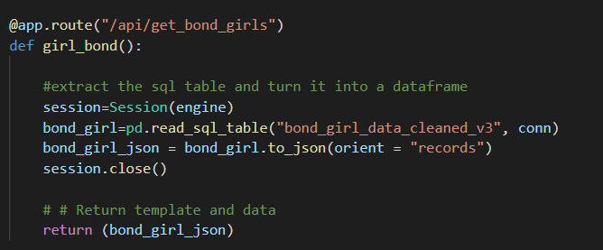
Access data
Use flask to access the database and jsonify data

Slide 5
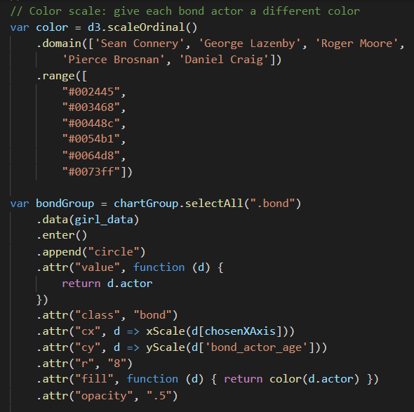
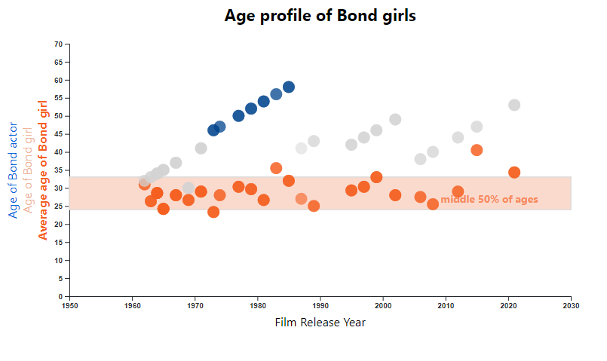
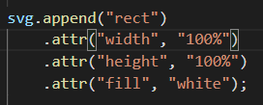
Charting with d3js
Add a value to each circle and use this value to assign colour and listen to in a click event.
Mostly I used the techniques covered in class, with a few additions.
I didn’t use the latest version of d3, because I couldn’t get the tooltips addin to work with the latest version.
Add a chart background (order matters)

Slide 6
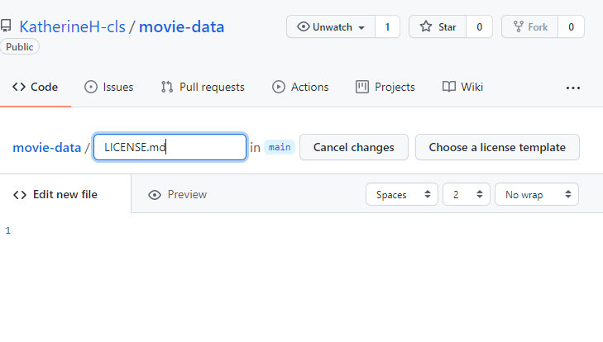
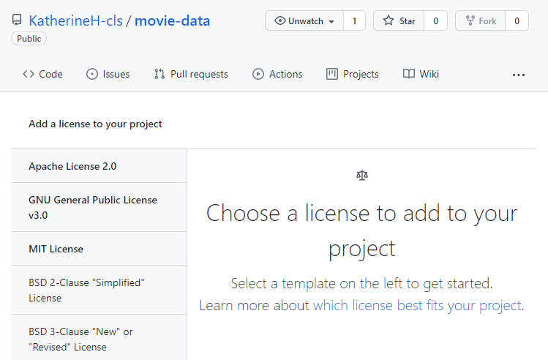
webpage
Javascript library – fullpage.js
link
https://alvarotrigo.com/fullPage/
docs
https://github.com/alvarotrigo/fullPage.js/#fullpagejs
Used to create fullscreen scrolling websites
Free for Open Source
fullPage v3 is an Open Source application licensed under a GPLv3 license. This license allows you to use fullPage in Open Source projects but it requires your project to be public and licensed under GPLv3
Create a license in github
Add file, call it LICENSE or LICENSE.md, select the appropriate license from a drop down list.

Slide 7
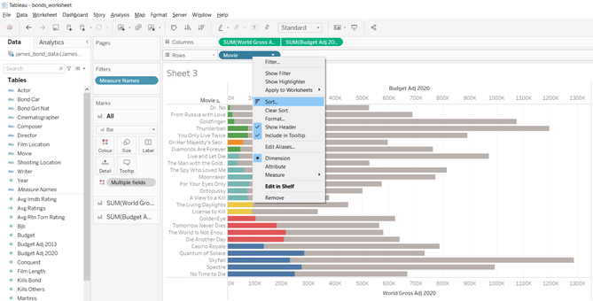
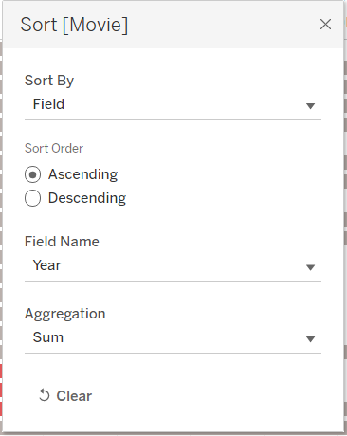
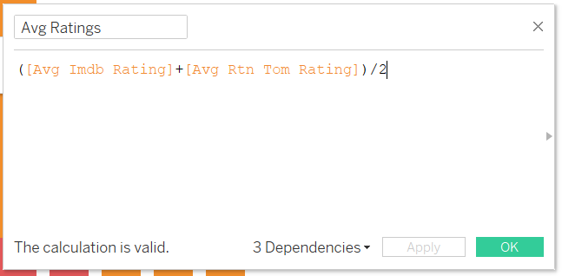
Tableau

Slide 8
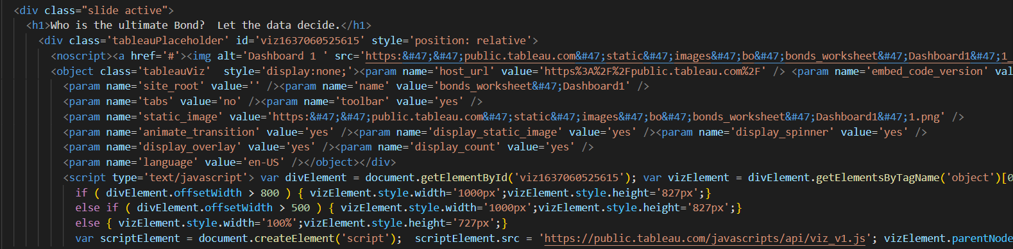
Embedding Tableau into HTML
Create Tableau public account
Connect Tableau desktop workbook to Tableau public
Share and embed information into HTML

Slide 9
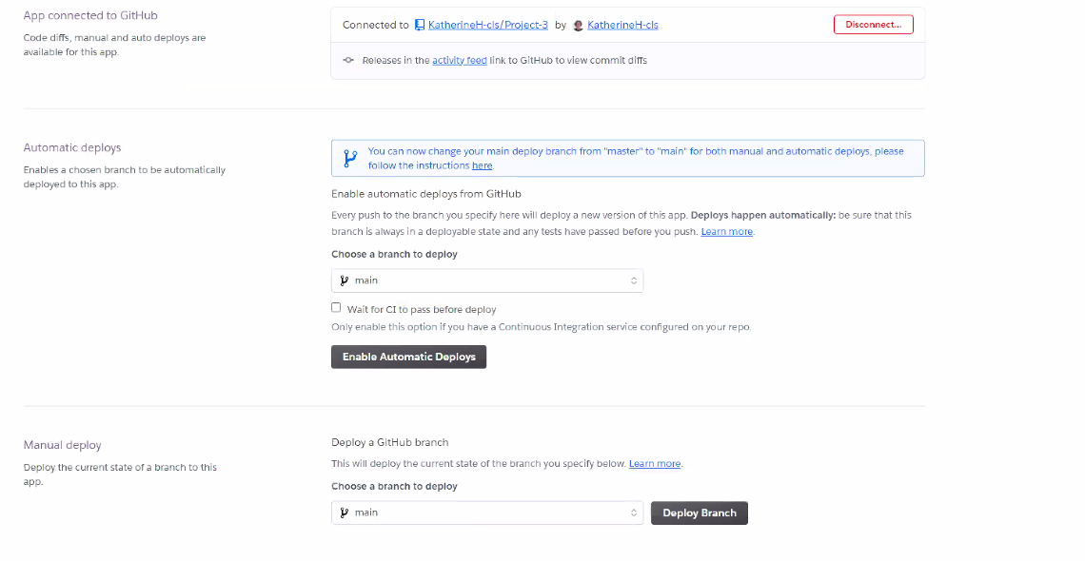
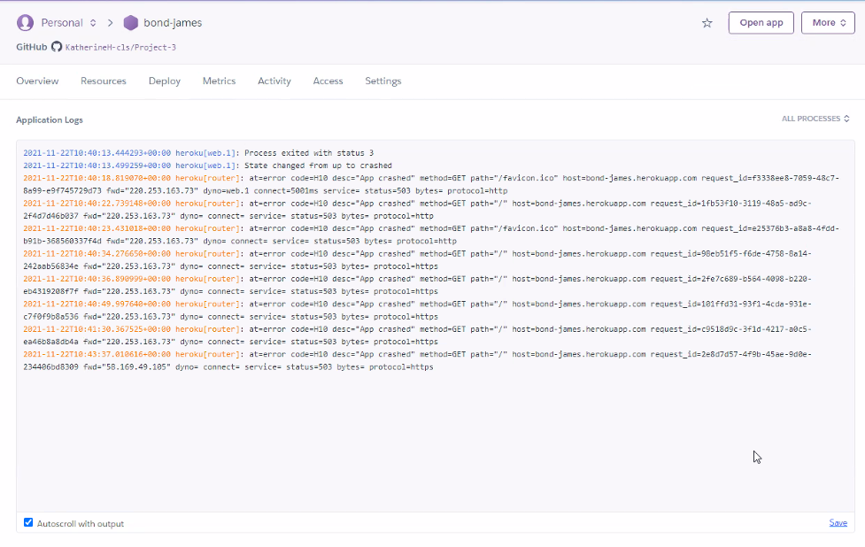
Heroku Deployment
Connect Heroku to the Github page
Select manually deploy
Check for Application Logs to check errors in deployment

