Slide 1

James Bond
Data analysis presented by: Katherine Howison

Slide 2
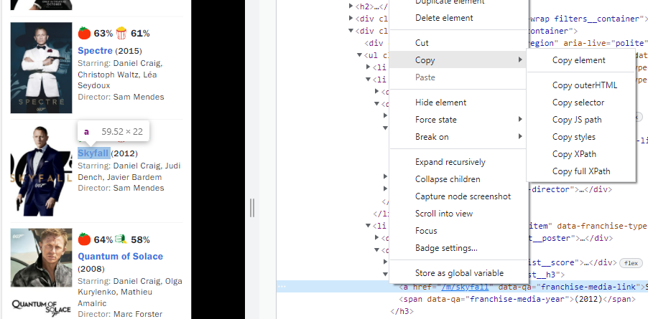
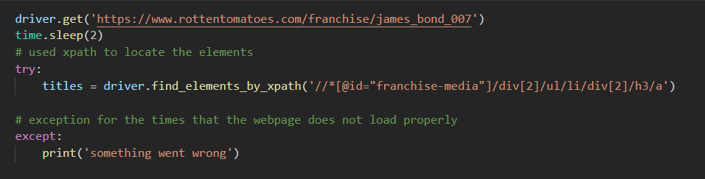
webscraping
Find element by xpath
A slightly different approach to the one we used in class

Slide 3

Python code
I had difficulty reading in some of the data to the d3 chart. I overcame these problems in two ways (this looks really simple, but it took me a few hours to work this out and overcome the data reading problems)
D
strings
A
T
integers
A
C
L
E
A
N
I
N
G

Slide 4
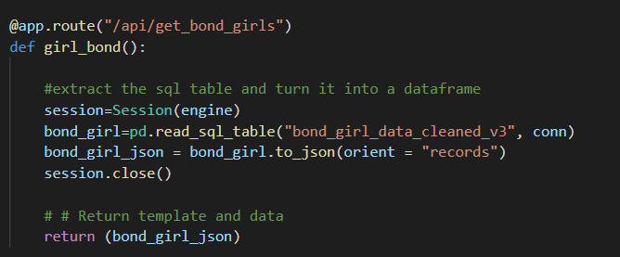
Access data
Use flask to access the database and jsonify data

Slide 5
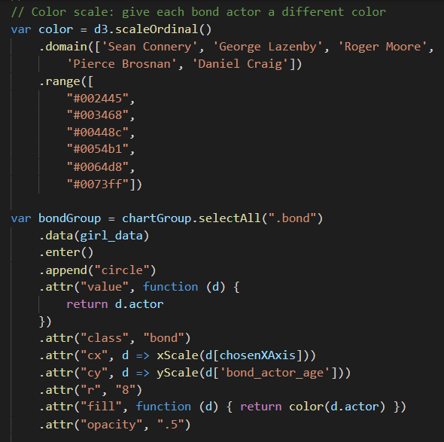
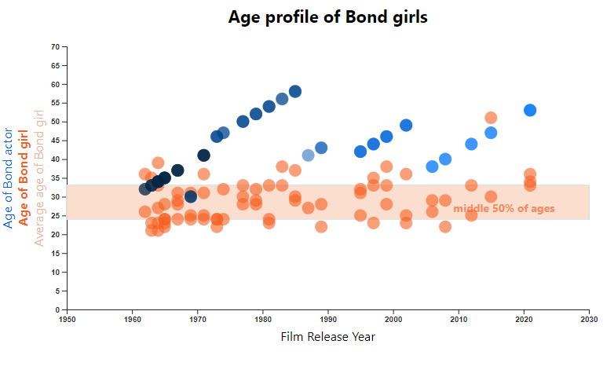
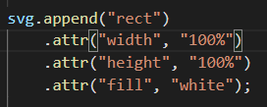
Charting with d3js
Add a value to each circle and use this value to assign colour and listen to in a click event.
Mostly I used the techniques covered in class, with a few additions.
I didn’t use the latest version of d3, because I couldn’t get the tooltips addin to work with the latest version.
Add a chart background (order matters)

Slide 6
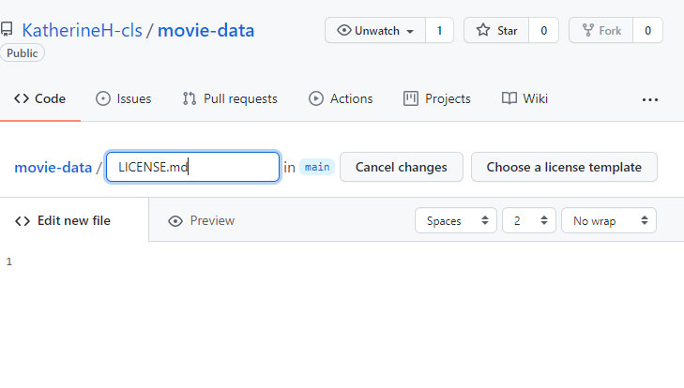
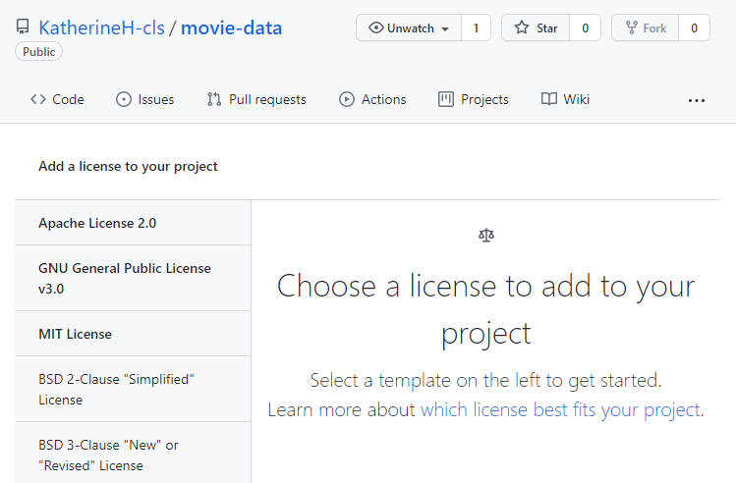
webpage
Javascript library – fullpage.js
link
https://alvarotrigo.com/fullPage/
docs
https://github.com/alvarotrigo/fullPage.js/#fullpagejs
Used to create fullscreen scrolling websites
Free for Open Source
fullPage v3 is an Open Source application licensed under a GPLv3 license. This license allows you to use fullPage in Open Source projects but it requires your project to be public and licensed under GPLv3
Create a license in github
Add file, call it LICENSE or LICENSE.md, select the appropriate license from a drop down list.

Slide 7
webscraping
Find elements by xpath
entrepreneurial activities differ substantially depending on the type of organization and creativity involved. entrepreneurship ranges in scale from solo. entrepreneurial activities differ substantially depending on the type of organization and creativity involved.
write another line here
entrepreneurial activities differ substantially depending on the type of organization and creativity involved. entrepreneurship ranges in scale from solo. entrepreneurial activities differ substantially depending on the type of organization and creativity involved.
01
write a title
entrepreneurial activities differ substantially depending on the type of organization and
02
write a title
entrepreneurial activities differ substantially depending on the type of organization and

Slide 8
our company values
Entrepreneurial activities differ substantially depending on the type of organization and creativity involved. Entrepreneurship ranges in scale from solo. Entrepreneurial activities differ substantially depending on the type of organization.
your title
your title
your title
entrepreneurial activities differ substantially depending
entrepreneurial activities differ substantially depending
entrepreneurial activities differ substantially depending

Slide 9
write here something
write a title in this section
entrepreneurial activities differ substantially depending on the type of organization and creativity involved. entrepreneurship ranges in scale from solo. entrepreneurial activities differ
write a title in this section
entrepreneurial activities differ substantially depending on the type of organization and creativity involved. entrepreneurship ranges in scale from solo. entrepreneurial activities differ
write a title in this section
entrepreneurial activities differ substantially depending on the type of organization and creativity involved. entrepreneurship ranges in scale from solo. entrepreneurial activities differ
write a title in this section
entrepreneurial activities differ substantially depending on the type of organization and creativity involved. entrepreneurship ranges in scale from solo. entrepreneurial activities differ
write a title in this section
entrepreneurial activities differ substantially depending on the type of organization and creativity involved. entrepreneurship ranges in scale from solo. entrepreneurial activities differ
write a title in this section
entrepreneurial activities differ substantially depending on the type of organization and creativity involved. entrepreneurship ranges in scale from solo. entrepreneurial activities differ

Slide 10
Get more Presentations
DOWNLOAD HERE

Slide 11
write another line here
entrepreneurial activities differ substantially depending on the type of organization and creativity involved. entrepreneurship ranges in scale from solo. entrepreneurial activities differ substantially depending on the type of organization and creativity involved.

