Slide 1
Experiment Management with Guild.ai

Slide 2
Motivation for robust experiment management in DS/ML/AI
Machine Learning projects have far more branching and experimentation than a typical software project.
Machine Learning code generally doesn’t throw errors, it just underperforms
Reproducing previous results requires a high-fidelity record of previous runs. A small change in training data, code or hyperparameters can wildly change a model’s performance.
Running machine learning experiments can be time consuming and just the compute costs can get expensive.
Lukas Biewald (Founder CEO of Weights and Biases)

Slide 3
Key Features of Guild AI:
Track Experiements
Captures key artifacts of training runs:
Source Code snapshots
Save outputs
Log scalar metrics
Compare and Analyze runs
Automate pipelines
Back up runs remotely
Publish and share results
Comand Line interface workflows
Works without having to modify existing scripts or connecting to exotic database. Uses the system file system for storing runs

Slide 4
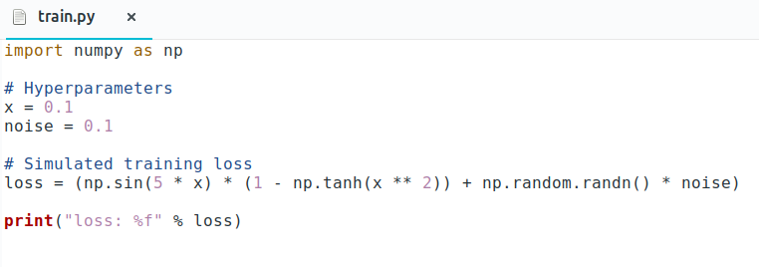
Main concept underlying Guild AI
📂 ml-project/
🐍 train.py
# make directory to save experiments to
~/ml-project-> mkdir runs/
# make experiment run dir
~/ml-project-> mkdir runs/train-x0.1_noise0.1
# make change to hyperparameters
~/ml-project-> vi train.py
# copy sourcecode
~/ml-project-> cp train.py runs/train-x0.1_noise0.1
# direct output to experiment folder
~/ml-project-> python runs/train-x0.1_noise0.1/train.py | \
tee runs/train-x0.1_noise0.1/output.txt
## loss: 0.802
# do above steps for all runs you want to do
~/ml-project -> ...
📂ml-project/
🐍train.py
📂runs/
📂train-x0.1_noise0.1
🐍train.py
📄 output.txt
📂train-x0.2_noise0.1
🐍train.py
📄 output.txt
📂train-x0.3_noise0.1
🐍train.py
📄 output.txt

Slide 5
Guild automates this process with a single command
~/ml-project -> guild run train.py

Slide 6
Demo

