Slide 1

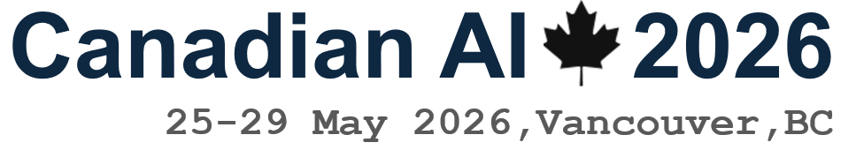
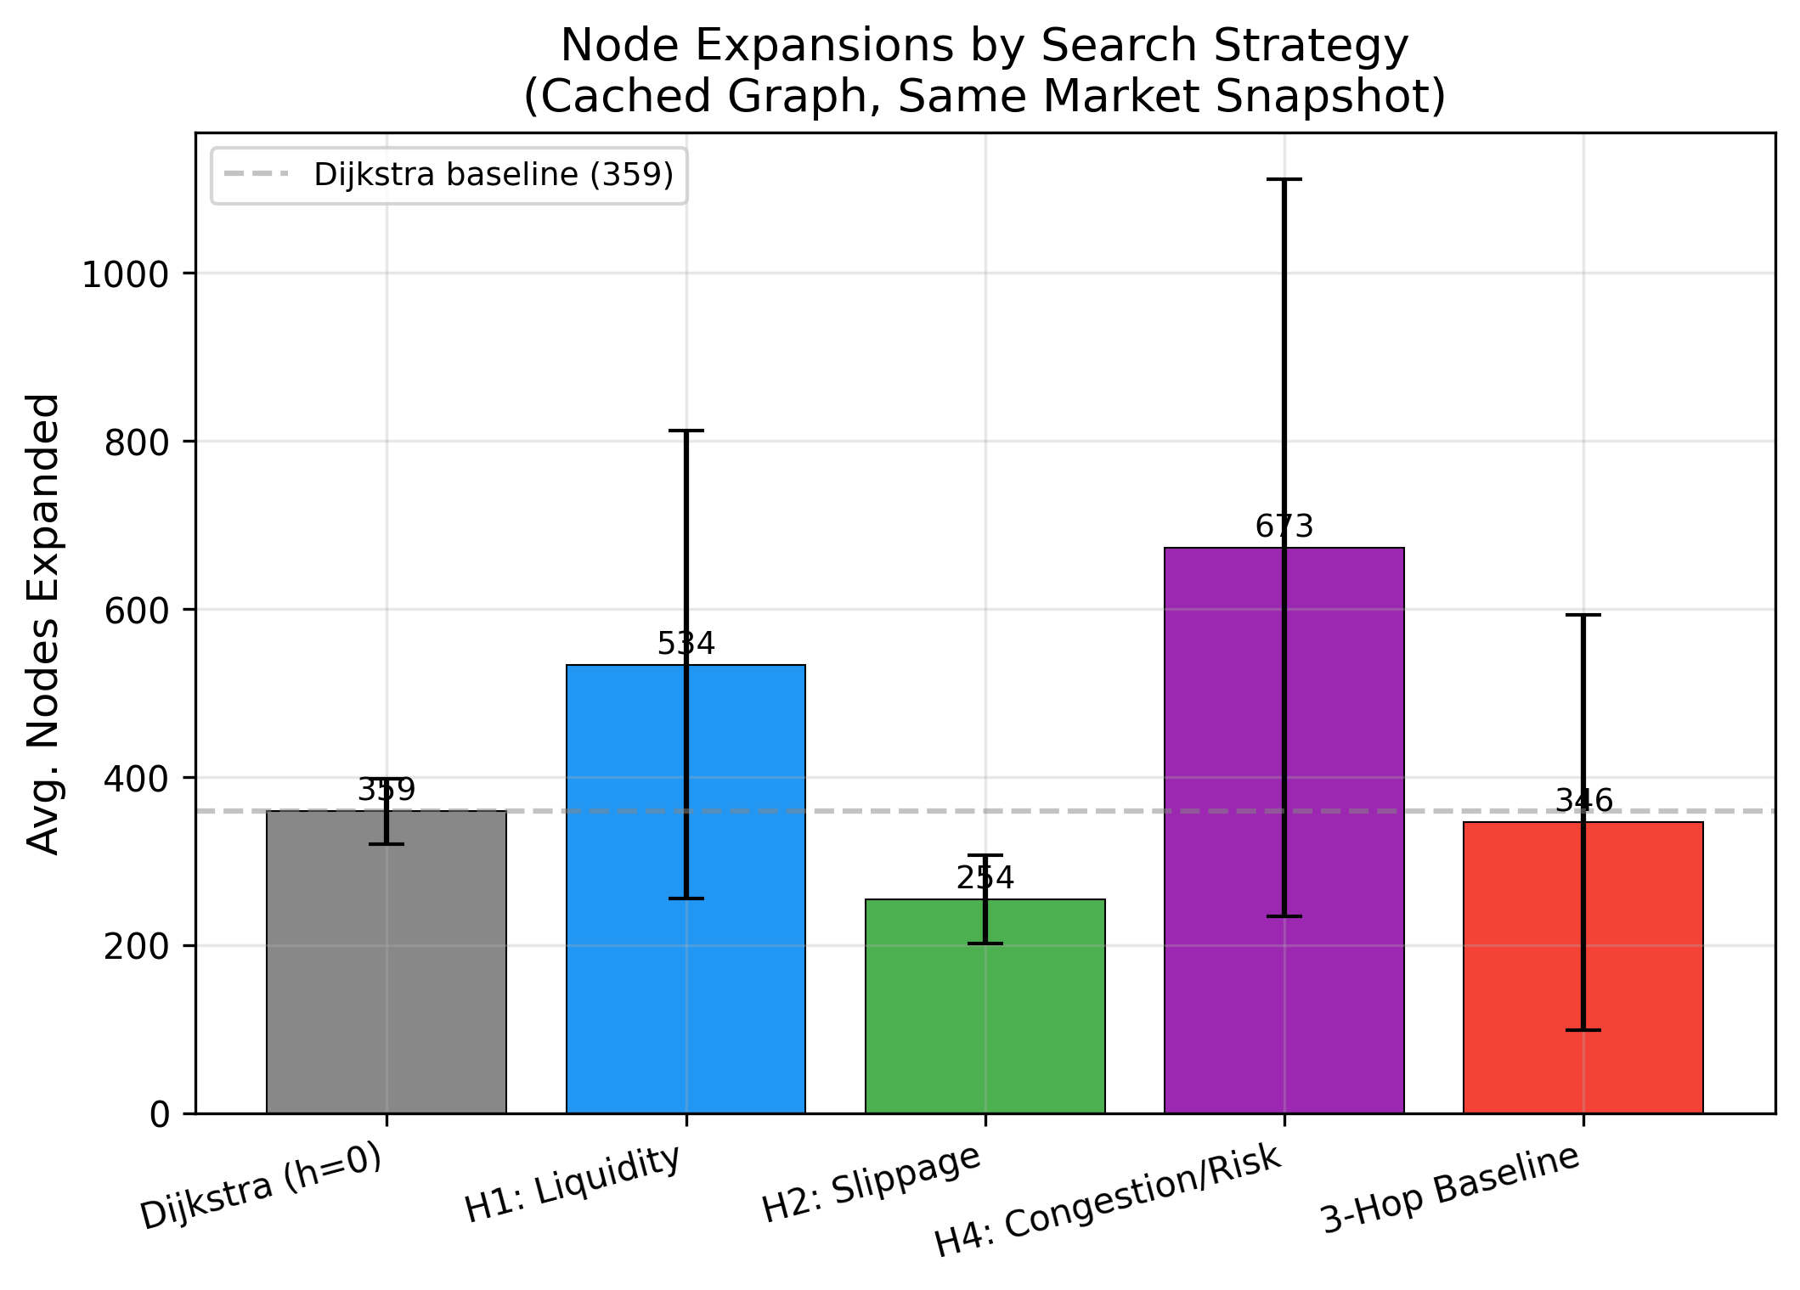
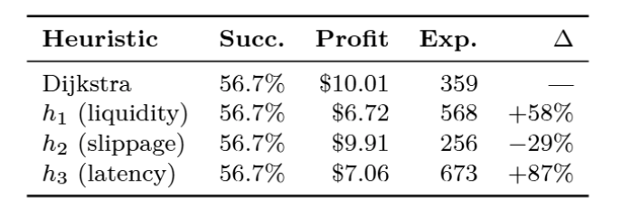
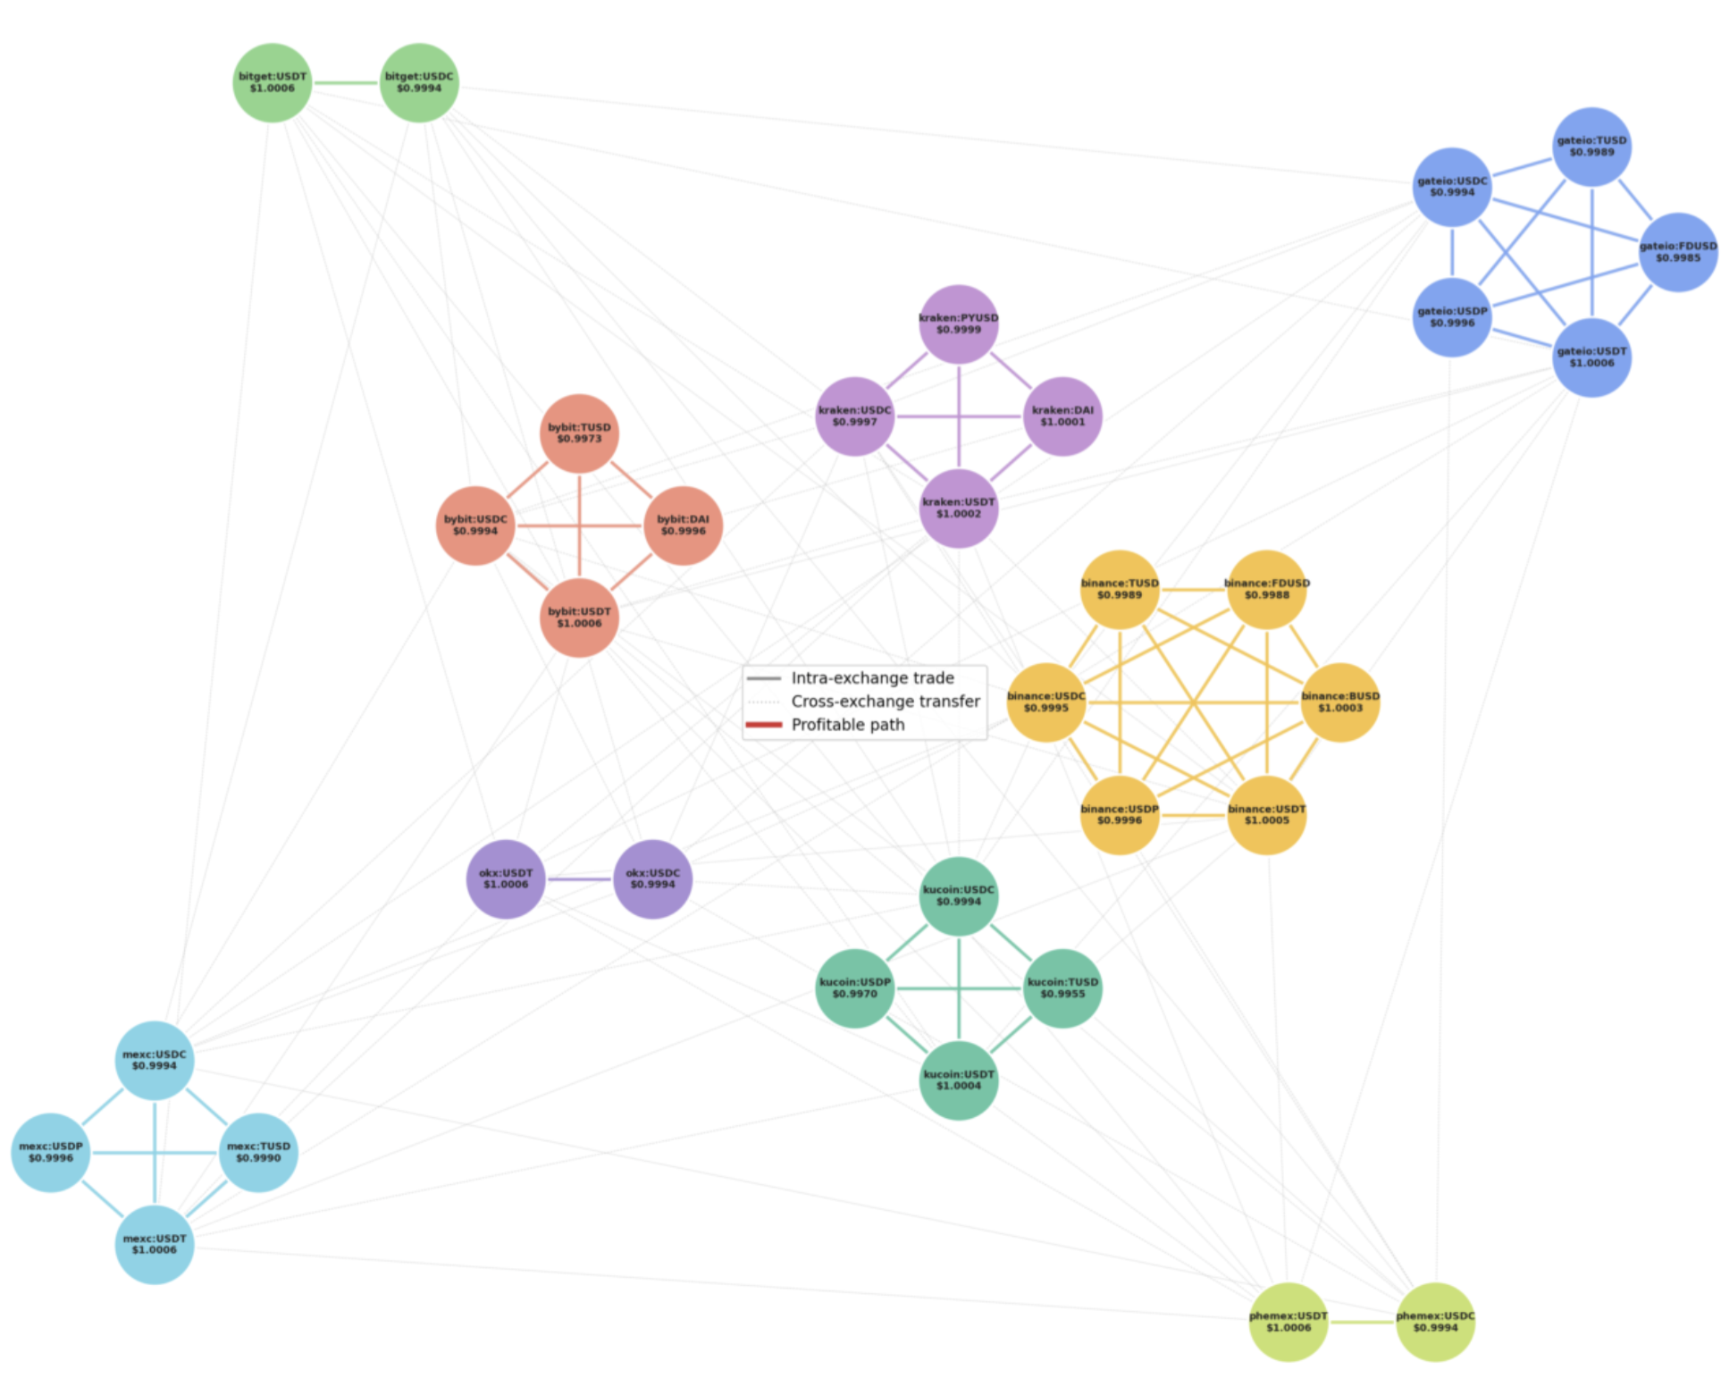
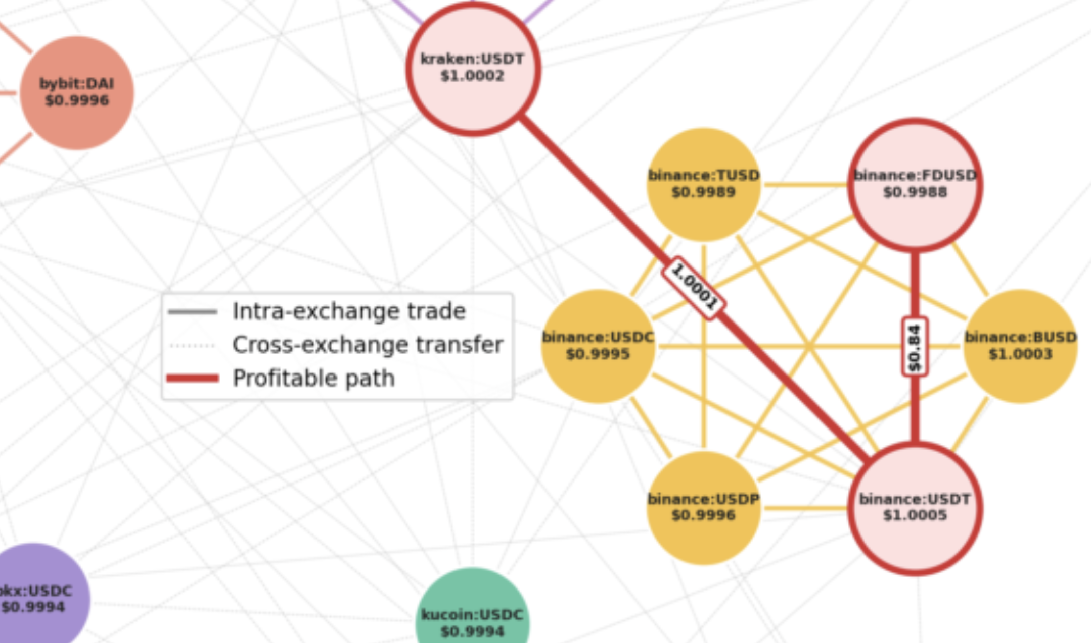
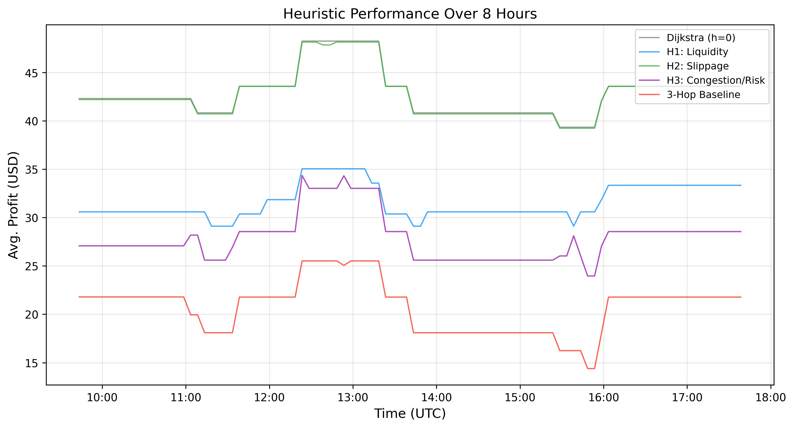
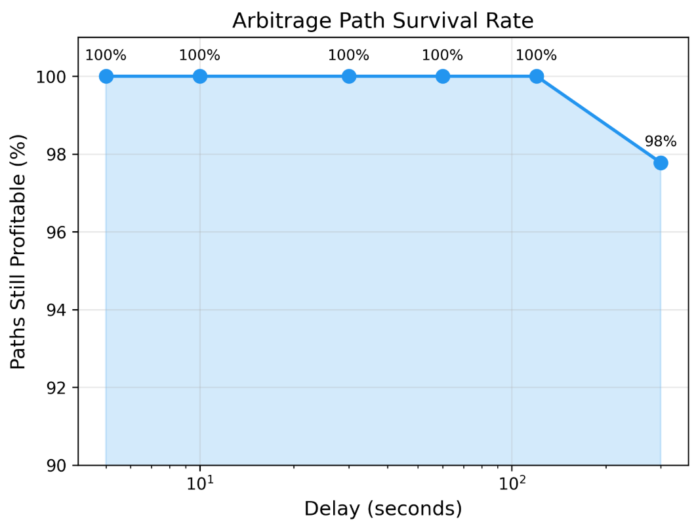


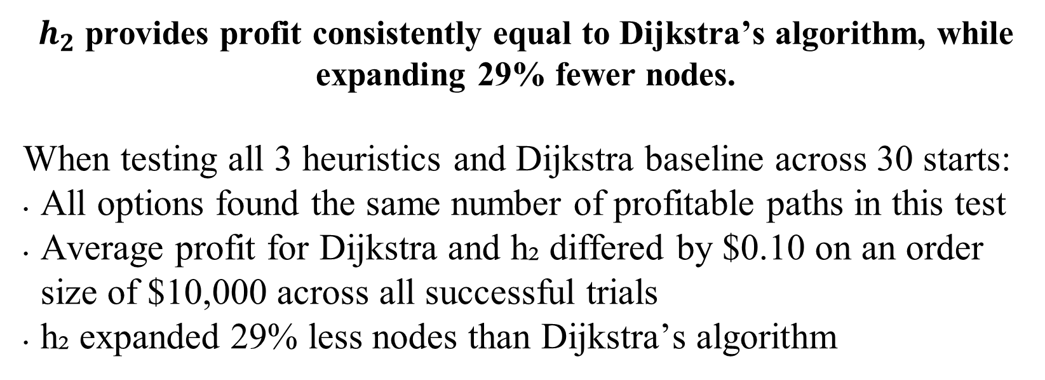
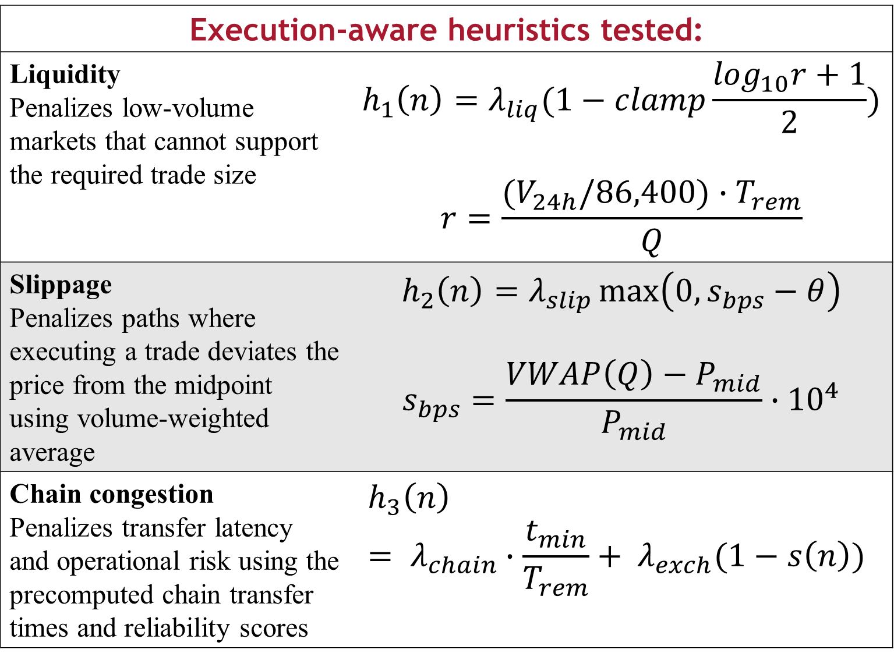
Execution-Aware A* Search for Cross-Exchange Stablecoin Arbitrage
Kevin Litvin — Simon Fraser University
Abstract: the $300B market traversal
Method: Execution-Aware A* Search
Key Results
Cross-exchange cryptocurrency arbitrage enables low-risk profit from price discrepancies across exchanges, yet existing approaches employ negative cycle detection that targets opportunity identification rather than execution feasibility. We introduce an execution-aware pathfinding framework using A* search with domain-specific guidance heuristics, applied to stablecoins, a unique asset class exceeding $300 billion in market capitalization that bridges cryptocurrency and fiat currency, offering a novel dataset for arbitrage research. The problem is modelled as a weighted directed graph where nodes represent (exchange, stablecoin) pairs across 12 centralized exchanges and edges encode real-world costs including fees, slippage, gas, transfer delays, and exchange reliability. Three guidance heuristics and a parallelized multi-start baseline are evaluated over 7,200 search instances. Our slippage-aware heuristic h₂ reduces node expansions by 29% relative to Dijkstra while matching its profit, demonstrating that domain-specific heuristics can meaningfully improve execution feasibility in real-time arbitrage planning.
Given a path $P=(υ_{0}, υ_{1}, ⋯, υ_{k})$, with initial capital $C_{0}$, final capital is:
$C_{k}=C_{0}∙\prod_{eεP}{r\left(e\right)}$, where $r\left(e\right)$ denotes the effective rate on edge $e$.
In log space this becomes: $\sum_{eεP}{−\log\left(r\left(e\right)\right)≤−log⁡(1+\frac{\min_{profit}}{C_{0}})}.$
Open-path formulation allows us to execute any pair where final USD value exceeds initial capital.
We apply A* search with evaluation function $f\left(n\right)=g\left(n\right)+h\left(n\right)$
$g\left(n\right)= \sum_{eεpath}{−log⁡(r\left(e\right))}$
h(n) estimates execution risk based on the domain-specific constraints
$h_{2}$ provides profit consistently equal to Dijkstra’s algorithm, while expanding 29% fewer nodes.
When testing all 3 heuristics and Dijkstra baseline across 30 starts:
All options found the same number of profitable paths in this test
Average profit for Dijkstra and h₂ differed by $0.10 on an order size of $10,000 across all successful trials
h₂ expanded 29% less nodes than Dijkstra’s algorithm
Execution-aware heuristics tested:
Liquidity Penalizes low-volume markets that cannot support the required trade size | $$h_{1}\left(n\right)=λ_{liq}(1−clamp\frac{\log_{10}r+1}{2})$$ $$r=\frac{(V_{24h}/86,400)∙T_{rem}}{Q}$$
Slippage Penalizes paths where executing a trade deviates the price from the midpoint using volume-weighted average | $$h_{2}\left(n\right)=λ_{slip}\max\left(0, s_{bps}−θ\right)$$ $$s_{bps}=\frac{VWAP\left(Q\right)−P_{mid}}{P_{mid}}∙{10}^{4}$$
Chain congestion Penalizes transfer latency and operational risk using the precomputed chain transfer times and reliability scores | $$h_{3}\left(n\right)= λ_{chain}∙\frac{t_{min}}{T_{rem}}+ λ_{exch}(1−s\left(n\right))$$
Heuristic comparison at $10k (30 starts)
Arbitrage Network
Each edge represents a spot trade and carries a taker fee, order-book slippage penalty, and venue reliability discount.
Each cross-exchange edge represents a stablecoin withdrawal and carries a gas fee plus an estimated blockchain-confirmation latency.
Node expansions per heuristic (cached graph, $10 k order)
Overnight Campaign
We ran an overnight campaign (7,200 trials over 8 hours) :
Average profit for h₂ consistently matched the average profit from Dijkstra, while h₁, h₃, and the 3-hop baseline performed worse
Time-delay analysis showed that 99.6% of profitable paths remained profitable at a 120-second delay
Stablecoin arbitrage graph: 9 exchanges shown
Average profit levels during the overnight campaign, and profitability after a time delay
github.com/kevinl03/Stablecoin-CrossExchange-Arbitrage Canadian AI 2026 | GSS Paper
An example of a profitable path: Kraken -> KuCoin (USDT -> TUSD)

