Slide 1
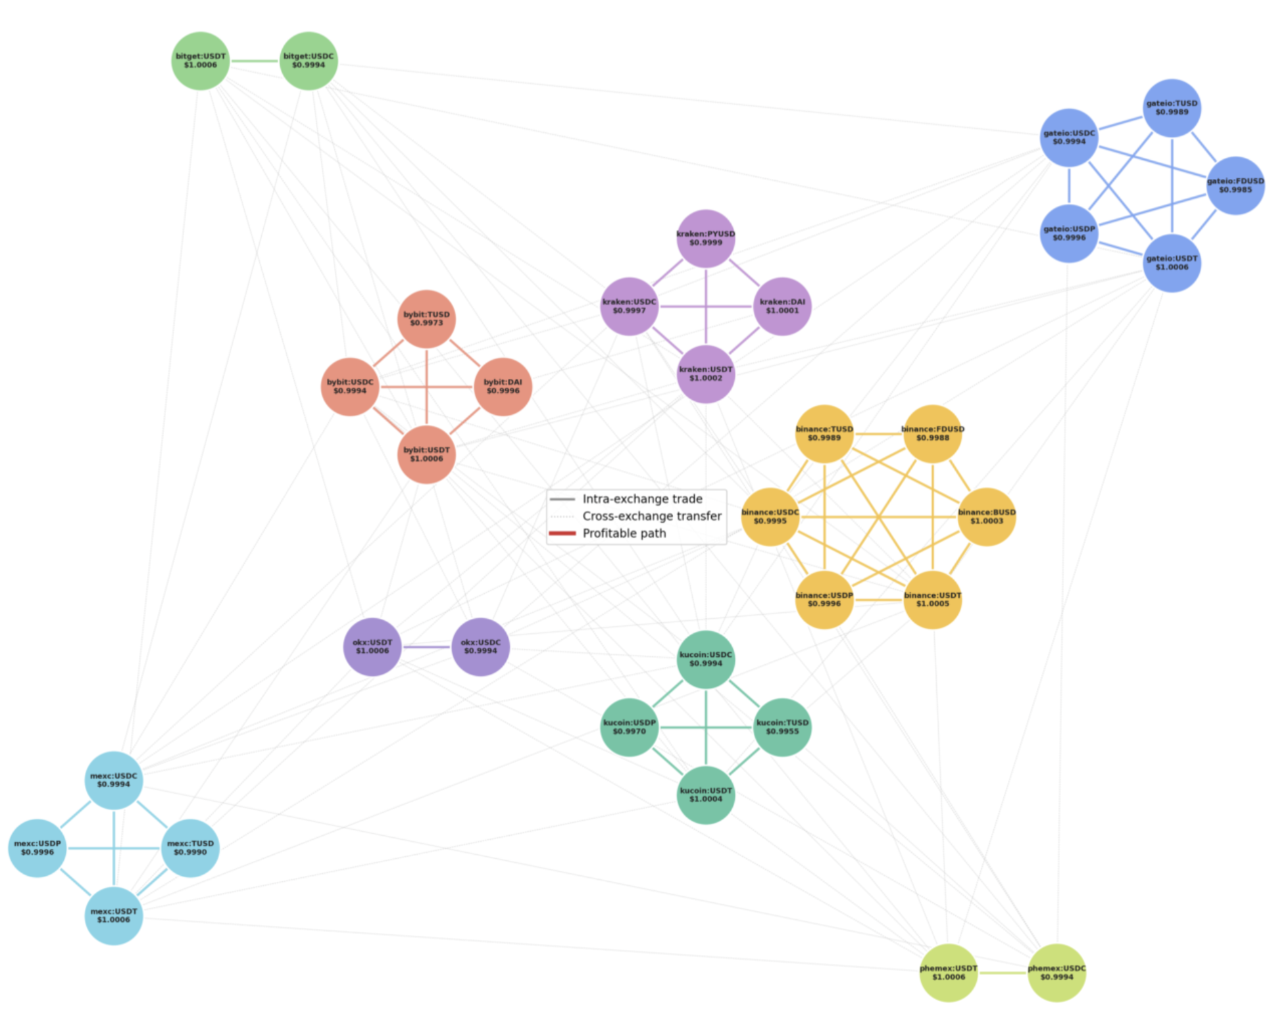
Execution-Aware A* Search for Cross-Exchange Stablecoin Arbitrage
Can domain-specific heuristics steer search faster than general-purpose graph algorithms without sacrificing profit?
Kevin Litvin – Simon Fraser University
github.com/kevinl03/Stablecoin-CrossExchange-Arbitrage
Canadian AI 2026 - GSS
Notes:
At any given moment, the same digital asset can be trading at a dozen different prices simultaneously across independent exchanges.
[PAUSE]
This is known as fragmentation, which is both the problem and the opportunity. And the stablecoin market, where it happens, moved more than thirty-three trillion dollars last year globally.
[BEAT]
I'm Kevin Litvin from Simon Fraser University.
I want to introduce a pathfinding heuristic that turns market fragmentation into executable profit by modifying Dijkstra’s Algorithm.

Slide 2
Stablecoin: Bridging international crypto trade
Key stablecoin stats
Key issue:
Stablecoin is spread across 12 different markets (market fragmentation)
Key opportunity:
Arbitrage and pathfinding can be used to extract profit from these differences
$300B +
Circulating supply
$33T
Annual on-chain volume (2024)
Stablecoins | All other crypto
Stablecoins make up the majority of all on-chain settled value across crypto markets
Notes:
QUESTION: Who here has heard about stablecoin?
Stablecoins are blockchain-native cryptocurrencies that are pegged one-to-one with fiat currencies such as USD, or Euro. The stablecoin market cap reached 300 billions dollars USD, and trade over 30 trillion dollars globally in 2024 [PAUSE]
Stablecoins are how traders rebalance positions, and how liquidity moves between international exchanges
[BEAT]
The stablecoin is listed at varying prices across independent exchanges.
[PAUSE]
I wanted to see if applying pathfinding algorithms onto a stablecoin dataset can lead to market profit.
Then can we optimize the search efficiency by having the algorithm take market data. a nd produce a better estimate of the next best trade.
[BEAT]

Slide 3
Why shortest-path isn’t enough: 4 real-world costs
Can domain-specific heuristics steer search faster than general-purpose graph algorithms without sacrificing profit?
4 domain-specific factors that affect profitability during pathfinding:
1. Fees
Flat transfer fees apply to each trade; the order needs to be large enough to offset
2. Slippage
Asset prices change during execution, impacting profit for larger order sizes
3. Latency
Some blockchains have longer processing time
Others are slower due to high volume
4. Operational risk
Withdrawals may be paused, regions geofenced, or VPNs blocked
Notes:
Why does this need new search heuristics? Why not just run shortest-path on the price graph?
[BEAT]
Because four real-world constraints collapse many candidate paths during execution which are not found during path planning.
Firstly, fees. The order needs to be large enough to offset fees.
Two, slippage. As trades execute, the price listed on the asset changes dynamically. The model needs to account for the fluctuations during the path planning based on market ask price depth.
Three, latency. Blockchain transfer times and high-volume congestion affect the profit window of opportunity.
Four, operational risk. Withdrawals can be paused, regions geofenced or VPN-blocked. A path that exists on paper can be unreachable in practice.
[PAUSE]
We tested three classical baselines, Bellman-Ford negative-cycle detection, one hop and two hop. None of them returned a profitable executable path under live conditions.
[BEAT]
This means we need search that builds execution cost directly into the heuristic itself.

Slide 4
The dataset: first academically integrated CEX stablecoin graph
The stablecoin graph
At-a-glance
12
Most popular centralized cryptocurrency exchanges
41
x
Nodes, representing possible coins to trade
864
Directed edges representing possible trades
The first academically integrated cross-exchange stablecoin graph
Notes:
Based on the factors discussed, we adapted the graph using live market data.
Each node represents a stablecoin within a centralized market.
Each edge encodes the live execution cost of the trade.
Nodes are clustered per exchange
To our knowledge, this is the first academic paper to apply optimized path finding to the stable coin dataset across centralized exchanges.

Slide 5
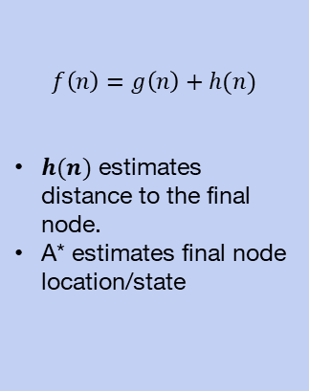
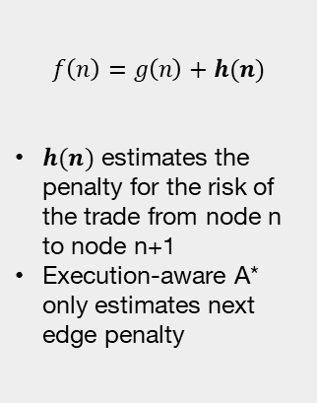
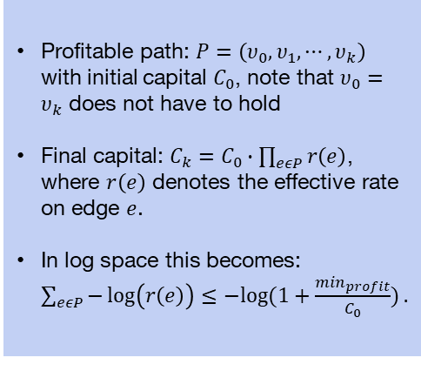
Methodology: A* search with execution-aware heuristic
Problem formulation and modification to A* search
Problem formulation
Standard A*
Execution-aware A*
Profitable path: $P=\left(υ_{0}, υ_{1}, ⋯, υ_{k}\right)$ with initial capital $C_{0}$, note that $υ_{0}=υ_{k}$ does not have to hold
Final capital: $C_{k}=C_{0}∙\prod_{eεP}{r\left(e\right)}$, where $r\left(e\right)$ denotes the effective rate on edge $e$.
In log space this becomes: $\sum_{eεP}{−\log\left(r\left(e\right)\right)≤−log⁡(1+\frac{\min_{profit}}{C_{0}})}.$
$$f\left(n\right)=g\left(n\right)+h(n)$$
$h(n)$ estimates distance to the final node.
A* estimates final node location/state
$$f\left(n\right)=g\left(n\right)+h(n)$$
$h(n)$ estimates the penalty for the risk of the trade from node n to node n+1
Execution-aware A* only estimates next edge penalty
Notes:
Our search backbone is A*, with a modified heuristic that estimates trade risk rather than end goal distance.
[PAUSE]
Unlike typical arbitrage, the search criteria is defined by an open path, not a cycle.
We apply a log transformation to the accumulated profit, to convert the prod into a sum.
[PAUSE]
g(n) accumulates the conversion profits between the assets.
h of n is our unique contribution: a domain-specific estimate of the execution risk at the current trade.
[BEAT]
Because we do not have information about the end node, we cannot use standard A*.
Therefore, we use market data to estimate the risk of the next trade, which is our execution-aware heuristic.

Slide 6
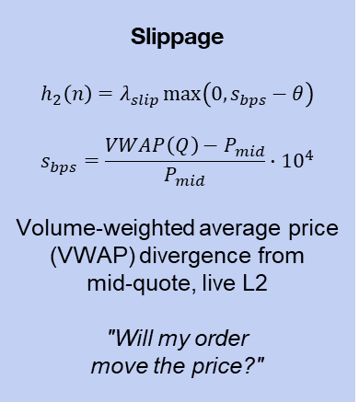
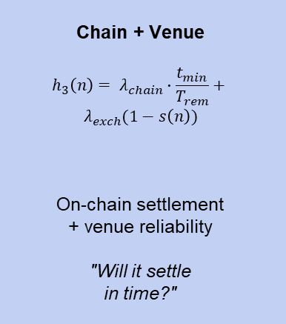
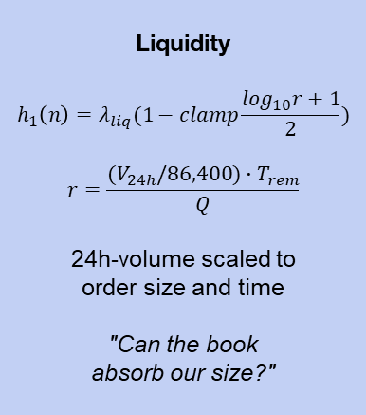
Three execution-aware heuristics
Each heuristic adds a domain-specific penalty to h(n), steering A* away
from paths too risky to execute under live costs.
h₁
h₂ ★
h₃
Liquidity
$$h_{1}\left(n\right)=λ_{liq}(1−clamp\frac{\log_{10}r+1}{2})$$
$$r=\frac{(V_{24h}/86,400)∙T_{rem}}{Q}$$
24h-volume scaled to order size and time
"Can the book absorb our size?"
Slippage
$$h_{2}\left(n\right)=λ_{slip}\max\left(0, s_{bps}−θ\right)$$
$$s_{bps}=\frac{VWAP\left(Q\right)−P_{mid}}{P_{mid}}∙{10}^{4}$$
Volume-weighted average price (VWAP) divergence from mid-quote, live L2
"Will my order move the price?"
Chain + Venue
$$h_{3}\left(n\right)= λ_{chain}∙\frac{t_{min}}{T_{rem}}+$$
$$λ_{exch}(1−s\left(n\right))$$
On-chain settlement + venue reliability
"Will it settle in time?"
Notes:
We tested three execution-aware heuristics. Each adds a domain-specific penalty to h of n, steering A* away from paths that look profitable on paper but are too risky to execute under live costs.
We used L2 order book. The L1 order book shows the best available price for an asset, which is typically what we see on stock exchanges. The L2 order book sorts all available prices for that asset from best to worst.
h-one — Liquidity. It penalizes trades in low-volume markets that cannot support the trade size
h-two — Slippage. Penalizes paths where executing a trade deviates the price from the midpoint. We calculate this by querying the L2 order book and computing a volume-weighted average price.
h-three — Chain risk. Penalizes transfer latency and operational risk using the known chain transfer times and reliability.
[BEAT]
Across all our experiments, the slippage heuristic, h2, consistently outperformed the others.

Slide 7
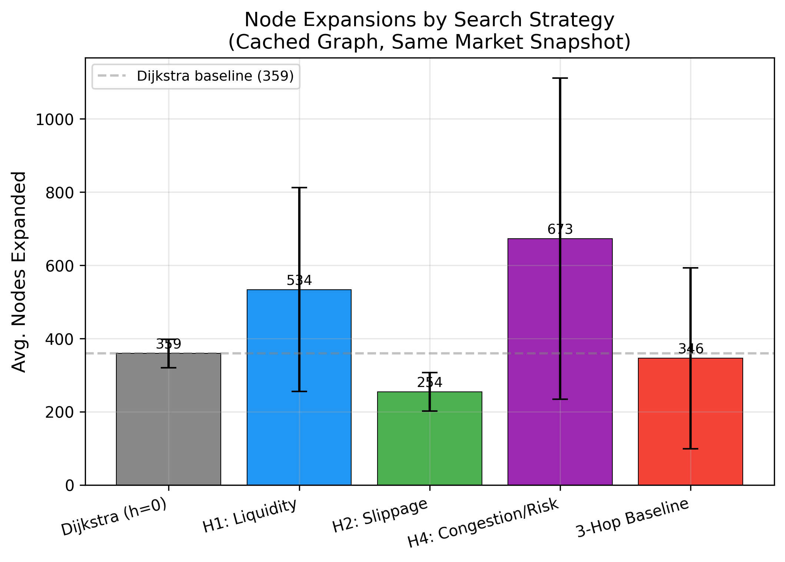
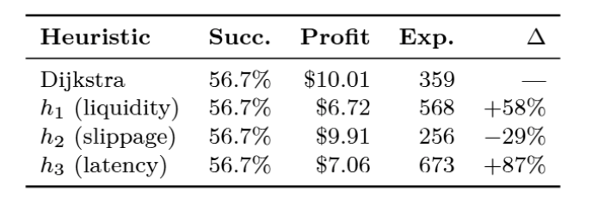
Results: h₂ (Slippage) expands 29% fewer nodes than Dijkstra while maintaining profitability
Heuristic comparison at $10k (30 starts)
When testing all 3 heuristics and the Dijkstra baseline across 30 starts:
All options found the same number of profitable paths in this test
Average profit for Dijkstra and h₂ was approximately equal
h₂ expanded 29% less nodes than Dijkstra in search of a profitable path
Notes:
The slippage heuristic — matched Dijkstra's profit quality while expanding twenty-nine percent fewer nodes.
Both h1 and h3 found lower profits, while expanding more nodes.
On a $10,000 order size, our heuristic matches Dijkstra’s profit within 10 cents. That is a 1% difference in absolute profit, and an 0.001% difference on our order size.
[PAUSE]
That is a measurable decrease in compute, with no meaningful loss in solution quality.
[BEAT]

Slide 8
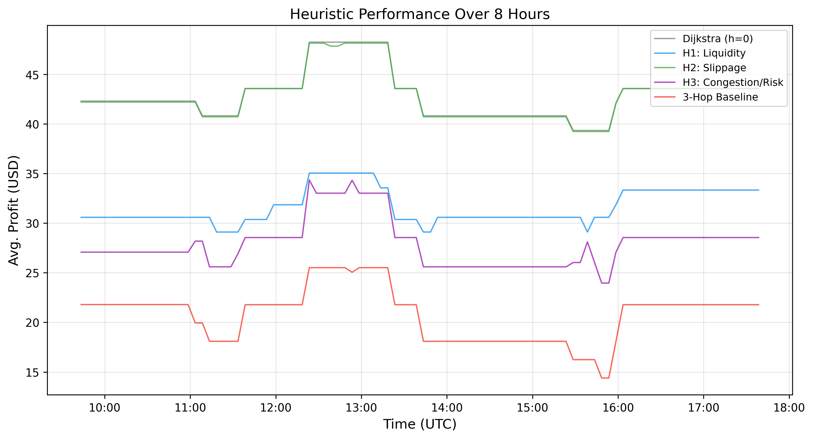
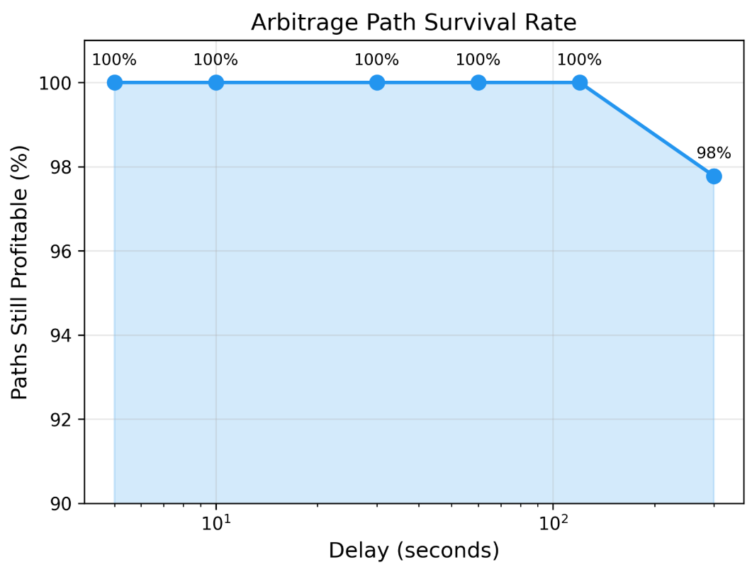
Results: overnight campaign indicates reproducibility at volume, and verifies the time constraint
The overnight campaign (7,200 trials over 8 hours) produces the following results:
Average profit for h₂ consistently matched the average profit from Dijkstra, while h₁, h₃, and the 3-hop baseline performed worse
Time-delay analysis showed that 99.6% of profitable paths remained profitable at a 120-second delay
Notes:
To stress-test our preliminary findings, we ran an overnight campaign. This was eight hours of continuous A* search against twelve live exchange feeds. From this, two findings stand out.
[BEAT]
First — over seven thousand searches, the execution-aware algorithm had an over 50% success rate in path planning. This indicates that profitable solutions can be reproduced at high volumes.
[PAUSE]
Second — staleness. There is always a gap between finding a path and executing the trade. We measured how long an opportunity actually persists. After two minutes, 99.6% of paths remained profitable. However, this does not guarantee that the full order can still be executed.
After that, the market converges, and the arbitrage opportunity is lost.

Slide 9

Execution-Aware A* Search for Cross-Exchange Stablecoin Arbitrage
Can domain-specific heuristics steer search faster than general-purpose graph algorithms without sacrificing profit?
Kevin Litvin – Simon Fraser University
github.com/kevinl03/Stablecoin-CrossExchange-Arbitrage
Canadian AI 2026 - GSS
Notes:
Why does this matter beyond stablecoin trading?
[BEAT]
At its core, our data preparation and methodology are a template for execution-aware search in any fragmented marketplace. A natural next step for this research would be decentralized exchanges, automated market making, and other financial sectors.
[PAUSE]
This project is available publicly on GitHub, so results can be referenced and reproduced. Feel free to scan the QR code up on screen and take a look for yourselves. The results are based on path planning and real-time data, but we did not execute the trades with a $10,000 funded wallet.
Next steps will be to execute these trades with real capital.
[PAUSE]
Going into this project, we asked: Can domain-specific heuristics steer search faster than general-purpose graph algorithms without sacrificing profit?
[PAUSE]
The short answer is yes. We were able to do less exploration, more execution, and achieve the same profits.
[BEAT]
"Thank you."

