Slide 1
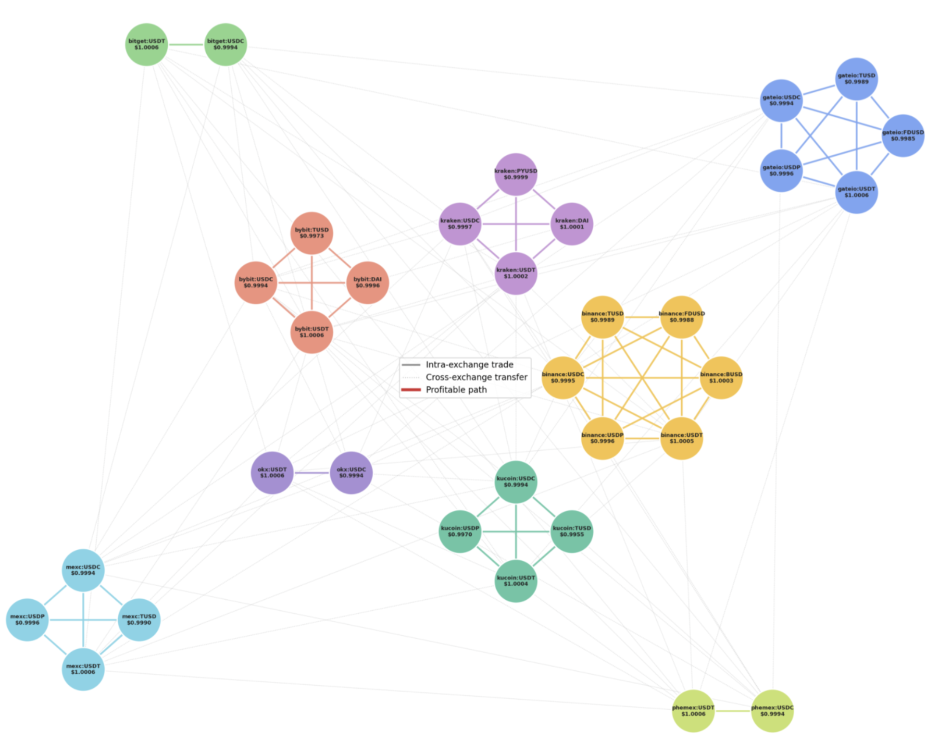
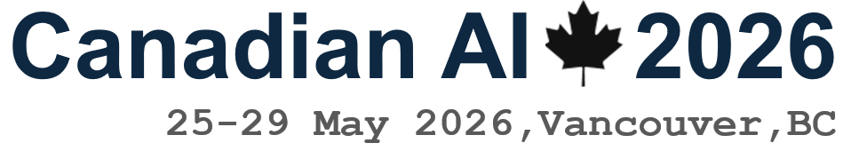
Execution-Aware A* Search for Cross-Exchange Stablecoin Arbitrage
Can domain-specific heuristics reduce search cost while preserving profit quality?
Kevin Litvin · Simon Fraser University
Canadian AI 2026 · GSS
Kevin Litvin · Simon Fraser University
Canadian AI 2026 · GSS
1 / 13

Slide 2
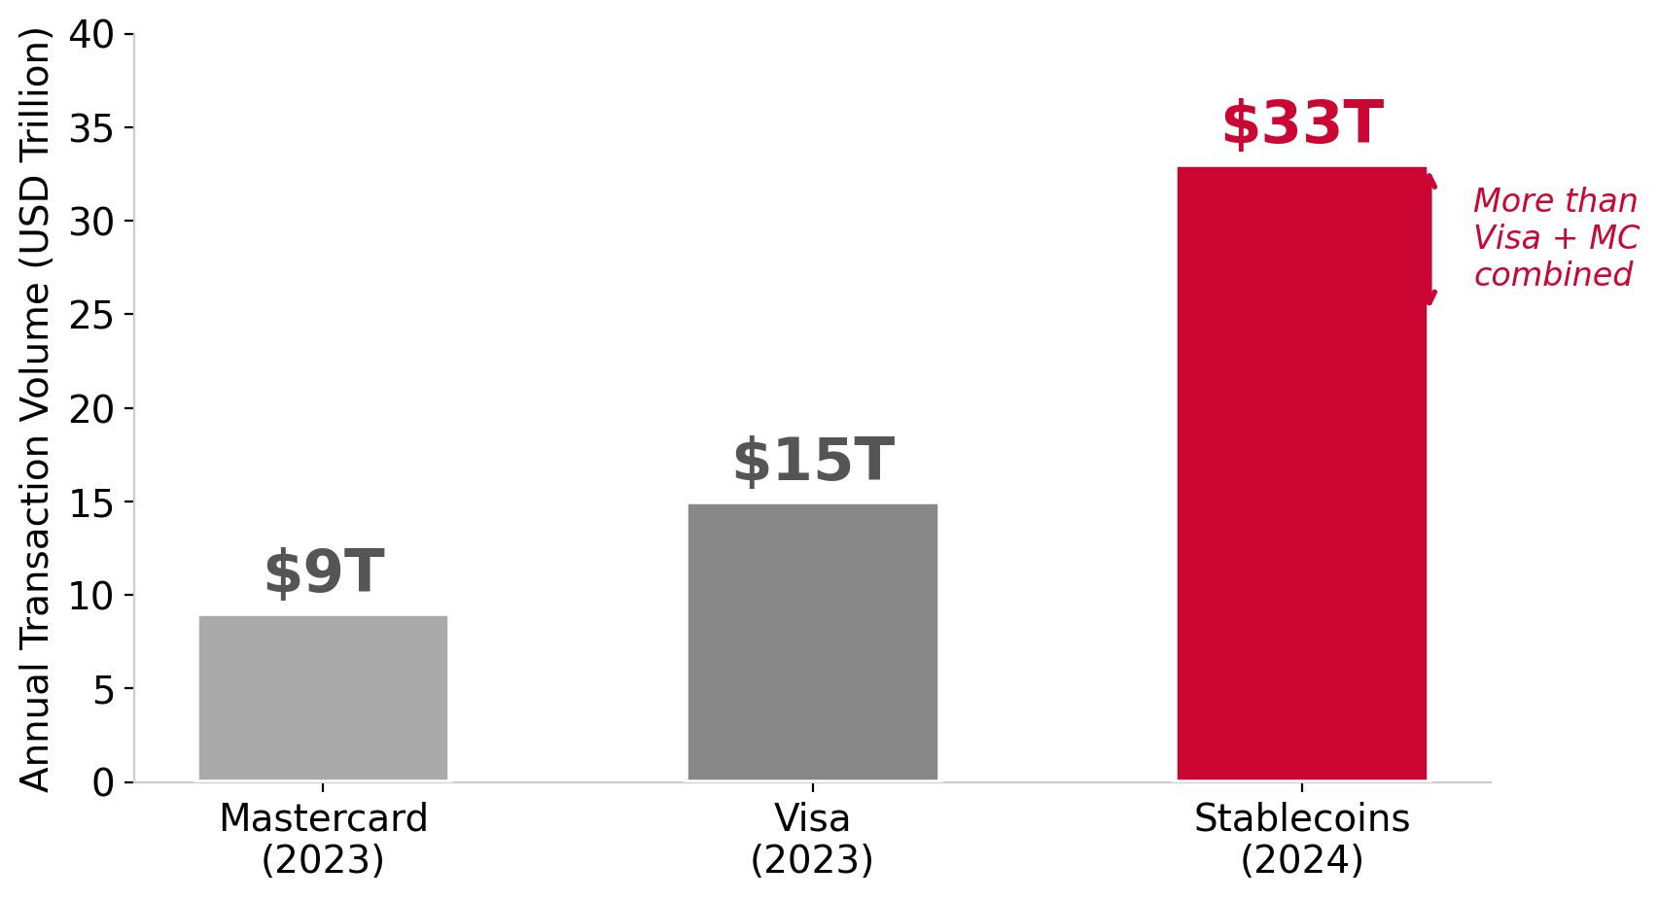
The $33 Trillion Market
Slide 2
$300B+
market cap in circulation
$33T
annual transaction volume
"The liquidity highways of the entire crypto ecosystem"
Kevin Litvin · Simon Fraser University
Canadian AI 2026 · GSS
2 / 13

Slide 3
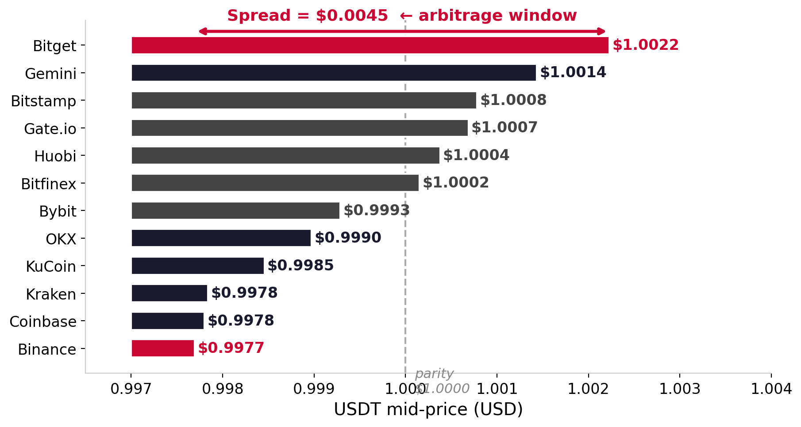
The Opportunity: Price Fragmentation Across 12 Exchanges
Slide 3
Kevin Litvin · Simon Fraser University
Canadian AI 2026 · GSS
3 / 13

Slide 4
The Problem: Four Execution Barriers
Slide 4
"Existing systems say: take it. But here is what they do not tell you."
1 Liquidity
2 Slippage ★
3 Latency
4 Reliability
Order size may exhaust the book depth
Large orders move price mid-execution (h₂)
Blockchain settlement may miss the window
Exchanges may suspend withdrawals overnight
Bellman-Ford, 1-hop, and 2-hop enumeration all fail to find a profitable executable path.
Kevin Litvin · Simon Fraser University
Canadian AI 2026 · GSS
4 / 13

Slide 5
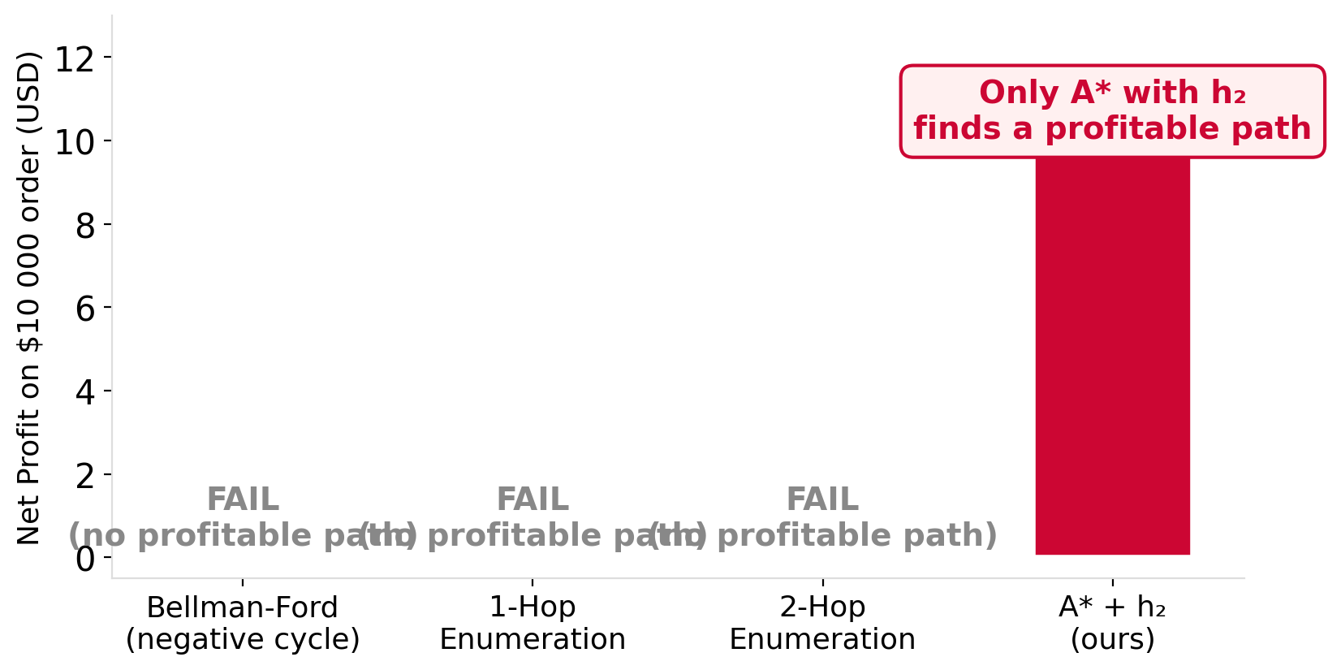
Why Existing Baselines Fail
Slide 5
Why they fail:
▶ Bellman-Ford finds closed cycles — ignores open-path stablecoin arbitrage
▶ 1-hop & 2-hop only scan ≤2 edges — miss multi-hop paths with > $0 net profit
▶ None model slippage, fees, or transfer latency
Kevin Litvin · Simon Fraser University
Canadian AI 2026 · GSS
5 / 13

Slide 6
Dataset: The First Execution-Aware Stablecoin Graph
Slide 6
12
centralized exchanges
9
stablecoin symbols (USDT, USDC, DAI…)
41
nodes
864
edges
Every edge carries: taker fee · live slippage (VWAP) · gas cost · venue reliability score
Kevin Litvin · Simon Fraser University
Canadian AI 2026 · GSS
6 / 13

Slide 7
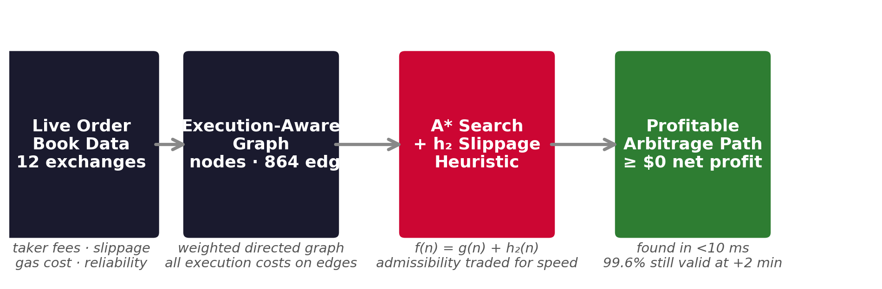
Method: A* Search — Google Maps for Money
Slide 7
f (n) = g(n) + h(n)
g(n) = accumulated execution cost so far h(n) = domain-specific risk estimate ahead
Kevin Litvin · Simon Fraser University
Canadian AI 2026 · GSS
7 / 13

Slide 8
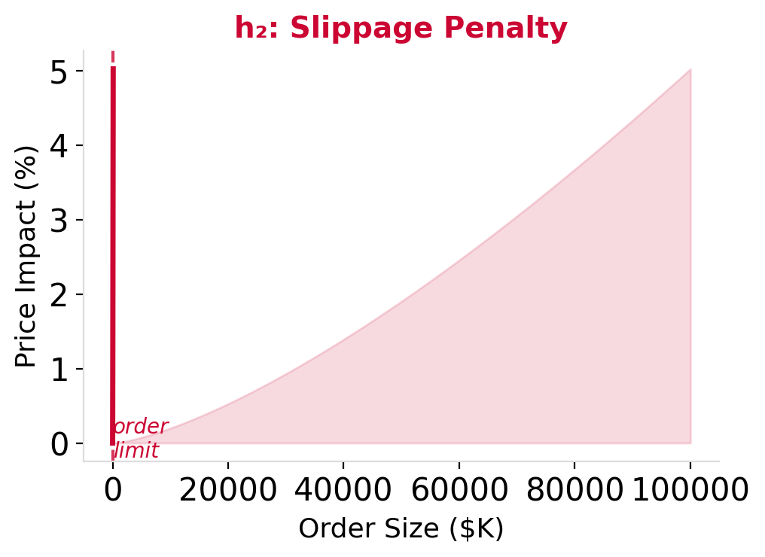
Three Execution-Aware Heuristics
Slide 8
Each heuristic adds a domain-specific penalty to h(n), steering A* toward paths that are profitable AND executable.
h₁
h₂ ★
h₃
h₂ in detail:
Liquidity
Slippage
Chain + Venue
Penalises paths where order size exceeds book depth
VWAP-based penalty: pen. = max(0, VWAP − mid) × order size
Congestion penalty + venue reliability discount
"Is there enough market depth?"
"Will my order move the price?"
"Will it settle in time?"
One of these three will prove decisive.
Kevin Litvin · Simon Fraser University
Canadian AI 2026 · GSS
8 / 13

Slide 9
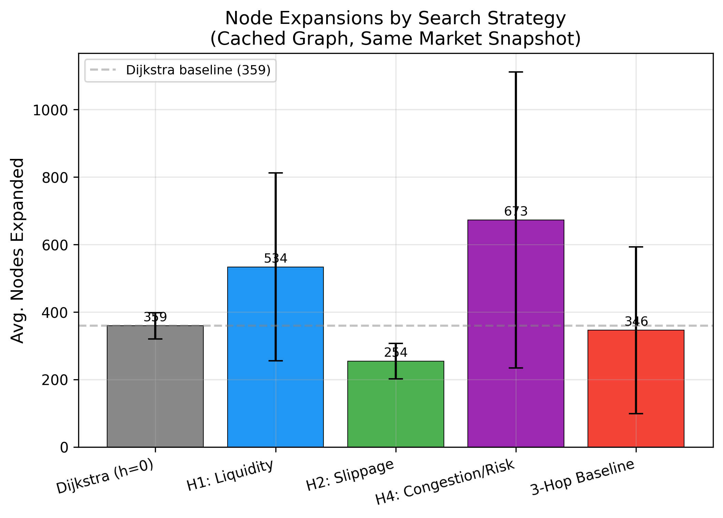
KEY RESULT
h₂ (Slippage Heuristic) — 29% fewer node expansions. Same profit.
Kevin Litvin · Simon Fraser University
Canadian AI 2026 · GSS
9 / 13

Slide 10
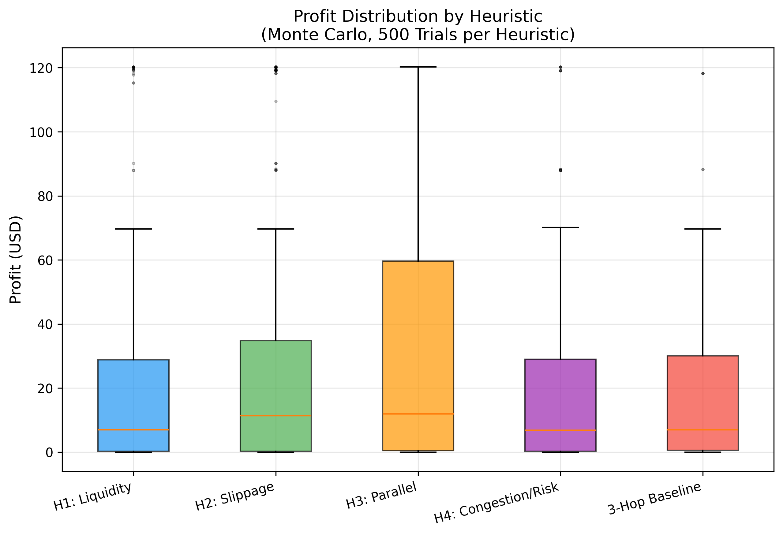
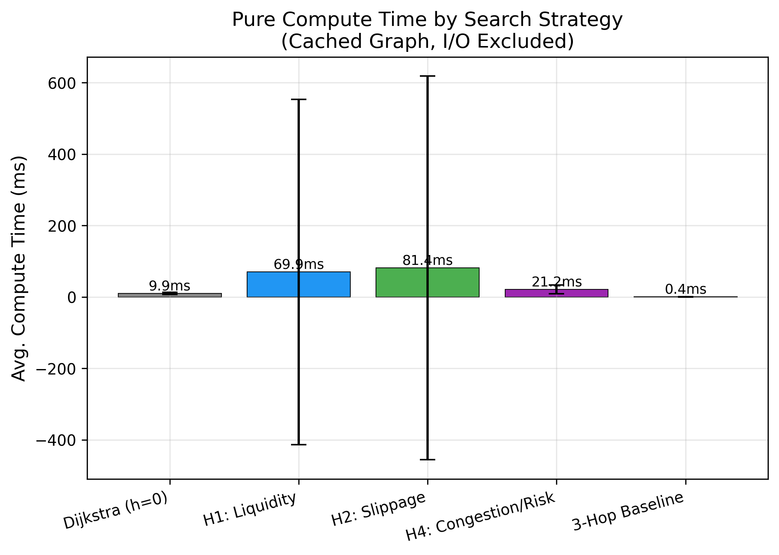
Profit Quality & Compute Cost — The Full Picture
Slide 10
h₂ matches Dijkstra profit within 1% · all heuristics run in <10 ms · no speed-quality trade-off
Kevin Litvin · Simon Fraser University
Canadian AI 2026 · GSS
10 / 13

Slide 11
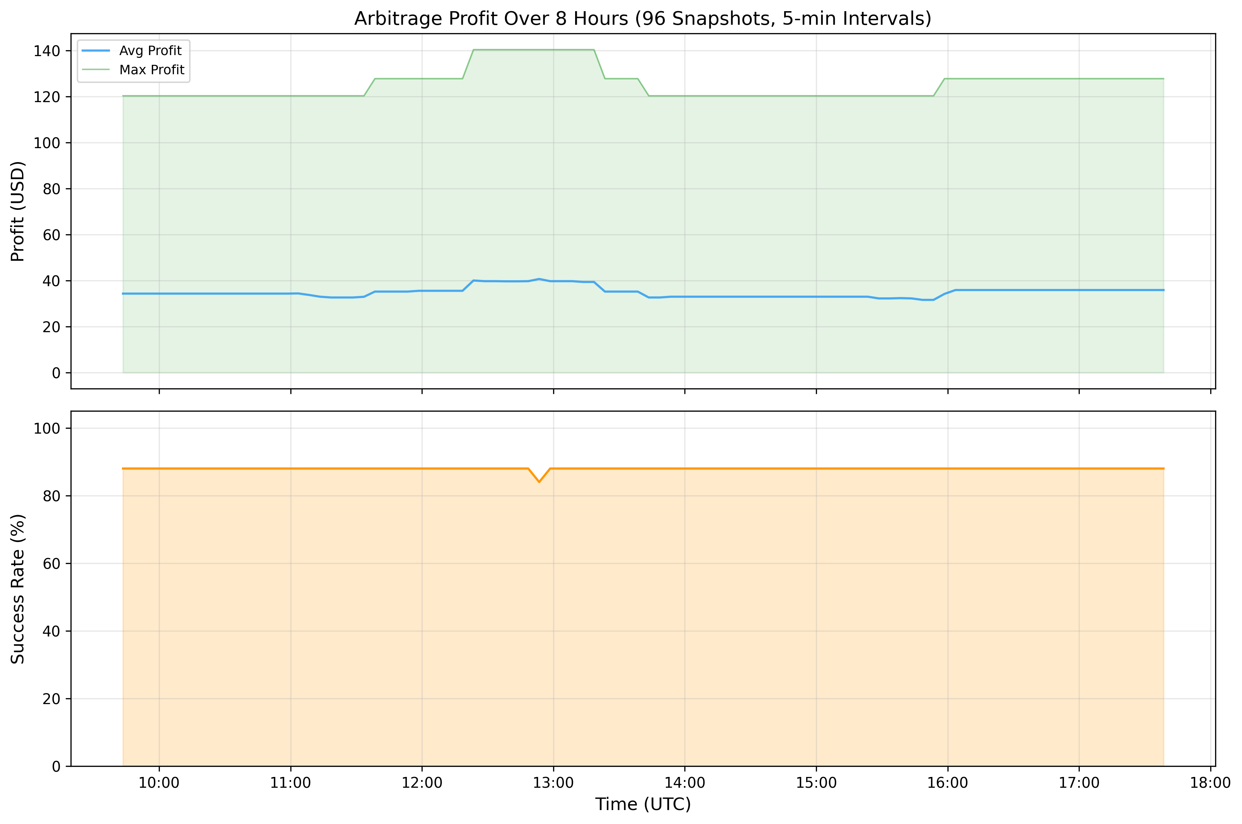
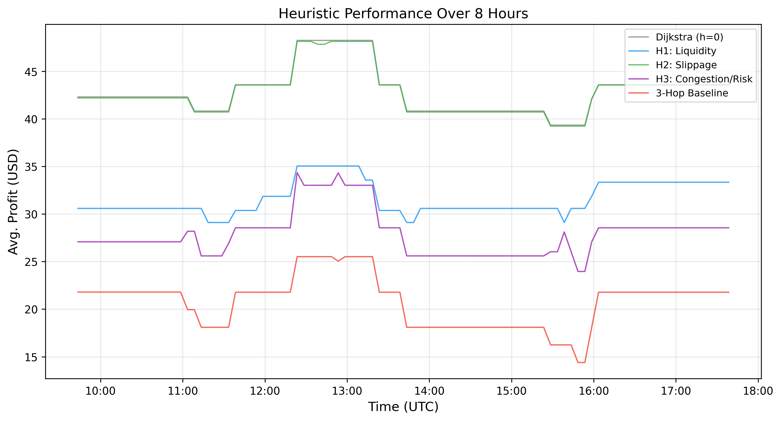
Overnight Validation — 7,200 Real Searches · Live Market Data
Slide 11
• 7 200 search instances
• 100% found a profitable path
• 8 hours continuous operation
• Live order book data
Kevin Litvin · Simon Fraser University
Canadian AI 2026 · GSS
11 / 13

Slide 12
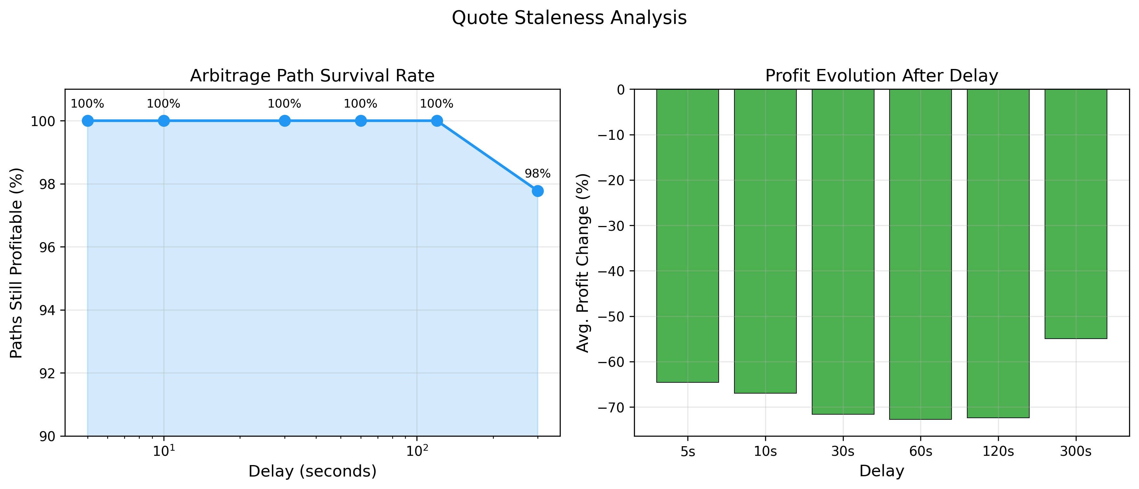
Execution Window — How Long Do Paths Stay Profitable?
Slide 12
99.6%
of paths remain profitable at +2 min
Practical guideline: act within 120 seconds of path discovery.
Kevin Litvin · Simon Fraser University
Canadian AI 2026 · GSS
12 / 13

Slide 13
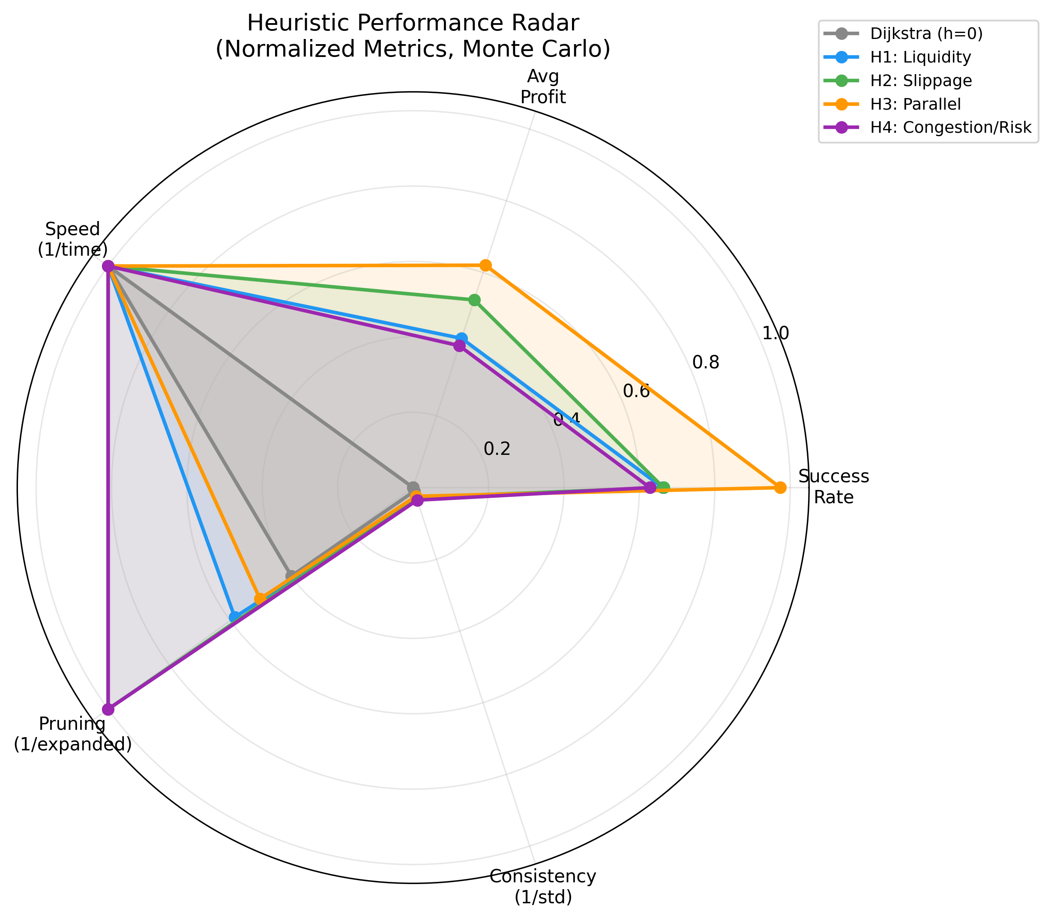
Method comparison (all metrics)
Less Exploration.
More Execution.
Same Profit.
Thank you · Questions?
github.com/kevinl03/Stablecoin-CrossExchange-Arbitrage
Kevin Litvin · Simon Fraser University
Canadian AI 2026 · GSS
13 / 13

