Slide 1
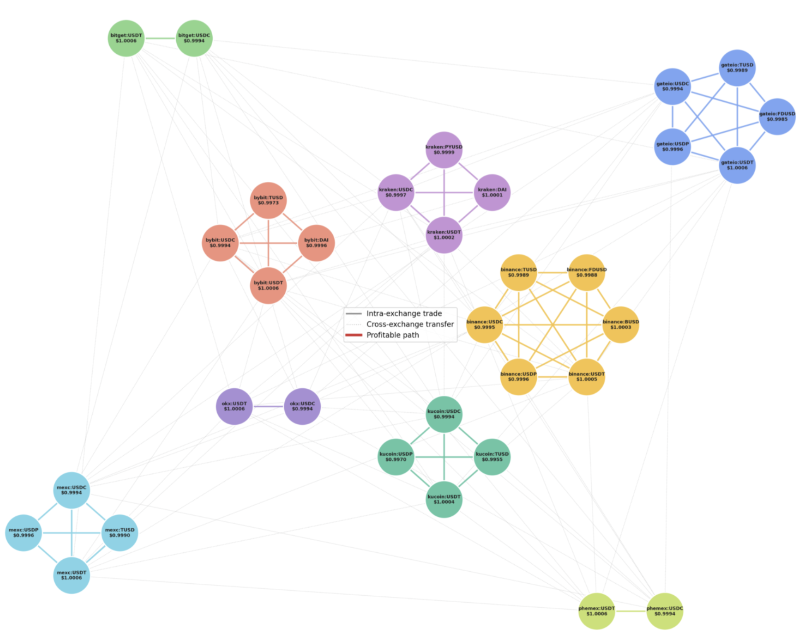
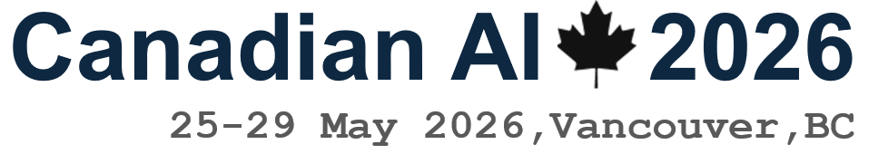
Execution-Aware A* Search for Cross-Exchange Stablecoin Arbitrage
Can domain-specific heuristics steer search faster than general-purpose graph algorithms — without sacrificing profit?
Kevin Litvin · Simon Fraser University
Canadian AI 2026 · GSS
Kevin Litvin · Simon Fraser University
Canadian AI 2026 · GSS
1 / 9

Slide 2
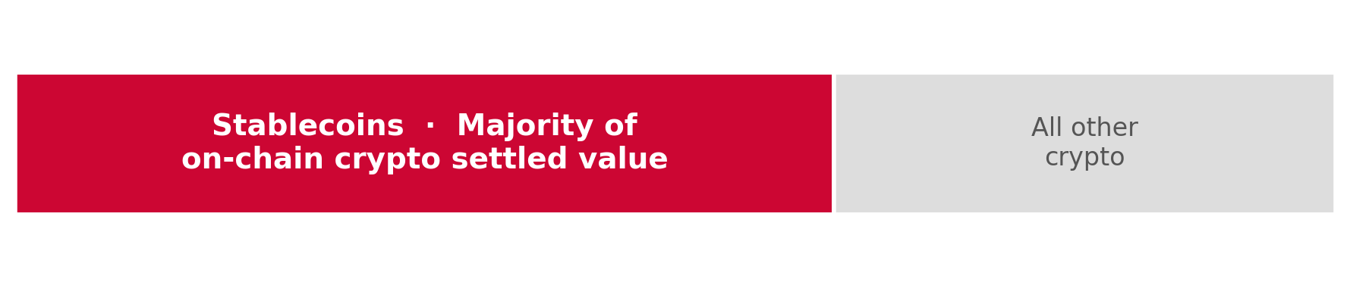
Stablecoins: The $33 Trillion Settlement Layer
$300B+
$33T
circulating supply
annual on-chain volume (2024)
12 independent exchanges · same asset · 12 different prices at the same instant
Source: stablecoin volume & supply — verify citation
Kevin Litvin · Simon Fraser University
Canadian AI 2026 · GSS
2 / 9

Slide 3
Why Shortest-Path Isn't Enough: Four Real-World Costs
Each cost collapses candidate paths the moment you try to execute them.
1 Fees
2 Slippage ★
3 Latency
4 Operational Risk
Taker fees compound across every hop
Large orders walk the L2 book — VWAP diverges from mid
Cross-exchange transfers settle on-chain; block times eat the window
Withdrawals paused · regions geofenced / VPN-blocked
Bellman-Ford · 1-hop · 2-hop enumeration — none returned a profitable executable path under live conditions.
Kevin Litvin · Simon Fraser University
Canadian AI 2026 · GSS
3 / 9

Slide 4
Dataset: First Academically Integrated CEX Stablecoin Graph
12
centralized exchanges
9
stablecoin symbols (USDT, USDC, DAI…)
41
nodes
864
directed edges
Every edge carries: taker fee · L2 slippage · on-chain settlement · venue reliability
Kevin Litvin · Simon Fraser University
Canadian AI 2026 · GSS
4 / 9

Slide 5
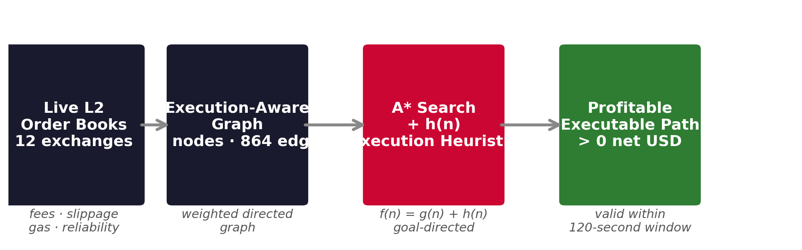
Method: A* Search with Execution-Aware Heuristic
f (n) = g(n) + h(n)
A* = Dijkstra's algorithm + goal-directed heuristic
g(n) accumulated execution cost so far h(n) domain-specific estimate of remaining risk
Kevin Litvin · Simon Fraser University
Canadian AI 2026 · GSS
5 / 9

Slide 6
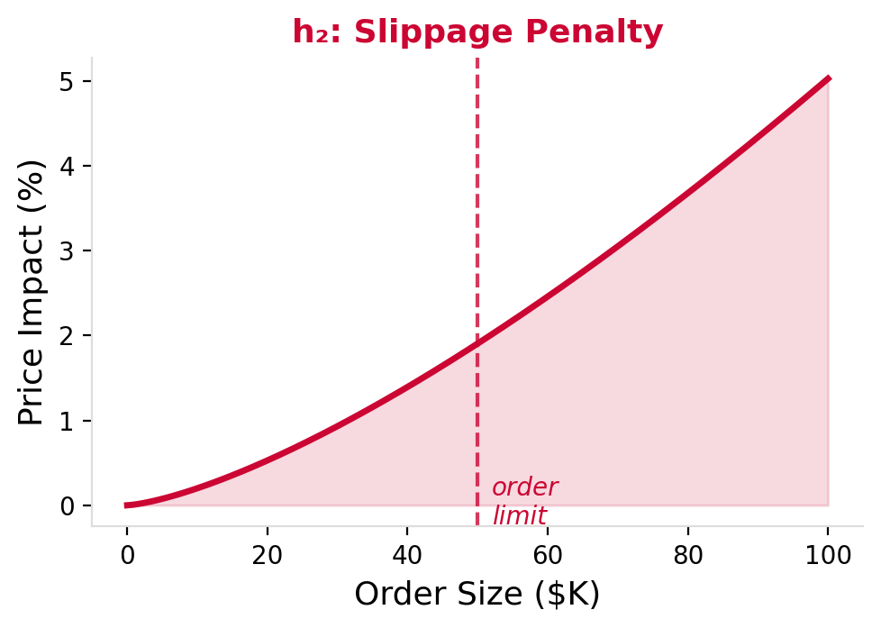



Three Execution-Aware Heuristics
Each adds a domain-specific penalty to h(n) — steering A* away from paths too risky to execute under live costs.
h₁
h₂ ★
h₃
h₂ in detail:
Liquidity
Slippage
Chain + Venue
24h-volume scaled to order size and time
VWAP divergence from mid-quote, live L2
On-chain settlement + venue reliability
"Can the book absorb our size?"
"Will my order move the price?"
"Will it settle in time?"
Paper notation: h₃ here = h₄ in paper §4.4. h₃ in the paper is the multi-start search strategy (§4.3).
One of these three consistently outperforms the others.
Kevin Litvin · Simon Fraser University
Canadian AI 2026 · GSS
6 / 9

Slide 7
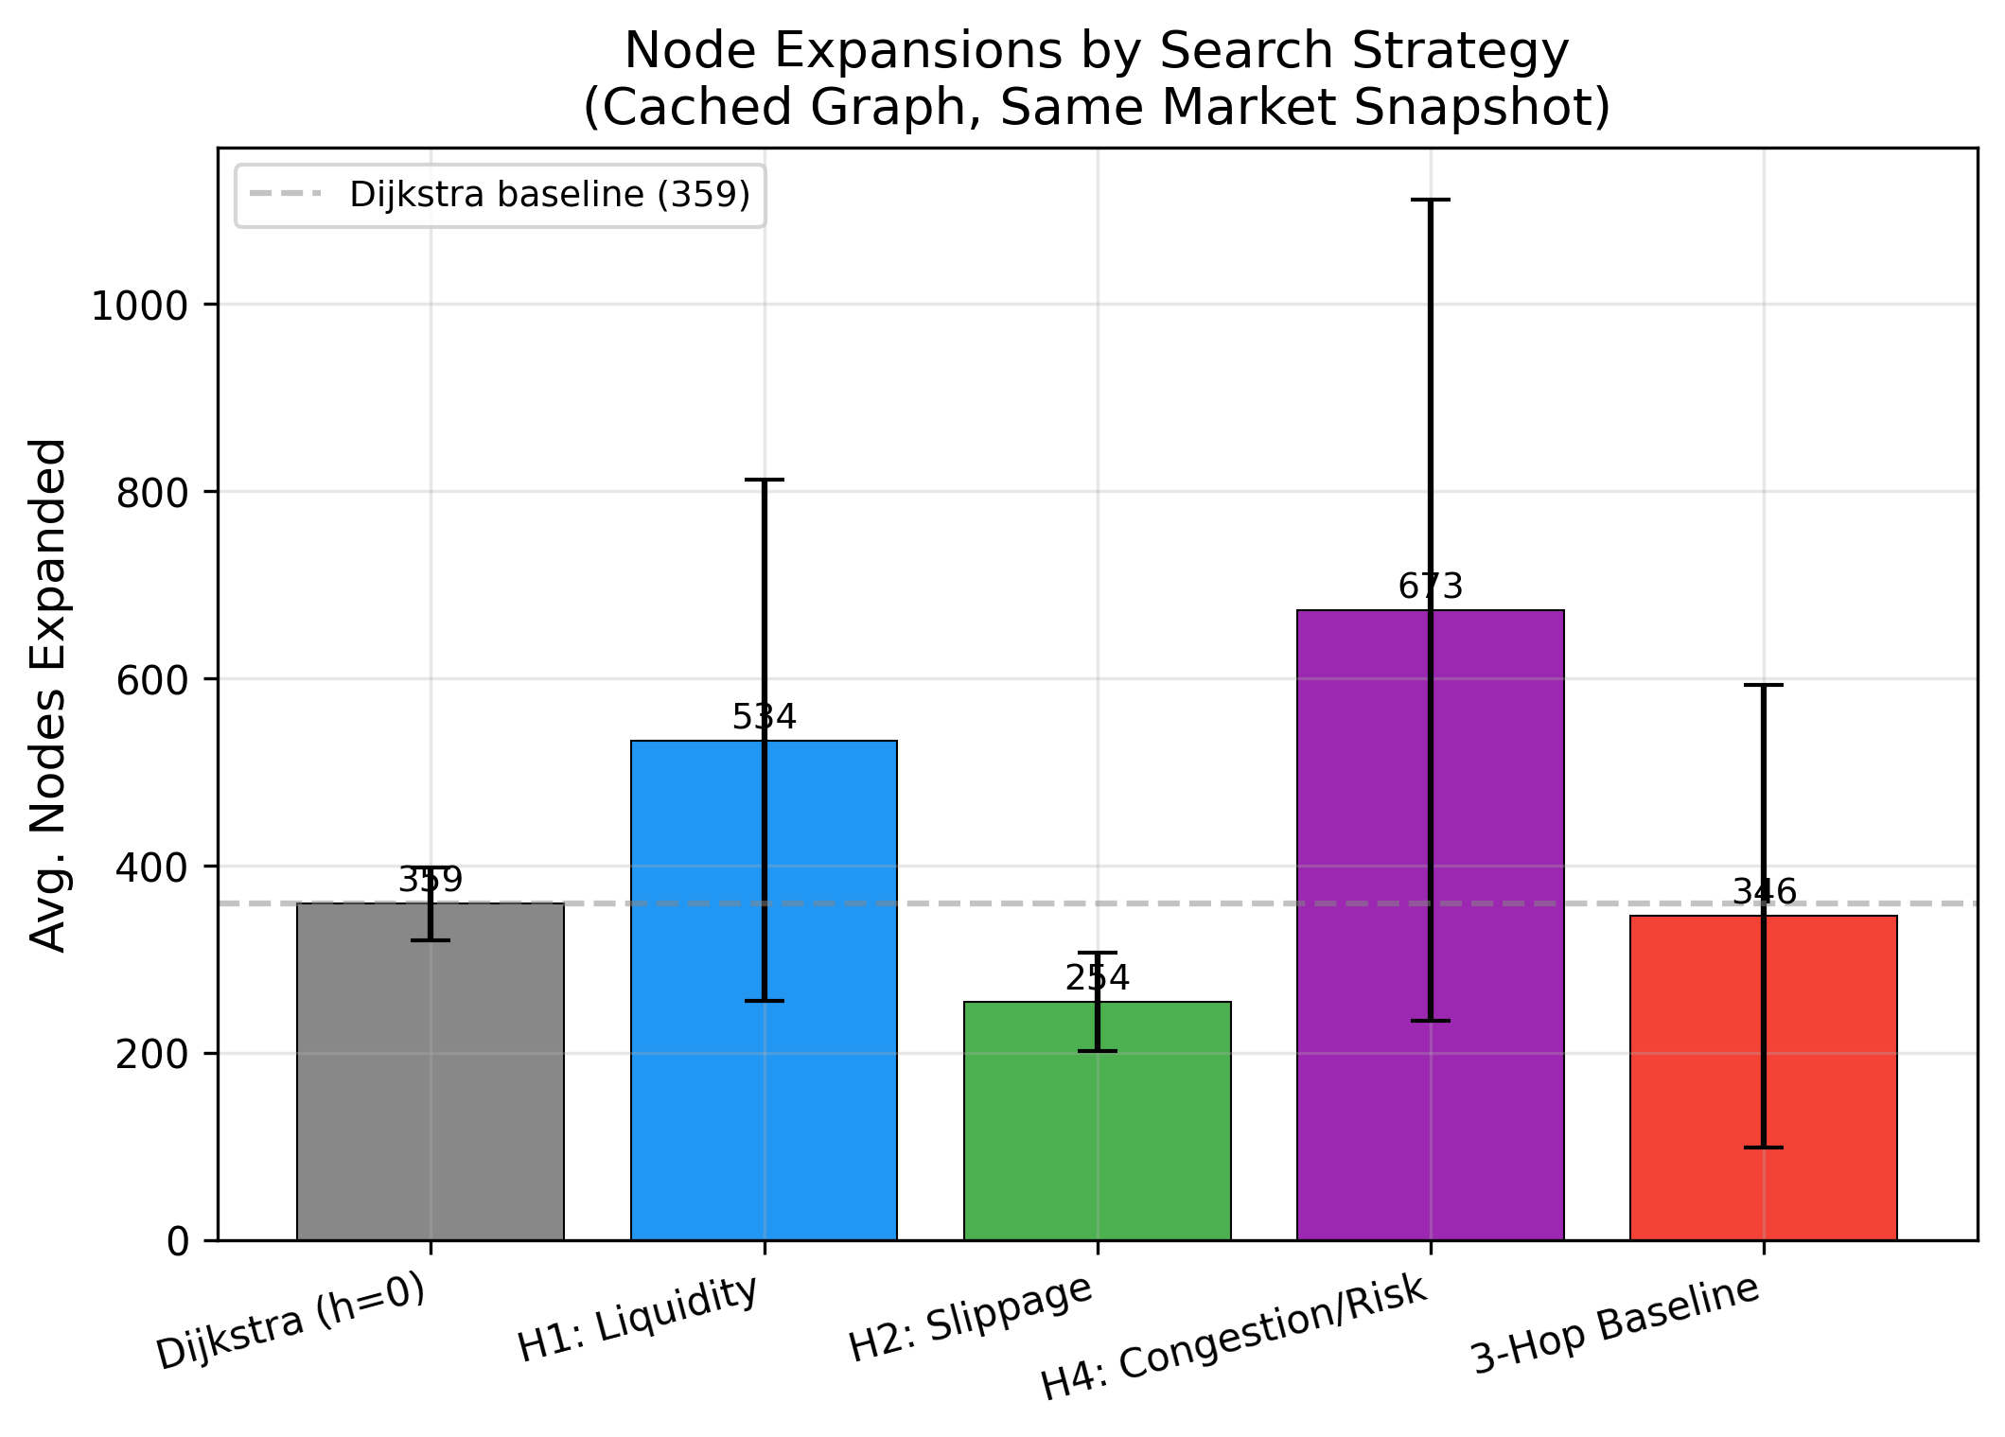
KEY RESULT
h₂ (Slippage Heuristic) · 29% fewer node expansions · same profit quality
Kevin Litvin · Simon Fraser University
Canadian AI 2026 · GSS
7 / 9

Slide 8
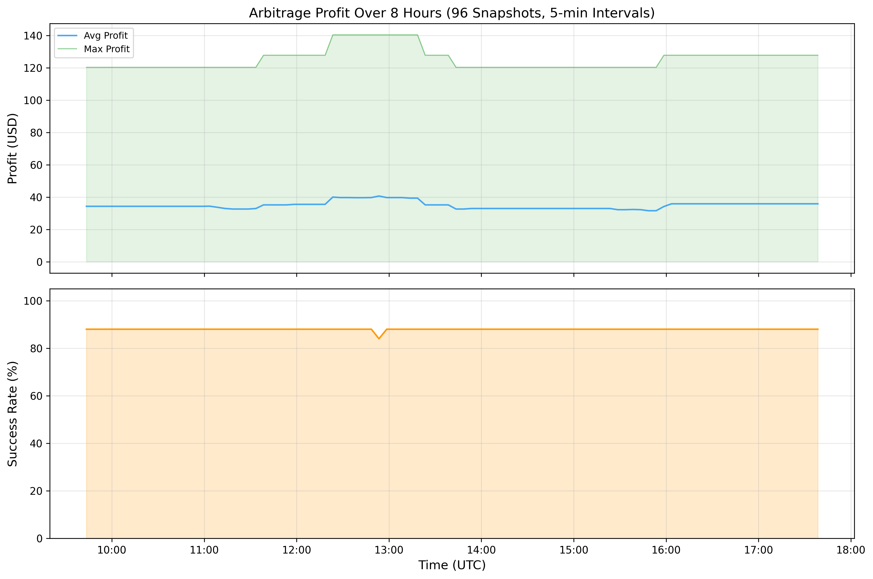
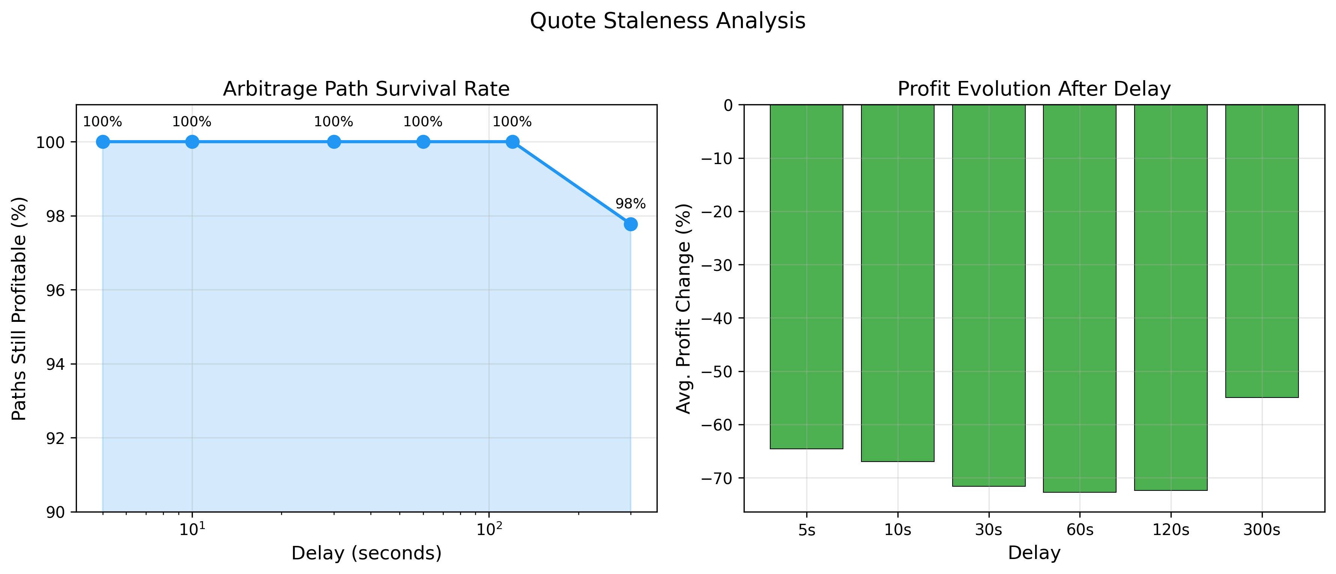
Real-World Proof — 7,200 Live Searches · 8 Hours · Live Market Data
7,200 / 7,200 surfaced profitable paths
Reproducible at high volume — not a one-off
99.6% still profitable at +2 minutes
→ Act within 120 seconds
Kevin Litvin · Simon Fraser University
Canadian AI 2026 · GSS
8 / 9

Slide 9
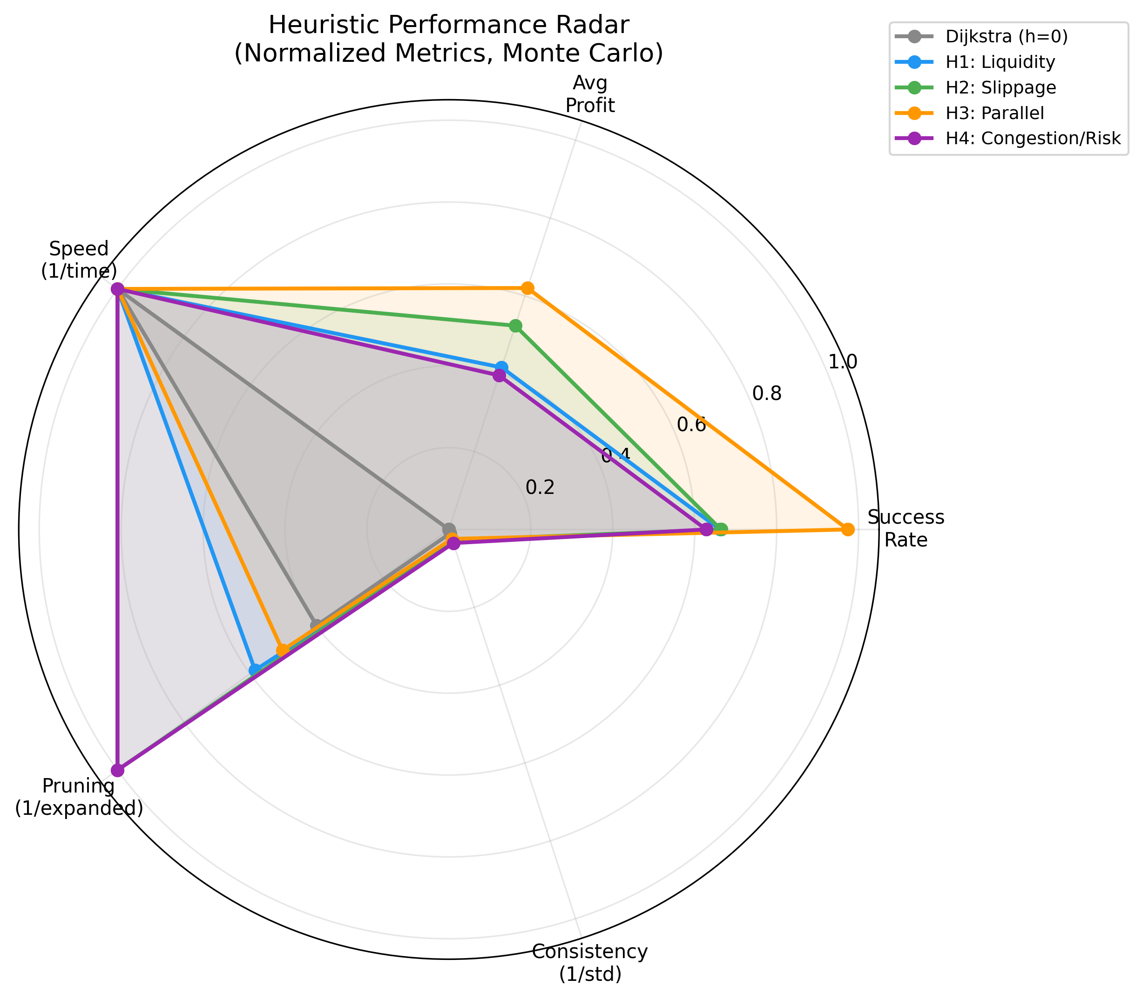
Method comparison — all metrics
Less Exploration.
More Execution.
Same Profit.
— Google Maps, for $33 trillion in stablecoin volume.
Thank you · Questions?
github.com/kevinl03/Stablecoin-CrossExchange-Arbitrage
Kevin Litvin · Simon Fraser University
Canadian AI 2026 · GSS
9 / 9

