Slide 1
Cross-Exchange Stablecoin Arbitrage
Finding profitable paths with A* search on L2 order book data
Algorithm Demo • Kevin Litvin
1

Slide 2
What are Cryptocurrencies?
Digital Assets
Tokens on a distributed
ledger — no bank needed.
Traded 24/7 globally.
Blockchain Execution
1. Sign TX with private key
2. Broadcast to network
3. Validator adds to block
4. Confirmed — immutable
Exchanges
Binance, Kraken, Bybit,
Coinbase, OKX, Gate.io
Each runs its own
order book independently.
Key insight: same asset can have different prices on different exchanges
2

Slide 3
Stablecoins: The “Cash” of Crypto
• Crypto tokens pegged to a fiat currency
• Not just USD — EUR, GBP, CAD, JPY stablecoins exist too (e.g. EURC, EURT)
• Backed by real reserves (cash, treasuries)
• Multiple issuers → multiple prices
USDT (Tether)
$1.0001
USDC (Circle)
$0.9999
DAI (Maker)
$0.9997
EURC (Circle, EUR)
€1.0002
EURT (Tether, EUR)
€0.9995
Cross-currency arbitrage is possible too: USD-pegged vs. EUR-pegged coins
3

Slide 4
How Do They Stay Pegged?
Three mechanisms — works for USD, EUR, GBP, CAD, etc.
Fiat-Backed
(USDT, EURC)
1:1 reserve of fiat cash
in bank accounts + bonds.
Redeem anytime at par.
Over-Collateralized
(DAI)
Lock $1.50 of ETH to
mint $1.00 of DAI.
Auto-liquidates if
collateral drops.
Algorithmic
(historical)
Expand/contract supply
to maintain peg.
High risk — UST
collapsed in 2022.
4

Slide 5
The Arbitrage Opportunity
Kraken
USDC = $0.99990
(cheap)
Binance
USDC = $1.00013
(expensive)
→
Buy on Kraken → Transfer → Sell on Binance = +2.3 bps profit
But: fees + slippage + transfer time can eat the profit.
With 5 exchanges × 4 coins = 20 nodes, 40+ edges — need an algorithm.
5

Slide 6
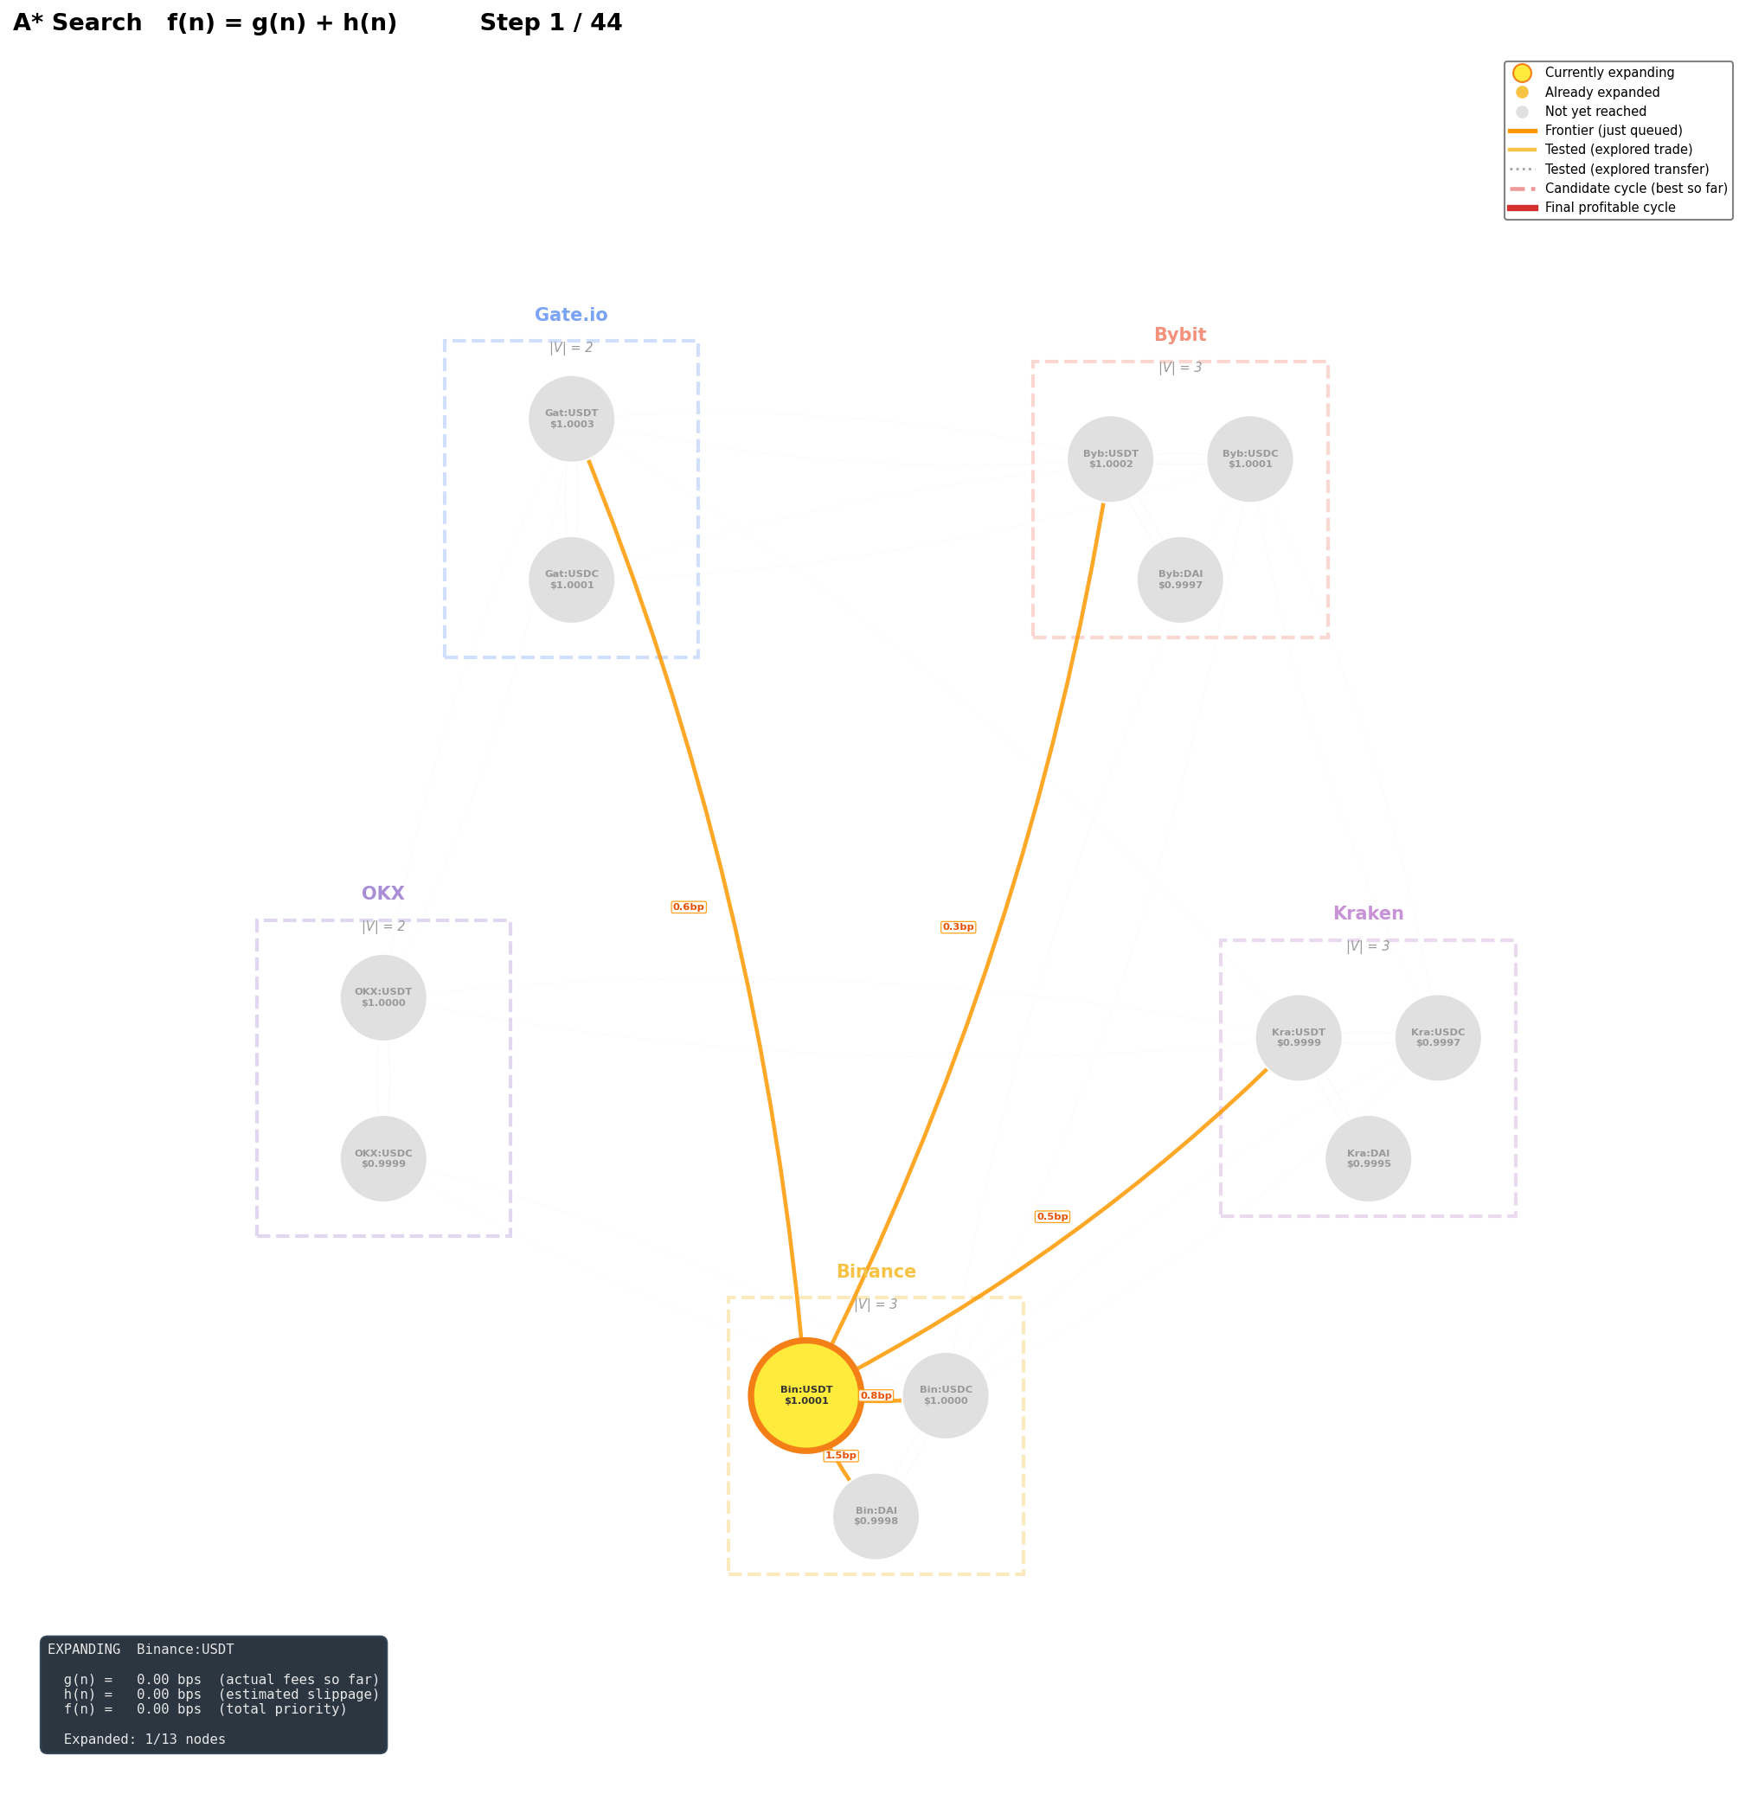
Model: Weighted Directed Graph
• Node = (exchange, coin)
• Trade edge: swap coins on same exchange
• Transfer edge: move coin between exchanges
• Edge weight = fee in bps
• Goal: find lowest-cost path — a closed cycle back to start, OR just the cheapest route between two nodes
6

Slide 7
Why Shortest-Path Isn’t Enough
4 real-world costs a naive graph search ignores
1. Fees
Flat transfer fees apply
per trade — the order needs
to be large enough to
offset them.
2. Slippage
Asset prices move during
execution — impacts profit
more for larger order
sizes.
3. Latency
Some blockchains take
longer to confirm — others
slow down under
high volume.
4. Operational risk — withdrawals may be paused,
regions geofenced, or VPNs blocked
7

Slide 8
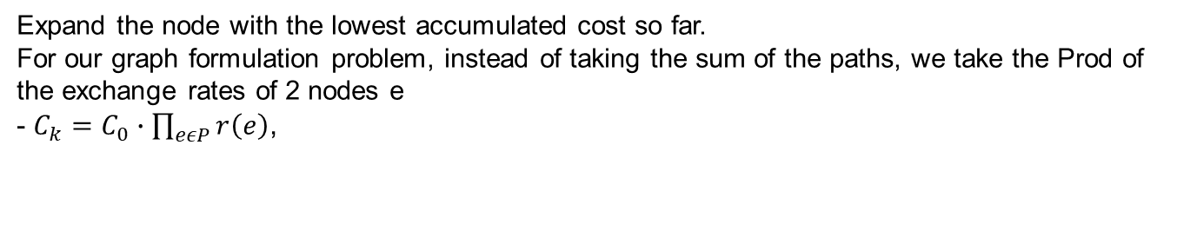
Dijkstra: f(n) = g(n)
Expand the node with the lowest accumulated cost so far.
For our graph formulation problem, instead of taking the sum of the paths, we take the Prod of the exchange rates of 2 nodes e - $C_{k}=C_{0}∙\prod_{eεP}{r\left(e\right)}$,
✓ Guaranteed optimal
✓ Simple to implement
✓ No domain knowledge needed
✗ Explores blindly
✗ Ignores slippage risk
✗ Ignores transfer time
✗ Wastes time on thin books
8

Slide 9
A*: f(n) = g(n) + h(n)
Add a heuristic that looks ahead at execution quality.
f(n) = g(n) + h(n)
h(n) = slippage(L2 order book) + σ · √(Δt)
Slippage: Walk the ask side for our trade size. Thin book = high cost.
Time risk: Stablecoin vol (~1.5 bps/min) × transfer duration.
Deep book + fast transfer → low h → A* explores that path first.
9

Slide 10
A* Step 1: Start Node
Begin at Binance:USDT. Orange = edges just pushed to priority queue.
10

Slide 11
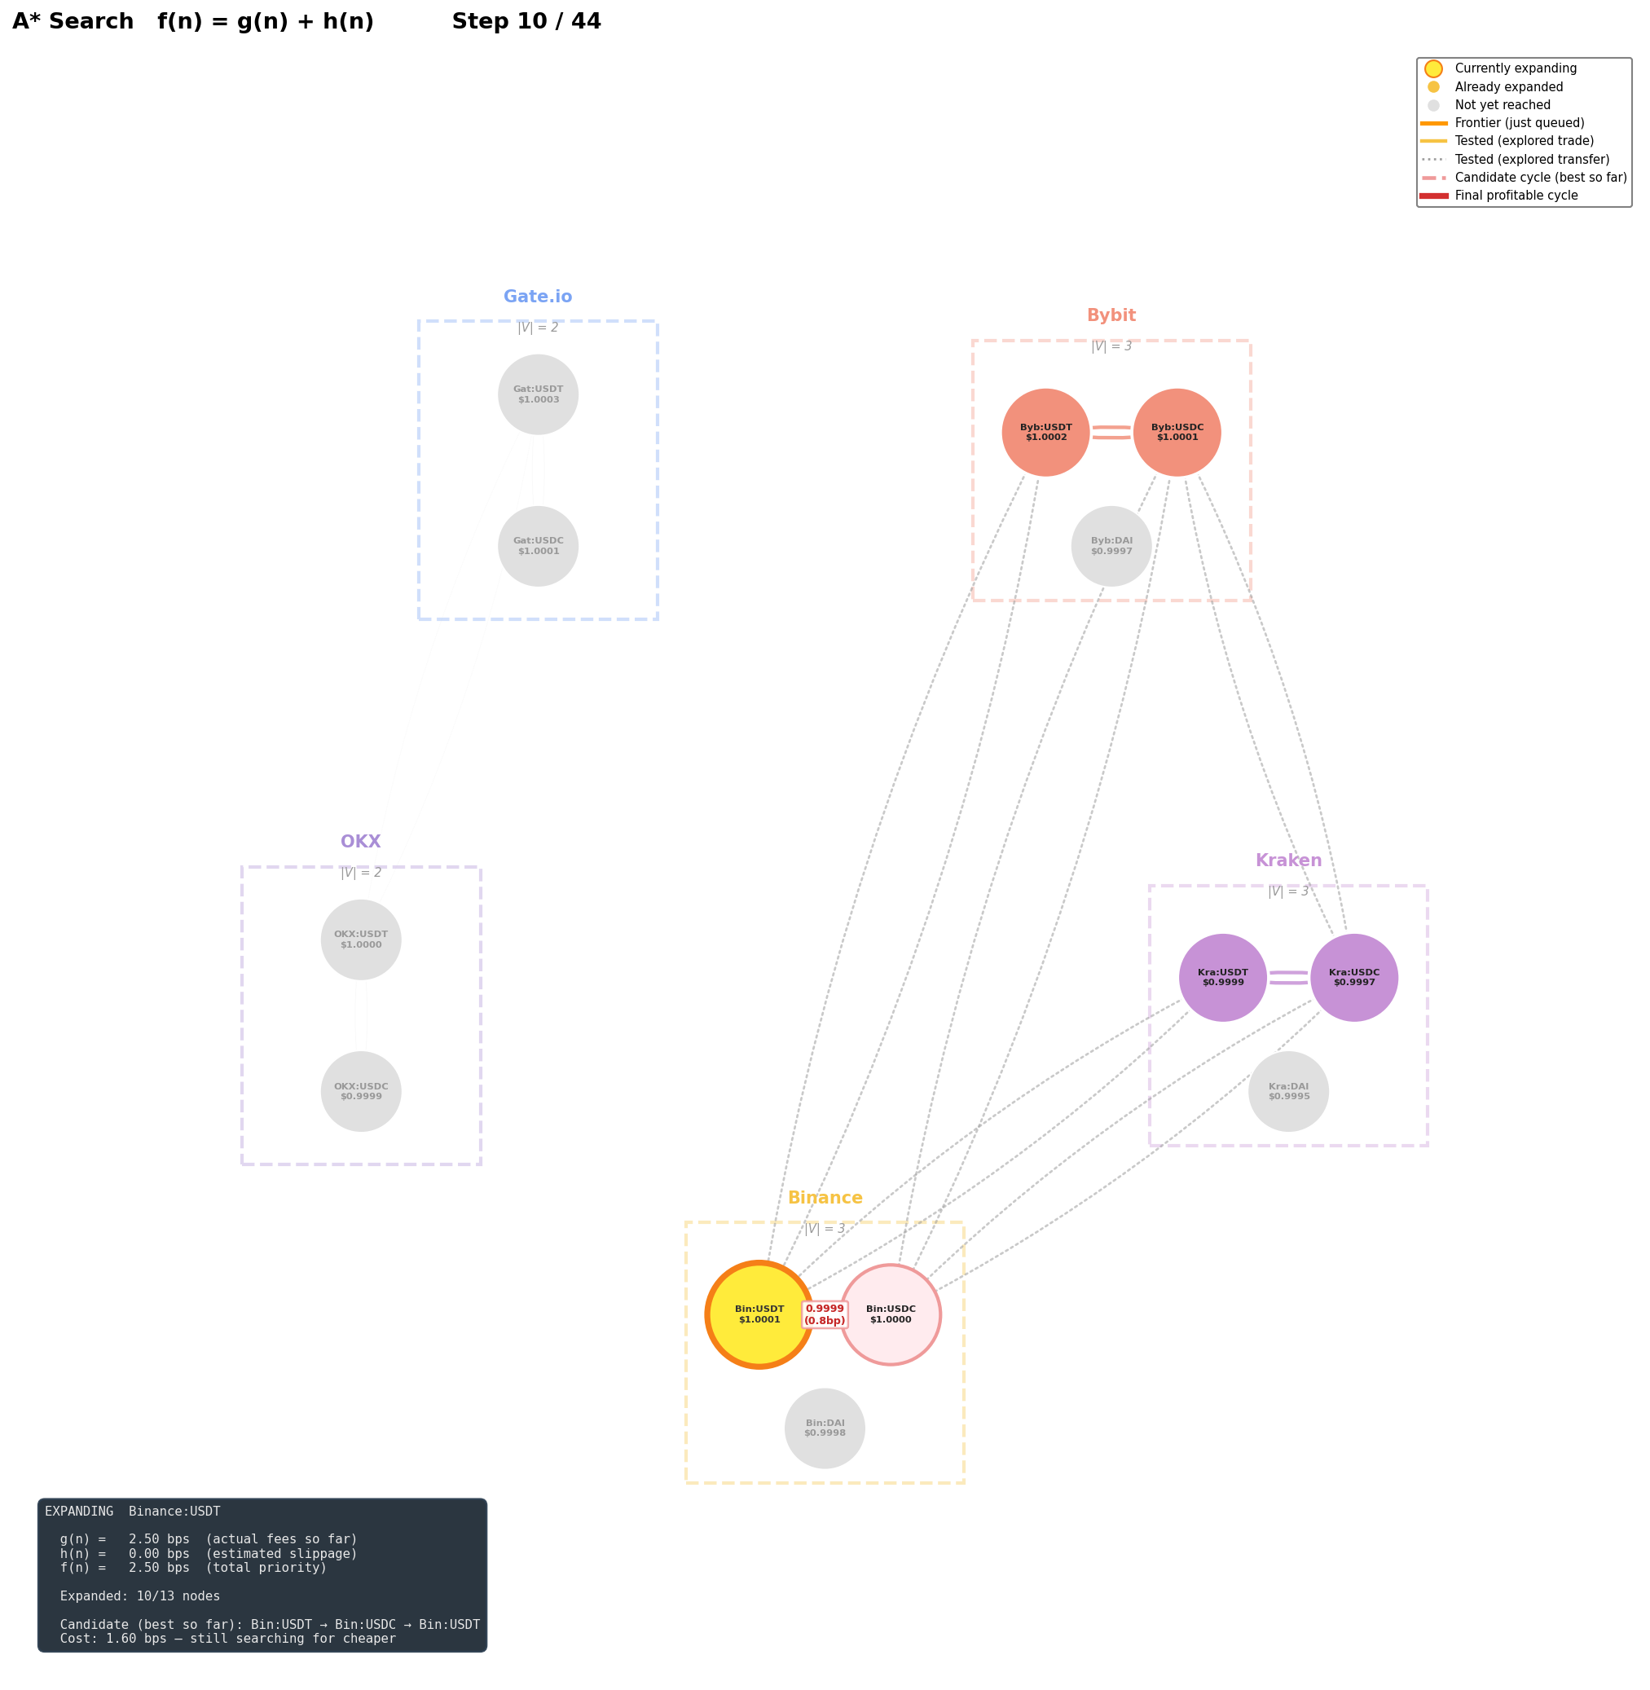
A* Step 3: Expanding Neighbors
Cheap, low-slippage paths explored first. Fee labels (bps) on each edge.
11

Slide 12
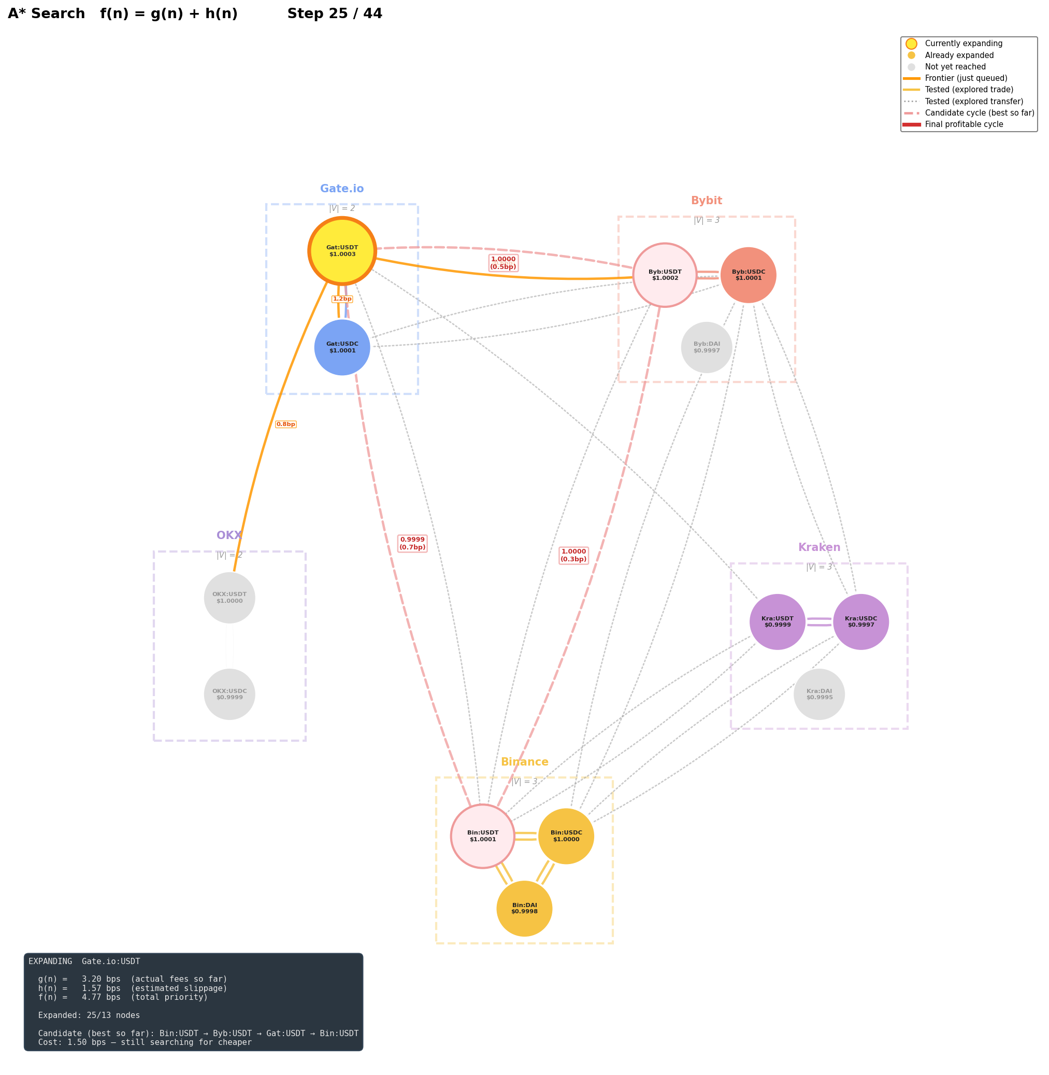
A* Mid-Search
Bybit and Kraken reached. High time-risk paths to OKX deprioritized.
12

Slide 13
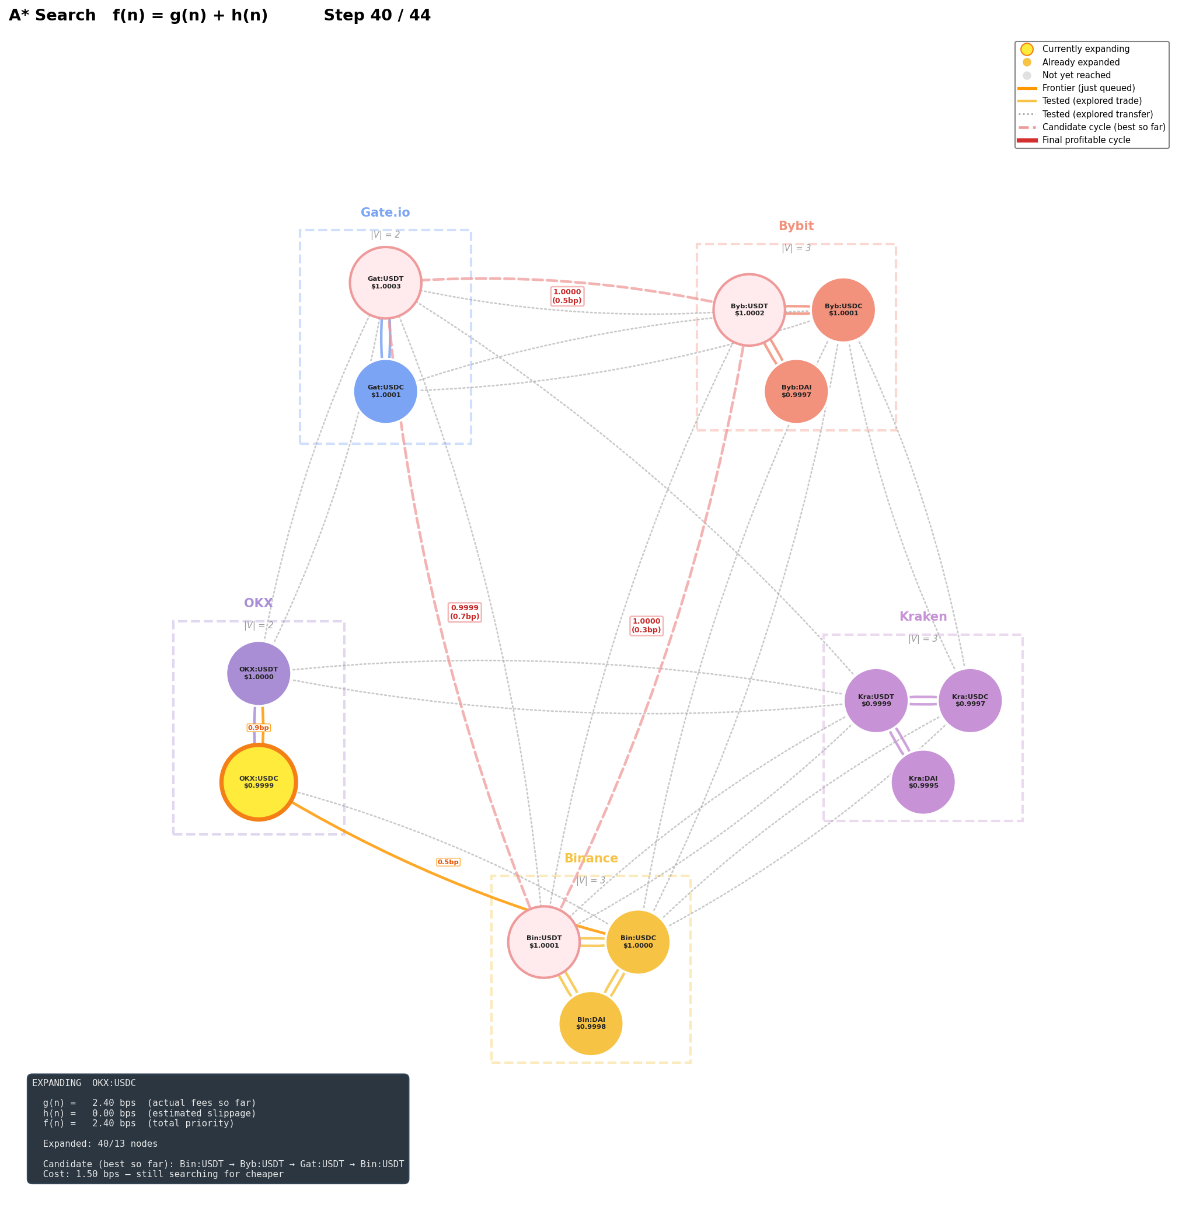
A* Nearing Completion
Most nodes expanded. Searching for profitable return path to start.
13

Slide 14
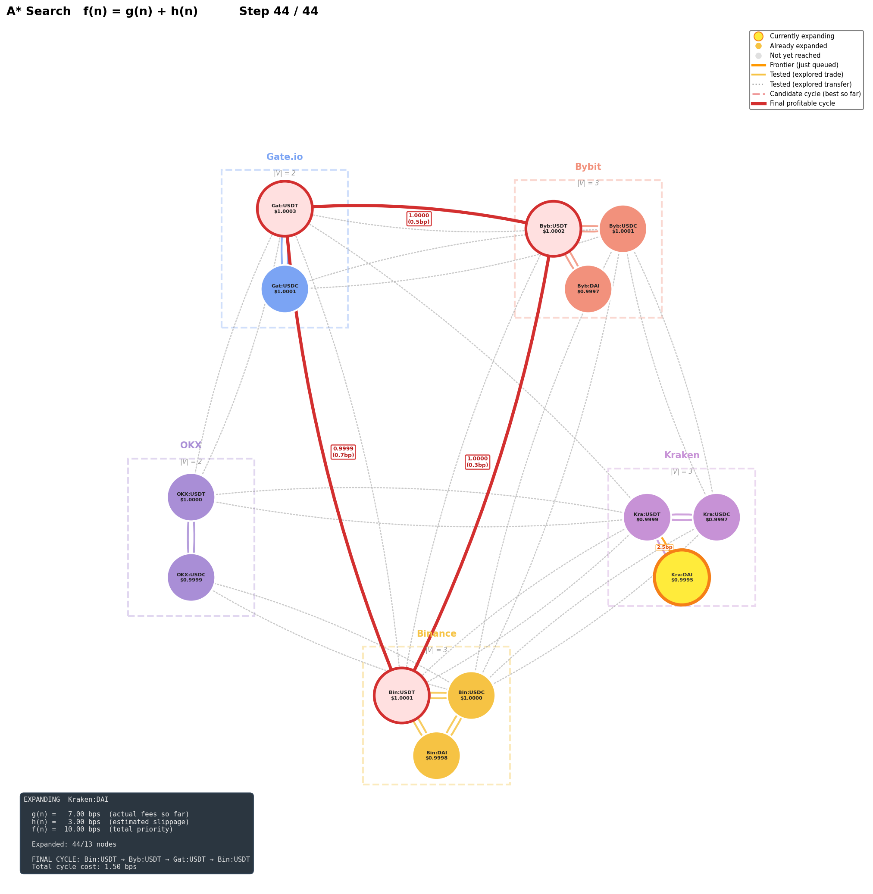
A* Final: Profitable Path Found
Red = lowest-cost route found. Doesn’t have to close a cycle —
a one-way path can be profitable too (e.g. rebalancing, one-off transfers).
14

Slide 15
The L2 Order Book → Slippage Heuristic
• 20 price levels of depth per book
• Walk the asks for our trade size → this is what guides h(n)
• Deep book (Binance) → low slippage → A* prefers it
• Thin book (Gate.io) → high slippage → A* avoids it
USDC/USDT | Bid | Ask
Binance (deep) | 1.00011 | 1.00014
 | 1.00010 | 1.00015
 | 1.00009 | 1.00016
Gate.io (thin) | 1.0006 | 1.0009
 | 1.0005 | 1.0010
 | 1.0004 | 1.0011
Also tested h(n) variants penalizing:
• Liquidity (order book depth)
• Latency (chain + venue confirm time)
$50K buy on Binance ≈ 0 bps slippage (millions of units at top)
$50K buy on Gate.io ≈ 0.5 bps slippage (only ~5K units at top)
15

Slide 16
Summary
• Stablecoins = crypto pegged to fiat (USD, EUR, etc.) — tiny cross-exchange gaps exist
• Model as a graph → arbitrage = finding a profitable path
• The path can close a cycle back to start, or just end at a cheaper destination — both count
• Real-world costs — fees, slippage, latency, operational risk — shape which paths are worth it
• A* + slippage heuristic guides search toward deep, fast routes
• Same optimality as Dijkstra, but focused exploration
Code: scripts/animate_astar_search.py
UI: streamlit run scripts/ui.py
16

