Slide 1

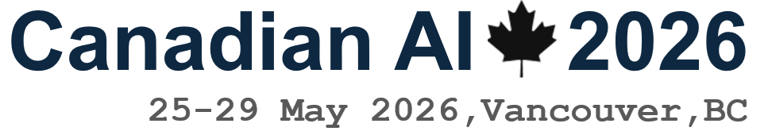
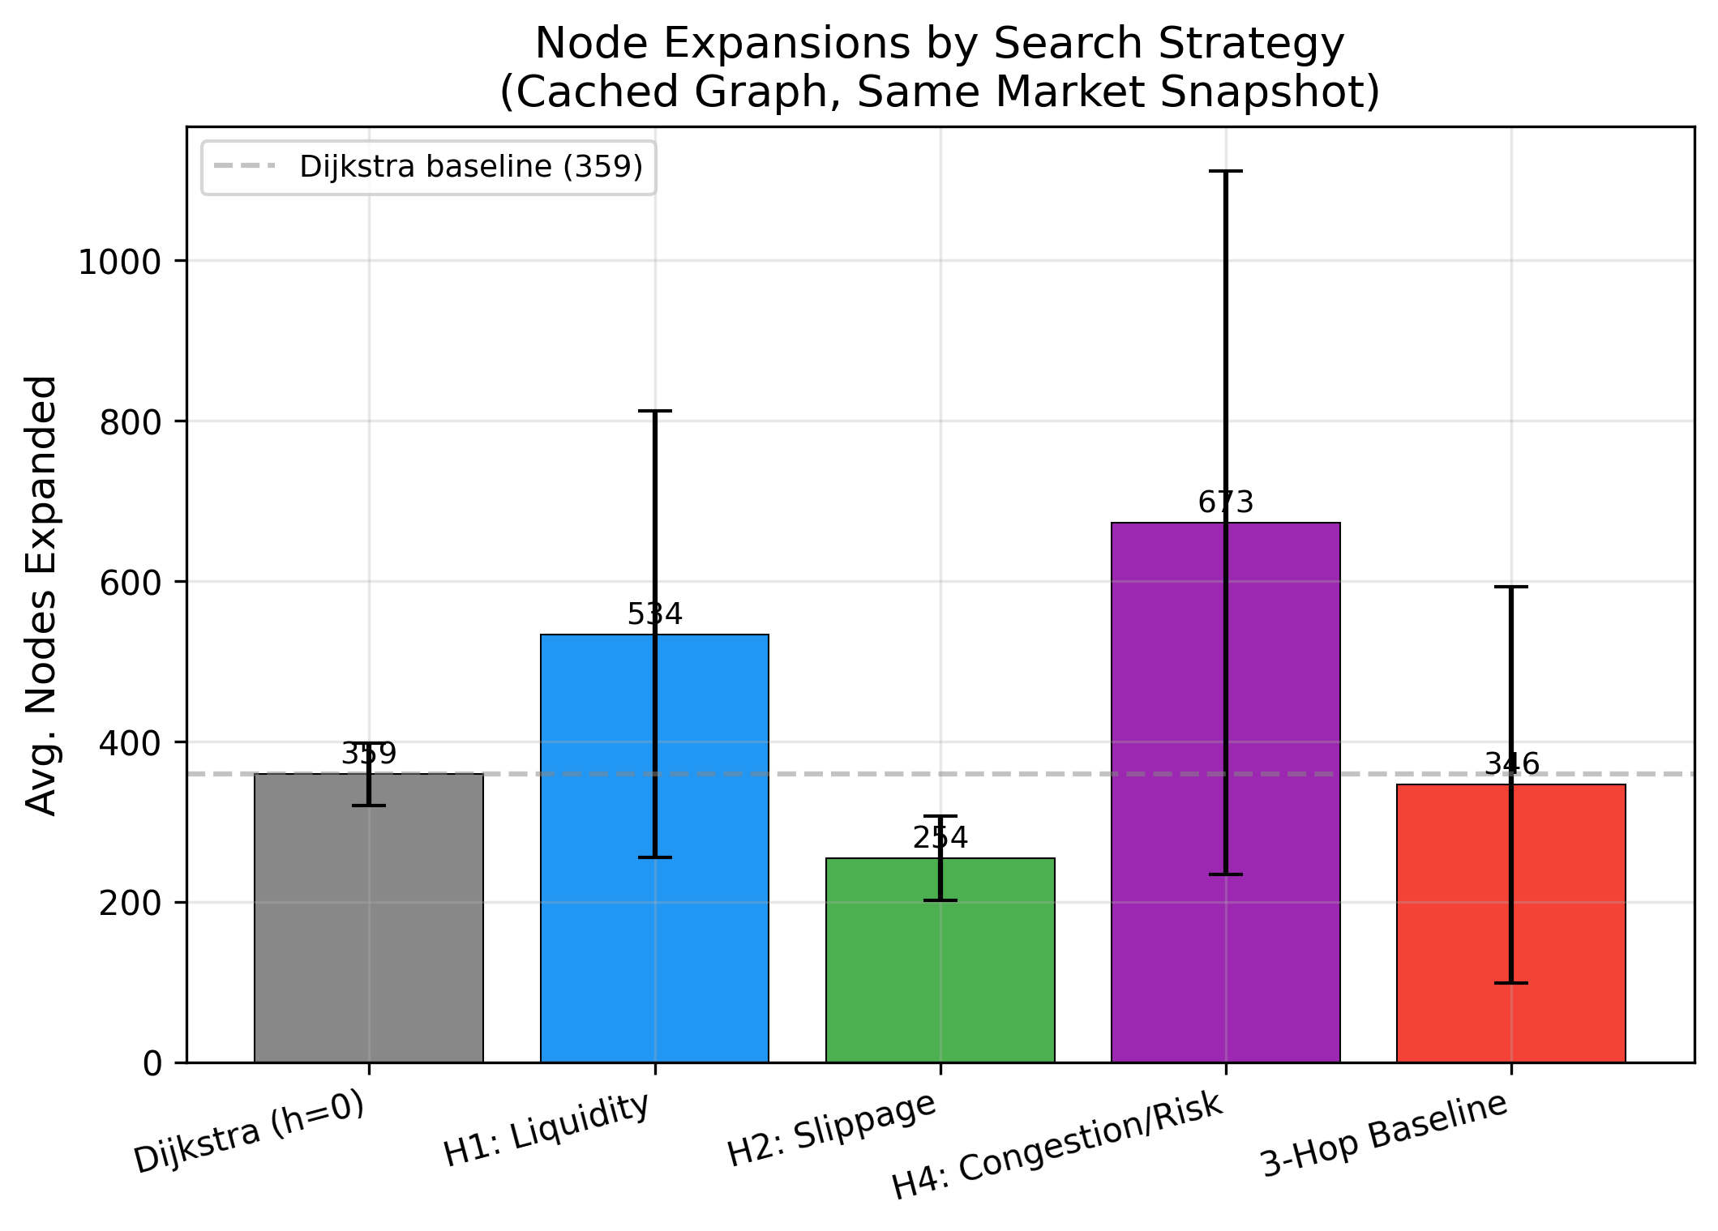
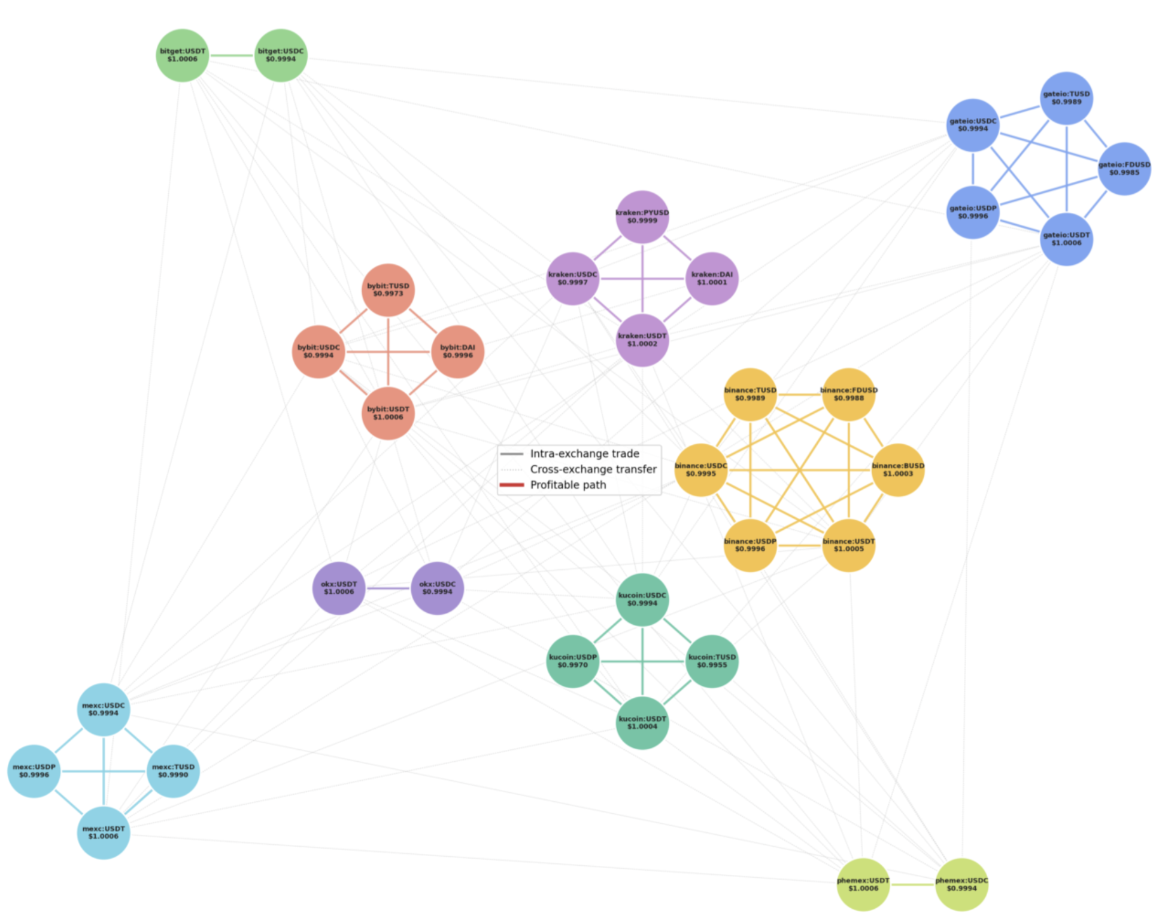
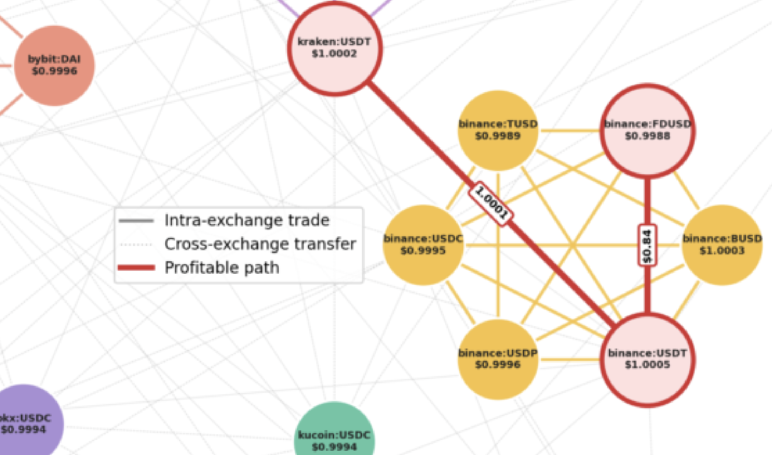
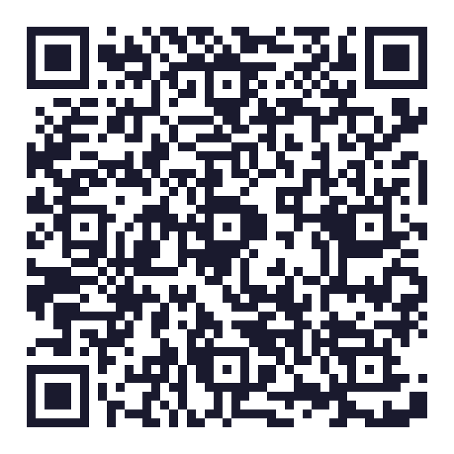
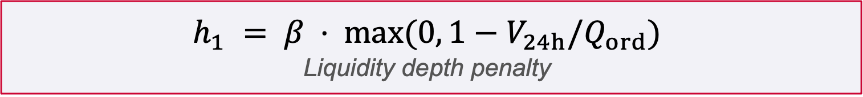
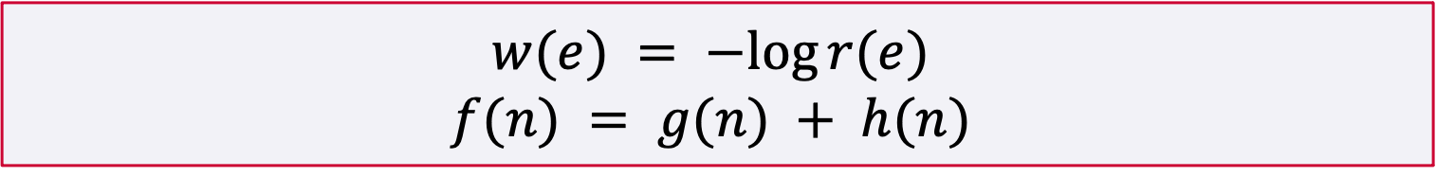
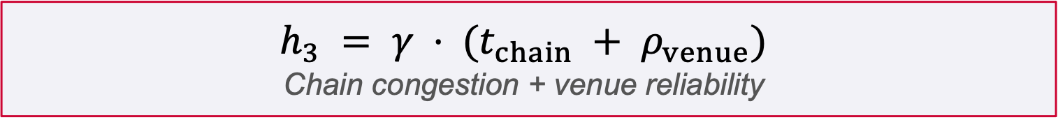
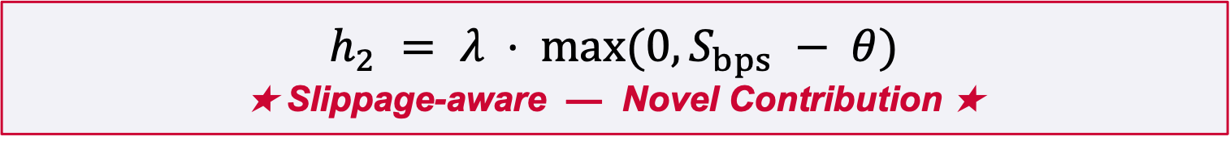
Execution-Aware A* Search for Cross-Exchange Stablecoin Arbitrage
Kevin Litvin — Simon Fraser University
Graph G=(V,E): nodes are (exchange, stablecoin) pairs; intra-exchange edges are spot trades, inter-exchange edges are same-coin cross-venue stablecoin transfers.
Edge weight w(e) = -log r(e); effective rate r(e) = (1-fee)(1-slippage)(1-gas) x reliability, converting all execution costs into a single multiplicative model.
Open-path goal: any node where final USD value exceeds start capital. No closed cycle is required because all assets are USD-pegged stablecoins (within +/-2%).
A* with f(n) = g(n) + h(n); terminates when a profitable path is found, the frontier is exhausted, or depth/time limits are reached. Search is not complete by design.
Cost function and three novel heuristics ▼
Abstract: the $300B Opportunity
Method: Execution-Aware A* Search
Key Results
Cross-exchange cryptocurrency arbitrage profits from price discrepancies between venues, yet existing approaches use negative-cycle detection targeting opportunity identification rather than execution feasibility. We introduce an execution-aware A* pathfinding framework applied to stablecoins, an asset class exceeding $300 B in market cap that bridges cryptocurrency and fiat currency.
Live market data is collected from 12 major centralized exchanges via CCXT, covering 9 stablecoin symbols (USDT, USDC, DAI, TUSD, FDUSD, and more). The problem is modelled as a weighted directed graph (up to 41 nodes, 864 edges) where each node is an (exchange, stablecoin) pair and each edge encodes fees, slippage, gas, transfer delays, and venue reliability. This novel proprietary CEX dataset spans 7,200 search instances.
★ 29% Fewer Node Expansions ★
Same profit as Dijkstra across all 7,200 instances
h₂ achieves the same profit as Dijkstra in all 7,200 overnight instances
99.6% of discovered paths remain profitable after 120 s of quote delay
h₁ and h₃ expand 58–87% more nodes and earn 30–33% less profit
Arbitrage Network
Subgraph of the stablecoin arbitrage network (9 of 12 exchanges shown). Nodes = (exchange, coin); solid edges = intra-exchange trades; light edges = same-coin cross-exchange transfers.
Each intra-exchange edge represents a spot trade and carries a taker fee, order-book slippage penalty, and venue reliability discount. Each cross-exchange edge represents a stablecoin withdrawal and carries a gas fee plus an estimated blockchain-confirmation latency.
$$w(e) = −log r(e)$$
$$f(n) = g(n) + h(n)$$
Fig. 2a — Node expansions per heuristic (cached graph, $10 k order)
Three Novel Heuristics
???
$$h_{1} = β ⋅ max(0, 1−V_{24h}/Q_{ord})$$
Liquidity depth penalty
subtitle.
What should go here :o
$$h_{2} = λ ⋅ max(0, S_{bps} − θ)$$
★ Slippage-aware — Novel Contribution ★
$$h_{3} = γ ⋅ (t_{chain} + ρ_{venue})$$
Chain congestion + venue reliability
Scan for source code & video demo
github.com/kevinl03/Stablecoin-CrossExchange-Arbitrage Canadian AI 2026 | GSS Paper | 36 × 24 in
Stablecoin arbitrage graph: 9 of 12 exchanges shown
Fig. 1b - A profitable path: Kraken -> KuCoin (USDT -> TUSD)

