Slide 1
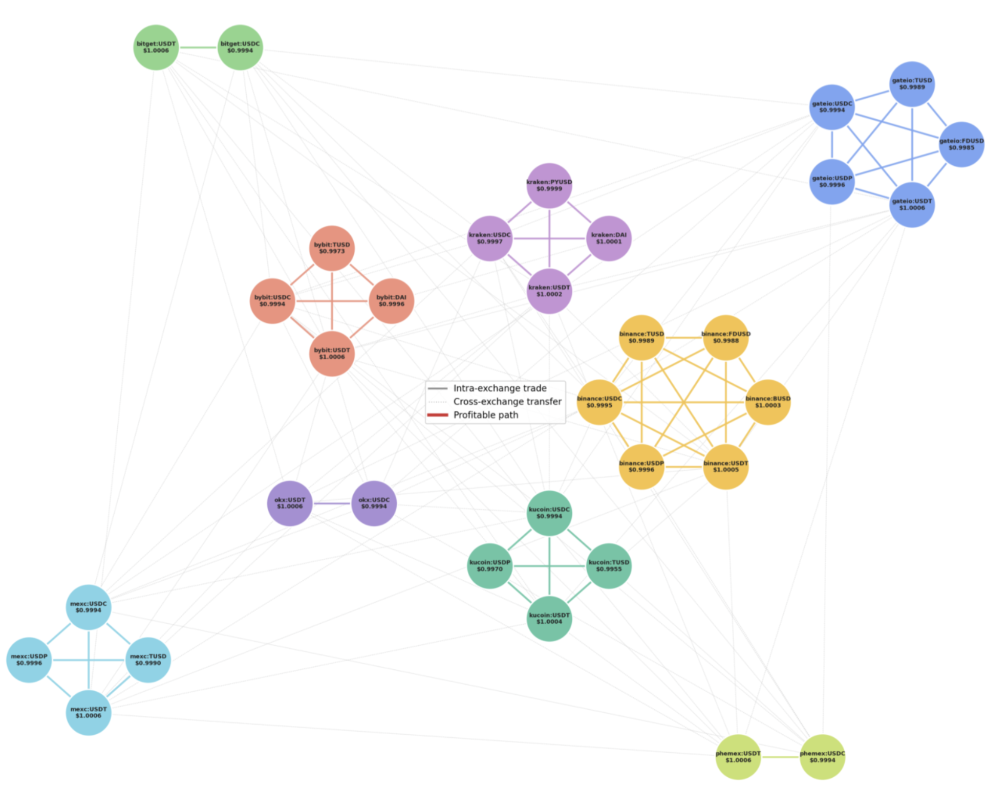
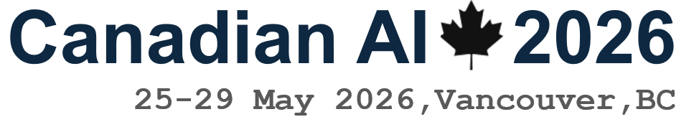
Execution-Aware A* Search for Cross-Exchange Stablecoin Arbitrage
Can domain-specific heuristics reduce search cost while maintaining profit quality?
Kevin Litvin · Simon Fraser University
Canadian AI 2026 · GSS
Kevin Litvin · Simon Fraser University
Canadian AI 2026 · GSS
1 / 9

Slide 2
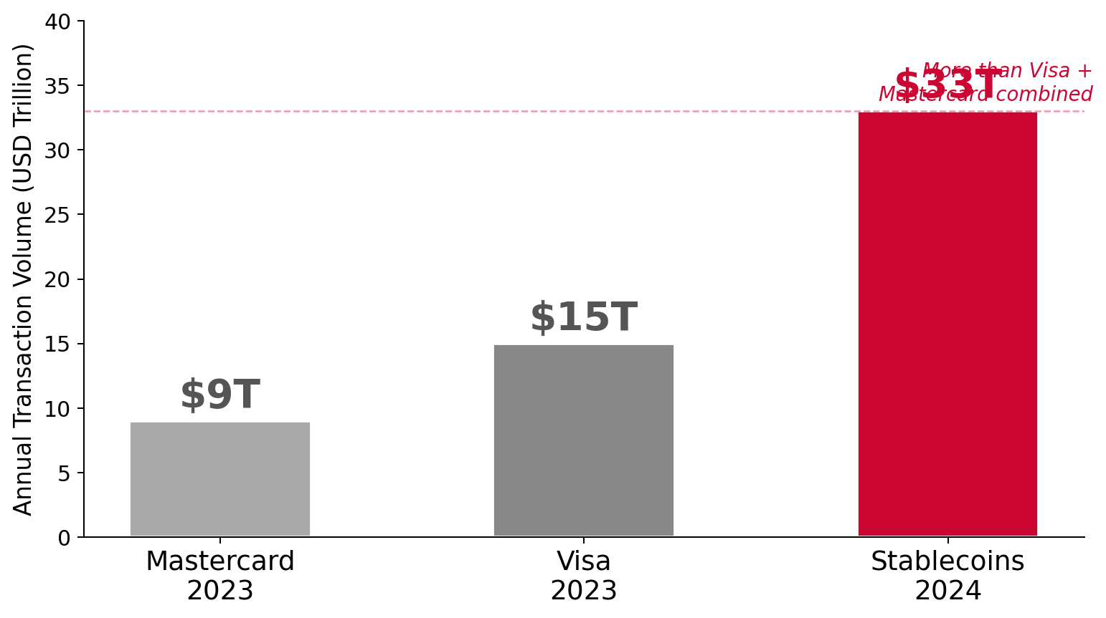
The $33 Trillion Market
Slide 2
$300B+
market cap in circulation
$33T
annual transaction volume
"They are the liquidity highways of the entire crypto ecosystem."
Kevin Litvin · Simon Fraser University
Canadian AI 2026 · GSS
2 / 9

Slide 3
The Problem: Execution Feasibility
Slide 3
"Imagine you are a quant trader. It is 2 AM. You see USDT trading cheaper on Kraken than on KuCoin. The math works. Existing systems say: take it."
But existing systems don't tell you about the four execution barriers:
1. Liquidity
2. Slippage ★
3. Latency
4. Reliability
Your order size may exhaust the book
Large orders move the price mid-execution
Blockchain settlement may miss the window
Exchanges may suspend withdrawals overnight
Bellman-Ford, 1-hop, and 2-hop baselines fail entirely. We need execution-aware pathfinding.
Kevin Litvin · Simon Fraser University
Canadian AI 2026 · GSS
3 / 9

Slide 4
The Dataset: A Novel Execution-Aware Graph
Slide 4
12
centralized exchanges
9
stablecoin symbols (USDT, USDC, DAI…)
41
nodes (exchange, coin pairs)
864
edges with live cost data
★ First execution-aware graph dataset built for stablecoin arbitrage research.
Kevin Litvin · Simon Fraser University
Canadian AI 2026 · GSS
4 / 9

Slide 5
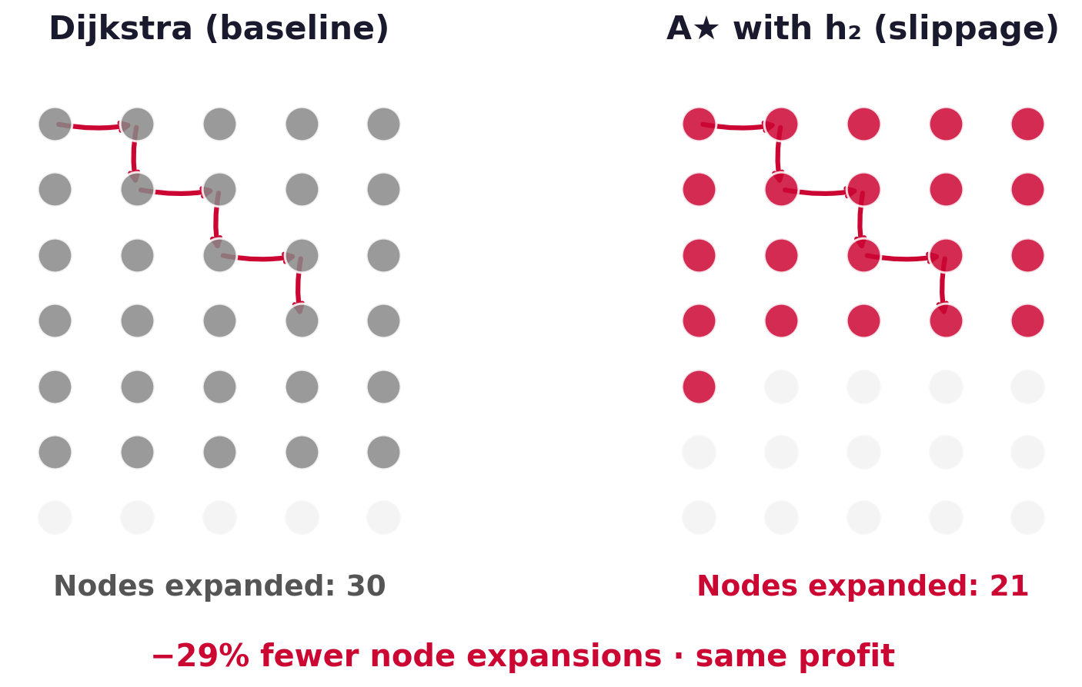
Method: A* — Google Maps for Money
Slide 5
f(n) = g(n) + h(n) · g(n): cost so far · h(n): execution risk estimate
Kevin Litvin · Simon Fraser University
Canadian AI 2026 · GSS
5 / 9

Slide 6
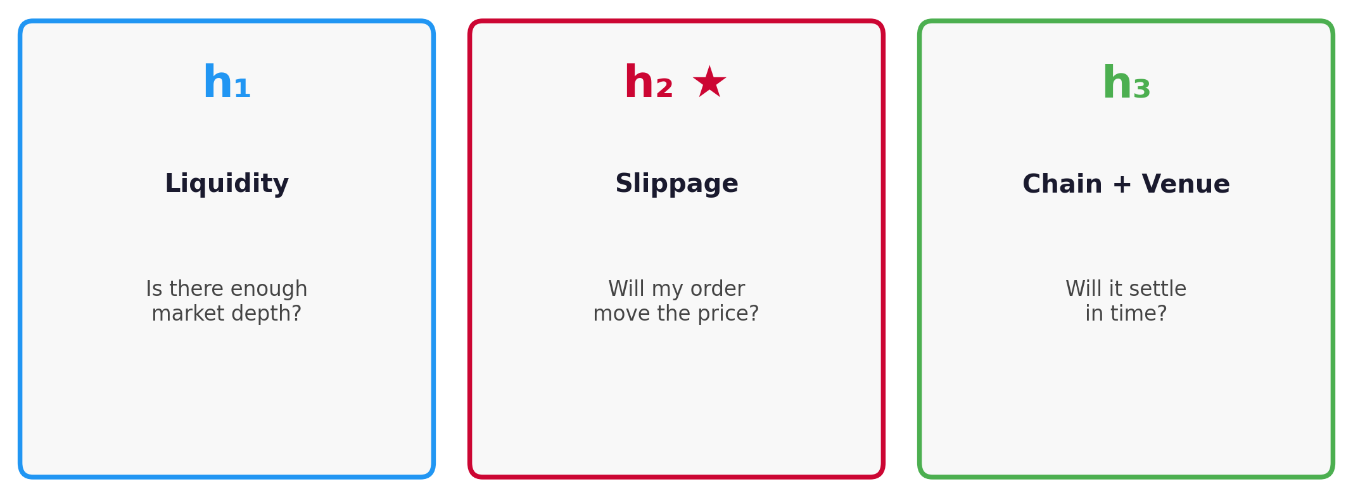
Three Novel Guidance Heuristics
Slide 6
Each heuristic adds a domain-specific penalty to h(n), steering A* toward paths that are not just profitable — but executable under live market conditions.
One of these three will prove decisive.
Kevin Litvin · Simon Fraser University
Canadian AI 2026 · GSS
6 / 9

Slide 7
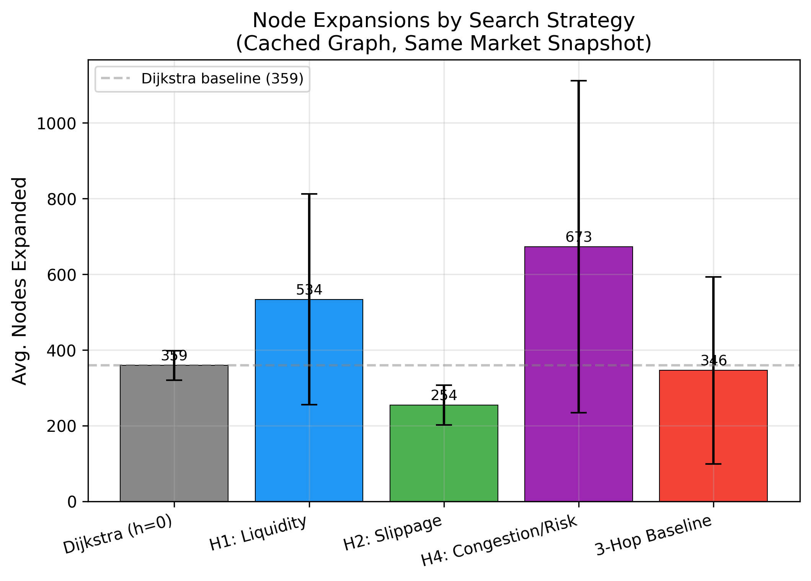
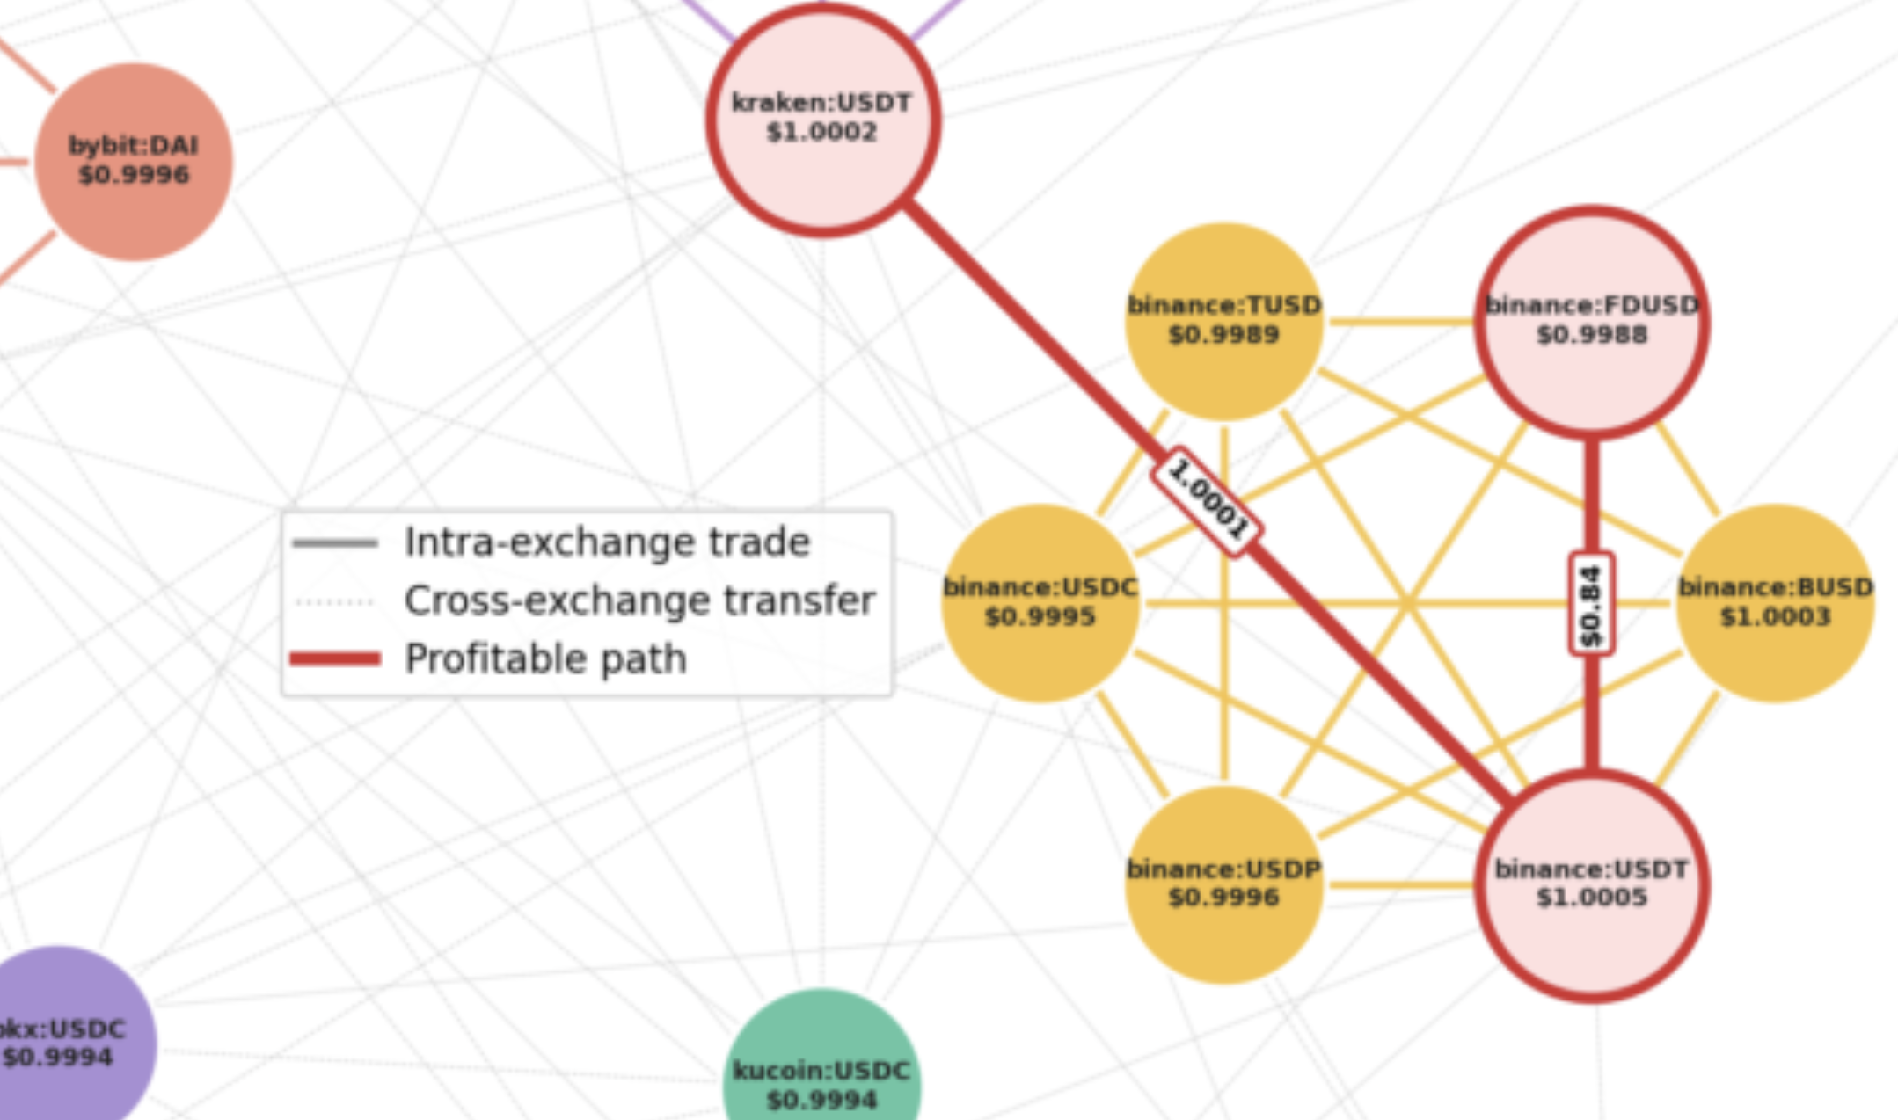
Key Result: 29% Fewer Node Expansions
Slide 7
Same profit. 29% less work.
• h₂ matches Dijkstra profit within 1%
• 7,200 overnight searches · 100% found a path
• 99.6% still profitable after 120 s
Kevin Litvin · Simon Fraser University
Canadian AI 2026 · GSS
7 / 9

Slide 8
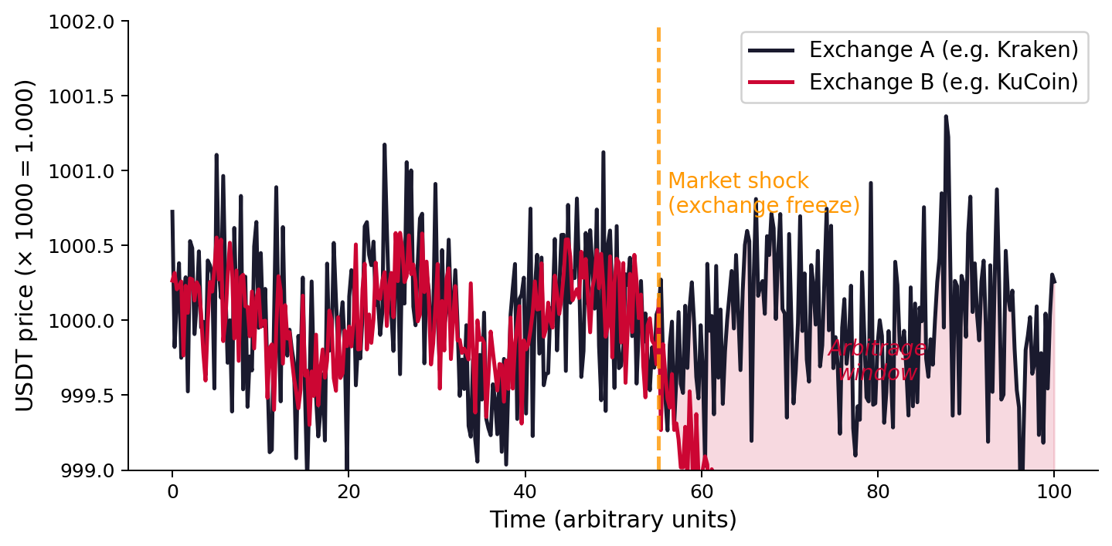
Why It Matters: Markets Under Stress
Slide 8
Price discrepancies spike during:
• Exchange freezes & withdrawal halts
• Geopolitical shocks & government bans
• Regulatory announcements
• Sudden liquidity crises
A 29% more efficient router is not just a trading tool — it is a lens for understanding how fragmented markets behave under stress.
Next: DEX / AMM markets (Uniswap, Curve)
Kevin Litvin · Simon Fraser University
Canadian AI 2026 · GSS
8 / 9

Slide 9
Less Exploration.
More Execution.
Same Profit.
Thank you. | Questions?
github.com/kevinl03/Stablecoin-CrossExchange-Arbitrage
Kevin Litvin · Simon Fraser University
Canadian AI 2026 · GSS
9 / 9

