Slide 1
Distributive Justice and Gender
Introduction to Political Theory
Semester 2 Week 10 Lecture
Dr. Billy Christmas

Slide 2
SUMMARY The Public-Private Distinction in Rawls The Gendered Division of Labour in the Family The Gendered Division of Labour in Society & Sexism Solutions Libertarianism and feminism

Slide 3
THE BASIC STRUCTURE AS THE SUBJECT OF JUSTICE [T]he major social institutions that distribute fundamental rights and duties that determine the division of advantages from social cooperation. […] Competitive markets, private property in the means of production, and the monogamous family are examples of major social institutions. (A Theory of Justice, §2)

Slide 4
Agents in the Original Position are Heads of Household

Slide 5
“Formal” characteristics agents have behind the Veil are masculine or male-coded Instrumental/economic rationality Mutual disinterest Historically grounds for political exclusion of women Emotional/sentimental Caring

Slide 6

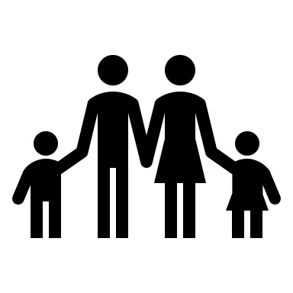
Justice in the Polis
Household Justice
Household Justice

Slide 7
THE PUBLIC-PRIVATE DISTINCTION Political Personal

Slide 8
THE PERSONAL IS POLITICAL 1. The private sphere of the family involves power relations of various kinds. The exercise of power between persons is in inherently political issue. 2. The private sphere is, to an extent, shaped by the political sphere. 3. The structure of the private sphere has spill-over effects into the public sphere.

Slide 9
The Gendered Division of Labour in the Family

Slide 10
Gender Norms
Division of Labour within the Family
Division of Labour outside the Family

Slide 11
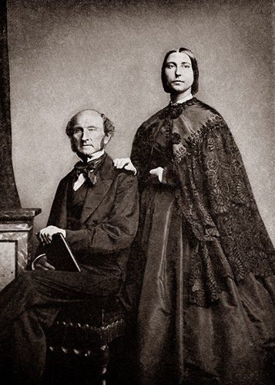
What is now called the nature of women is an eminently artificial thing – the result of forced repression in some directions, unnatural stimulation in others. – Harriet Taylor Mill & John Stuart Mill, The subjection of women, 1869
This Photo by Unknown Author is licensed under CC BY-NC-ND

Slide 12
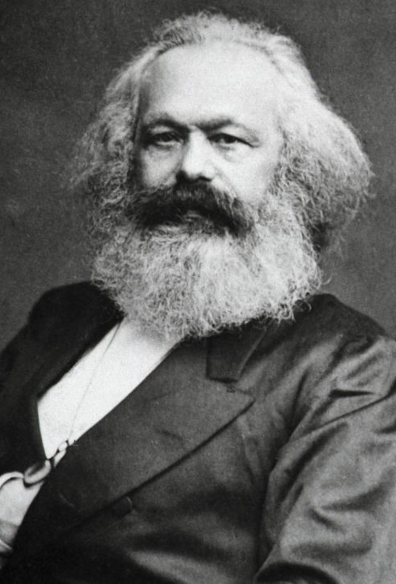
Productive vs. Reproductive Labour Man (as worker) produces commodities Woman reproduces the worker (and his household)
This Photo by Unknown Author is licensed under CC BY-SA-NC

Slide 13
1. Economic inequity between men and women that the gendered division of labour constitutes 2. economic inequity between men and women that the gendered division of labour causes

Slide 14
The Gendered Division of Labour in Society

Slide 15
DISCRIMINATION 1. Less mobile people are given priority seats on the tube (justified) 2. People of African descent not permitted to apply to University (wrongful) Sexism = wrongful discrimination on grounds of sex

Slide 16
We are looking for a full-time chief employment consultant. The consultant will be based in London, but asked to travel to other locations on a needs basis. Applicants should have proven leadership and organisational abilities, high problem-solving skills, and solid knowledge of the employment sector.

Slide 17
The gendered division of household labour has the following, two-pronged spill-over effect: 1. The job market has evolved to direct jobs toward men 2. Women are socialised into (or, presumed to have ben socialised into, or, have incentives to signal that they are socialised into) patterns of behaviour that make them unsuitable for these jobs

Slide 18
The gendered division of labour appears to be a distributive injustice (in some way, from most perspectives) → This means women remain dependent upon male partners economically, and are unable to secure the highest paying (among other benefits) jobs

Slide 19
THE OTHER SEXISM Wrongful discrimination also exists against men. These do not typically create distributive injustices, however. Absence of immunity from conscription More likely to be victimised by violent crime; more likely to be imprisoned Fathers much less likely to win custody battles/be accepted as carers Less likely to have mental health and educational needs seriously → Gender norms in general create wrongful discrimination

Slide 20
SOLUTIONS

Slide 21
ABOLISH THE FAMILY Children raised in “well-run” orphanages → Would abolishing the family necessarily remove gender norms? → Would children receive the intimacy needed for development? → Freedom?

Slide 22
UNIVERSAL BREAD-WINNING/CARE-GIVING PARITY 1. Facilitate women accessing high quality employment opportunities 2. Provision of child- and elder-care; remuneration for care work 3. Altering the nature of professional roles to make them compatible with child-care responsibilities (for both men and women) 4. Socialising women into the traits that are deemed “masculine” 5. Altering the nature of professional roles to be more fitted (where possible) to traits deemed “feminine”

Slide 23
Only when men participate equally in what has been principally women’s realm of meeting the daily material and psychological needs of those close to them, and when women participate equally in what have been principally men’s realms of larger scale production, government, and intellectual and creative life, will members of both sexes develop a more complete human personality than has hitherto been possible. (Okin, “Justice and Gender,” p. 71)

Slide 24
LIBERTARIANISM AND FEMINISM Entitlements assigned directly to individuals, “heads of household” have no special standing → Family is not a black box → BUT, more likely to be regarded as just (if/because consensual) → Unless gender norms are coercively enforced → Rape culture as system of coercive gender enforcement?

Slide 25
Thank You!

