Slide 1
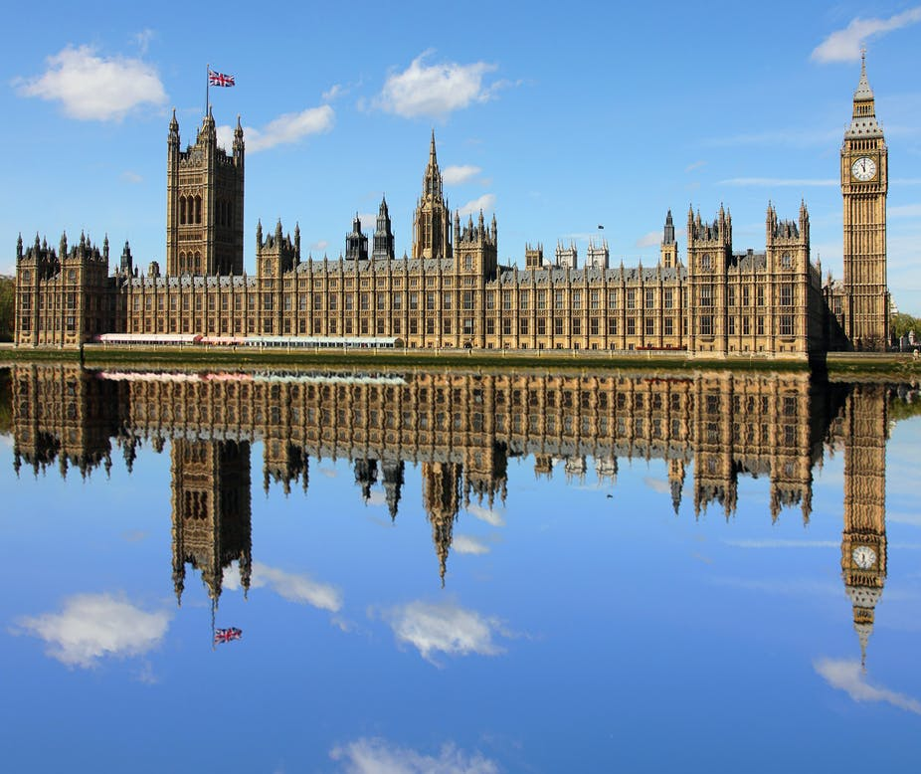
Week 6 Legislatures
Dr Fredrick Ajwang

Slide 2
Last 4 weeks
Next 4 Weeks
Democratic rules and democratisation
Autocratic rules and democratic backsliding
Political culture
Comparative methods
Legislatures
Executive
Constitutions and Courts
Subnational governments

Slide 3

Overview
Types of legislatures
Organizational structure
Functions
Assess their power

Slide 4
Institutions
Are the rules of the game that shape human behavior
Reduce uncertainty
Are continuously evolving
Typically change incrementally
Explain the path of historical change (North 1990)

Slide 5
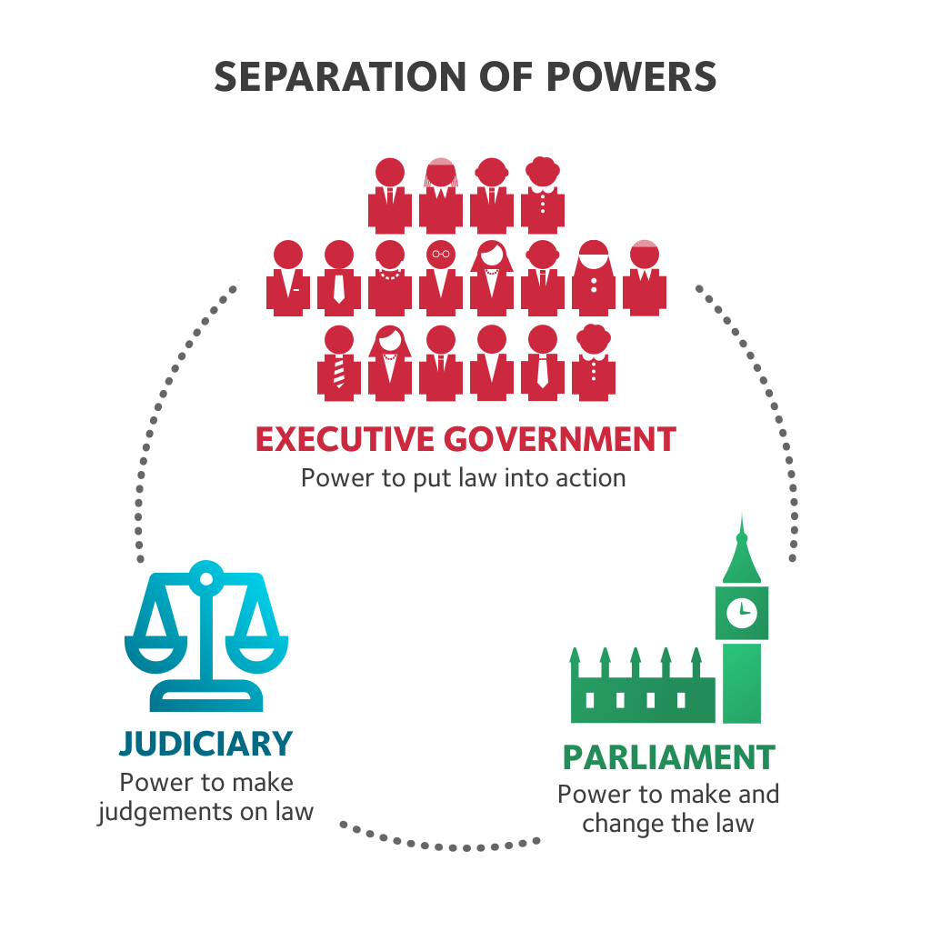
‘When the legislative and executive powers are united in the same person, or in the same body of magistrates, there can be no liberty... there is no liberty if the power of judging is not separated from the legislative and executive... there would be an end to everything, if the same man or the same body... were to exercise those three powers’
(Montesquieu 1748)

Slide 6
Legislatures
Legislature - ‘an organized body having the authority to make laws for a political unit’ (Kreppel 2017: 118)
Legislative tasks - representation, deliberation, legislation, expenditure approval and oversight of the executive.
Congress, parliament – not to be used interchangeably
Parliaments exist in fused-powers – usually parliamentary systems
Congresses exist in separation-of-powers – typically presidential systems

Slide 7
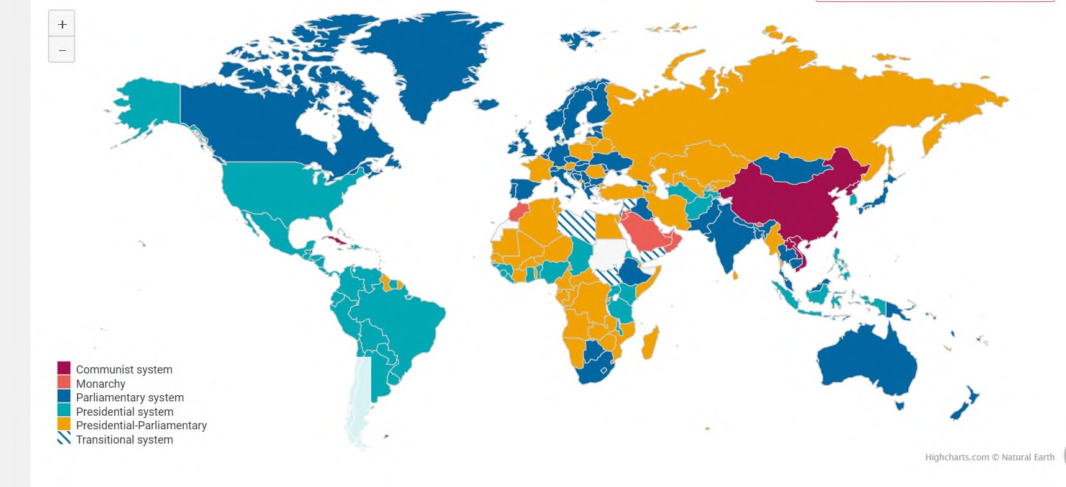
Systems of government
Source: Inter-Parliamentary Union 2020

Slide 8
Organisational Structure
Bicameral
Upper and lower chamber
Lower chamber usually more powerful (budgetary powers), whilst upper chamber scrutinizes, delays.
Often found in larger, more diverse, and federal political systems.
Weak bicameralism(UK, France) vs. strong bicameralism (US, Italy).
Unicameral
About 60% of global legislatures have single chambers
Sweden, Iceland.
Many post-communist (Lithuania, Slovakia, Moldova) and post-colonial states opted to have one chamber only (Egypt, Vietnam).

Slide 9
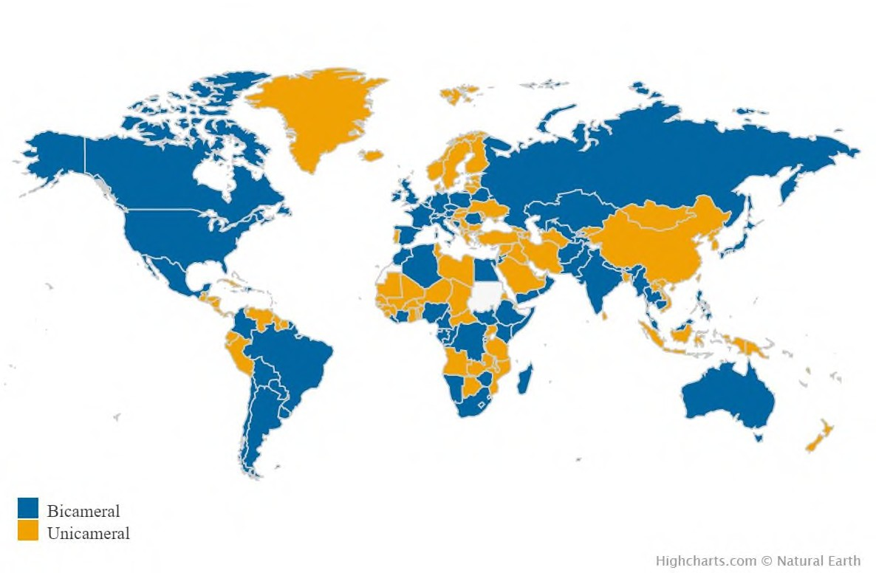
The internal organizational structure of legislatures
Source: Inter-Parliamentary Union 2020

Slide 10
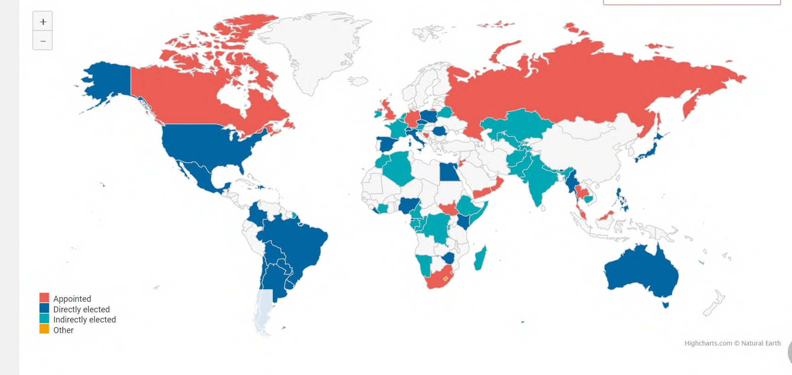
Method of selection of the upper chamber
Source: Inter-Parliamentary Union 2020

Slide 11
Deliberation
Committees
Deliberation takes the form of general discussion in the chamber
Key issues discussed in the floor of the chamber
Debate are an arena for national political discussion, forming part of a continuous election campaign.
The mood of the House, as revealed in debate, is often more significant than the vote which follows
Organized internally on the basis of committees.
Can be few or many, ad hoc or institutionalized
Permanency: Offers stability if institutionalized but may limit specialization.
Specialization – mirror the executive branch – with committees for each portfolio
Temporary committees – to react to different events and crisis
If legislation is fully vetted before being assigned to the committee - the committees unlikely to have a major role.

Slide 12
A) Representation (I)
Pitkin (1967)
FUNCTIONS
1. Formalistic Representation:
The institutional arrangements that precede and initiate representation. Formal representation has two dimensions:
Authorization: the means by which representative obtains their standing/ office (e.g. elections).
Accountability: ability of constituents to punish their representative for failing to act in accordance with their wishes (e.g. voting an elected official out of office) or the responsiveness of the representative to the constituents.

Slide 13
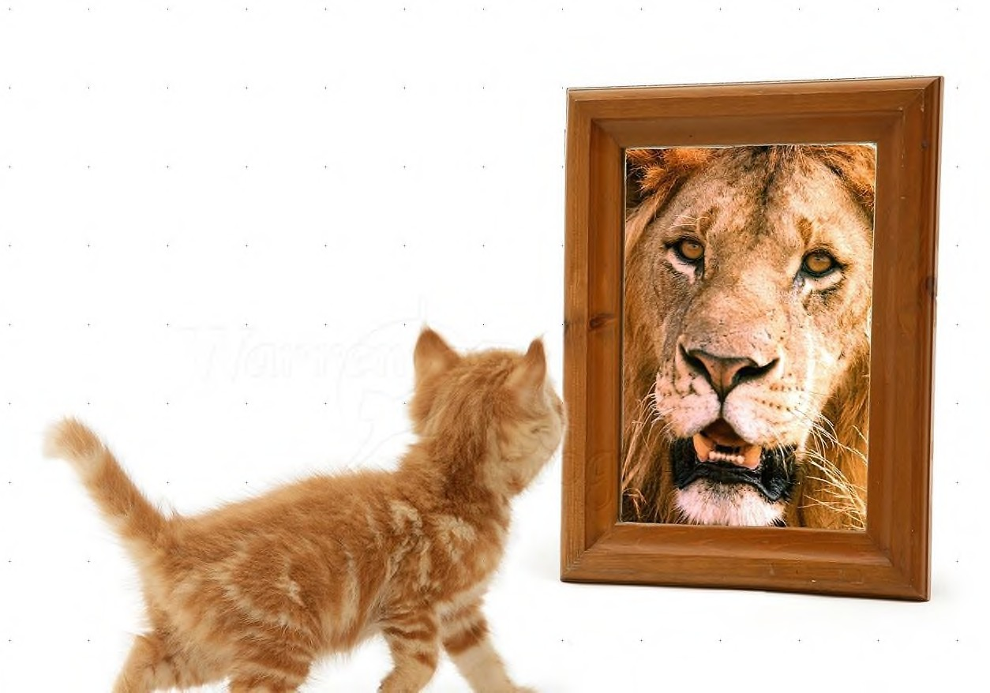
Representation (II)
2. Symbolic Representation:
The ways that a representative “stands for” the represented —
Fair and effective representation of voters by the representative.

Slide 14
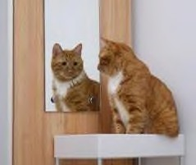
Representation (III)
Descriptive Representation:
The extent to which a representative resembles those being represented.
Descriptive representation - should resemble and be in some way similar to those represented.
It is simply a ‘descriptive likeness’ (Pitkin 1967: 92).
For instance, the representation of women and minorities
But does looking alike come with shared interests and experiences?
E.g A Latino representative who might inadvertently represent straight Latinos at the expense of gay and lesbian Latinos (Young 1986: 350).

Slide 15
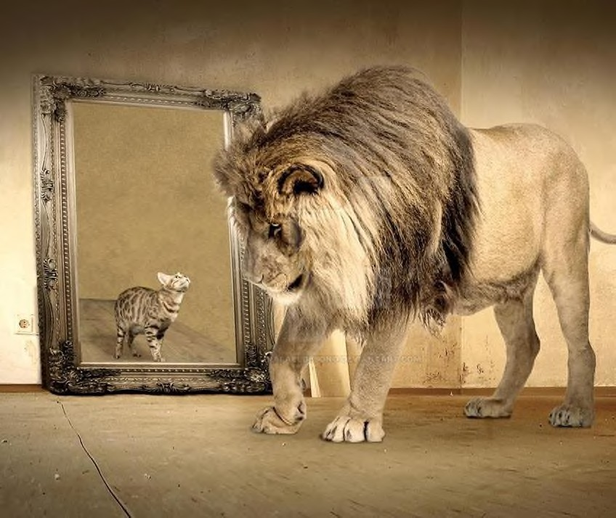
Representation (IV)
4. Substantive Representation
Legislatures advocate on behalf of certain groups.
For example, acting on the expressed wishes of citizens, or acting according to what the representatives themselves judge is in the best interests of citizens.
One can assess a representative by the extent to which policy outcomes advanced by a representative serve “the best interests” of their constituents.

Slide 16
Representative V
Collective representation
Ideally members should represent the interests of all voters, not just those in the districts they represent.
National interests over partisanship

Slide 17
B) Legislation
The legislative procedures are explicitly deliberative, involving several readings (debates) as the bill moves from the floor to committee and back again.
In bicameral legislatures, different versions passed by each chamber must be reconciled.
But legislation is rarely the function in which legislatures exert the greatest influence, as effective control over legislation in most liberal democracies rests with the government.
Initiation depends on the system of government and type of legislature.
Consultation, delay, veto, or amendment are other powerful tools that depend on the system of government and type of legislature.
Sometimes bills pass through the legislature without being designed, or even
transformed
Parliaments have become law-influencing legislatures rather than law-makers (Norton 1990).

Slide 18
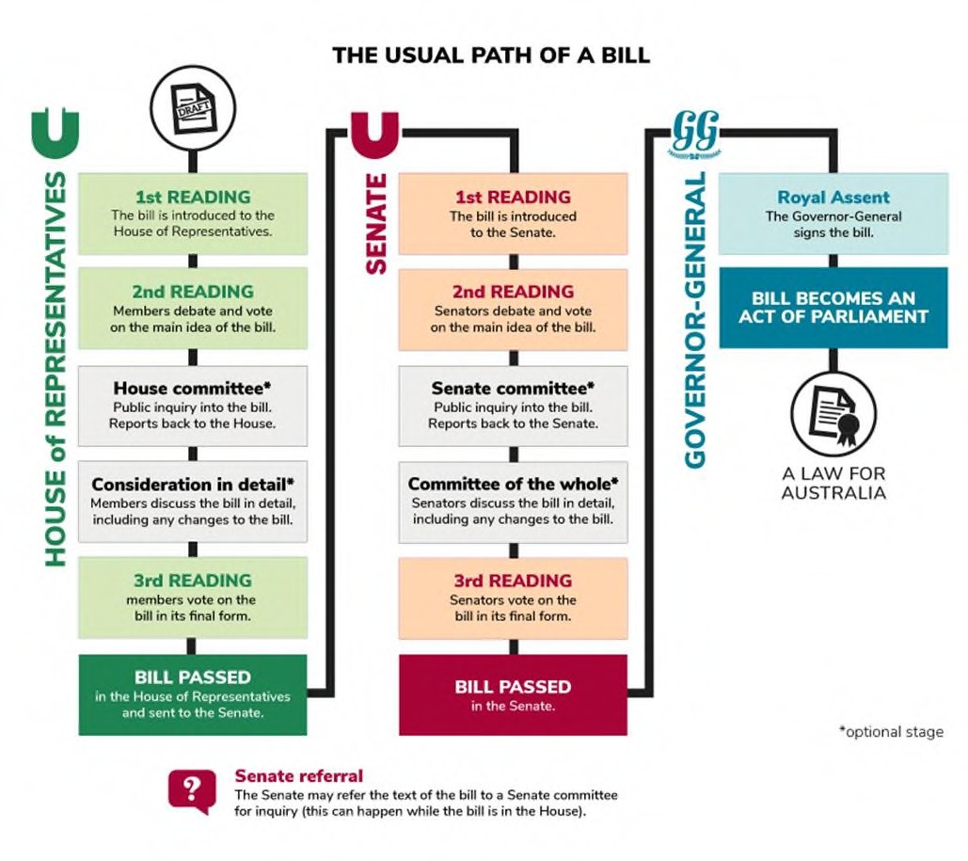
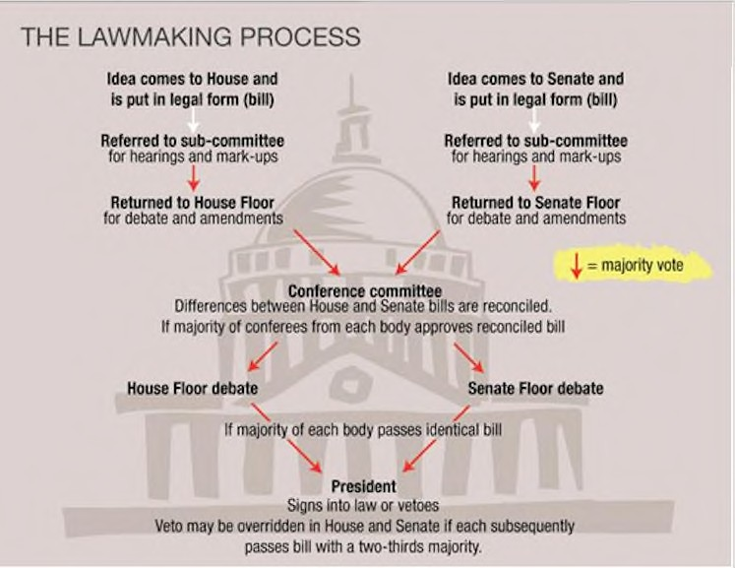
Different legislative procedures
Australia
The U.S.A.
Source: Parliamentary Education Office n.d.
Source: https://guides.nyu.edu

Slide 19
Different powers
Judged by their ability to directly impact the policy process
In some legislatures, all proposals must be formally initiated by the legislature (the USA), while in others the parliament has no formal ability to independently initiate the proposal (the European Union)
In Western European countries between 80-90% of successful legislative proposals are initiated by the executive.
In Britain, the governing party has historically dominated law-making (secure government majorities mean that legislative proposals are hardly ever overturned).

Slide 20
C) Control (I) - Budget control
Budget Control - nearly all legislature require legislative approval of national budgets and tax policies
Powerful tool and influence government policy
For the legislature to possess the power of the purse, Wehner (2006) suggests they must have the ability to consider and amend the budget.
In the US, the Congress remains central to budget-making -all money spent by executive departments must be approved by Congress

Slide 21
Control (II) Oversight
Oversight (accountability) - monitoring and limiting the power of the executive
Tools:
question time (usually in Parliaments),
inquiries,
hearings (usually ad hoc to investigate on specific topics),
investigative committees (higher order issues)
might ask individual agencies to give them reports on specific issues

Slide 22
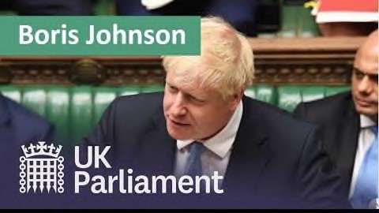

Slide 23
Control (III) Making and breaking governments
Between elections – the main task is to monitor the executive
Control is limited in separation-of-power systems where the policy agenda is not subject of legislative control
Impeachment or vote of no confidence rare and generally a complex procedure
In fused powers - policy control is explicitly stated
The government may be removed from office

Slide 24
Legislatures
in presidential systems
Separation of powers
Legislative elections have no effect on the
identity of the government
The main function of legislatures (e.g. US Congress) in presidential governments is to legislate (Laver 2006)
Elections at the national level are about electing representatives to the legislature.

Slide 25
The most important political job for the ‘legislature’ in a parliamentary system (and a semi-presidential system) is not legislating, but making and breaking of governments (Laver, 2006, 122)
Appointment and dismissal of governments
Parliamentary elections at the national level are more about ‘electing’ governments
The executive both derives from, and is constitutionally responsible to the parliament
Parliaments in parliamentary
systems

Slide 26
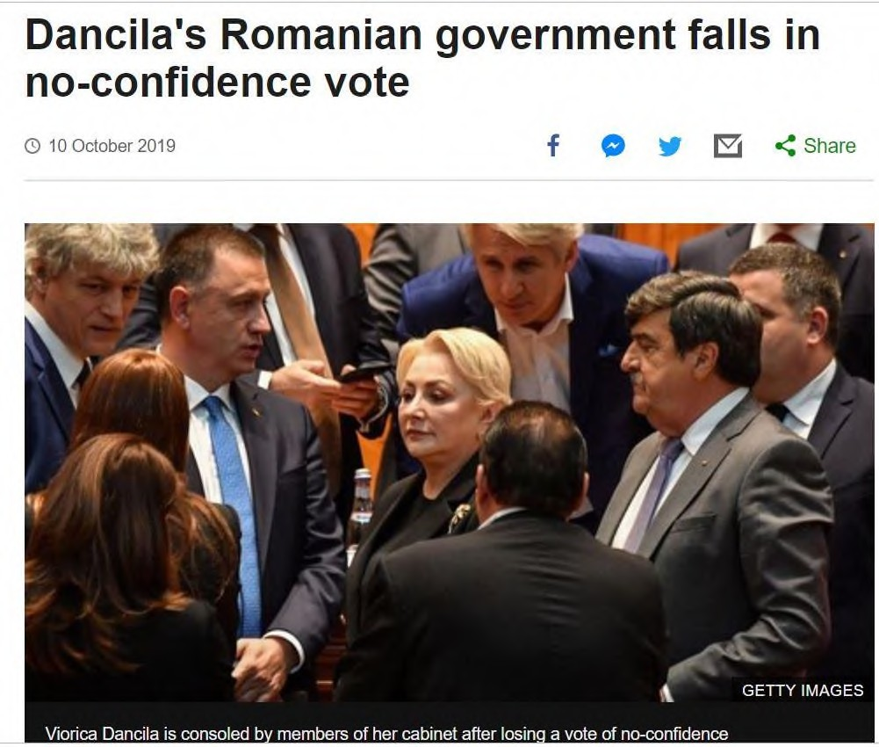
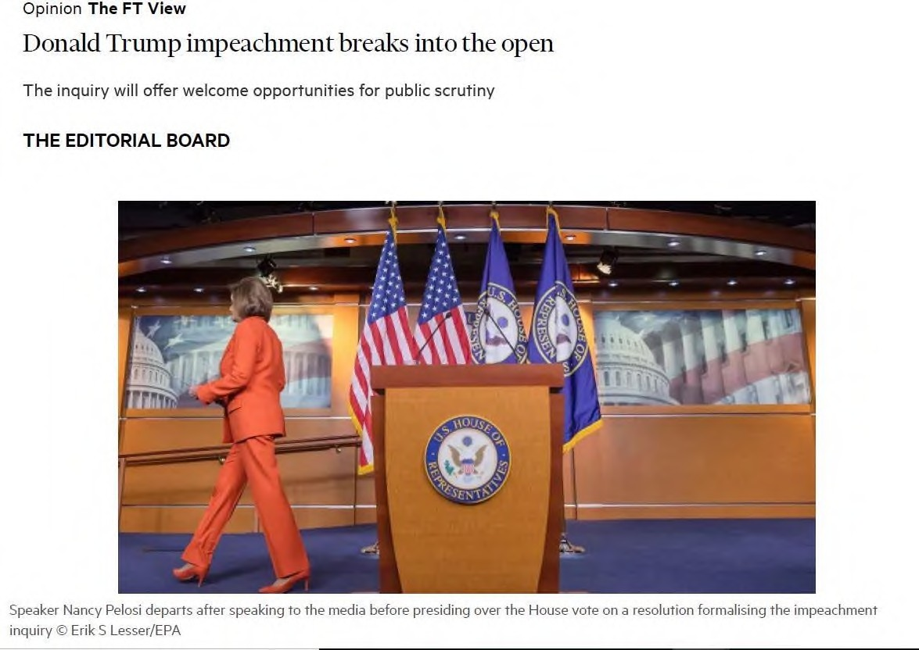
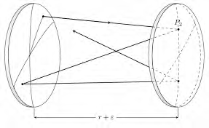

Slide 27
Presidential and Parliamentary Governments
 | Presidential | Parliamentary
The Head of government | President | Prime Minister
The Head of State | President | Monarch/President
Executive/legislati ve relations | Fixed term, seperation of powers | Vote of no confidence, ‘fusion’ of powers
Election of chief executive | Directly elected | Chosen by the elected parliament

Slide 28
Separation of powers?
Describing relationship between the president and Congress as a separation of powers is misleading.
It’s a separation of institutions, but they share authority and seek to influence each other, but neither is in a situation to dictate.
The relationship between parliaments and governments is completely inversed nowadays (Gallagher, Laver and Mair 2011)

Slide 29
Assessing their power and stability
Their degree of autonomy depends on:
Institutional independence: the power to elect and dismiss the executive branch serves to reduce the independent policy influence of a legislature
Member independence: the greater the party leadership’s control over a member’s re-election, the smaller the member’s autonomy
(Kreppel 2017)

Slide 30
Conclusions
Legislatures engage in a variety of tasks including representing citizen interests and participating in the policy-making process
Most legislatures in democratic systems perform all these functions to some extent
The emphasis placed on the various roles will vary between legislatures – especially between congresses and parliaments

Slide 31
References
Gallagher, Michael, Michael Laver, and Peter Mair (2011). Representative government in modern Europe. McGraw-Hill.
Griglio, Elena (2020). Parliamentary Oversight under the Covid-19 Emergency: Striving Against Executive Dominance. The Theory and Practice of Legislation 8(1-2): 49-70.
Inter-Parliamentary Union. Parliaments of the World. Available at: http://www.ipu.org/english/home.htm
Kreppel, Amie (2017). ‘Legislatures’. In D Caramani (ed.) Comparative Politics. Oxford University Press.
Laver, Michael (2006). ‘Legislatures and Parliaments in Comparative Context’. In B Weingast and D Wittman (eds.) The Oxford Handbook of Political Economy. Oxford University Press.
Montesquieu, Charles (1748). The Spirit of the Laws, Paris.
North, Douglas (1990). Institutions, Institutional Change and Economic performance. New York: Cambridge University Press.
Norton, Philip (1990) Parliaments: A Framework for Analysis. West European Politics
Pitkin, Hanna F. (1967). The concept of representation. Univ of California Press.
Wehner, Joachim (2006). Assessing the power of the purse: an index of legislative budget institutions. Political studies 54, no. 4:
767-785.
Young, Iris Marion (1986). The ideal of community and the politics of difference. Social theory and practice, 1-26.

