Slide 1

WEEK 7 - EXECUTIVES
Dr. Fredrick Ajwang

Slide 2
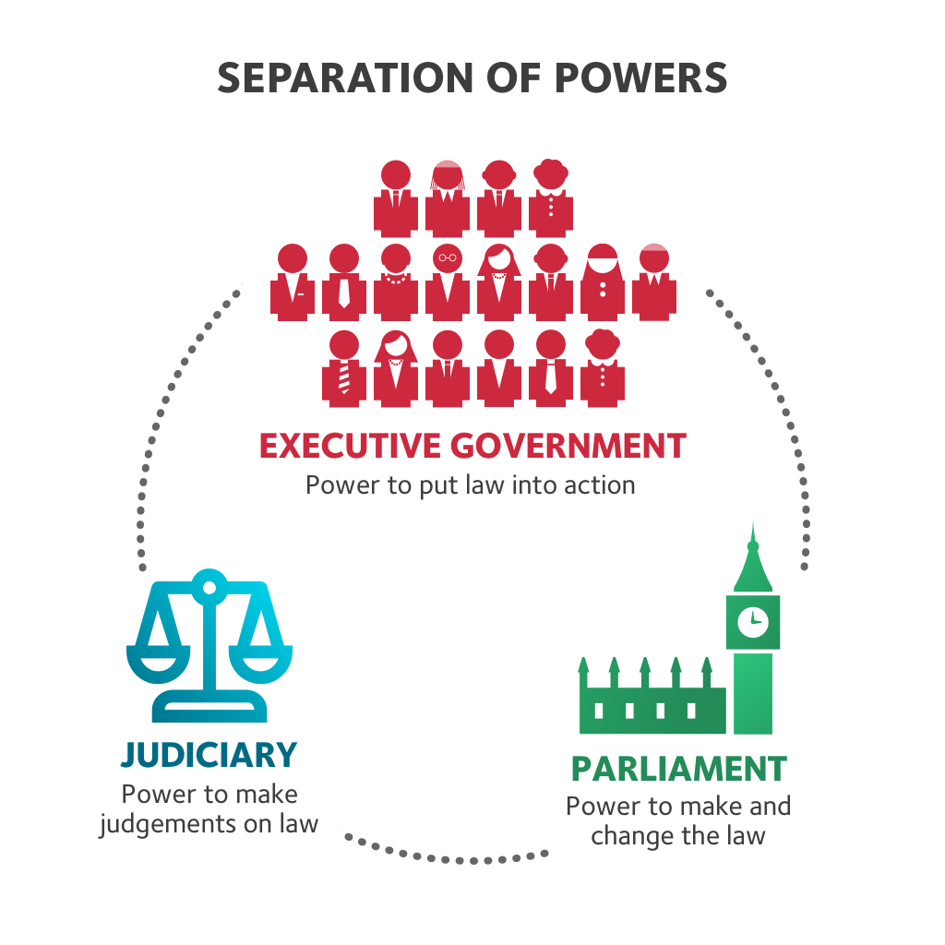
OVERVIEW
Presidential systems
Parliamentary systems
Semi-presidential systems
The parliamentarism- presidentialism debate
How different?

Slide 3
The Executive
The core of government, consisting of the president, prime minister, and the cabinet.
It sets policy, reacts to problems, resolve crises, make decisions, and oversee their execution.
A state can be governed without a legislature or judiciary but governing without an executive is (arguably) impossible.
Political executive; directly elected and makes policy:
Bureaucratic executive; the civil service which puts policy into effect.
The executive is accountable for the activities of government
Roles of the executive;
Head of State: Figurehead representative of the state and citizens. (The Queen)
Head of Government: Political leader of the government (The Prime Minister)

Slide 4
The executives in liberal democracies fall into three groups: presidential, parliamentary, and semi- presidential.
Executives in Liberal Democracy | Authoritarian Executives
Is elected with a fixed term | Is or is not elected
Is under constitutional restraints | Constitutional restraint absent or ineffective
Patterned by formal rules | Patterned by informal rules or relationships

Slide 5
Presidential and parliamentary governments
 | Presidential | Parliamentary
The Head of government | President | Prime Minister
The Head of State | President | Monarch/President
Executive/legislative relations | Fixed term, seperation of powers | Vote of no confidence, ‘fusion’ of powers
Election of chief executive | Directly elected | Chosen by the elected parliament

Slide 6
Presidential executives
Power is divided between a president and the legislature; institutional separation.
The president governs through authority derived from popular election.
The president cannot dissolve the legislature and the legislature can only remove the president through impeachment.
The president is the head of state and government.
Makes appointments to key government institutions, but subject to confirmation by the legislature.
The president and legislature are elected for a fixed term, and neither can bring down the other; institutional autonomy

Slide 7
Case study: Brazil
Executive Branch
Federal presidential system; the president directly elected in a term of four years
Legislative Branch; Bicameral parliament with upper and lower house:
The Senate representing the 26 states (three Senators for each)
The Chamber of Deputies is elected for a four-year term
Both Houses have fixed terms

Slide 8
BRAZIL
Powerful Congress and Supreme Court
‘Faced with a hostile Congress, Mr Bolsonaro has tried to govern by executive decree, issuing 202 in his first six months.
By contrast, his predecessor, Michel Temer, used 94 decrees in his first six months, and Mr Temer’s predecessor, Dilma Rousseff, used 174’
In July 2019 the Senate approved a constitutional amendment imposing stricter conditions on presidential directives
“It is not surprising that Congress and the judiciary are reacting: the president is trying to govern alone — without Congress — by abusing his constitutional powers to issue decrees” (Machado 2019)
At the same time Bolsonaro accused the Congress of trying to turn him into a “Queen of England”. (Harris and Schipani 2019)

Slide 9
Parliamentary executives
Executive in a parliamentary government is organically linked to the legislature.
Leader (the prime minister, or – in Germany and Austria – the chancellor) is the head of the largest party in parliament.
Or head of one of the parties in the governing coalition
Prime Minster, Taoiseach or Chancellor is the head of government and works with the head of state who has little power.
Prime-minister and the cabinet are politically accountable to the parliament
Can be removed through vote of no confidence.
In some countries (Germany, Spain), the vote of no confidence has to be constructive - the parliament must propose an alternative government
Most parliamentary democracies allow for parliamentary dissolution - by the head of state at the prime minister’s proposal (Muller 2017)

Slide 10
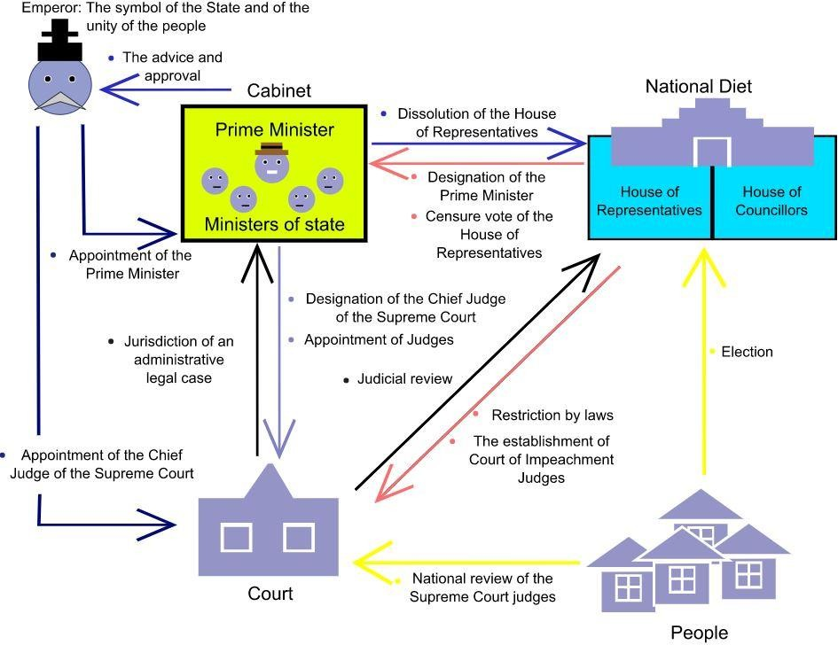
JAPAN
The Japanese parliament (National Diet) is made of
the House
of
Representatives and the
House of Councillors - both are directly elected
The Diet is responsible of
selecting the prime minister
The Cabinet may advise the
Emperor to dissolve the
House of Representatives
The government can also be dissolved by the Diet with a motion of no confidence
By Derfel73

Slide 11
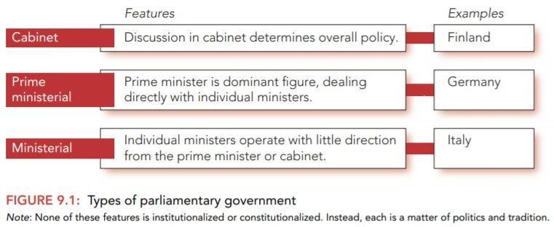
Types of Parliamentary Executives
Source: Hague et al 2016: 151

Slide 12
Semi-Presidential
‘A popularly elected fixed-term president exists alongside a prime minister and cabinet who are responsible to parliament’ (Elgie 1999: 13).
The president is directly elected and appoints the cabinet
The cabinet is politically accountable to parliament
Two kinds of semi-presidential (Shugart and Carey, 1992).
President-parliamentary: The prime minister and the cabinet collectively responsible to both the president and the legislature, and can be dismissed by either (Peru & Russia)
2) Premier-presidential: the prime minister and cabinet collectively responsible only
to the legislature, can only be removed from office through a vote of no confidence in the legislature (France, Portugal, Romania).

Slide 13
Semi-Presidential France
An outcome of the 1958 Constitution of the Fifth Republic and the 1962 reforms that mandated direct election for the president.
The president appoints the prime minister and chairs cabinet meetings
The president can dissolve the National Assembly and require the parliament to reconsider a bill
The president has to sign all decrees that are considered in the Council of Ministers.

Slide 14
Executives in Authoritarian States
President operates without constitutional restraints found in liberal democracies.
Presidents use what they define as the direct mandate from the people to cast a shadow over competing institutions such as the courts and the legislature
Power concentrated on the president and not institutions; personal rule
Highly unstable as authoritarian leaders can only keep their job, as long as they can ward off potential rivals
E.g. most post colonial African states; Kenya under Daniel Moi, Democratic Republic of Congo under Mobutu, Uganda under Idi Amin, Venezuela under Nicolas Maduro and Nicaragua under the Ortega family.

Slide 15
THE PARLIAMENTARISM-PRESIDENTIALISM DEBATE
Presidential is less likely than parliamentary to sustain stable democratic regimes (Linz 1990)
Because:
The executive and legislature advance competing claims to legitimacy
The fixed terms of office make presidential regimes more rigid than parliamentary systems
Presidentialism encourages winner-takes-all outcomes; hence violence in African context.
Presidentialism encourages populist candidates

Slide 16
The Parliamentary-Presidential Debate
52.2% of the presidential regimes have broken down, while a higher percentage (59.1%) of the parliamentary systems have broken down (Shugart and Carey 1992)
But most long-established democracies have parliamentary systems and presidential systems are poorly represented among long established democracies.
Of the thirty-three long established democracies, only six are presidential despite the prevalence of presidential system in many parts of the globe. Twenty-two are parliamentary, and five fall into the "other" category.

Slide 17
The Parliamentary-presidential Debate
Advantages of parliamentary
Flexibility
Broad representation
Conciliation and cooperation
Promotes coalition-building (Linz 1990)
Advantages of presidential
Greater choice for voters
Electoral accountability and identification
Congressional independence in legislative matters
Functions better with electoral rules or sequences that avoid extreme multi-partism
Semi-presidentialism – the best of two worlds?
(Mainwaring and Shugart 1997)

Slide 18
HOW DIFFERENT?
‘Emergency powers are more typically associated with presidential constitutions,
Decree powers – have been more easily justified in the context of parliamentary regimes, even though they have been a concern in constitutions representing all regime types – parliamentary, presidential and semi presidential.
The purpose is to create a more muscular executive.
In parliamentary systems – decrees seen as an issue of legal technique, changing parliamentary practice from ex ante to ex post approval of government action.
It is precisely because this justification cannot be extended to presidential constitutions that concerns about the abuse of decree powers by presidents is so heightened in new democracies: granting legislative authority to the executive in a system of separation of powers implies legislative abdication as the legislature has no ex post mechanisms for controlling the actions taken by decree’ (Cheibub Elkins and Ginsburg 2013: 7).

Slide 19
EMERGENCY POWERS
National emergencies in the US
Emergency powers offer a broad array of tools that would otherwise be unavailable to the executive branch.
Although the very concept of “emergency” suggests a temporary, short-term event, states of emergency last a long time, and they’re getting longer (an average of 9.6 years).
Since the National Emergencies Act was passed 69 emergencies have been declared; 34 have expired and another 35 are currently in effect, each having been renewed annually by the president
Of the 136 authorities available to the president in a national emergency, 96 require nothing more than her signature on the emergency declaration. Only 13 require a congressional (versus presidential) declaration of emergency.
(Brennan Center for Justice at New York University School of Law 2020)

Slide 20
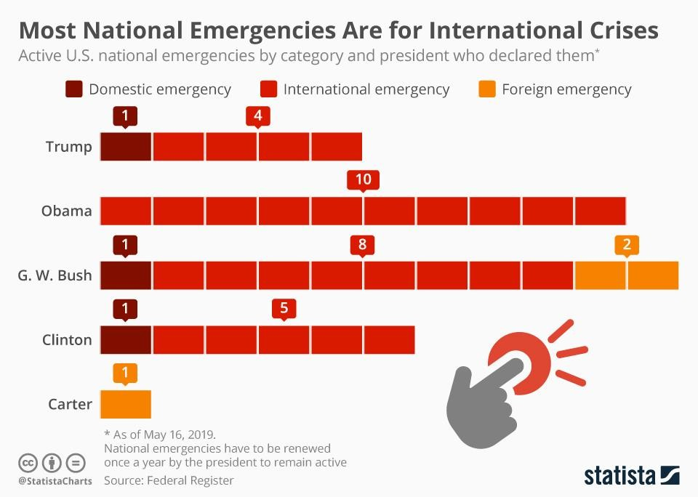
US President Donald Trump declared a national emergency over border wall funding on the 15th of February making this the country's 32nd on-going state of emergency.
Declaring a national emergency to get funds for a border wall has been a way out of a 35-day partial government shutdown over wall funding during December 2018 and January 2019 — the longest shutdown in US history.
(PRI 2019)

Slide 21

CONCLUSIONS
Three types of executives:
presidential, presidential,
Only?
All systems
parliamentary, semi-
have strengths and
weaknesses, and all can become dysfunctional.
In practice, the differences between them become less visible

Slide 22
REFERENCES
Cheibub, José Antonio, Zachary Elkins, and Tom Ginsburg (2013). Beyond presidentialism and parliamentarism. British Journal of Political Science : 515-544.
Duverger, Maurice. (1980) A new political system model: Semi‐presidential government. European Journal of Political Research 8, no. 2 : 165-187.
Linz, Juan J (1990). The Perils of Presidentialism. Journal of Democracy 1(1): 51-69.
Mainwaring, Scott, and Matthew S. Shugart (1997). Juan Linz, Presidentialism, and Democracy: A Critical Appraisal.
Comparative Politics 29(4): 449-471.
Muller, Wolfgang C. (2017). Governments and bureaucracies, Chapter 8. In D Caramani (ed.) Comparative Politics. Oxford University Press.
Shugart, Matthew Soberg, and John M. Carey (1992). Presidents and assemblies: Constitutional design and electoral
dynamics. Cambridge University Press.

