Slide 1
EXTENDED NUMERIC XControl

Slide 2

_x0016__x0015_Understanding The
Extended Numeric XControl
Attached to this zip file you'll find a VI Lib called "ExNumeric.llb" which contains the Extended Numeric control, three example implementations showing different
features and the source code. You'll also find a complied help file that I'm using to show off the tooltip and help features of the Extended Numeric Ctrl.
Once you have downloaded the files, open the vi lib and select the example called "Base Example.vi".
Run this Vi and hover your mouse over the numeric control, after a short period a tooltip will be displayed. If you move your mouse outside the controls bounds then the tooltip will disappear.
Fig 1: Example of the tooltip display.

Slide 3

Data Keypad Entry Dialog
Another feature of this basic implementation is the numeric keypad data entry dialog which you can access by pressing the button defined in Fig 2 below.
FIG 2:
Display
Keypad Data
Entry Dialog

Slide 4
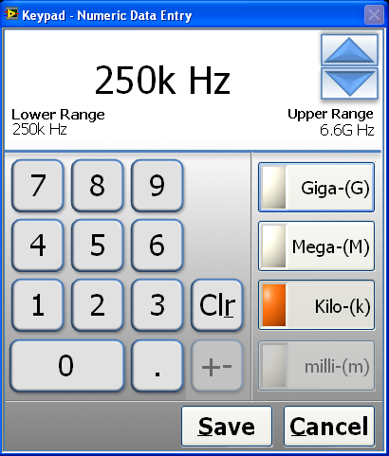
_x0016_Data Keypad Entry Dialog
Continued
Fig 3 shows the Numeric Data entry dialog, you input data either by using the mouse to click the virtual keyboard or touch screen, increment, decrement buttons or
using your computers keyboard. The page up, down and the arrow up/down keys will increment/decrement the controls value.
FIG 3:

Slide 5
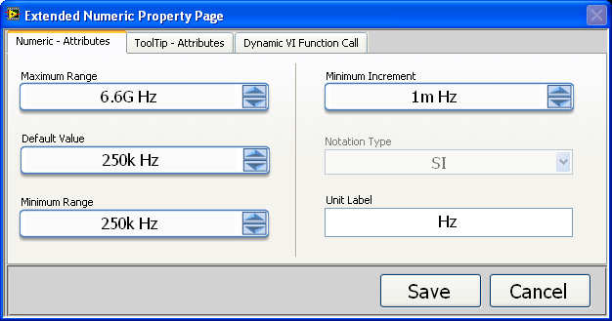
Extended Numeric Controls
Property Page
Now stop the Base Example VI, right mouse click the numeric control and select the extended properties short cut menu item. This displays the extended numeric property page, which allows you to configure the controls properties.

Slide 6
Numeric - Attribute Page
Within this property page you configure the base numeric settings, if the min, max ranges are set to -inf and +inf, then at runtime the control doesn't coerce the runtime data value within the set ranges.
You may notice that compared to a std numeric control, there is allot of missing properties such as number of significant digits. Basically the extended numeric control auto calculates these for you at runtime, based on the viewable numeric value. The control will always increment/decrement the least significant digit of the
viewable data, unless this value is lower then the minimum increment value and then it uses the minimum increment.
So for example if the user decided to enter into the control 100, I would only
update the units. If the user entered 1.123G then I would increment/decrement the 1M position.
When you move between ranges and the user has defined a decimal point, I retain the number of precision digits after the decimal point.
For example transitioning between 999.99 to 1k and then incrementing again would display 1.01k.
So the visualization and increment/decrement is controlled by the user needs not by the developer.

Slide 7
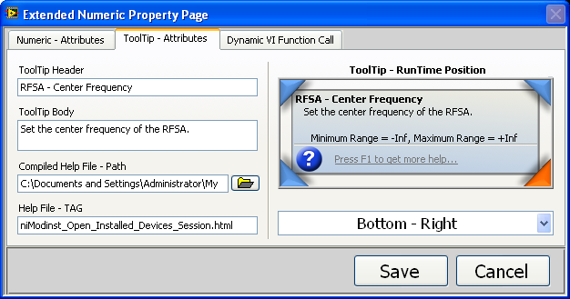
ToolTip - Attribute Page
If the tooltip header is empty then the tooltip will not be displayed, as you type the header and the body information, it is displayed on the tooltip control image on the right hand side. Currently I don't check the header and body string length, but what you see in the image on the right will be displayed to the user. In the future I may dynamically
expand the tooltip bounds, based on the length of the tooltip data. "If anybody wants to implement this feel free...”
You can select the position of the tooltip at runtime by either selected a value from the ring control on the right or by mouse clicking one of the corners on the tooltip image.
XControls currently don't support the std LV help mechanism, I've added my own to this control, but to use this feature you need to call the Initialize Extended Feature VI, within your own project code.

Slide 8
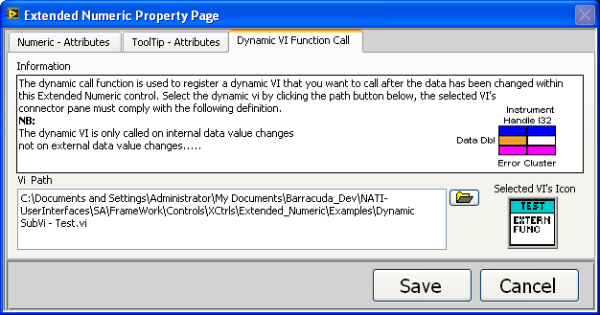
Dynamic VI Function Call
Attribute Page
This feature reduces the amount of development work I have to do on a property page.
You use this attribute page to register a VI that is compliant with a specific vi type def.
When the control is in run-mode, any change to the internal value data or the value property
Being programmatically called will trigger the calling of the registered dynamic vi.
To use this feature you also have to call initialize extended feature method within you application.
** PLEASE BE AWARE I HAVE NO THREAD MARSHALLING IMPLEMENTED AT THE MOMOMENT**

Slide 9
Extended Example
Before running the extended example please re-configure the help file path within the tooltip attribute page to the hard disk location of the niModInst.chm file, which was included in the zip file. (The niModInst.chm file is used to illustrate how to open a help file – it does not relate to the XControl.)
Now run the example, move your mouse over one of the two controls. You’ll note that
The control automatically get’s key focus, now press F1 and you should see the help file associated with that control, try it on both controls.
Again with the mouse over one of the controls, press the keyboard space bar and the numeric data entry dialog will be shown, press cancel on this dialog or “c” on your keyboard.
Now press one of the increment/decrement buttons on the numeric control, this will increment the numeric controls value first then call the dynamic vi which has been registered within this control. The dynamic vi in this example will show a dialog box, if you click generate error button at the bottom of the dialog, this will cause an error within the the dynamic vi, the numeric xcontrol will then generate a user error event which I have registered within the Extended Example user interface event case.

