Slide 1
Goals
Get you interested in Chatbots
Get you interested in AI, Machine Learning, NLP
Get you started
Get you to learn something
80/20 rule applies (80% of the time)

Slide 2
Introduction
What’s a bot like you doing in a chatroom like this?

Slide 3
HISTORY & Related Stuff
ELIZA
IVRS
Watson
Siri, Google Assistant, Alexa, Cortana
Chatbot gone wild– Microsoft Tay

Slide 4
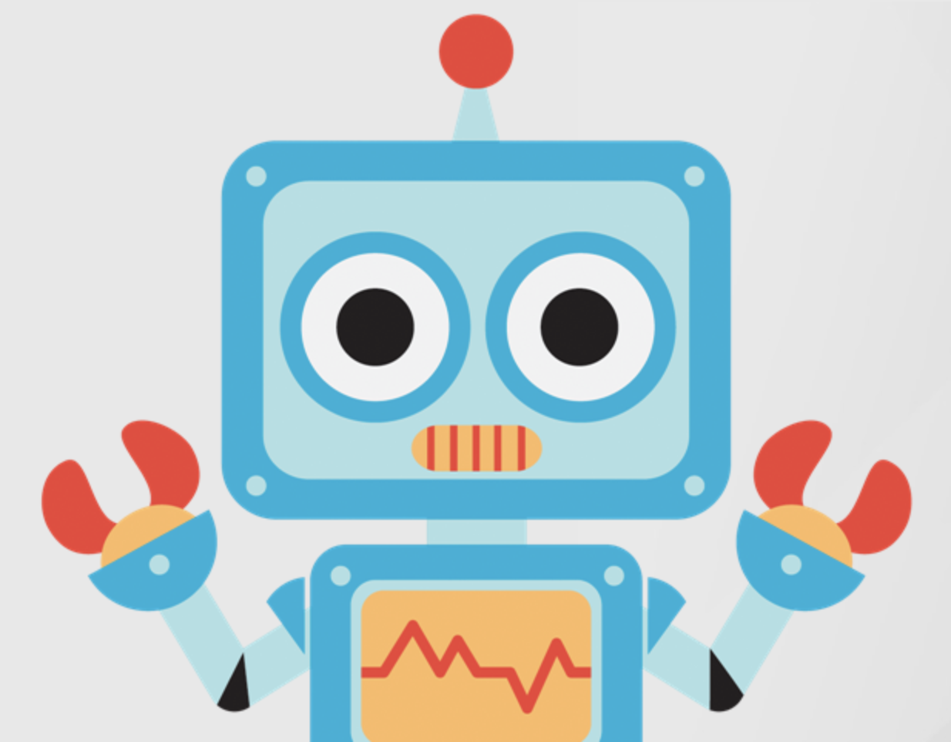
HISTORY & Related Stuff
Zubot

Slide 5
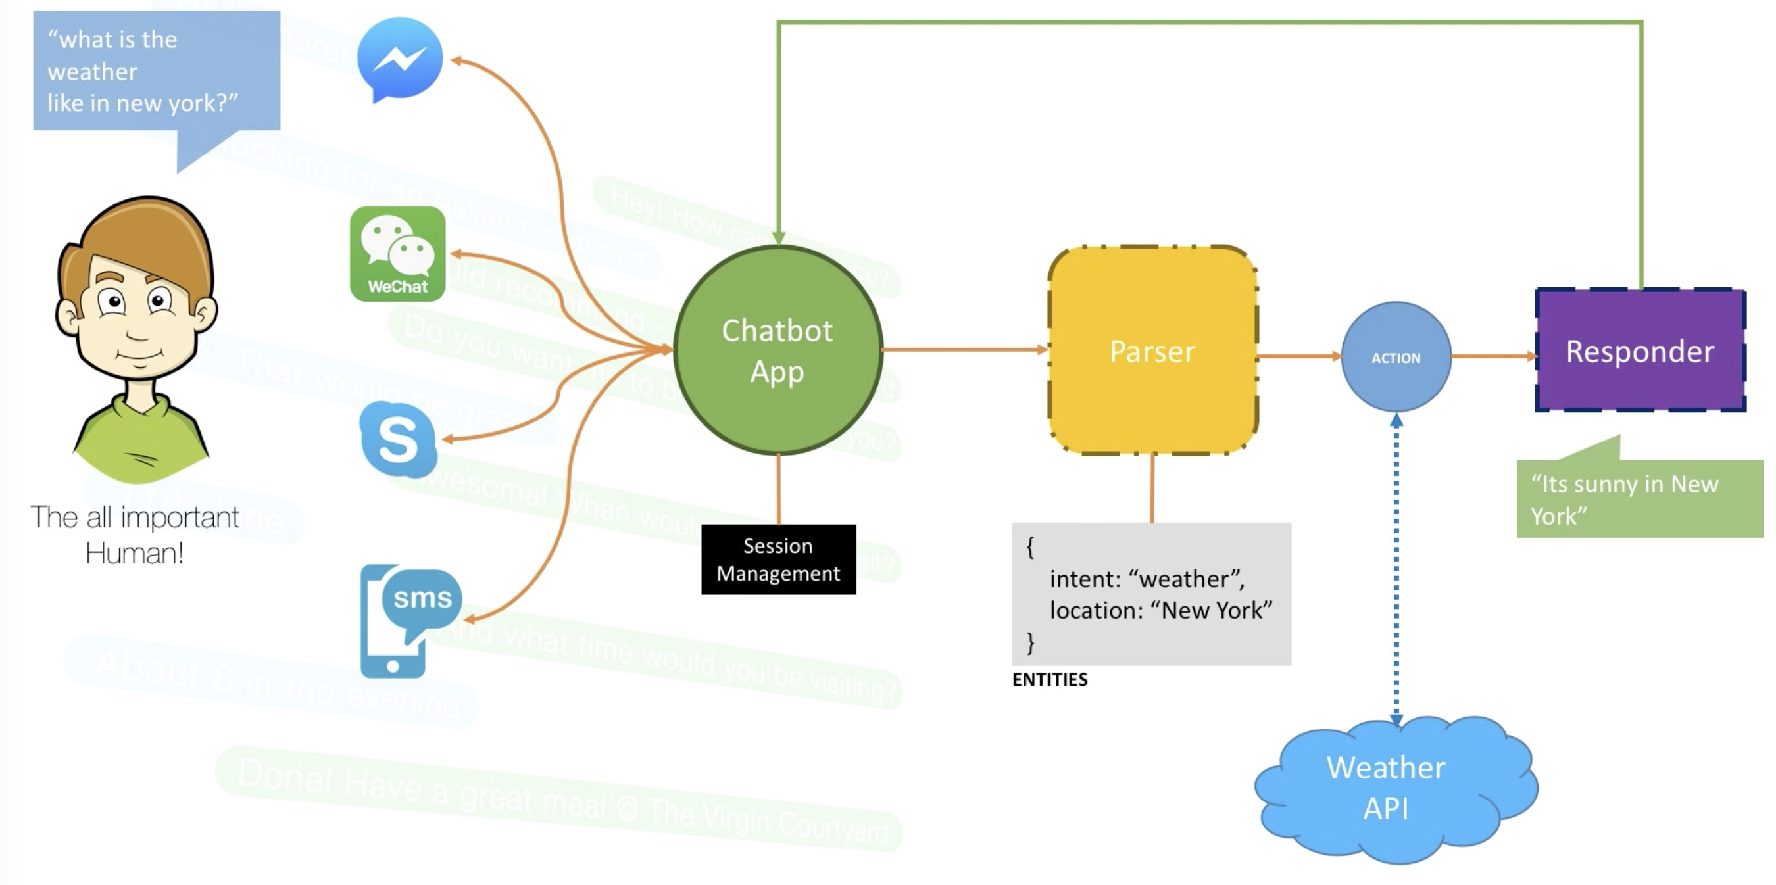
Chatbot Anatomy
Lizard & Tails & Puppy Dog’s Tails

