Slide 1
Traffic Speed Prediction Near University of Toronto
A Machine Learning Approach Using Urban Midblock Speed Data
ECE1513 — Introduction to Machine Learning
April 2026

Slide 2
Problem Definition
The Challenge
Our Approach
• Urban traffic congestion costs Toronto $6B+ annually
• Existing systems (loop detectors, GPS probes) give real-time data but limited prediction capability
• City planners and commuters need 15-min ahead forecasts to enable proactive decision-making
• Challenge: traffic patterns vary by road segment, time of day, day of week, weather, and season
• Predict average traffic speed (km/h) on city streets within ~1.5 km of U of T St. George campus
• 15-minute interval predictions using historical speed bins, weather, and temporal features
• Progressive model improvement: XGBoost baseline → feature engineering → neural network with residual connections
• Evaluation: MAE, RMSE, R² on chronological test split (no data leakage)

Slide 3
Data Overview
Traffic Speed Data
Weather Data
Merged Dataset
• Toronto Open Data Portal
• 2,106,533 records (2020–2025)
• 14 speed bins → weighted avg speed
• 15-min intervals, 3,500+ road segments
• Filtered to 1,947 segments (≥72h data)
• Environment Canada (Stn 6158359)
• 53,943 hourly observations
• Temperature, precipitation, wind,
• visibility, humidity
• Rain/snow/fog binary flags
• Traffic + weather joined on hour
• 1,578,402 rows after quality filter
• 49 engineered features
• 70/10/20 chronological split
• Train → Val → Test (no shuffling)

Slide 4
Feature Engineering
Temporal
Weather
Lag & Rolling
Historical
• Hour, day of week, month
• Cyclical encoding (sin/cos)
• Rush hour flags (AM/PM)
• Weekend indicator
• Temperature, wind speed
• Precipitation, visibility
• Wind direction (sin/cos)
• Rain/snow/fog flags
• Speed deviation lags (1,2,4,8,12,16)
• Volume deviation lags
• Rolling mean/std (4,8,16 window)
• Raw speed rolling (shifted by 2)
• Avg speed per segment/hour/DOW
• Avg volume per segment/hour/DOW
• Speed deviation from historical
• Lagged speed × volume interaction
Target: speed_deviation (difference from historical average) → add back hist_avg_speed at prediction time

Slide 5
Model Iteration: XGBoost Phase
Systematic hyperparameter tuning and feature engineering using autoresearch loop
Baseline
Hyperparams
+Features
Data Filter
MAE Loss
Final XGB
MAE: 2.246
MAE: 2.229
MAE: 2.153
MAE: 2.082
MAE: 2.021
MAE: 2.018
Default XGBoost lr=0.05, depth=6
depth=8, lr=0.03 3000 trees
Rush hour flags lag 12/16, interactions
Remove segments with < 72h data
Switch to MAE objective function
lr=0.008, 15k trees early stopping=50
XGBoost Phase: MAE 2.246 → 2.018 (10.2% improvement) | R² 0.891 → 0.904

Slide 6
Model Iteration: Neural Network Phase
Switching to PyTorch MLP on GPU (RTX 5090) unlocked further gains
Simple MLP
Wider MLP
ResNet MLP
Deviation Target
+2025 Data
SiLU Activation
MAE: 1.931
MAE: 1.900
MAE: 1.848
MAE: 1.842
MAE: 1.830
MAE: 1.825
512-256-128 3 linear layers
1024-512-256-128 4 linear layers
Residual connections 512→512→256 blocks
Predict deviation from hist. average
Added 370K rows of 2025 speed data
SiLU (Swish) replaces ReLU
Neural Network Phase: MAE 1.931 → 1.825 (5.5% improvement) | R² 0.910 → 0.917

Slide 7
Final Model Architecture
49 Features (Input)
Linear 512 + SiLU + BN + Dropout(0.3)
ResBlock 512 (2 layers + skip) + Dropout(0.2)
ResBlock 512 (2 layers + skip) + Dropout(0.2)
Linear 256 + SiLU + BN
ResBlock 256 (2 layers + skip) + Dropout(0.1)
Linear 1 → speed_deviation
Training Configuration
• Optimizer: AdamW (lr=1e-3, wd=1e-4)
• Scheduler: ReduceLROnPlateau (patience=5)
• Loss: L1 (MAE)
• Batch size: 4096
• Early stopping: patience=20 on val MAE
• Gradient clipping: max_norm=1.0
• GPU: NVIDIA RTX 5090 (32GB)
• Training time: ~50 seconds

Slide 8
Results: Model Comparison
Model | MAE | RMSE | R²
XGBoost Baseline | 2.246 | 3.418 | 0.891
XGBoost Tuned | 2.018 | 3.220 | 0.904
Simple MLP | 1.931 | 3.120 | 0.910
Wider MLP | 1.900 | 3.107 | 0.911
ResNet MLP | 1.848 | 3.091 | 0.911
Final (best) | 1.825 | 3.055 | 0.917
Overall: 18.7% MAE reduction R² improved from 0.891 to 0.917 47 experiments, 28 kept

Slide 9
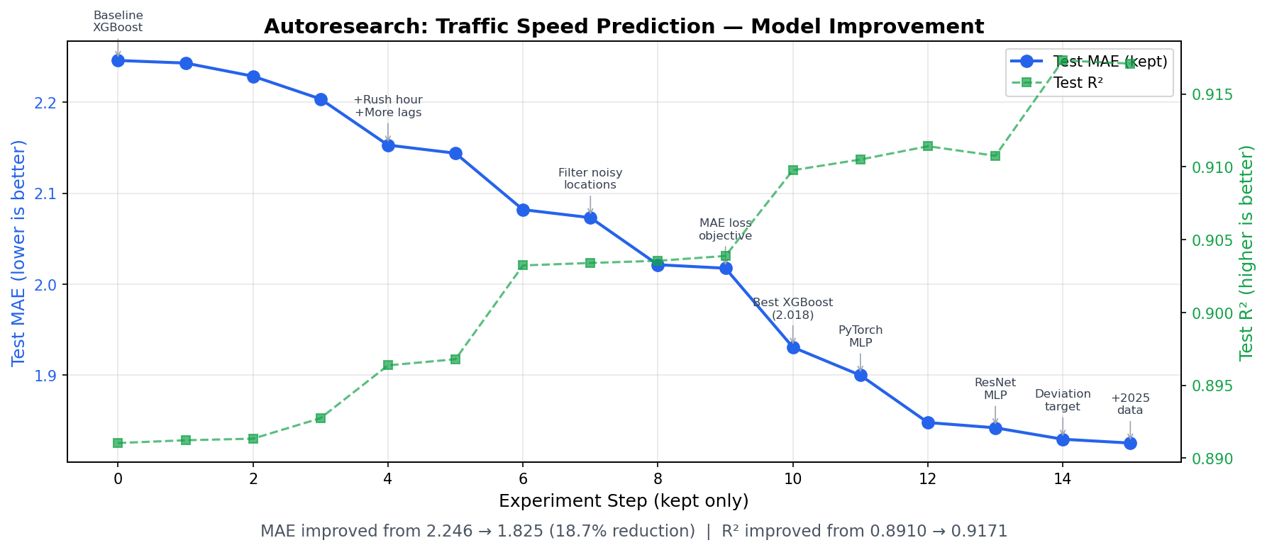
Autoresearch: Experiment Progress
Inspired by karpathy/autoresearch — autonomous AI-driven experiment loop with keep/discard decisions

Slide 10
Key Findings
What Worked
What Didn't Work
✓ MAE loss objective (aligning loss with metric)
✓ Filtering low-quality road segments (< 72h data)
✓ Residual connections in MLP
✓ Speed deviation target (centering near 0)
✓ More data (adding 2025 speed observations)
✓ SiLU activation over ReLU
✓ Lag features at multiple time horizons
✓ Data quality > data quantity
✗ Entity embeddings (too few samples per segment)
✗ CatBoost (couldn't match XGBoost on this data)
✗ OneCycleLR (ReduceLROnPlateau was better)
✗ GELU / SmoothL1 loss
✗ LayerNorm (BatchNorm was superior)
✗ XGB+MLP ensemble (MLP already dominant)
✗ Very low learning rate (0.005) for XGBoost
✗ Seasonal features (month sin/cos, week_of_year)

Slide 11
Conclusion
18.7%
0.917
47
MAE Reduction
R² Score
Experiments Run
2.246 → 1.825 km/h
up from 0.891 baseline
28 kept, 19 discarded
• Progressive model improvement from tree-based to neural network methods yields consistent gains
• Data quality (filtering noisy segments) and loss alignment (MAE objective) had the biggest single impacts
• ResNet-style MLP with SiLU activation outperforms gradient boosting on this traffic prediction task
• Autoresearch methodology enables systematic, reproducible experimentation at scale

