Slide 1

Interfaces
Kevin Lin

Slide 2
What are interfaces?
Interfaces are named collections of method signatures

Slide 3
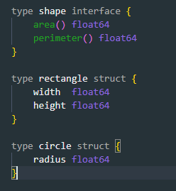
Example using shapes
We will use shapes as an example for working with interfaces.
We will have a shape interface, which a circle and rectangle type will implement.

Slide 4
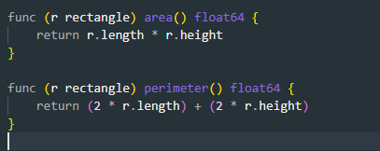
How to implement an interface
To implement an interface in Go, we just need to implement all the methods in the interface.
Here we implement shape on rectangle

Slide 5
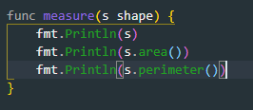
Why is this useful?
If a variable has an interface type, then we can call methods that are in the named interface. Here’s a generic measure function taking advantage of this to work on any shape.

