Slide 1

Struct(s)
Kevin Lin

Slide 2
What is a struct?
Structs in Go are typed collections of fields. They are used in grouping data together.
For example a person struct could have a field for first & last name & phone number or like in our card project we could have a card struct with a suit and value field.

Slide 3
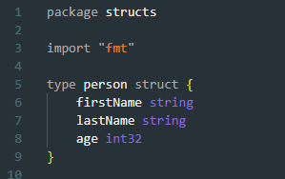
Struct syntax
In our example we will create a struct that represents a person with a first and last name and age.

Slide 4
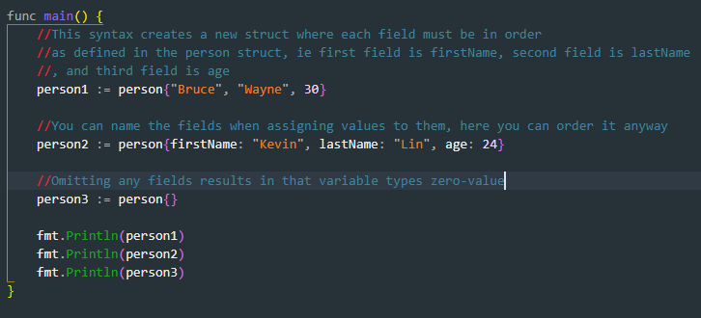

Struct syntax
Now that we have created our person struct. There are multiple ways we can declare and initialize a person struct variable.

Slide 5


Struct syntax
To access specific fields in a struct variable you use the dot operator.

