Slide 1

Looping & Conditionals
Kevin Lin

Slide 2
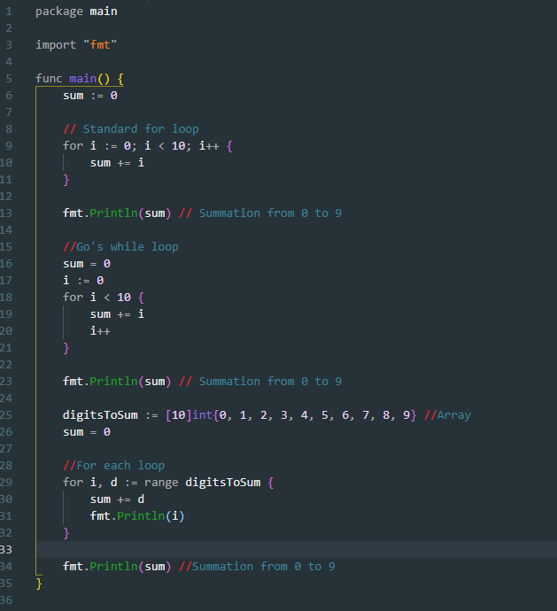
For Loop While Loop For-each Loop

Slide 3
Decision Making (if / if else)
if
if / else
Evaluate Condition
If condition == true
else
Execute this code inside if block
Execute this code inside else block
If condition == true
Execute this code inside if block
Evaluate
Condition

Slide 4
Decision Making If, else if, else
Evaluate Condition
If condition == true
Else if condition == true
else
Execute Code in if block
Execute Code in else If block
Execute code in else block
if, else if, else

Slide 5
Extra content
Keywords:
Continue –
Terminate the current iteration and go to the next iteration.
Break –
Exit the whole loop and go to the next line of code.

