Slide 1

Custom Types & Receiver Functions
Kevin Lin

Slide 2
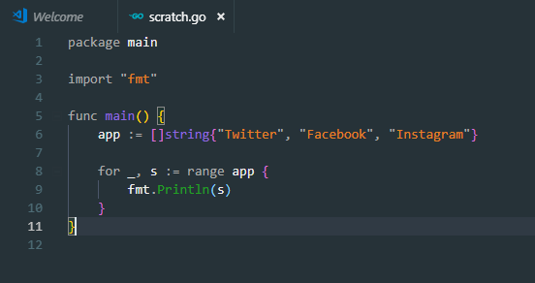
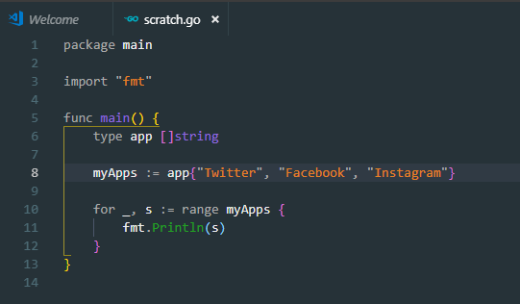
What is a custom type declaration?
We define a custom variable type.
Example:

