Slide 1

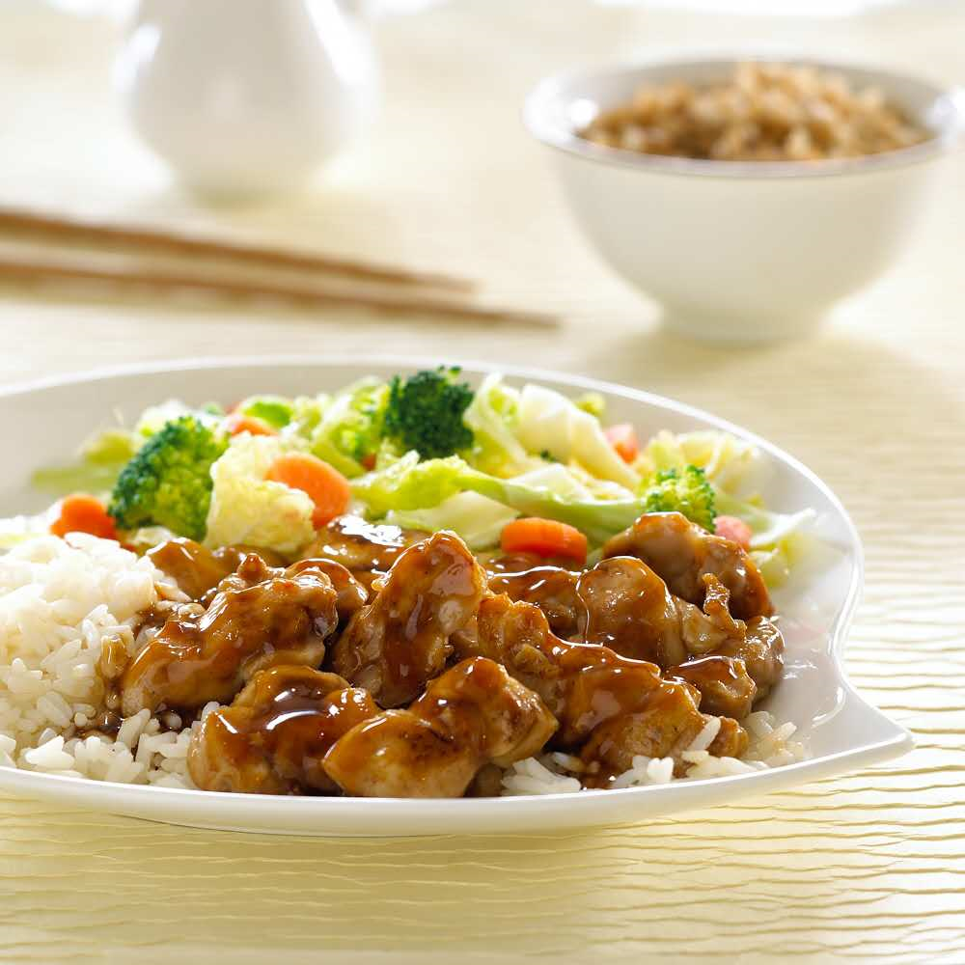

SPECIAL OF THE DAY
TERIYAKI
SERVER WITH: • Steamed Rice • Mixed Vegetables
ITEM 1
ITEM 2
ITEM 3
ITEM 4
Chicken Teriyaki $6.39
640 Cal
SERVED WITH: • Mixed Vegetables • Steamed Rice
ITEM 5
Substitute Steamed
Rice with
Extra Chicken $1.69
(4 oz.) 170 Cal

Slide 2

SIDE ORDERS
ITEM 1
ITEM 2
BEVERAGES
ITEM 3
ITEM 4
DRINKS
VEGETARIAN
VEGGIE
ITEMS
2,000calories a day is used for general nutrition advice, but calorie needs vary. Additional nutrition information available upon request.

