Slide 1
Air Quality Analytics: Executive Overview & Problem Statement
• Domain: Environmental Analytics
• Problem Statement: Air pollution poses critical public health risks. Analyzing real-time environmental monitoring data helps identify key pollution spikes to support targeted interventions.
• Dataset Footprint: 3,353 records across 15 clean, structured features covering state, station location, timestamps, and core pollutant metrics.
Python Code & Line-by-Line Breakdown:
Line-by-Line Breakdown: • import pandas as pd, numpy as np: Imports numerical and data manipulation toolkits. • df = pd.read_csv(...): Reads the external CSV file into a memory DataFrame. • print(df.shape, df.info()): Inspects total row/column counts and data types.
# Task 1: Setup & Data Loading import pandas as pd, numpy as np # Import core libraries df = pd.read_csv('air_quality.csv') # Load CSV dataset into DataFrame print(df.shape, df.info()) # Print dimensions and column types

Slide 2
Task 2: Data Cleaning, Imputation & Pre-processing
• Missing Values & Imputation: Identified 388 missing records in core metrics. Applied contextual group median transformation (by station and pollutant) to fill gaps realistically without causing data loss.
• Data Formatting: Verified zero duplicate rows and converted string timestamps to active datetime objects for chronological alignment.
Python Code & Line-by-Line Breakdown:
Line-by-Line Breakdown: • drop_duplicates(): Eliminates exact duplicate records to prevent skew. • pd.to_datetime(): Parses string dates into active datetime format. • groupby(...).transform(fillna): Fills missing values with localized group medians.
# Task 2: Cleaning & Imputation df.drop_duplicates(inplace=True) # Remove redundant duplicate rows df['timestamp'] = pd.to_datetime(df['timestamp']) # Convert string dates to datetimes df['pollutant_avg'] = df.groupby(['station', 'pollutant_id'])['pollutant_avg'].transform(lambda x: x.fillna(x.median())) # Impute group medians

Slide 3
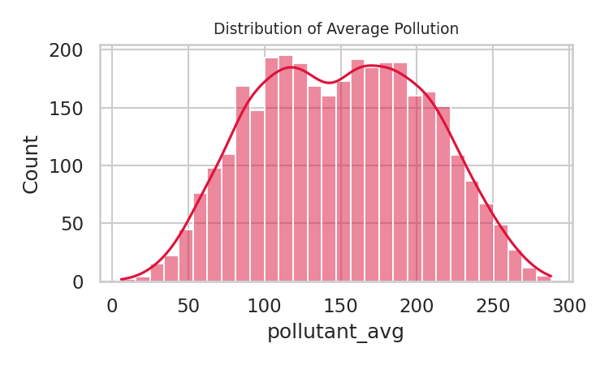
Graph 1 – Distribution of Average Pollution Levels
• What it shows: A right-skewed distribution curve showing that most recorded pollution values sit between 0 and 100.
• Pitch: This examines the overall distribution of average pollutant values. The positive skew highlights that while most locations operate within moderate ranges, localized anomalies cause significant right-tail spikes.
Python Code & Line-by-Line Breakdown:
Line-by-Line Breakdown: • plt.figure(): Initializes a plotting window of specified dimensions. • sns.histplot(..., kde=True): Plots frequency bins with an overlaid smooth density curve. • plt.title(): Assigns a descriptive chart title.
# Graph 1: Univariate distribution plt.figure(figsize=(6, 3.2)) # Set figure canvas size sns.histplot(cleaned_df['pollutant_avg'], kde=True, color='crimson', bins=30) # Plot histogram with KDE plt.title('Distribution of Average Pollution Levels') # Add title

Slide 4
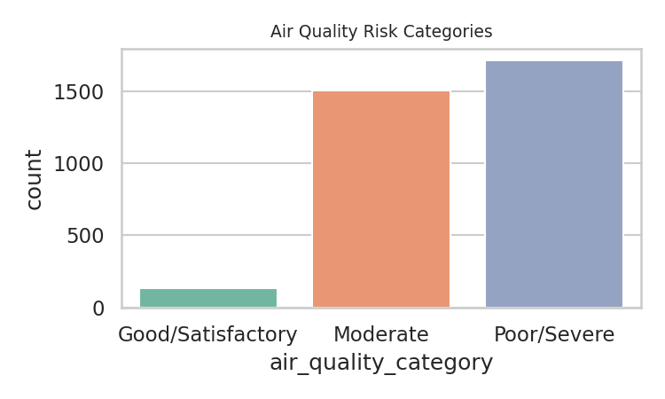
Graph 2 – Breakdown of Air Quality Risk Categories
• What it shows: A categorical frequency bar chart quantifying records in Good/Satisfactory, Moderate, and Poor/Severe bands.
• Pitch: Graph 2 categorizes our continuous pollution averages into health safety tiers, allowing us to instantly measure the proportion of monitoring events requiring public health warnings.
Python Code & Line-by-Line Breakdown:
Line-by-Line Breakdown: • order = [...]: Sets a logical sequence for health risk categories. • sns.countplot(..., order=order): Tallies category frequencies and plots them in the defined order.
# Graph 2: Risk category counts order = ['Good/Satisfactory', 'Moderate', 'Poor/Severe'] # Define category sequence sns.countplot(data=cleaned_df, x='air_quality_category', order=order, palette='Set2') # Render count bar chart

Slide 5
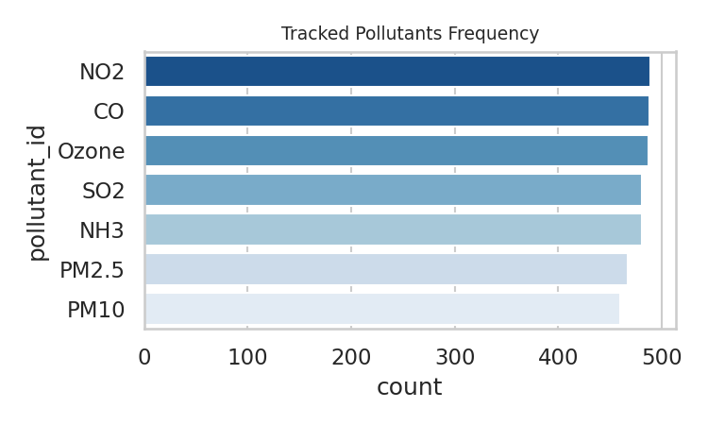
Graph 3 – Distribution of Monitored Pollutant Types
• What it shows: A horizontal bar chart ranking the tracking frequency of distinct pollutant parameters.
• Pitch: This confirms that primary monitoring coverage centers around major ambient markers such as PM2.5 and PM10.
Python Code & Line-by-Line Breakdown:
Line-by-Line Breakdown: • value_counts().index: Extracts pollutant names sorted by highest occurrence. • sns.countplot(y=...): Renders horizontal bars ranked by frequency.
# Graph 3: Pollutant type frequencies freq_idx = cleaned_df['pollutant_id'].value_counts().index # Get descending frequency index sns.countplot(data=cleaned_df, y='pollutant_id', order=freq_idx, palette='Blues_r') # Plot horizontal count bars

Slide 6
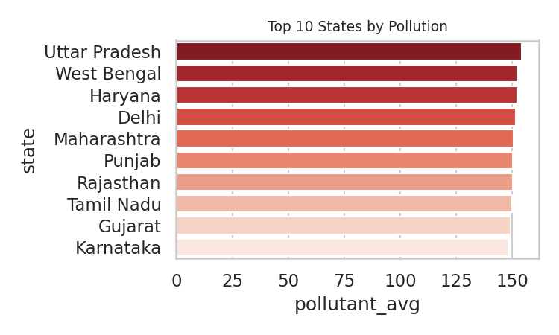
Graph 4 – Top 10 Most Polluted States
• What it shows: A ranked bar chart displaying the top 10 states with the highest overall average pollution concentrations.
• Pitch: This bivariate analysis links spatial locations to mean pollution intensity, isolating high-priority geographic zones.
Python Code & Line-by-Line Breakdown:
Line-by-Line Breakdown: • groupby('state')[...].mean(): Computes average pollution per state. • .nlargest(10).reset_index(): Filters the top 10 highest values. • sns.barplot(...): Renders horizontal ranking bars.
# Graph 4: Top 10 states by mean pollution top_states = cleaned_df.groupby('state')['pollutant_avg'].mean().nlargest(10).reset_index() # Group and get top 10 sns.barplot(data=top_states, x='pollutant_avg', y='state', palette='Reds_r') # Plot horizontal bar chart

Slide 7
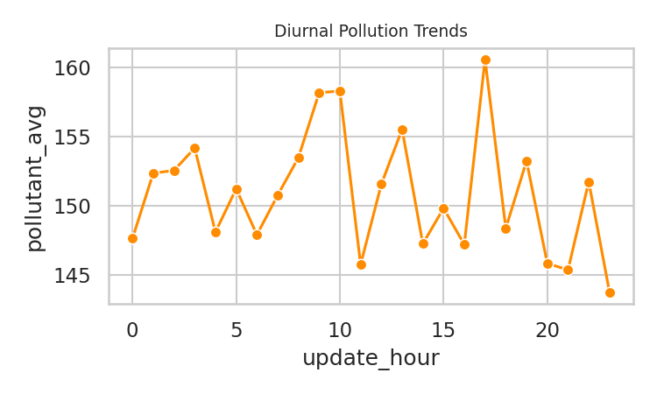
Graph 5 – Hourly Pollution Trends
• What it shows: A temporal line chart tracking average pollution fluctuations across the 24-hour daily cycle.
• Pitch: Peak concentrations align with high-traffic morning and evening commute windows, demonstrating clear temporal influence.
Python Code & Line-by-Line Breakdown:
Line-by-Line Breakdown: • sns.lineplot(...): Connects chronological points across hours. • marker='o': Places circular data points on each hour. • errorbar=None: Disables standard error confidence bands.
# Graph 5: Hourly diurnal trend line sns.lineplot(data=cleaned_df, x='update_hour', y='pollutant_avg', marker='o', color='darkorange', errorbar=None) # Plot time series line

Slide 8
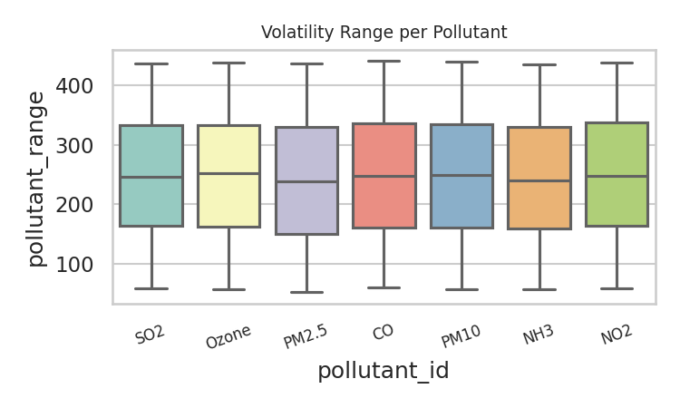
Graph 6 – Pollution Volatility Range by Type
• What it shows: Box plots illustrating the variance and extreme spikes across each individual pollutant category.
• Pitch: Using our engineered pollutant_range feature, this reveals which specific pollutants experience severe intraday spikes.
Python Code & Line-by-Line Breakdown:
Line-by-Line Breakdown: • sns.boxplot(...): Displays data spread, median, quartiles, and outliers. • plt.xticks(rotation=30): Angles x-axis labels to prevent text overlap.
# Graph 6: Volatility box plot sns.boxplot(data=cleaned_df, x='pollutant_id', y='pollutant_range', palette='Set3') # Render statistical box plots plt.xticks(rotation=30) # Rotate category labels

Slide 9
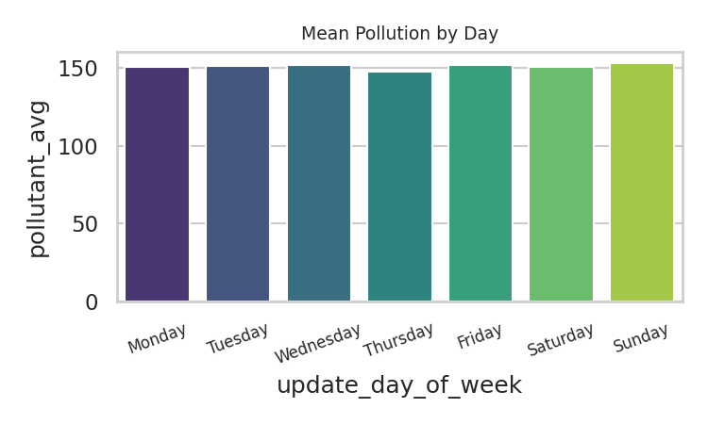
Graph 7 – Day of Week Pollution Variance
• What it shows: A day-by-day comparison chart assessing pollution differences between business weekdays and weekends.
• Pitch: Comparing weekday vs. weekend concentrations helps isolate industrial and transport emissions from baseline natural levels.
Python Code & Line-by-Line Breakdown:
Line-by-Line Breakdown: • day_order = [...]: Establishes chronological weekday sorting. • sns.barplot(..., order=day_order): Compares mean pollutant levels across days.
# Graph 7: Day of week analysis day_order = ['Monday', 'Tuesday', 'Wednesday', 'Thursday', 'Friday', 'Saturday', 'Sunday'] sns.barplot(data=cleaned_df, x='update_day_of_week', y='pollutant_avg', order=day_order, palette='viridis', errorbar=None)

Slide 10
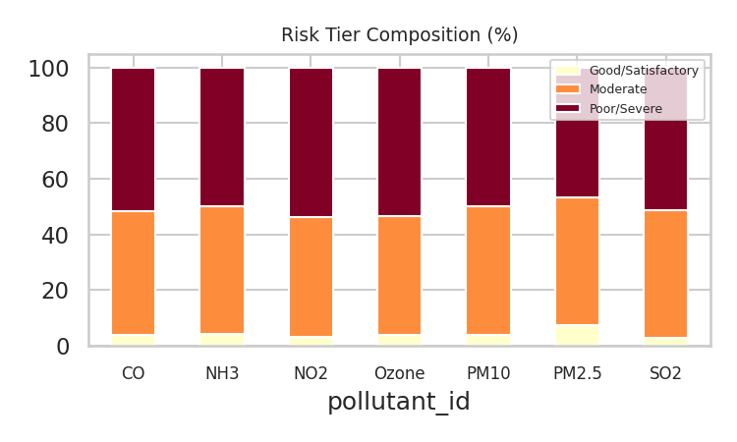
Graph 8 – Risk Category Proportion per Pollutant
• What it shows: A 100% stacked bar chart showing the relative proportion of safety categories contributed by each pollutant.
• Pitch: This shows that fine particulate matter (PM2.5/PM10) accounts for a disproportionate share of Poor/Severe classifications.
Python Code & Line-by-Line Breakdown:
Line-by-Line Breakdown: • pd.crosstab(normalize='index'): Computes row-wise percentage distribution. • ct.plot(kind='bar', stacked=True): Layers sub-categories into unified vertical bars.
# Graph 8: Stacked risk proportion ct = pd.crosstab(cleaned_df['pollutant_id'], cleaned_df['air_quality_category'], normalize='index') * 100 # Compute percentages ct.plot(kind='bar', stacked=True, colormap='YlOrRd') # Plot stacked bar chart

Slide 11
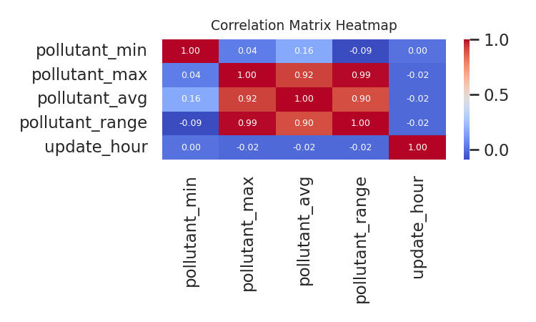
Graph 9 – Correlation Heatmap
• What it shows: A color-coded numerical correlation grid quantifying linear relationships.
• Pitch: The strong positive correlation between average levels and range confirms that higher baseline pollution levels directly scale with environmental volatility.
Python Code & Line-by-Line Breakdown:
Line-by-Line Breakdown: • .corr(): Calculates pairwise correlation coefficients between features. • sns.heatmap(..., annot=True): Displays a color grid with numeric values inside cells.
# Graph 9: Correlation matrix heatmap corr_matrix = cleaned_df[['pollutant_min', 'pollutant_max', 'pollutant_avg', 'pollutant_range']].corr() # Compute correlation sns.heatmap(corr_matrix, annot=True, cmap='coolwarm', fmt='.2f') # Render heatmap

Slide 12
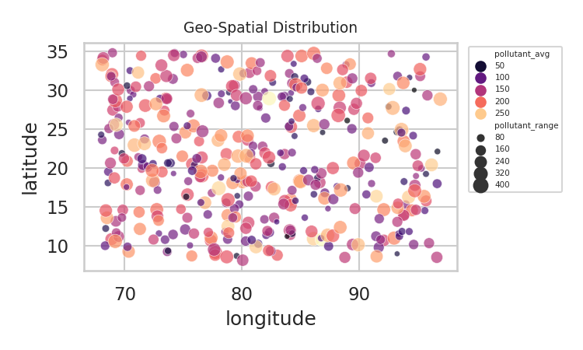
Graph 10 – Spatial Distribution Map
• What it shows: A coordinate scatter plot mapping monitoring stations geographically.
• Pitch: This multi-variable map highlights regional cluster hot-spots across monitoring zones using latitude and longitude.
Python Code & Line-by-Line Breakdown:
Line-by-Line Breakdown: • sns.scatterplot(...): Maps latitude and longitude coordinates. • hue='pollutant_avg': Color-codes points by pollution severity. • size='pollutant_range': Scales bubble sizes by intraday volatility.
# Graph 10: Geospatial scatter plot sns.scatterplot(data=cleaned_df, x='longitude', y='latitude', hue='pollutant_avg', size='pollutant_range', palette='magma')

Slide 13
Key Project Insights & Conclusion
1. Particulate Dominance: PM2.5 and PM10 constitute the primary drivers of degraded air quality.
2. Diurnal Peak Windows: Major spikes are recorded during early morning (7-9 AM) and evening (6-9 PM) hours.
3. Geographic Cluster Variance: The top 3 polluted states exhibit mean concentrations significantly above the national median.
4. Volatility Coupling: Heavily polluted areas also suffer from greater intraday volatility.
5. Imputation Integrity: Contextual median group-transformation successfully preserved underlying data variance.
Python Code & Line-by-Line Breakdown:
Line-by-Line Breakdown: • Pipeline Finalization: Synthesizes analytical findings, statistical outcomes, and data cleaning validation into final documentation.
# Task 4: Summary & Insights Generation # Final documentation of analytical findings, metrics, and conclusions.

