Slide 1
Mobile Programming
Kevin McMahon
kevin@kevfoo.com

Slide 2


Slide 3
Agenda
Install the tools
Java SDK, Android SDK, Eclipse
A whole lotta Java

Slide 4
Computers 10 1
Fetch-and-Execute
CPU
Memory
Machine Language
Polling Loops and Interrupts
Multitasking
Process vs. Threads
Virtual Machines

Slide 5
Java Basics
“The Bubble”
Platform Independence
Security
Variables
Primatives
int, float, double, char, etc.
Types
classes

Slide 6
Java Basics
Class Permission and Access
Public
Private
Protected
Methods
Array

Slide 7
Android SDK
Compiler
Simulator
Libraries
Tools and utilities

Slide 8
The raw pieces
Source code
Compiler
Byte code
Virtual machine
Run time

Slide 9
Tools
Java SDK
Eclipse
Android ADT
Android SDK

Slide 10
Hello *
HelloWorld (Java)
HelloActivity (Android)

Slide 11
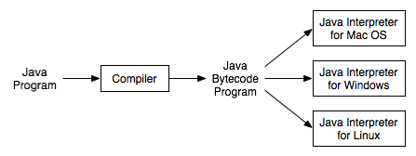

Slide 12

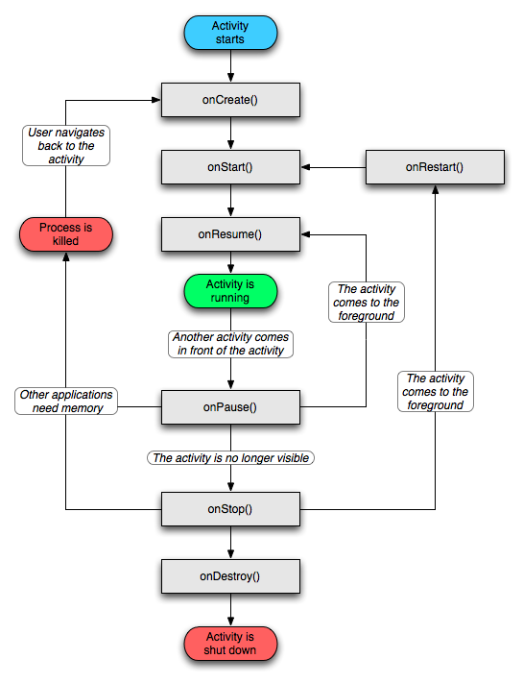

Slide 13
Arithmetic Expressions
a * ( b + c )
( ( a + b ) * c)
Operations
Addition +
Subtraction -
Multiplication *
Division /
Remainder %

Slide 14
Equality and Relational Operations
Equality
Equal ==
Not Equal !=
Relational operators
Greater than >
Less than <
Greater than or equal >=
Less than or equal <=

Slide 15
Precedence
Operators | Associativity | Type
* / % | left to right | multiplicative
+ - | left to right | additive
< <= > >= | left to right | relational
== != | left to right | equality
= | right to left | assignment

Slide 16
Control
If…then
while
do…while
Switch
For
Break and continue

Slide 17
Conditional Logic
&&
||
&
|
^
!

Slide 18

Object Oriented Programming
Why?
Modularity
Information Hiding
Code re-use
Pluggability
Three Pillars
Encapsulation
Polymorphism
Inheritance

Slide 19
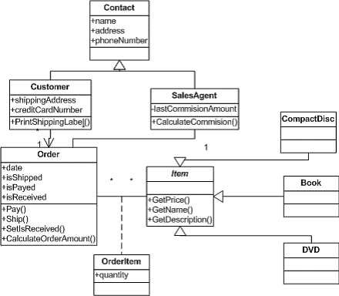

Slide 20
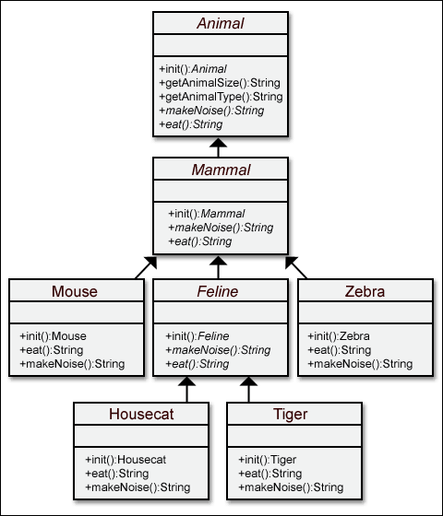

Slide 21
Code
Addition
Comparison
Gradebook
Account

Slide 22
More on Methods - Statics
What is static
aka : class method
Methods
Fields
Example: Math class
abs
sqrt
max(x,y)
PI
E

Slide 23
Arrays
Data structure
Can hold any type (primative or reference)
int[] array same as int array[]

Slide 24
Summary
Install the tools
Java SDK, Android SDK, Eclipse
Java, Java, Java

Slide 25
Resources
http://j.mp/java-book
http://j.mp/android-fundamentals
http://www.androidpatterns.com/

Slide 26
Email: kevin@kevfoo.com
Twitter: @klmcmahon
Via Basecamp

