Slide 1
Mobile Programming
Kevin McMahon
kevin@kevfoo.com

Slide 2
Agenda
Recap
Review concepts covered
GradeBook exercise
More Java
Android Hello Activity

Slide 3
Resources
http://j.mp/java-book
http://j.mp/android-fundamentals
http://www.androidpatterns.com/

Slide 4
Code
Addition
Comparison
Gradebook
Account

Slide 5
Classes, Objects, & Methods
Suppose you want to drive a car and make it go faster by pressing down on its accelerator pedal.
What will you need to make this happen?

Slide 6
Classes, Objects, & Methods
We need a car
Design / Blueprint
Manufacture the car based off the specs
Once you have the car?
Put the pedal down!

Slide 7
Classes, Objects, & Methods
Class
Design / Blueprint
Object
Created from the blueprint
Press the Pedal
Method

Slide 8
Classes, Objects, & Methods
The object
Nouns
Behaviors
Verbs
Attributes
Adjectives
Constructors
Creation
this keywords

Slide 9
Methods
How to declare methods
Overloads
Access modifiers
public
private
Data Hiding / Encapsulation

Slide 10
More on Methods - Statics
What is static
aka : class method
Methods
Fields
Example: Math class
abs
sqrt
max(x,y)
PI
E

Slide 11
More on Methods - Advanced
Call stack
Overrides
scope

Slide 12
Control
If then
While
Do while
For
Switch
Break and continue
Conditionals && ||

Slide 13
Control - If
If - Then
Single Select (if)
Double Select (if else)
Conditional Operator (? :)
Nested
Blocks ( { } )

Slide 14
Control – While
Repetition statement
Counter controlled
Sentinel controlled

Slide 15
Control –
Do While
Do { /*Stuff */} while (condition)
For
for(int i = 0; i < 10; i++)
for( x : arrayOfInts)

Slide 16
Arrays
Data structure
Can hold any type (primative or reference)
int[] array same as int array[]

Slide 17

Object Oriented Programming
Why?
Modularity
Information Hiding
Code re-use
Pluggability
Three Pillars
Encapsulation
Polymorphism
Inheritance

Slide 18
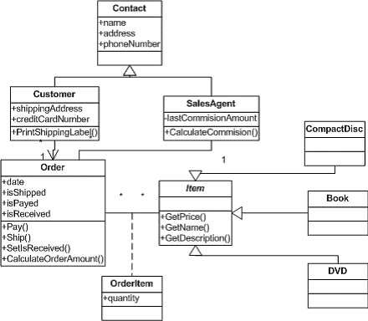

Slide 19
