Slide 1
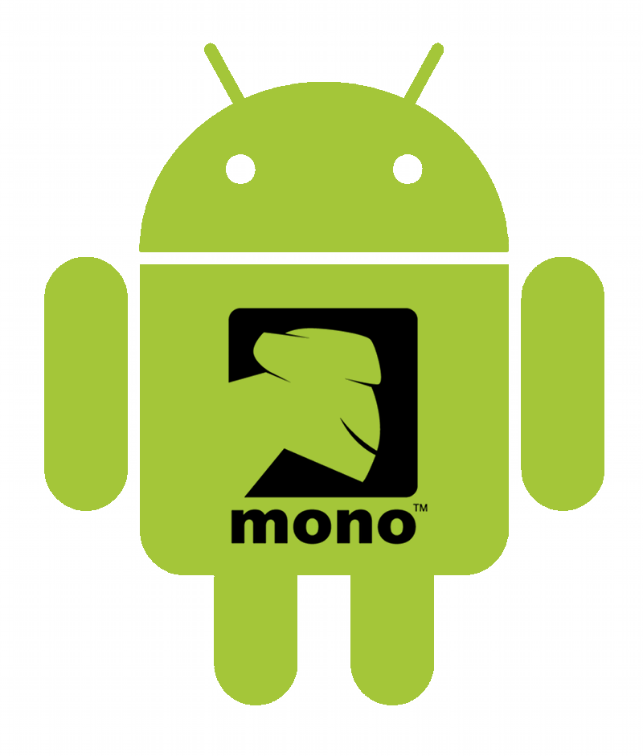
Kevin McMahon
@klmcmahon
http://blog.kevfoo.com

Slide 2
Overview
Overview of Android
MonoDroid : What, How, Why
Code Demo
MonoDroid Resources

Slide 3
What is Android?
Application Framework
Dalvik Virtual Machine
Optimized OpenGL ES 1.0 graphics library
Customized Linux 2.6 kernel
Rich development environment

Slide 4
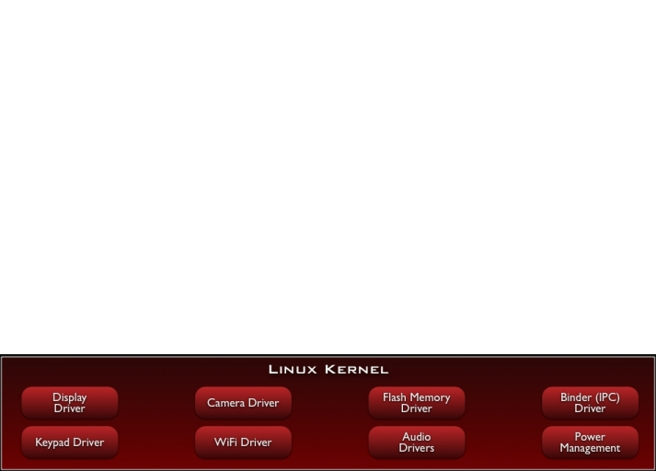
Android Stack

Slide 5
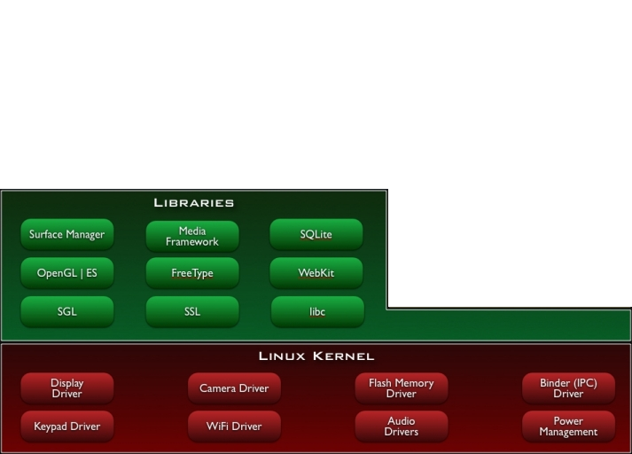
Android Stack

Slide 6
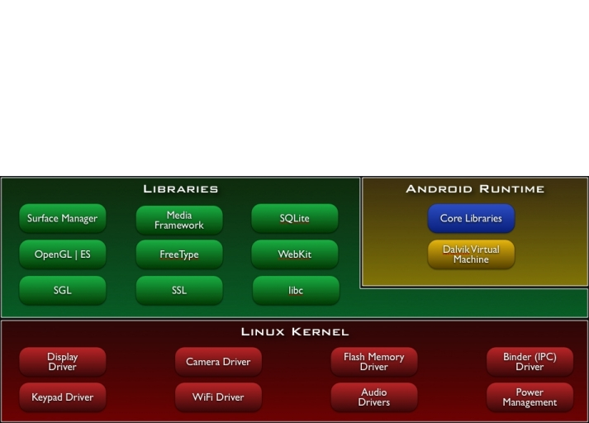
Android Stack

Slide 7
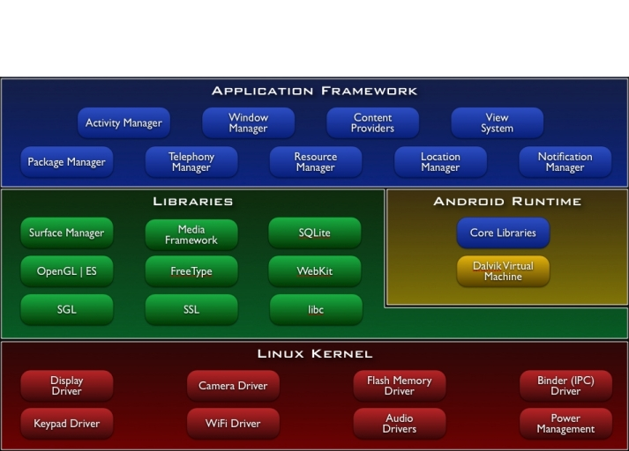
Android Stack

Slide 8
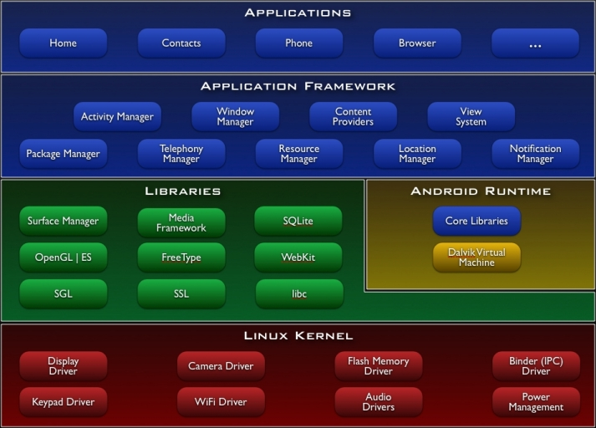
Android Stack

Slide 9
Application Framework
Views
Content Providers
Resource Manager
Notification Manager
Activity Manager

Slide 10
Android Libraries
System C
Media libraries based on OpenCORE
LibWebCore
SGL for 2D and OpenGL ES for 3D Graphics
SQLite

Slide 11
Dalvik Virtual Machine
Dalvik Virtual Machine
Register-based
Efficient when running multiple VMs
Java classes turned into Dalvik Executable
JIT (as of Android 2.2)
Android Applications
Run in own process
Run on own instance of Dalvik VM

Slide 12
What is MonoDroid?
Commercial Product from Novell
~$400 individual / ~$1000 enterprise
Project is in Preview state
Not Beta, not even alpha.
Closed preview
SIGN UP! Each preview brings more people into the mix.

Slide 13
How Does it Work?
Mono Runtime
Native to the device
Executes .Net code
Runs side-by-side with Dalvik
Mono to Android Communication
Java proxies
Android Callable Wrappers
Managed Callable Wrappers

Slide 14
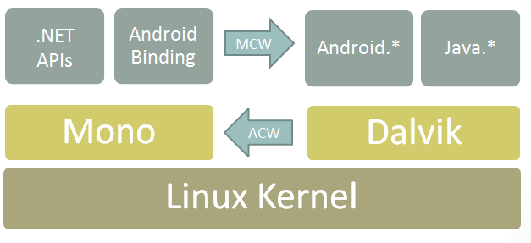
MonoDroid Architecture
Notes:
System.*, System.IO.*, System.Net.* and the rest of the .NET class libraries to access the underlying Linux operating system facilities
Audio, Graphics, OpenGL and Telephony are only exposed through the Dalvik Java APIs in Java.* or Android.* namespace

Slide 15
MonoDroid Design Principals
Follow the Framework Design Guidelines
Allow developers to subclass any Java class
Java properties as C# properties
Strongly typed API
C# delegates (lambdas, anonymous methods)

Slide 16
Why would you use MonoDroid?
Monodroid story not as compelling as MonoTouch.
GC, decent IDE, not Objective-C
Opportunities for re-use across platforms
XNA for games
iOS, Android, Windows Phone 7 non-UI components
Development tooling and environment
Visual Studio
MonoDevelop (support targeted for v1.0)
C# > Java ;)
Still have some Java idioms and architecture friction.

Slide 17
Deployment
Deploy to Android Virtual Device
Deploy to Device
Debug capabilities on both
Sell (eventually) via Android Marketplace
No “Go Live” license yet
$25 Google developer account

Slide 18
Android Application Concepts
Activities
Services
Content Providers
Intents
Resources

Slide 19
Activities
Orchestrates a UI view
Applications are composed of 1-to-Many activities
One activity marked as main and shown first upon launch

Slide 20
Activities - Views
Each activity is given a default window to draw in.
Content of the window is provided by a hierarchy of views
A view hierarchy is placed within an activity's window by the Activity.SetContentView()

Slide 21
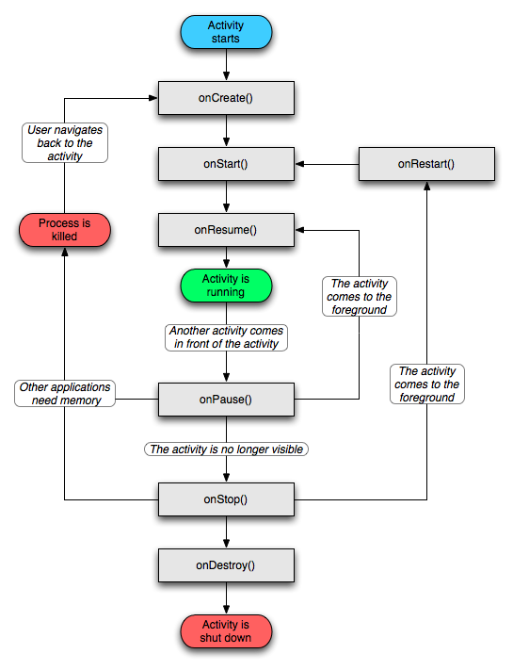

Slide 22
Services
Android service are what you’d expect.
Possible to bind to an ongoing service and communicate via exposed interface
Runs in main application process but doesn’t block other components or UI

Slide 23
Content Providers
Queryable application data stores
Only way to share data amongst other apps
Android ships with common providers
Audio, video, images, contacts, etc.
Making your application’s data public
Create a new provider
Add your data to existing provider

Slide 24
Intents
Eventing mechanism
Intent objects are passive data that is of interest to the component that is receiving the intent
Filterable

Slide 25
Resources
Abstraction layer which decouples code and the various assets which compose your app
Makes localization easier
Eases support of multiple devices and capabilities

Slide 26
Code Demo
https://github.com/kevinmcmahon/MonoDroid101

Slide 27
MonoDroid Resources
Links
http://www.monodroid.net
http://developer.android.com/
IRC Support / Discussion
#monodroid on irc.gnome.org
Code
https://github.com/mono/monodroid-samples
https://github.com/kevinmcmahon/MonoDroid-101
SIGN UP FOR THE BETA!
http://go-mono.com/monodroid/

