Slide 1
.NET? Mono for Android Does

Slide 2
Overview
Overview of Android
Mono for Android : What, How, Why
Mono for Android Resources
Code Demo

Slide 3

http://about.me/kevinmcmahon
@klmcmahon

Slide 4
What is Android?
Application Framework
Dalvik Virtual Machine
Optimized OpenGL ES 1.0 graphics library
Customized Linux 2.6 kernel
Rich development environment

Slide 5
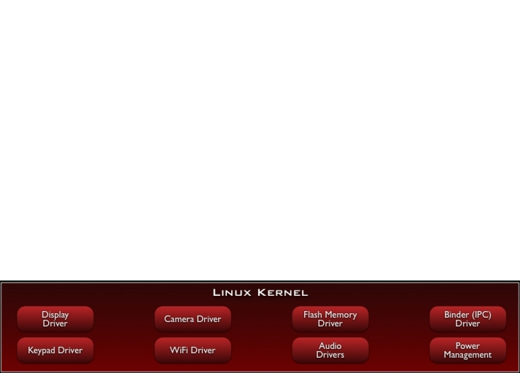
Android Stack

Slide 6
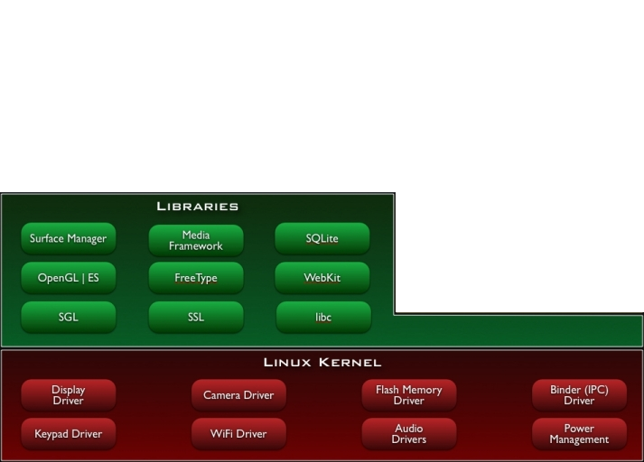
Android Stack
Notes:
libc
Media libraries based on OpenCORE
LibWebCore
SGL for 2D and OpenGL ES for 3D Graphics
SQLite

Slide 7
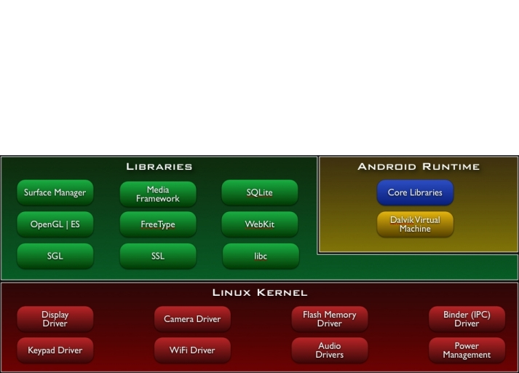
Android Stack

Slide 8
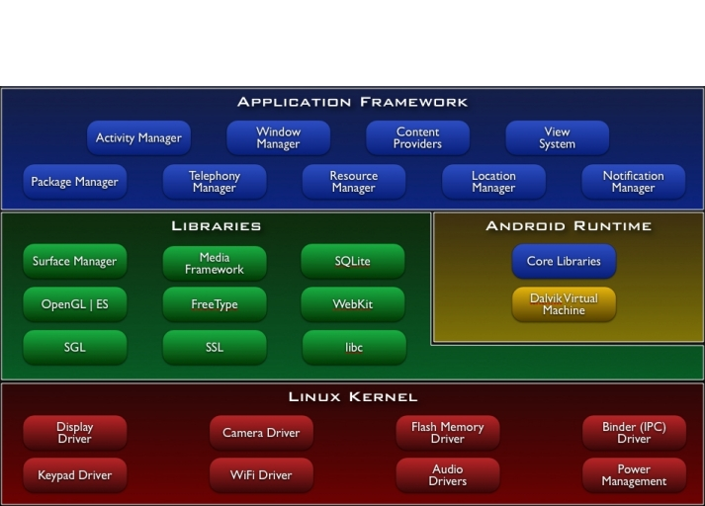
Android Stack
Notes:
Views
Content Providers
Resource Manager
Notification Manager
Activity Manager

Slide 9
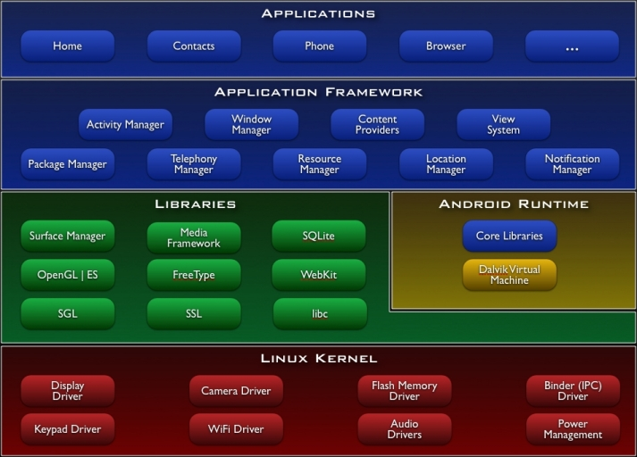
Android Stack

Slide 10
Dalvik Virtual Machine
Dalvik Virtual Machine
Register-based
Runs multiple VMs efficiently
Requires a .class to .dex transformation
JIT (as of Android 2.2)
Each Android Application:
Runs in their own process
Runs on their own VM

Slide 11
What is Mono for Android?
Commercial Product from Novell
$399 individual / ~$999 enterprise / ~$99 student
Windows and Mac OS X (Linux soon)
Demo can do everything but deploy
DOWNLOAD AND TRY IT!
Shipped v1.0 in early April

Slide 12
How Does it Work?
Mono Runtime
Native to the device
Executes .Net code
Runs side-by-side with Dalvik
Mono to Android Communication
Java proxies
Android Callable Wrappers
Managed Callable Wrappers

Slide 13
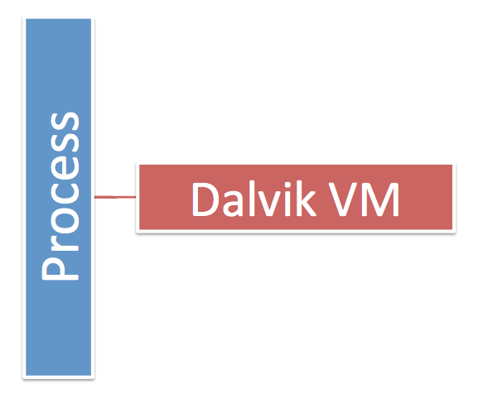

Slide 14
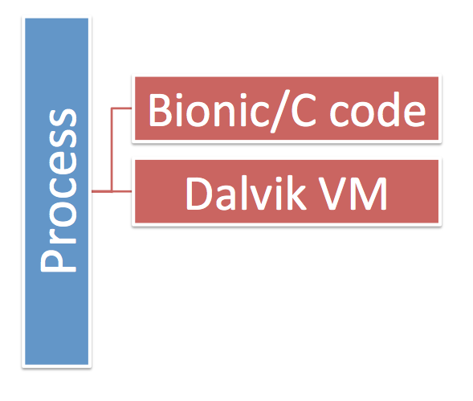

Slide 15
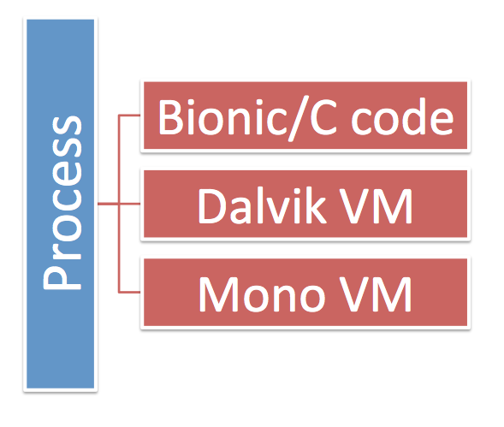

Slide 16
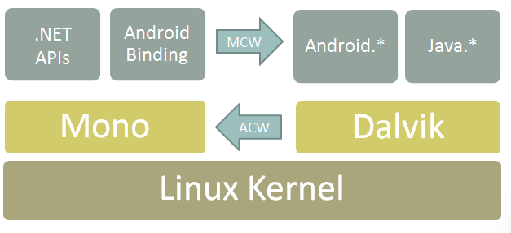
Mono for Android Architecture
Notes:
System.*, System.IO.*, System.Net.* and the rest of the .NET class libraries to access the underlying Linux operating system facilities
Audio, Graphics, OpenGL and Telephony are only exposed through the Dalvik Java APIs in Java.* or Android.* namespace

Slide 17
Mono for Android Design Principles
Follow the Framework Design Guidelines
Allow developers to subclass any Java class
C# delegates (lambdas, anonymous methods)
Java properties as C# properties
Strongly typed API

Slide 18
WHY?

Slide 19
Mono for Android story not as compelling as MonoTouch.

Slide 20
Opportunities for re-use across platforms

Slide 21
Development tooling and environment

Slide 22
C# > Java

Slide 23
Deployment Options
Deploy to Android Virtual Device
Deploy to Device
Debug capabilities on both
Sell (eventually)
Android Marketplace
Amazon App Store

Slide 24
Android Application Concepts
Activities
Services
Content Providers
Intents
Resources

Slide 25
Activities
Orchestrates a UI view
Applications are composed of 1-to-Many activities
One activity marked as main and shown first upon launch

Slide 26
Activities - Views
Each activity is given a default window to draw in.
Content of the window is provided by a hierarchy of views
A view hierarchy is placed within an activity's window by the Activity.SetContentView()

Slide 27
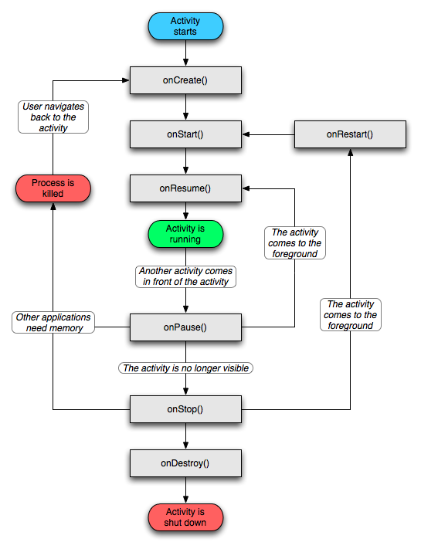

Slide 28
Activity Life Cycle
onCreate
onStart
onResume
onPause
onStop
onDestroy

Slide 29
Intents
Eventing mechanism
Intent objects are passive data that is of interest to the component that is receiving the intent
Filterable so you can pick and choose which events to respond to

Slide 30
Services
Android service are what you’d expect.
Possible to bind to an ongoing service and communicate via exposed interface
Runs in main application process but doesn’t block other components or UI

Slide 31
Content Providers
Queryable application data stores
Only way to share data amongst other apps
Android ships with common providers
Audio, video, images, contacts, etc.
Making your application’s data public
Create a new provider
Add your data to existing provider

Slide 32
Content Provider Layer
Applications
Content Providers
Contacts
Music
Videos
Pictures
…

Slide 33
Resources
Images, layout descriptions, binary blobs and string dictionaries
Abstraction layer which helps decouples code
Makes managing assets easier
Localization
Multiple displays
Different hardware configurations
Notes:
“The native Android APIs do not operate directly with filenames, but instead operate on resource IDs. When you compile an Android application that uses resources, the build system will package the resources for distribution and generate a class called "R" (this is an Android convention) that contains the tokens for each one of the resources included.” – http://http://monodroid.net/Documentation/API_Design

Slide 34
Code Demo
https://github.com/kevinmcmahon/MonoDroid101
Notes:
Demo Order:
HelloLinearLayout
HelloListView
HelloL10N
CABarCode
HelloSpinner
GPSMap

Slide 35
Mono for Android Resources
Download the Preview!
http://mono-android.net/Welcome
Links
http://www.mono-android.net
http://developer.android.com/
IRC Support / Discussion
#monodroid on irc.gnome.org
Code
https://github.com/mono/monodroid-samples
https://github.com/kevinmcmahon/MonoDroid101

