Slide 1
2-D Traceback Spherically!

Slide 2
Three Calculations
Star↔Cluster Direction: θ
PM Direction Boundary: γ
Star PM Direction: φ
Using spherical trigonometry presented in:
W. M. Smart: Spherical Astronomy, 1949 Edition
PDF: http://aprsa.villanova.edu/files/Smart-SphericalAstronomy.pdf

Slide 3
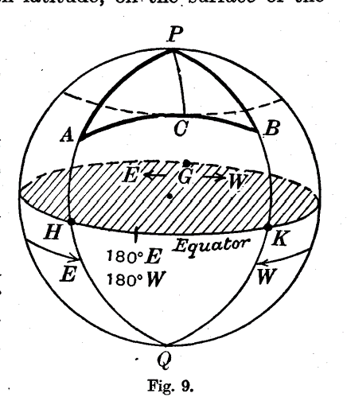
1. Star ↔ Cluster Direction: ∢ PAB
A, B = star and cluster, respectively
P = North Celestial Pole
Angle ∢APB = difference in Right Ascension
Segments PA, PB are co-latitudes of A,B (90-δ)
Segment AB can be calculated by cosine formula:
$$\cos{AB}=\cos{PA} \cos{PB}+ \sin{PA}\sin{PB}\cos{∢APB}$$
Now with AB, PA and PB, use cosine formula again to solve for ∢ PAB
$$\cos{PB}=\cos{AB} \cos{PA}+ \sin{AB}\sin{PA}\cos{∢PAB}$$
$$\cos{∢PAB}={(\cos{PB}− cos{AB}\cos{PA)}}/{\left(\sin{AB}\sin{PA}\right)}$$
Denote ∢PAB as θ
Smart, p 16, PDF p 29

Slide 4
2a: PM Direction Boundaries
Cluster
Proper Motion of S in the reference frame of C
S
Spherical!
Opposite of Star’s proper motion must fall within ± ∢ S

Slide 5




2b: Find ∢ S
First, calculate c from law of cosines:
C’
$$\cos{c}=\cos{c^{′}} \cos{s}+ \sin{c′}\sin{s}\cos{∢C; \cos{∢C}=0}$$
c
Cluster Radius
$$\cos{c}=\cos{c^{′}} \cos{s}$$
s
γ
$$c =\cos^{−1}{(}cos{c^{′}} \cos{s})$$
c’
C
Now, calculate ∢S also from law of cosines:
S
$$\cos{s}=\cos{c^{′}} \cos{c}+ \sin{c′}\sin{c}\cos{∢S}$$
Solve for ∢S:
$$\cos{∢S}={(\cos{s}− cos{c′}\cos{c)}}/{\left(\sin{c′}\sin{c}\right)}$$
c = arc subtending ∢C
c’ = arc subtending ∢C’ = current separation C ↔ S
s = arc subtending ∢S = Cluster Radius
∢ C = 90° ⇒ cos(∢C ) = 0
$$∢S=\cos^{−1}\left({(\cos{s}− cos{c′}\cos{c)}}/{\left(\sin{c′}\sin{c}\right)}\right)$$
Denote ∢S as γ.
Spherical!

Slide 6
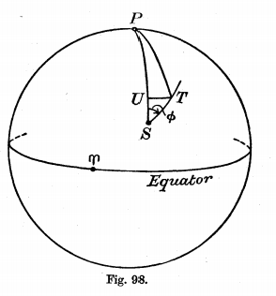
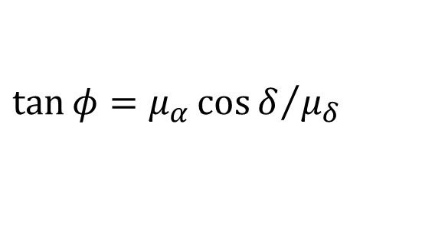







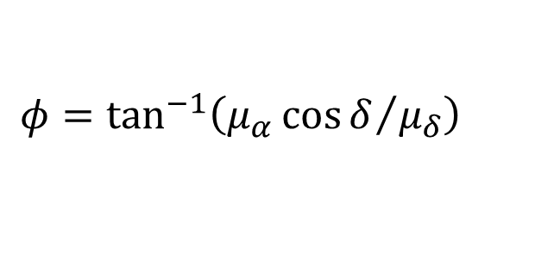
3: Direction of Proper Motion: ϕ
Smart, Eq 10, 11:
Proper Motion of S in the reference frame of C
$$μ_{α}=μ\sin{φ}\sec{δ and μ_{δ}= μ\cos{φ}}$$
Solve for $φ$:
$$μ={μ_{δ}}/{\cos{φ}}$$
$$μ_{α}=μ_{δ}\sin{φ}∕\left(\cos{φ}\cos{δ}\right)$$
$$μ_{α}\cos{δ}=μ_{δ}\tan{φ}$$
$$\tan{φ}={μ_{α}\cos{δ}}/{μ_{δ}}$$
$$φ=\tan^{−1}\left({μ_{α}\cos{δ}}/{μ_{δ}}\right)$$
Need opposite direction $φ′$:
Smart, p 252, PDF p 265
$$φ′=φ−π$$

Slide 7

2D Traceback Relationship
Star S traces back to Cluster C if and only if:
$$θ−γ≤φ^{′}≤θ+γ$$

