Slide 1
An Analysis on the Relationship between Weather and Crime in Chicago, IL
Kevin McManus
Colorado State University Global
MIS 581: Capstone – Business Intelligence and Data Analytics
Dr. Kimberly Ford
July 4, 2021
Notes:
Hello,
I wanted to take some time to discuss my research project titled, An Analysis on the Relationship between Weather and Crime in Chicago, IL. This paper completes the requirements for MIS581: Capstone – Business Intelligence and Data Analytics. All of the research documents, datasets, and code can be found on my GitHub repository for resources to recreate my study, https://github.com/kevinmcmanus16/CapstoneProject.

Slide 2
Objectives
Determine if a relationship exists between types of crimes committed and different weather factors.
Determine if a relationship exists between types of crimes committed and maximum temperature
Determine if temperature influences the location of crimes committed
Notes:
To get us started, the main objectives of the study is for the Chicago Police Department to be able to identify if there is a relationship between different weather factors and types of crimes committed, such as violent, non-violent and property crimes. The study will also determine if there is a relationship between the types of crimes committed and the maximum temperature for the day. Lastly, this analysis will determine what weather factors can help predict the type of crimes that will be committed by offenders. A look will also be taken to determine if temperature influences the location of where the crimes are committed. By properly being able to predict the types of crimes committed and locations, CPD can properly staff different precincts and beats to ensure that their citizens can rely on the support of the department.

Slide 3
Overview of Study
Two datasets were utilized:
Crimes – 2001 – Present
Chicago Weather
The above datasets handled tasks for manipulation, cleaning, and were joined to create a single dataset for analysis
The combined dataset was utilized to undergo hypothesis testing for this study
Notes:
The two datasets that are utilized for this study, Crimes – 2001 – Present and Chicago Weather, will be joined together to provide additional insights into the already established study of how weather affects the types of crimes to assist in better evidence-based decision-making (O’Leary, 2021). The Crimes -2001 – Present dataset is a very informational dataset to the city and their criminal analysts. This dataset has been chosen as it provides information about each criminal report that is made by the CPD and allows for the analysis of data over any desired time that is within the dataset’s beginning collection period of January 1, 2001, to seven days prior to current day. The Chicago Weather dataset will provide insights into the temperature, precipitation, wind speed, and weather conditions in the city on any day that is collected by the National Oceanic and Atmospheric Administration (NOAA). The crime data for each incident, in addition to the climate data points that occurred on the day of the incident, can be combined to allow for an analysis to be completed on how weather impacts the types of crimes that are committed in the city, along with any trends that may be found that correspond with the city’s climate trends. By being able to identify how weather may impact crimes in a particular city, crime cycles may be uncovered which could allow police departments to conduct additional trainings on crimes that may begin to increase due to seasonality.

Slide 4
Research Questions and Hypotheses
RQ 1: Is there a relationship between all external weather factors and the types of crimes committed?
H0 1: There is not a relationship between all external weather factors and the types of crimes committed.
HA 1: There is a relationship between all external weather factors and the types of crimes committed.
RQ 2: Is there a relationship between the maximum temperature for the day and the types of crimes committed?
H0 2: There is not a relationship between the maximum temperature for the day and the types of crimes committed.
HA 2: There is a relationship between the maximum temperature for the day and the types of crimes committed.
RQ 3: Will one or more weather variables be able to predict the type of crime committed?
H0 3: One or more weather variables will not be able to predict the type of crime committed.
HA 3: One or more weather variables will be able to predict the type of crime committed.
Notes:
There are three business questions that are being asked for this project. Each business question has a null and alternate hypothesis that will be tested. These questions are: is there a relationship between all external weather factors and the types of crimes committed; is there a relationship between the maximum temperature for the day and the types of crimes committed; and will one or more weather variables be able to predict the types of crimes committed? Under each business question, you can see what the null and alternate hypotheses are.

Slide 5
Similar Studies Already Completed
Violent crimes increase with temperature rises (Michel et al., 2016; Butke & Sheridan, 2010; Ranson, 2014)
Baltimore, MD
Cleveland, OH
Countrywide
Location of the weather data collection can cause difficulties with the analysis (Hofer et al., 2019)
Notes:
There have been various studies completed by researchers to try to understand how weather plays a role in violent criminal activities. These studies found that violent crimes increase with temperature rises (Michel et al., 2016; Butke & Sheridan, 2010; Ranson, 2014). The studies completed by Michael et al. (2016), Butke and Sheridan (2010), and Ranson (2014) each took place in difference cities throughout the United States outside of Chicago, IL that provide a base for this analysis. This analysis takes the findings from previous studies a step further as it raises additional curiosities. In the prior studies listed above, the analysis is completed utilizing temperature and violent crimes only. This analysis suspects that temperature will play a significant impact on the types of crimes committed, such as violent crimes, but will also examine if the types of crimes committed are statistically impacted by other types of weather conditions, such as snow or rain.
The location of the weather station used for the weather data plays an important part to the study. Hofer et al. (2019) discusses the difficulty that the location can play into a study as the exact weather attributes is not fully representative of the area. Careful selection should be utilized when selecting a weather station location, which Chicago-Midway Airport has 100% coverage of the city for their attributes, according to the NOAA. However, because the station is on the southern end of the city, areas on the northern side could not be fully accurate. This is due to temperature variances that could be a result of the heavily populated areas such as downtown in comparison to more suburban areas of the city.

Slide 6
Research Methods
Correlation testing
Relationship between weather variables and types of crimes committed
Relationship between maximum temperature and types of crimes committed
Nominal logistic regression analysis
Determine if any weather variables can predict types of crimes committed
Visual analysis of locations of crimes committed
Notes:
Correlation testing will be completed to identify relationships between crime and the different weather conditions, in addition to identifying the relationship between maximum temperature and types of crimes committed. This testing will see if they are positively or negatively correlated and if that relationship is statistically significant.
Ranson (2014) completed a regression analysis to see how weather has impacted crime in historical data and identified that increasing temperatures resulted in more violent criminal activity throughout the United States. Nominal logistic regression tests allow for users to evaluate relationships between predictor variables and a response variable that has 3 or more groupings. A nominal logistic regression test will be utilized to determine which weather variables could assist in accurately predicting a crime as violent, non-violent, or property.
Visualizations will be created in Tableau showing the density of crime locations for the entire merged dataset to see where the hotspots are located within the city. Butke and Sheridan (2010) emphasize the point that a temperature should be set as the defining point between what is considered “hot” and what would be considered “cold” to allow for the proper analysis of how colder and hotter temperatures play a part in the crime rates throughout the City of Chicago. For this project, 70 degrees Fahrenheit will be the dividing temperature. After creating this visual, 2 additional visuals will be created to display the hotspots of crime when the maximum temperature is above and below 70 degrees Fahrenheit to see potential variations while the temperature was considered “hot” and “cold” outside. All three of the created visuals will be compared to one another to see how temperature impacts the crime density throughout the city.

Slide 7
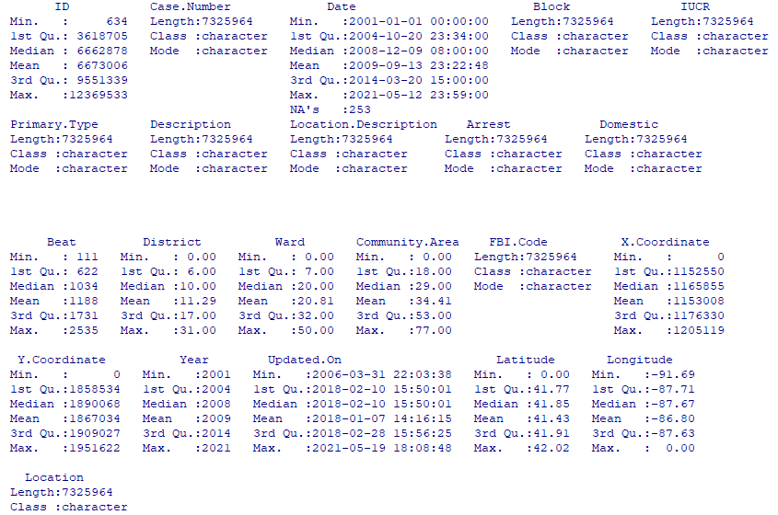
Dataset Discussion
Figure 1
Crimes – 2001 – Present Summary Statistics
Notes:
The Crimes – 2001 – Present dataset consists of over 7.3M rows of data ranging from January 1, 2001, to May 12, 2021, which can be seen as the total number of rows in Case.Number. There are 253 missing values in the Date variable but these will be excluded from the analysis once a defined time is chosen for the project. As you can see there was a significant time before the first update was made to the dataset from when the collection period began. There are 0 values in the District, Ward, Community.Area, X. Coordinate, Y. Coordinate, Latitude and Longitude variables, which indicate that there are missing values in those fields as those coordinates do not include the City of Chicago and there are not any district, beats, or community areas in Chicago that include 0 for their values.

Slide 8
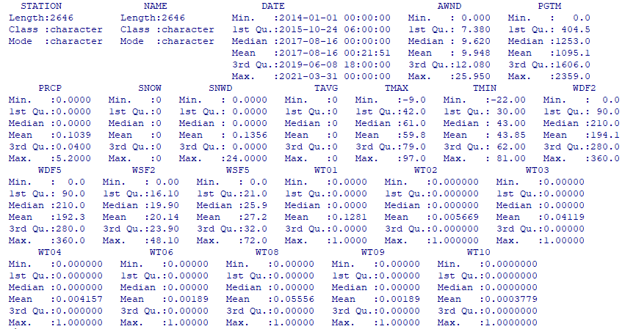
Dataset Discussion
Figure 2
Chicago Weather Summary Statistics
Notes:
In the Chicago Weather dataset, the column utilized to display if certain weather conditions were present, which uses the variables WT##, utilize an integer value of 1 to signify if the weather condition was present and is left blank/null if the condition was not present. The weather dataset has a total of 2,646 records that span from January 1, 2014, through March 31, 2021. The SNOW and TAVG variables do not have any values that were included in the dataset other than 0. As all of these values are recorded at the same station, the Station and Name variables will likely not be needed. The two datasets were then merged based on the date to create a single dataset for analysis and testing between January 1, 2014 and December 31, 2020.

Slide 9
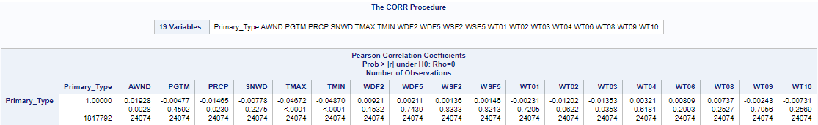
Discussion of Findings
Figure 3
Partial Correlation Chart between Primary_Type and All-Weather Variables
RQ 1: Is there a relationship between all external weather factors and the types of crimes committed?
H0 1: There is not a relationship between all external weather factors and the types of crimes committed.
HA 1: There is a relationship between all external weather factors and the types of crimes committed.
Notes:
Now to take a look at the results of our hypothesis testing. Based on the correlation chart, there is a statistically significant relationship between the type of crime and average daily wind speed (AWND), precipitation (PRCP), maximum temperature (TMAX), minimum temperature (TMIN), and weather where thunder was present (WT03). This is determined as the p-value is less than 0.05. Between these relationships, there is a direct relationship between the type of crime and average daily wind speed due to a positive correlation coefficient. The remaining statistically significant weather categories have an indirect relationship with the type of crime due to the negative correlation coefficient. The strength of the relationship can be determined by how close the correlation coefficient is to 1 for a positive relationship and -1 for a negative relationship. The values that are close to 0 mean that the relationship is not strong, but rather weak. As not all of the weather variables were found to be statistically significant in having a relationship with the type of crime, the null hypothesis was accepted.

Slide 10
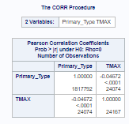
Discussion of Findings (continued)
Figure 4
Correlation Chart between Primary_Type and TMAX
RQ 2: Is there a relationship between the maximum temperature for the day and the types of crimes committed?
H0 2: There is not a relationship between the maximum temperature for the day and the types of crimes committed.
HA 2: There is a relationship between the maximum temperature for the day and the types of crimes committed.
Notes:
For our second question, the above chart shows that there is a statistically significant negative relationship between the type of crime and the maximum temperature. The violent crime category for this study is 1, the nonviolent crime category is 2, and the property crime category is 3. Using these category values, as the temperature increases, the type of crime goes from property all the way to violent showing that more violent crimes occur in higher temperatures. This negative relationship is what would be expected based on the studies previously mentioned which all found that violent crimes increase as temperatures rise(Michel et al., 2016; Butke and Sheridan, 2010; and Ranson, 2014) . Due to the statistically significant relationship that was found, the null hypothesis was rejected.

Slide 11
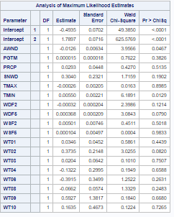
Discussion of Findings (continued)
Figure 5
Logistic Regression Analysis of Primary_Type and Weather Variables
RQ 3: Will one or more weather variables be able to predict the type of crime committed?
H0 3: One or more weather variables will not be able to predict the type of crime committed.
HA 3: One or more weather variables will be able to predict the type of crime committed.
Notes:
For our last question, based on the chart, average daily wind speed (AWND) and minimum temperature (TMIN) are statistically significant in predicting the type of crime committed. This is determined as the p-value is less than 0.05 to identify the significance and the larger the parameter estimate, the stronger impact it has on the type of crime. It is important to note that the average daily wind speed has a negative impact on the type of crime due to the negative parameter estimate value. Since the average daily wind speed and minimum temperature are statistically significant in predicting the type of crime committed, the null hypothesis was rejected.

Slide 12
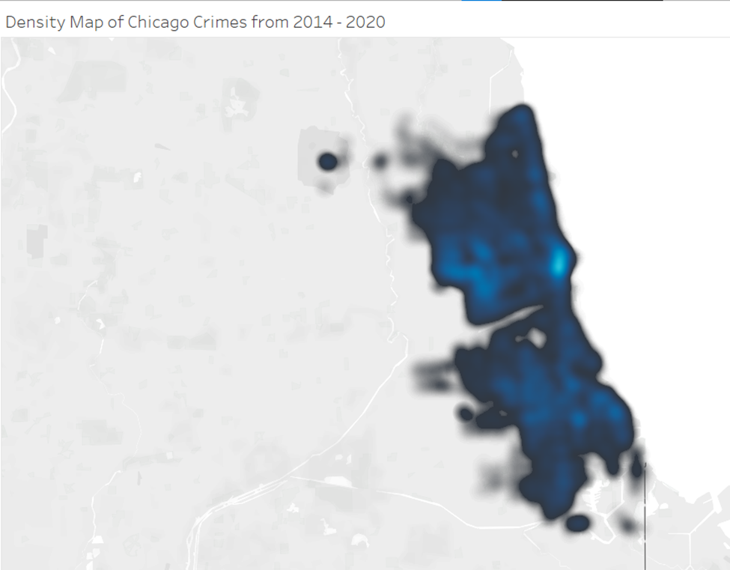
Figure 6
Density Map of Chicago Crimes from 2014-2020
Notes:
The next 3 slides look at the crime density maps within Chicago from 2014 to 2020. The density color range changes from black and lightening in color all the way to white as the density increases within the city. In looking at the above visual for the crime density throughout the entire City of Chicago, the largest density of crimes occurs towards the downtown area of Chicago, which is signified by the noticeably light blue/white color. The outskirts of the city are mostly black in color, which would signify that crime densities increase as you move away from the city limits.

Slide 13
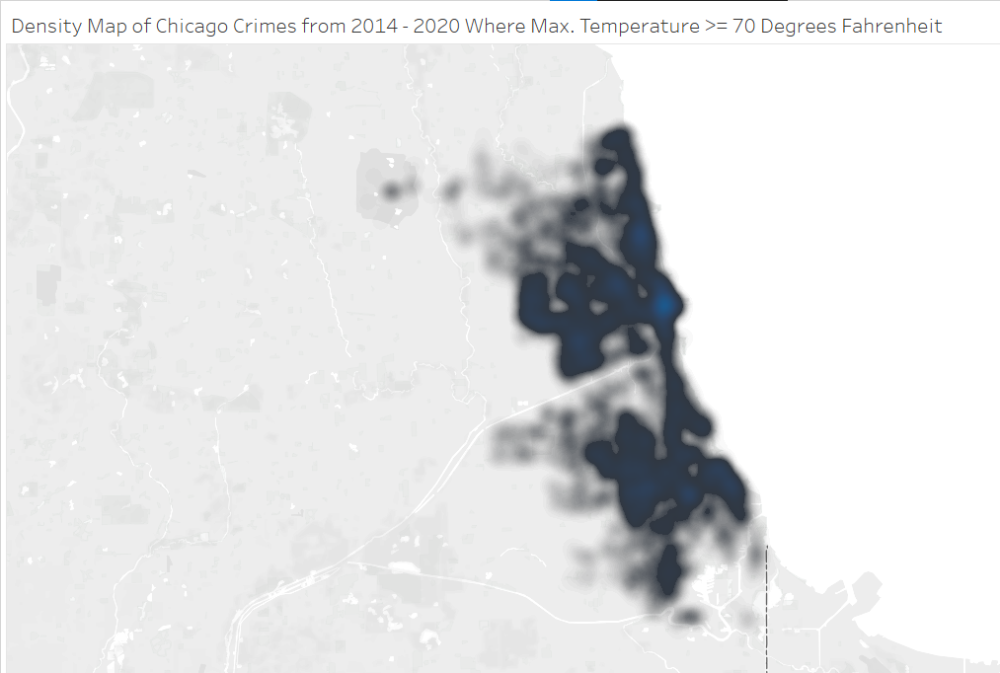
Figure 7
Density Map of Chicago Crimes from 2014-2020 Where Maximum Temperature ≥ 70°F
Notes:
This image shows the crime densities in Chicago where the maximum temperatures are 70° Fahrenheit or higher. This gives an idea of where the crimes have occurred when the weather is considered “hot”. When compared with the total crime density of the city, crimes when the temperature is “hot” tend to occur even less frequently around the city limits and concentrate in the downtown area, east of downtown, and the south side of Chicago.

Slide 14
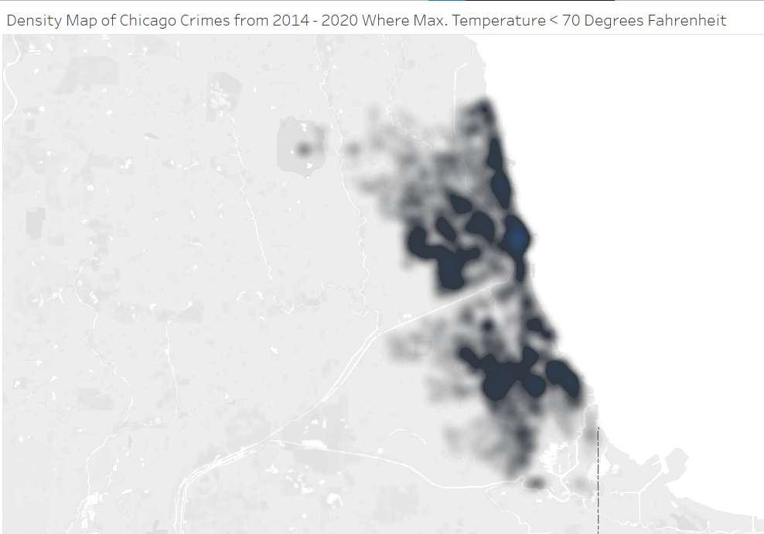
Figure 8
Density Map of Chicago Crimes from 2014-2020 Where Maximum Temperature < 70°F
Notes:
Crimes when the weather is “cold” outside still occur in the downtown area, but less frequently on the south side and east of downtown, in comparison to the weather when it is “hot” outside. Visually it would appear that less crimes occur in frequented areas when it is “cold” outside as the strength in color variations and boldness of the dark colors are not as dominant when compared to Figure 7. When comparing the “hot” and “cold” density maps, it is apparent that as the temperatures reach 70°F or higher, the crime densities shift as crimes became more frequent and in repetitive areas of the city.

Slide 15
Final Thoughts
If collecting weather data is found beneficial, then data should be collected at each precinct
Hotter temperatures result in more violent crimes occurring
Hotter temperatures also shift crime location patterns
Average daily wind speed, minimum and maximum temperature, precipitation, and the presence of thunder affect types of crime committed
Notes:
The CPD must ask themselves if using weather data to predict types of crimes committed is worth collecting. However, given the location of where the weather data is collected and its impact on crime as studied by Hofer et al. (2020), it would be beneficial for CPD to collect weather data at each precinct station. By doing this, the crimes committed in each precinct can be run through the same tests above to truly identify if this study is representative of each precinct compared to the whole city as only a single weather station dataset was utilized.
In conclusion, the rise in temperature has a statistically significant effect in an increase in violent crimes, while average daily wind speed, minimum and maximum temperature, precipitation, and the presence of thunder all have a statistically significant relationship with the type of crimes committed. The rise in temperatures also play a part in the locations of where crimes are committed. By being able to identify weather factors that played a role in crime from 2014 to 2020, the CPD can leverage this data to have an upper hand on preparing their officers for any potential rise in crimes or ensuring that their department is properly staffed if an influx of crimes is suggested in future months based on the weather forecast.

Slide 16
References
Butke, P., & Sheridan, S. C. (2010). An analysis of the relationship between weather and aggressive crime in Cleveland, Ohio. Weather, Climate, and Society, 2(2), 127–139.
Chicago Police Department. (n.d.). History. Chicago Police Department. Retrieved May 12, 2020, from https://home.chicagopolice.org/about/history/
The Civic Federation. (2020, June 23). What is the Chicago police department budget? The Civic Federation. Retrieved May 13, 2020, from https://www.civicfed.org/civic- federation/blog/what-chicago-police-department-budget
Hofer, I. M. J., Hart, A. J., Martín-Vega, D., & Hall, M. J. R. (2020). Estimating crime scene temperatures from nearby meteorological station data. Forensic Science International, 306. https://doi.org/10.1016/j.forsciint.2019.110028
Michel, S. J., Wang, H., Selvarajah, S., Canner, J. K., Murrill, M., Chi, A., Efron, D. T., & Schneider, E. B. (2016). Investigating the relationship between weather and violence in Baltimore, Maryland, USA. Injury, 47(1), 272–276. https://doi.org/10.1016/j.injury.2015.07.006
O'Leary, Z. (2021). The essential guide for doing your research project (4th ed.). Sage Publishing.
Ranson, M. (2014). Crime, weather, and climate change. Journal of Environmental Economics and Management, 67(3), 274–302. https://doi.org/10.1016/j.jeem.2013.11.008

