Slide 1

Zarahemla Branch
We will be offline shortly as we restart the
broadcast system.
Once we’re back, we will also be live on
Facebook at:
https://facebook.com/zarahemlabranch
August 4th, 2019

Slide 2

Choppy Video?
This service is also live on Facebook at:
Zarahemla
Branch
facebook.com/zarahemlabranch

Slide 3
https://av.zarahemlabranch.org/choppy
Zarahemla
Branch

Slide 4
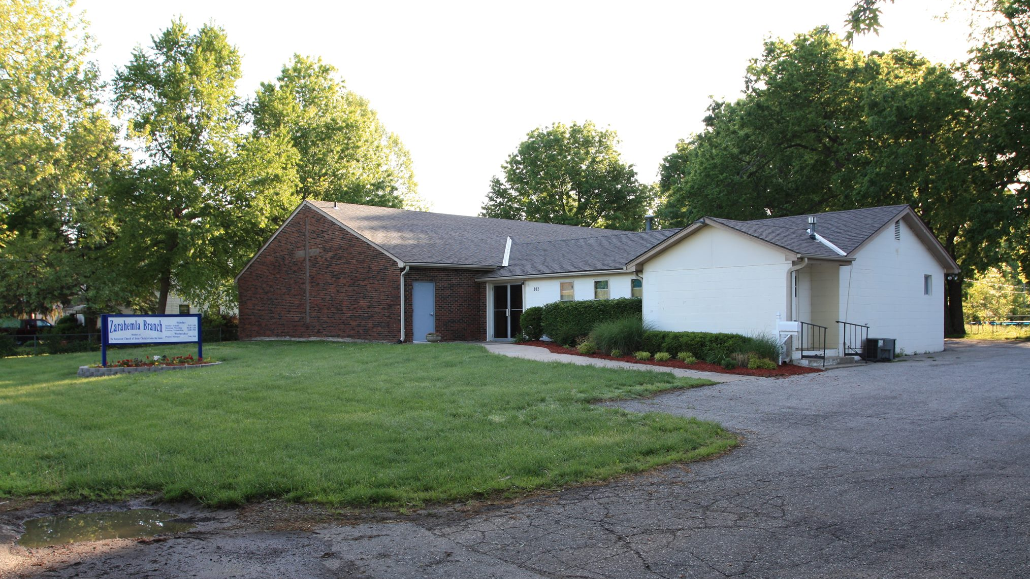
Zarahemla Branch
Announcement

Slide 5
Zarahemla Branch
Announcement

Slide 6
Zarahemla Branch
Announcement

Slide 7
Psalms 72:15
And he shall live, and to him shall be given of the gold of Sheba; prayer also shall be made for him continually; and daily shall he be praised.
Acts 6:4
But we will give ourselves continually to prayer, and to the ministry of the word.
Alma 16:222
Yea, and when you do not cry unto the Lord, let your hearts be full, drawn out in prayer unto him continually for your welfare, and also for the welfare of those who are around you.

Slide 8
You have given so much of yourself and still have more to share When others closes their hearts to love you always seem to care My mother, my friend how gracious you've shown your love to me You give of your heart so freely for all of the world to see
A beautiful rose and petals from a flower, the root of the family tree My mother, my friend a gift from God you mean all the world to me There is no replacement for the unconditional love of a mother When God formed her he broke the mold for there could never be another You're just like a tiger in a den that’s protective of her lair The sharing of your countless love shows others that you care We sometimes forget that a mother is a blessing from above My mother, my friend a deep well of never ending love

Slide 9
Teacher Kevin McMilian
Sermon

