Slide 1
Zarahemla Branch
We are experiencing technical difficulties.
We will return shortly.

Slide 2


Slide 3

Zarahemla Branch
Deacon Andrew Canfield, Preaching
Elder David Bronson, Presiding
August 26, 2018

Slide 4
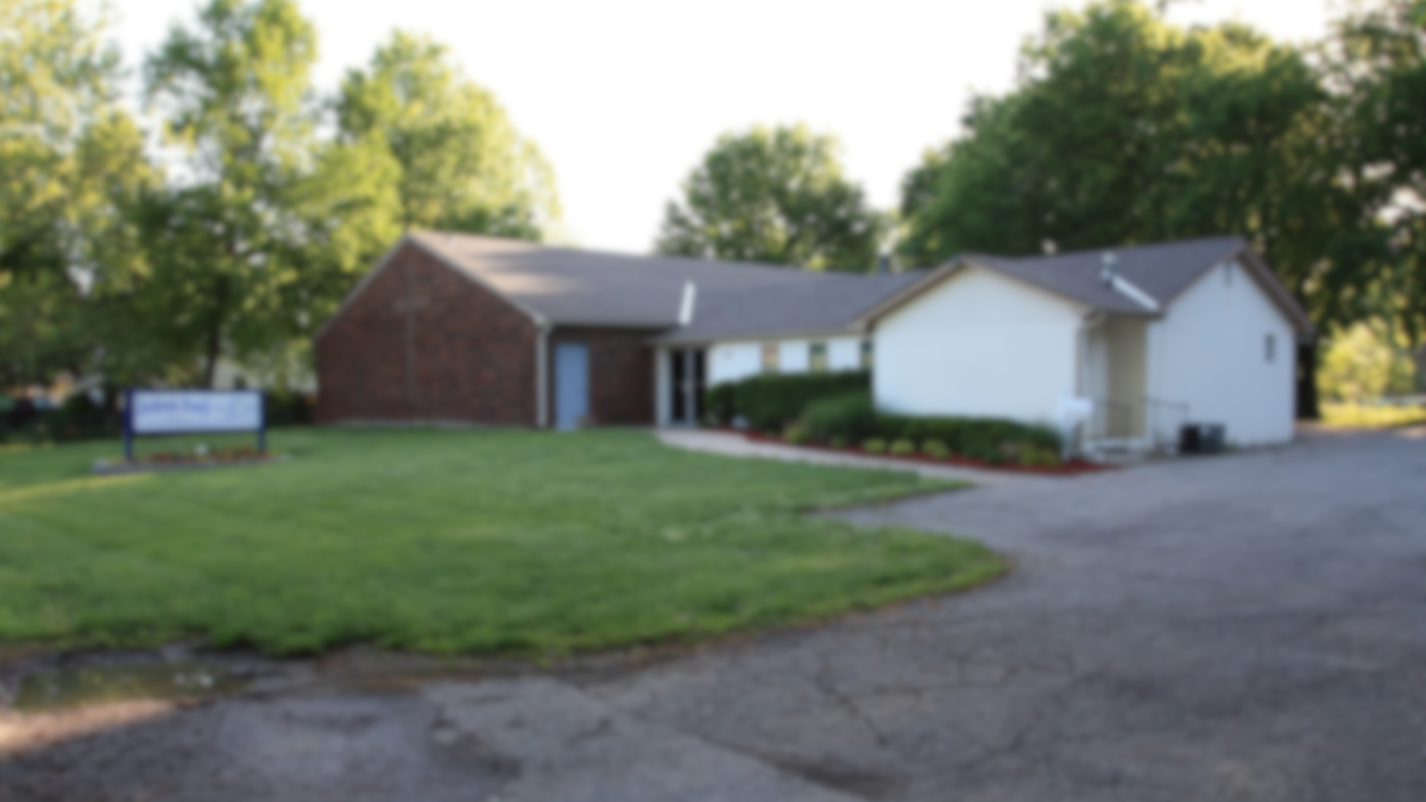
Zarahemla Branch

Slide 5
Zarahemla Branch
Due to a congregational prayer service, this morning’s broadcast will
not begin until 10:15 AM CST.

