Slide 1
Zarahemla Branch
We are experiencing technical difficulties.
We will return shortly.

Slide 2


Slide 3

Zarahemla Branch
Deacon Andrew Canfield, Preaching
Elder David Bronson, Presiding
August 26, 2018

Slide 4
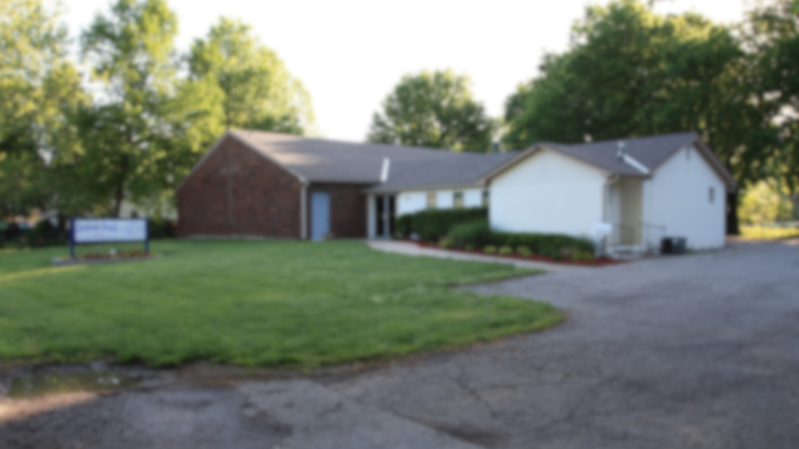
Zarahemla Branch

Slide 5
Zarahemla Branch
Please join us tonight at 6:00 PM CDT for an ordination service.
Kelvin Henson will be ordained to the office of Elder.

