Slide 1
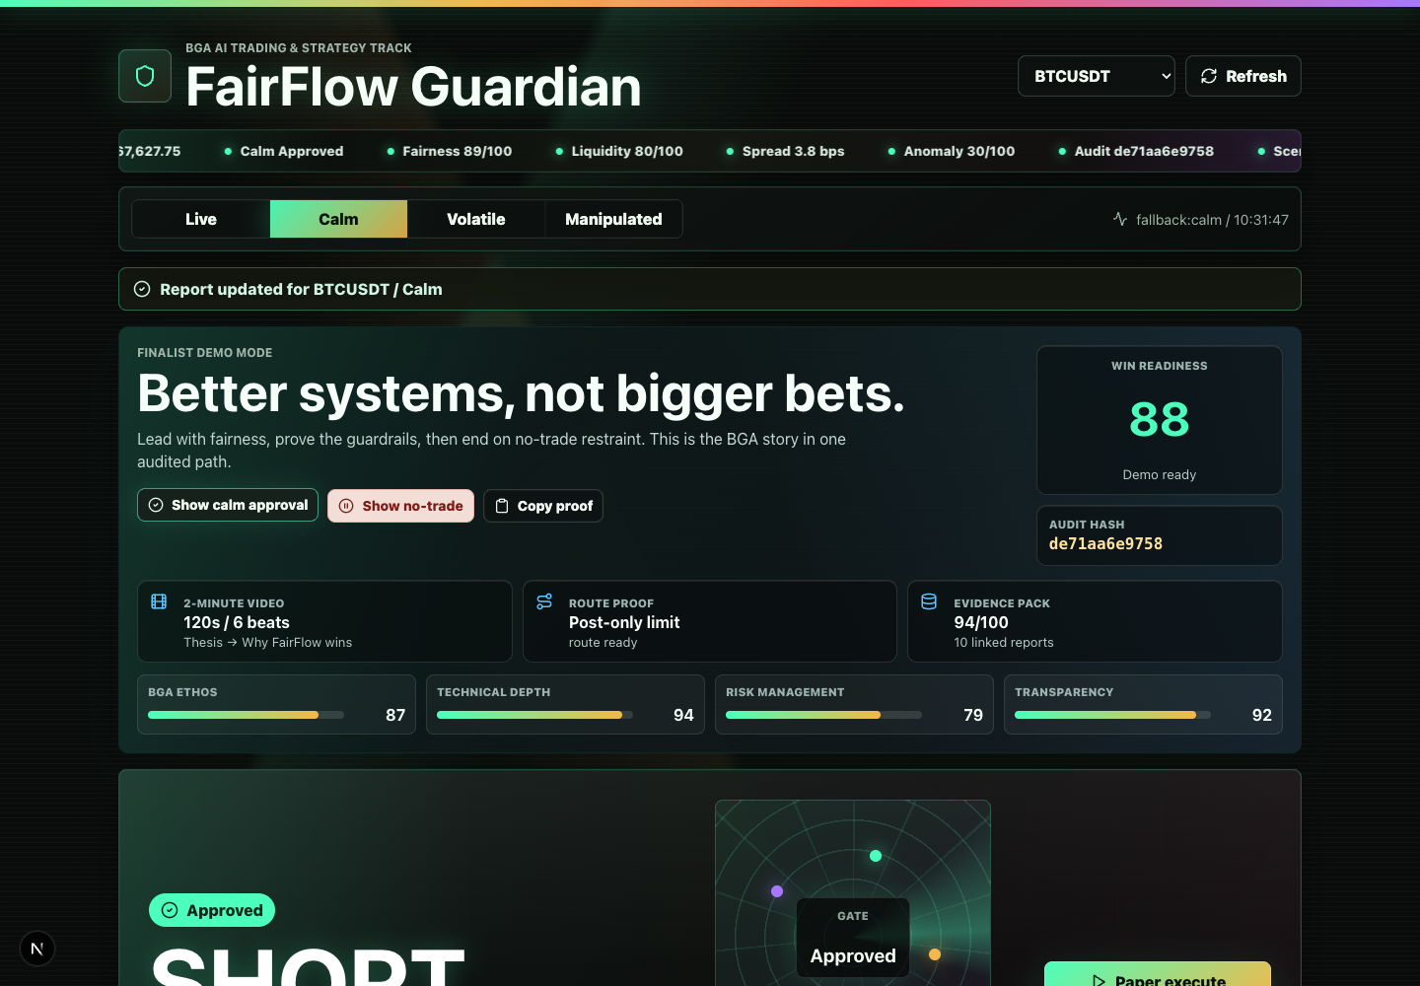
BGA AI TRADING & STRATEGY TRACK
FairFlow Guardian
The AI trading safety layer whose strongest signal is when not to trade.
Built for the BGA AI Trading & Strategy Track: fairer routing, explainable agents, risk gates, and audit proofs.
Readiness
Evidence
Route
88/100
94/100
Post-only limit
Better systems, not bigger bets.
FairFlow Guardian / 01
Video-ready deck: 2:00
Notes:
0:00-0:15
FairFlow Guardian is an AI trading safety layer for the BGA track. It proves when a market is fair enough to review, and when no trade is the healthiest action.

Slide 2
BGA AI TRADING & STRATEGY TRACK
Most trading bots answer the wrong question.
Retail users do not only need a prediction. They need market-quality evidence before a route is allowed.
Information gap
Retail friction
Unsafe autonomy
Institutions see depth
Costs hide in bps
Bots can run away
FairFlow changes the question from “will this make money?” to “is this market fair enough to route at all?”
FairFlow Guardian / 02
Video-ready deck: 2:00
Notes:
0:15-0:34
The retail problem is not only prediction. A trade can look profitable and still be unfair because of hidden costs, thin liquidity, spoofing, leverage pressure, or opaque automation.

Slide 3
BGA AI TRADING & STRATEGY TRACK
The product is a guarded agent committee.
The strategy agent can propose. It cannot execute alone.
1
2
3
4
5
Market data
Agent debate
Fairness pass
Route gate
Audit hash
Live Bybit data or deterministic fallback. Same typed backend. Same audit hash.
FairFlow Guardian / 03
Video-ready deck: 2:00
Notes:
0:34-0:54
FairFlow turns public market data into liquidity, volatility, cost, manipulation, and risk features. The strategy agent can propose, but execution requires fairness, risk, route, and audit gates.

Slide 4
BGA AI TRADING & STRATEGY TRACK
The finalist demo runway.
1. Runway
Lead with win readiness, audit hash, evidence pack, route proof, and calm approval.
2. Submission Kit
Open the 2-minute path, proof block, generated assets, and rubric-aligned checklist.
3. No-trade proof
Switch to Manipulated and show restraint as a protective outcome, not a failure.
FairFlow Guardian / 04
Video-ready deck: 2:00
Notes:
0:54-1:18
In the demo, start with the Competition Runway: readiness, audit hash, evidence pack, route proof, and calm paper approval. Then switch to Manipulated and show the refusal.

Slide 5
BGA AI TRADING & STRATEGY TRACK
No-trade is the proof.
Same system, same asset, different market integrity. Calm can route. Manipulated cannot.
Calm scenario
Manipulated
APPROVED
BLOCKED
SHORT / fairness 89/100
NO TRADE / fairness 50/100
Hidden cost: 3.8 bps. Route: Post-only limit.
No execution route unlocks when market quality fails.
One click proves the thesis: restraint is a product feature.
FairFlow Guardian / 05
Video-ready deck: 2:00
Notes:
1:18-1:41
The best proof is the manipulated case. Same system, same asset, lower market integrity. FairFlow blocks the trade, locks the route, and records why.

Slide 6
BGA AI TRADING & STRATEGY TRACK
Why FairFlow wins.
BGA ethos
reduces information asymmetry for retail
Technical depth
agent committee + typed API + Solidity anchor kit
Risk design
costs, liquidation, volatility, manipulation, route gates
Transparency
evidence pack, receipt, provenance, audit hash
Final demo move: copy the evidence pack and show the audit hash.
Better systems, not bigger bets.
FairFlow Guardian / 06
Video-ready deck: 2:00
Notes:
1:41-2:00
Close on the judging criteria: retail fairness, agentic depth, risk-first design, and inspectable proof. Better systems, not bigger bets.

