Slide 1
A/
REIMAGINE HEALTH / EMED
Adherence OS
An AI decision layer for safer at-home GLP-1 adherence support
01
02
03
04
PREDICT
EXPLAIN
TEST
REVIEW
Local ML + typed evidence map + deterministic safety
SYNTHETIC PROTOTYPE / NOT CLINICAL VALIDATION
01

Slide 2
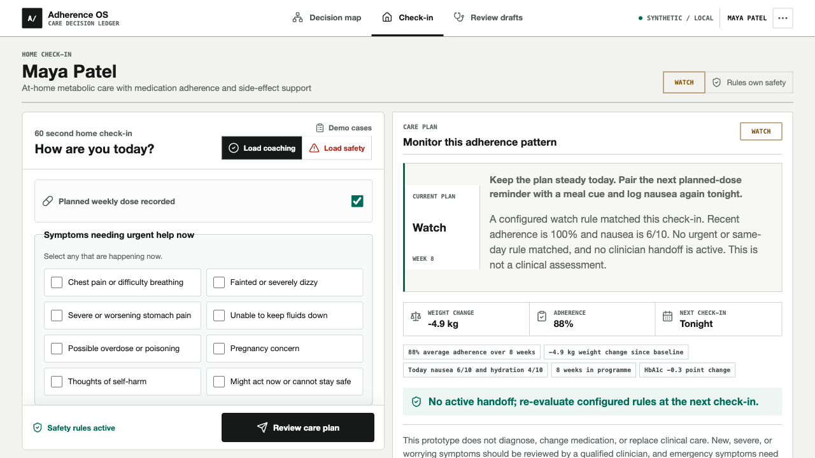
THE PATIENT NEED
Chronic care breaks in the time between appointments
01
Friction accumulates
Symptoms, routine changes, and missed doses become a pattern before the next appointment.
02
Data is hard to interpret
Patients should not have to decide which home signal matters or when to seek help.
03
Clinical attention is scarce
Care teams need a concise record that makes rule-matched review evidence obvious.
SYNTHETIC PROTOTYPE / NOT CLINICAL VALIDATION
02

Slide 3
DECISION ARCHITECTURE
One ledger separates model inference from deterministic safety
OBSERVE
PREDICT
EXPLAIN
OWN
Home check-in
Local risk model
Evidence map
Local review draft
→
→
→
Dose event, symptoms, hydration, routine, language
Prospective score, marginal bounds, exact decomposition
Context signal, model contributor, tested-action comparison
Rule trigger, in-memory state, unsent draft, audit trail
DETERMINISTIC SAFETY OVERRIDE
Red flags suppress coaching and every tested action, even when the model abstains.
SYNTHETIC PROTOTYPE / NOT CLINICAL VALIDATION
03

Slide 4
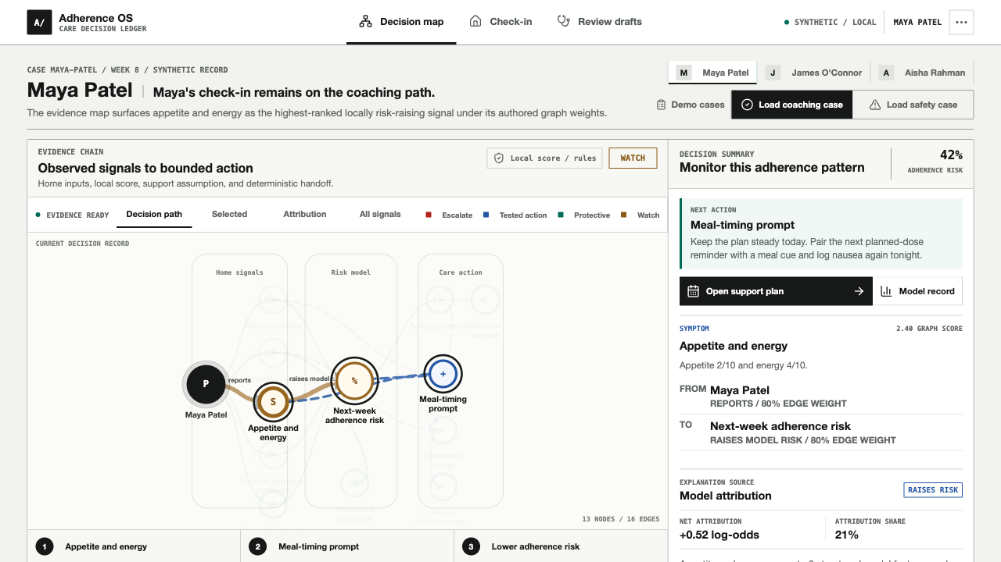
COACHING STATE
The first screen is an inspectable decision, not a dashboard
01 / CURRENT CASE
42% supported score
Risk-raising signal visible
Watch / no handoff

Slide 5
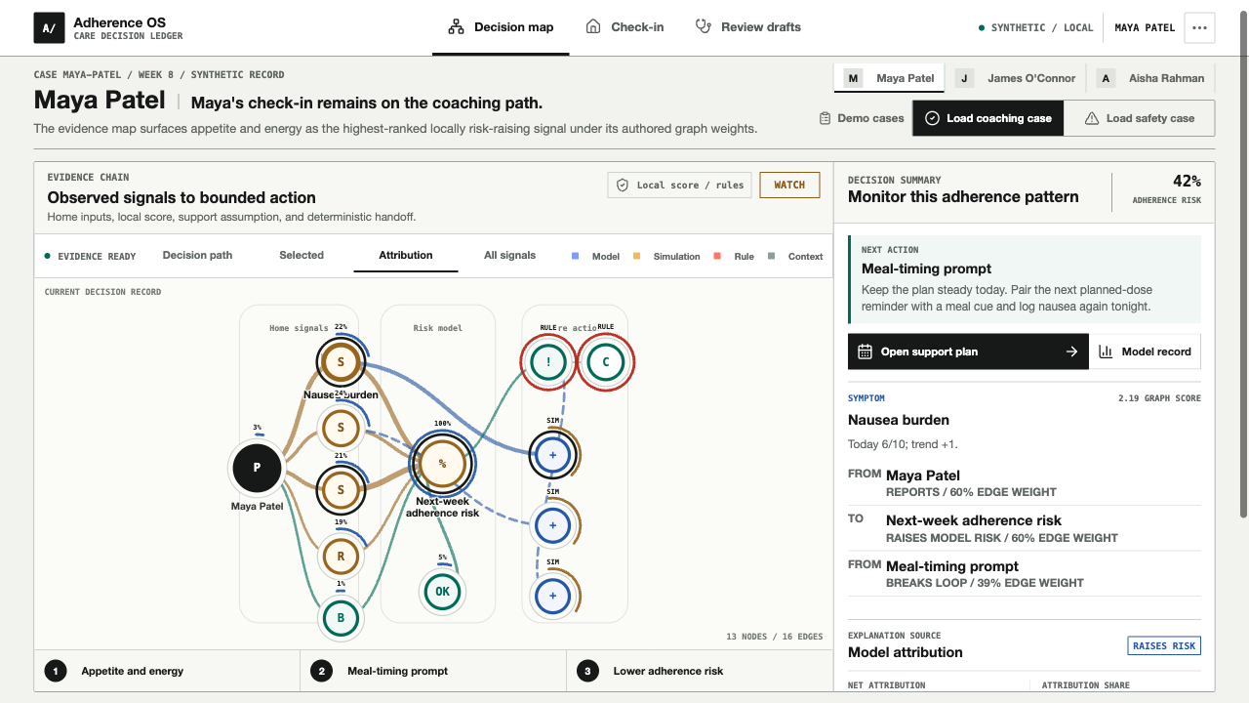
EXPLAINABILITY
The map separates context from model contribution
02 / ATTRIBUTION
Appetite + energy
Nausea burden
Typed provenance

Slide 6
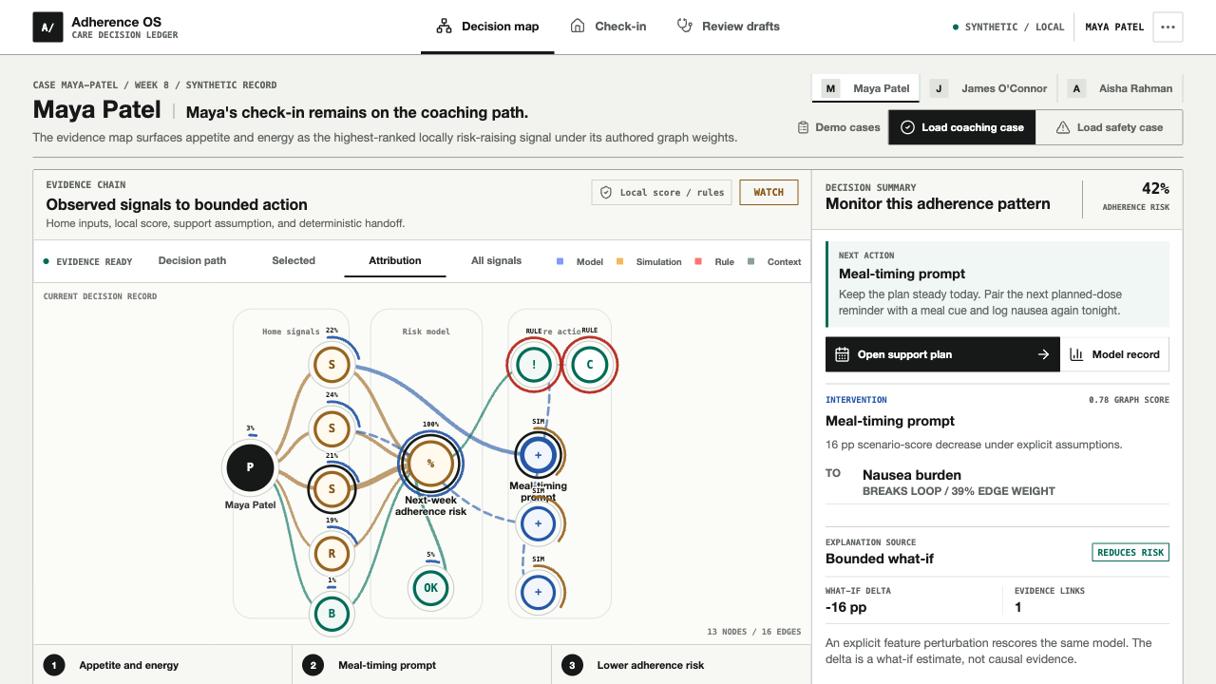
BOUNDED PLANNING
Tested actions are transparent assumptions, not causal claims
03 / TESTED ACTION
Meal timing
−16 pp scenario score
Marginal bounds only

Slide 7
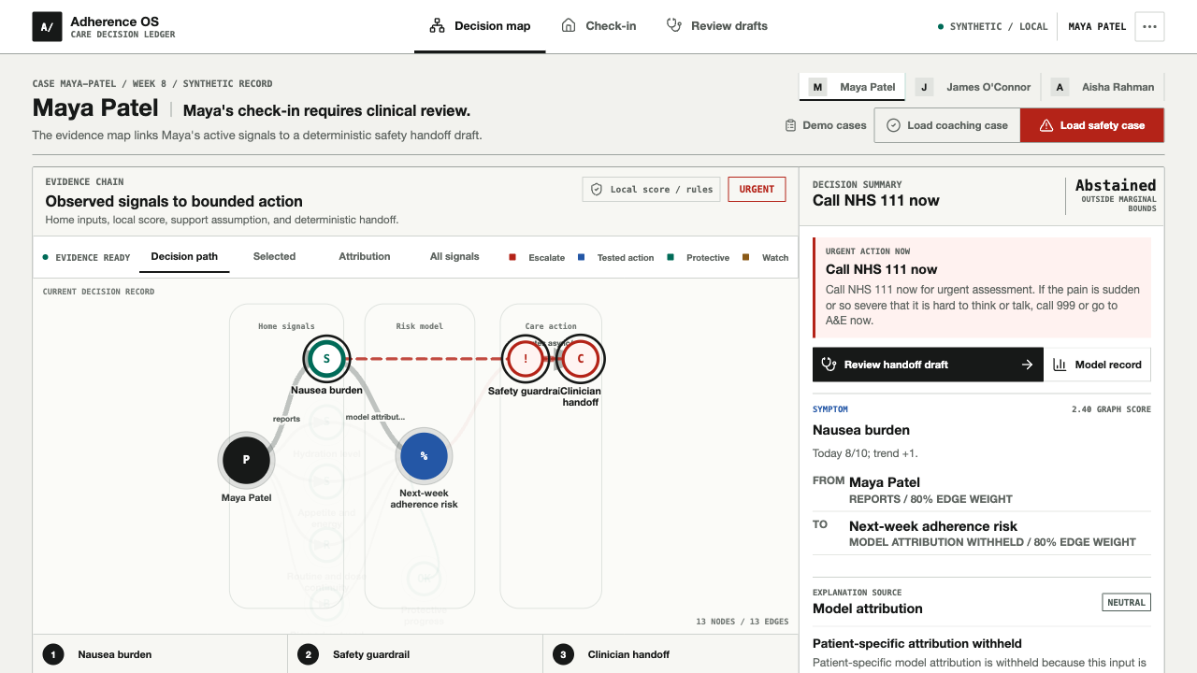
SAFETY OVERRIDE
When red flags appear, the model abstains and safety still acts
04 / SAFETY CASE
Model abstained
Actions suppressed
Local review draft

Slide 8
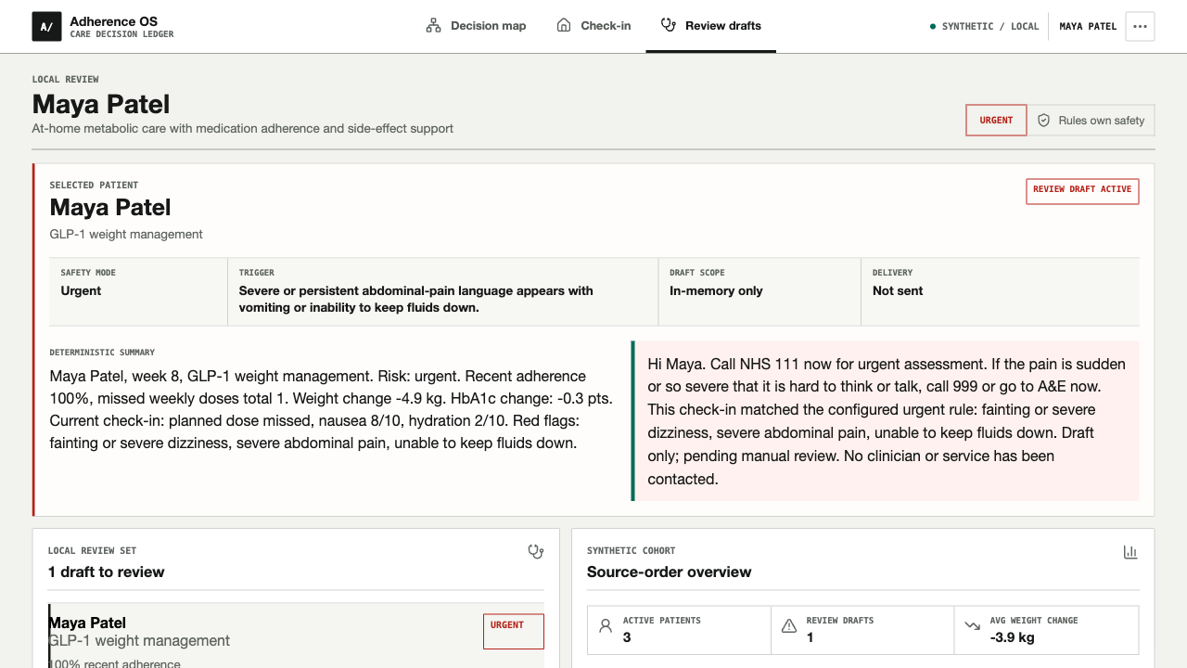
HUMAN OWNERSHIP
A local review draft is prepared, never sent or prescribed
05 / HANDOFF
Rule match
In-memory only
Not sent

Slide 9
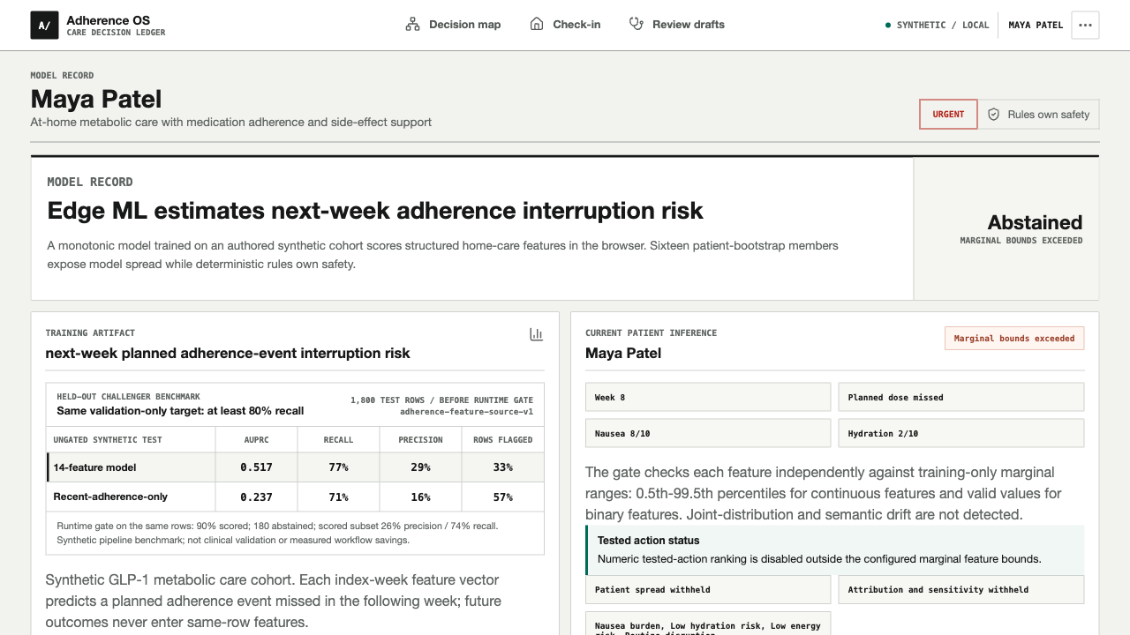
TECHNICAL PROOF
The ML layer is prospective, local, and allowed to abstain
06 / MODEL RECORD
AUPRC 0.517 / 0.237
Rows flagged 33% / 57%
Runtime coverage 90%

Slide 10
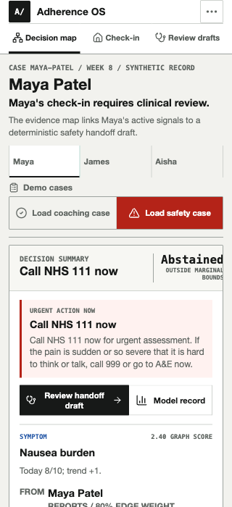
WHY THIS CAN WIN
Judges can see the value, novelty, and safety in one live path
IMPACT
Catch adherence friction early and make escalation easier for patients.
INNOVATION
Combine prospective edge ML, an evidence map, and independent safety.
FEASIBILITY
Run keyless with synthetic data, local inference, and deterministic safety.
DEMO QUALITY
Switch from a supported coaching case to a local, unsent safety draft in one click.
PREDICT → EXPLAIN → TEST → HAND OFF SAFELY
SYNTHETIC PROTOTYPE / NOT CLINICAL VALIDATION
10

