Slide 1
DevOps Project 2 Presentation – Diagram Generation Pipeline
Kevin & Akshay

Slide 2
Table of Contents
Introduction
Diagram
Technologies Used Overview
Live Demo
Q&A

Slide 3
Introduction…

Slide 4
Repository Link
https://github.com/kevinmenotyou/devops_project2

Slide 5
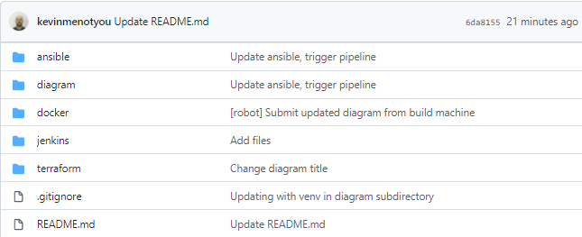
Git Hub Structure
Each technology used is stored in its own folder for clarity

Slide 6
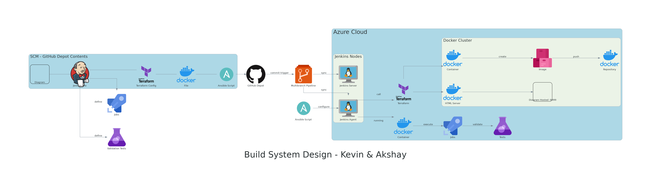
Key Components:
Diagram.py
3 Azure VMs (Ansible, Jenkins Server, Jenkins Agent)
SCM – GitHub
Configuration Management – Ansible
Infrastructure as Code - Terraform
Containerization – Docker
CI/CD – Jenkins Multibranch Pipeline - Diagram Pipeline

Slide 7
Diagram.py
100% Version Controlled
Using python library diagram
Changes are made in code, then image is subsequently generated
Advantages:
Changes are tracked
Coders can design diagram without help of artists
Helps multiple users collaborate

Slide 8
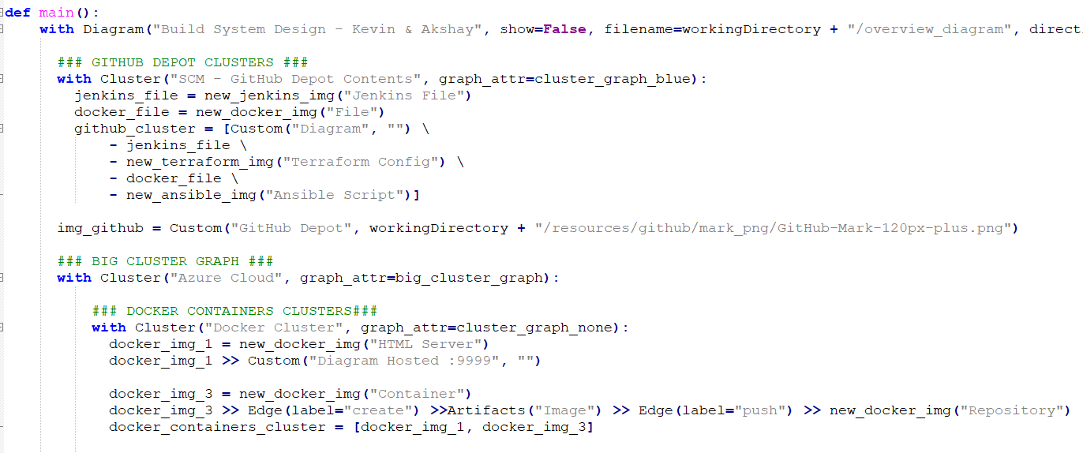
Diagram.py

Slide 9
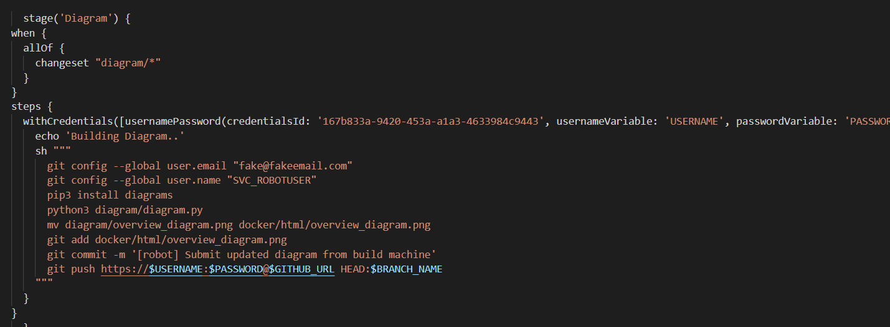
Diagram Generation & Commit to Depot

Slide 10
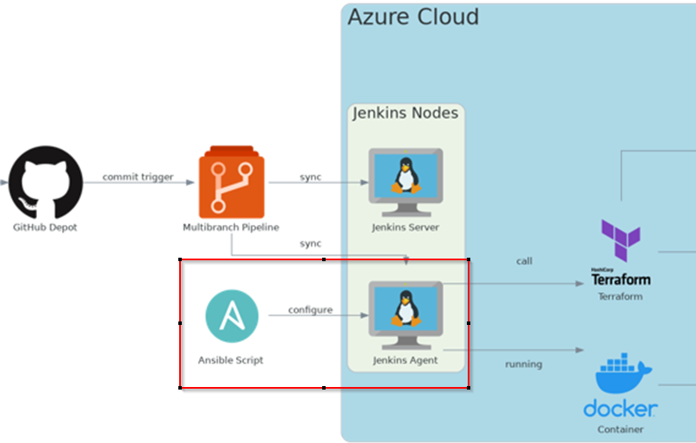
Ansible Overview – Configuration Management

Slide 11
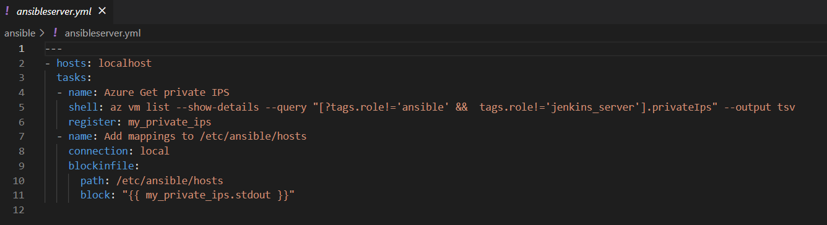
Ansible – ansibleserver.yml
Azure is queried using azure CLI to get the private IPs all active VMs, avoiding those with the tag ansible, or jenkins_server
az vm list –show-details –query …

Slide 12

Ansible – ansibleserver.yml
Job only runs on ansible host to modify the /etc/ansible/hosts files
Puts all available private_ips in ansible-managed block using built-in block_in_file command
In our case, we only have one jenkins build agent we’d like to automate installations for
Since ansible agent is hosted in azure, we can use the private ips for ssh

Slide 13
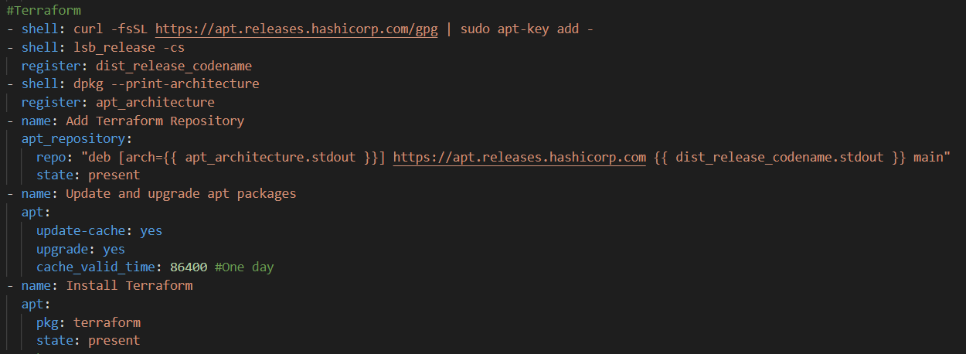
Ansible – main.yml
Automated installation of Terraform, Docker, and Python Packages

Slide 14
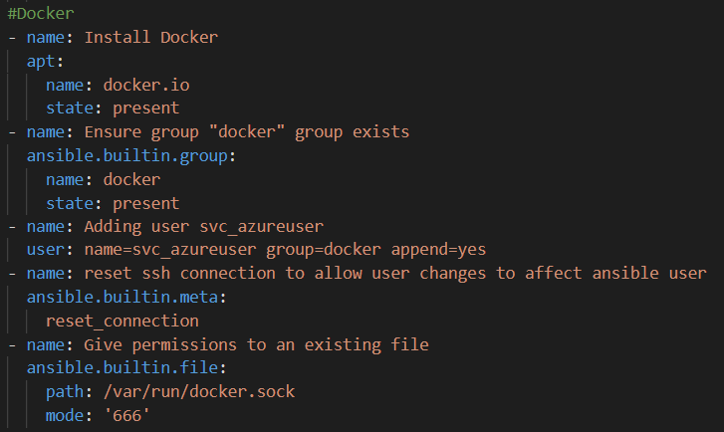
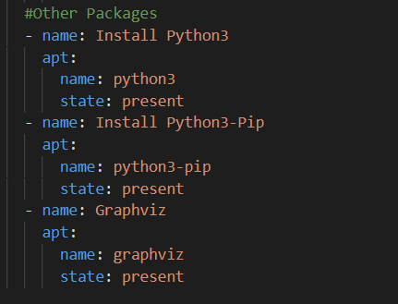
Ansible – main.yml
Automated installation of Terraform, Docker, and Python Packages

Slide 15
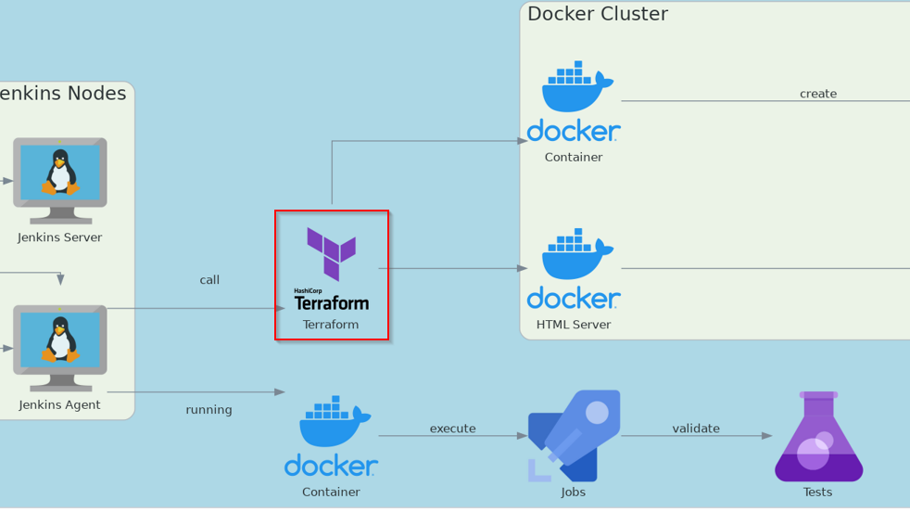
Terraform Overview
Terraform is called directly from the Jenkins Agent to ensure we have the right docker infrastructure available

Slide 16
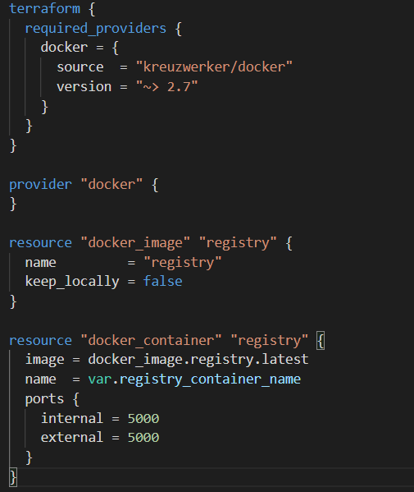
Terraform Overview – Infrastructure as Code
We configured two terraform solutions
The first solution hosts a local docker registry, for us to be able to publish our own images

Slide 17
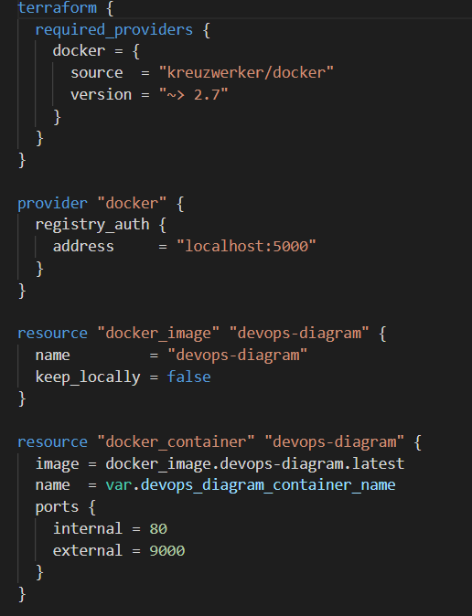
Terraform Overview – Infrastructure as Code
We configured two terraform solutions
The second solution loads our published Devops-Image docker image, based on NGinx, which hosts our Diagram on a web server in simple HTML
It defines a connection to the local registry localhost:5000 where the devops-diagram image is published

Slide 18
Terraform Overview – Infrastructure as Code
Originally we looked into having a single terraform solution for both the registry and the devops-diagram image hosted on the registry
However, the devops-diagram has a hard dependency on the registry both being spawned, and the devops-diagram image being published, which happens later in the pipeline
As a result, we chose to manage two terraform solutions

Slide 19
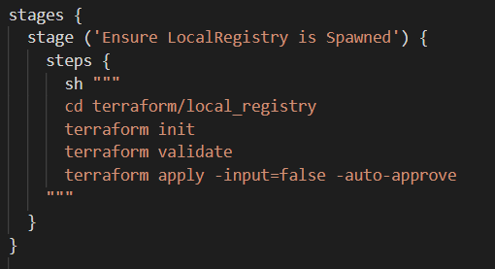
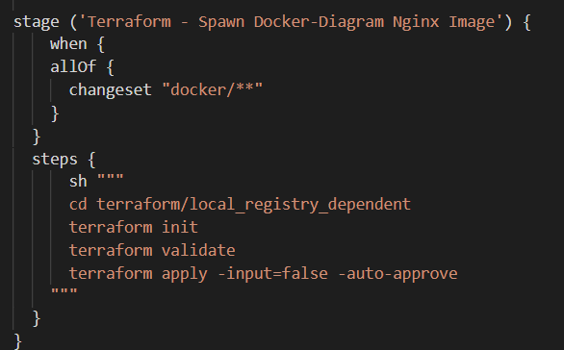
Terraform Pipeline
Ensuring local-registry is spawned
Later… ensuring devops-diagram is spawned

Slide 20
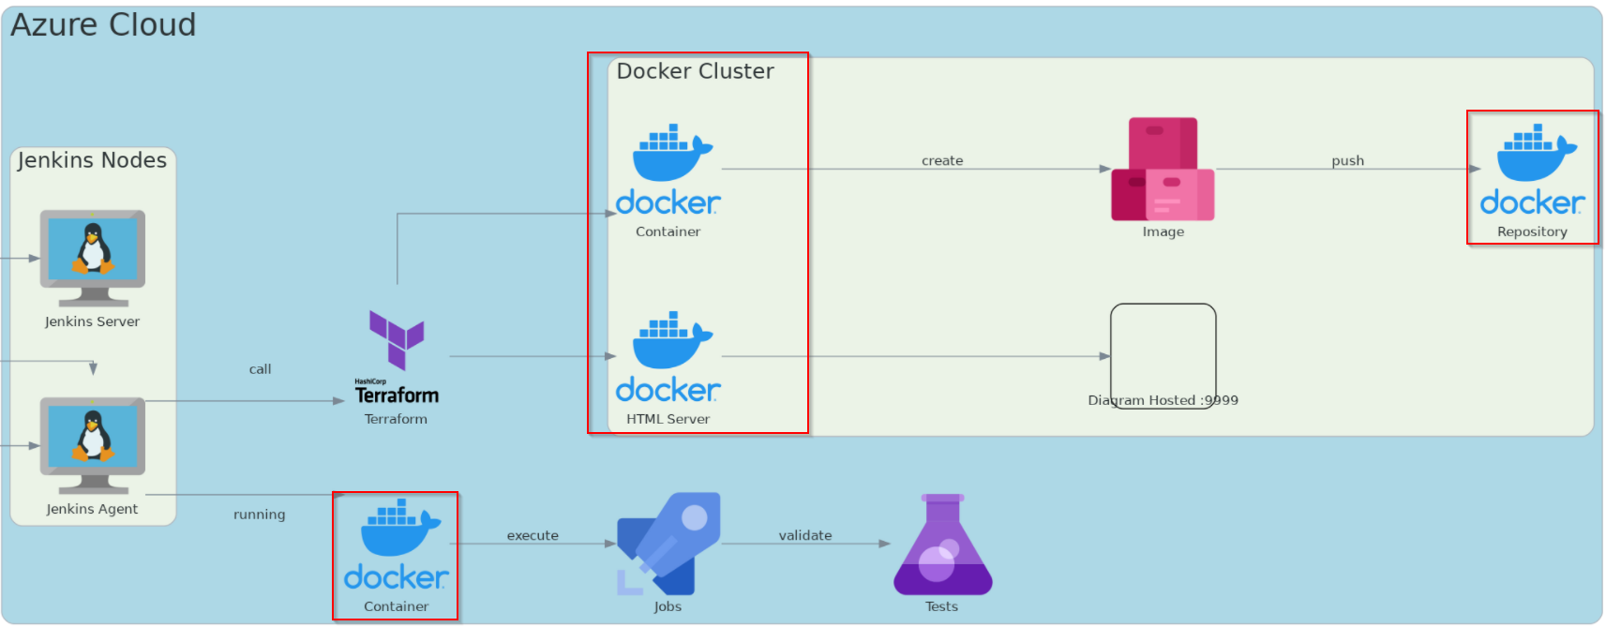
Docker Overview

Slide 21
Docker Overview - Containerization
Both the Jenkins server and Jenkins agent are running as docker containers as seen in assignment 2
The local registry is hosted in a docker container
The Devops Diagram is hosted in a docker container

Slide 22
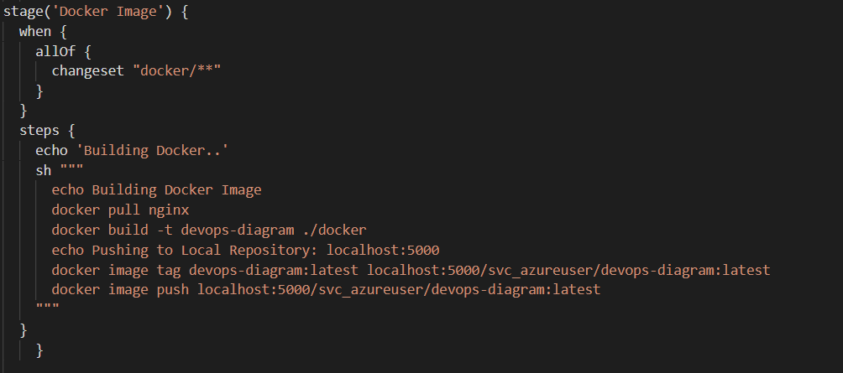

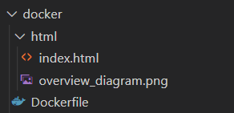
Devops-Diagram - Docker Image Generation Pipeline
Image is submitted to docker/html directory, where it triggers the generation of a new Docker Image for us to host
Dockerfile & Directory Structure

Slide 23
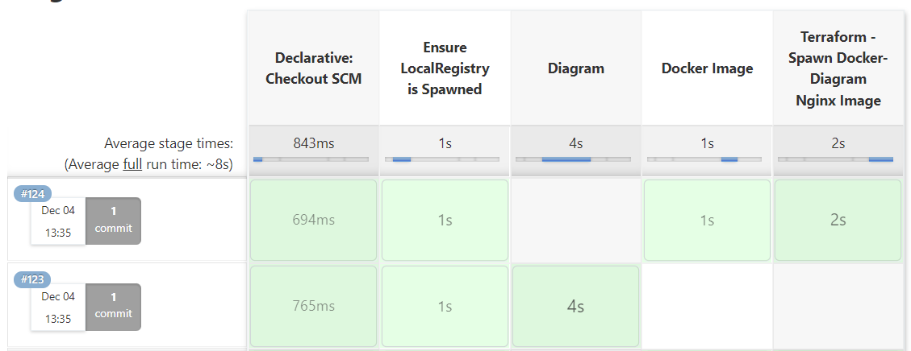
Tying it all together… Jenkins
Multibranch pipeline picks up on pull-requests
Some validation tests are ran as well (e.g. terraform validate)

Slide 24
Jenkins
Per commit path, different jobs are ran
Changes to diagram/ will trigger diagram generation
If successful, the diagram will be submitted under docker/html/
Changes made to docker/ trigger the rebuild of the image, as well as the push to the local registry
Later this is new image is spawned by terraform

Slide 25

DEMO

Slide 26
Q & A

