Slide 1
DevOps Project 2 Presentation – Diagram Generation Pipeline
Kevin Hutchison

Slide 2
Table of Contents
Introduction
Q&A
Diagram
Technologies Used Overview
Live Demo

Slide 3
What are 5 R strategies of Cloud Rationalization in Azure?
Rehost
Lifting and shifting an application to a new environment
Refactor
Updating application code to improve update times, portability, and cloud efficiency
Rearchitect
Changing application architecture to improve application scale and agility
Rebuild
Rebuilding application from cloud compatible to cloud native
Replace
Schedule workload for replacement, removing it from the transformation effort

Slide 4
What is application modernization?
Updating applications to be scalable, cloud-native, on new technology stacks
Including:
New coding languages, new frameworks, new infrastructure
Extends the lifespan of applications while also taking advantage of innovations

Slide 5
What is GitOps and when do you use it?
A practice using Git version control used for setting up declarative pipelines, infrastructure and configurations – in the name of automation
Fully versioned - git version control acts as single source for all the infrastructure needs and configurations
GitOps requires 3 components: IaC, CI/CD, PR

Slide 6
What are the differences between GitOps and DevOps?
DevOps promotes a cultural change that enables development teams and operations teams to collaborate effectively
GitOps provides a toolset and framework through which to apply DevOps practices

Slide 7
Introduction…

Slide 8
Repository Link
https://github.com/kevinmenotyou/devops_project2

Slide 9
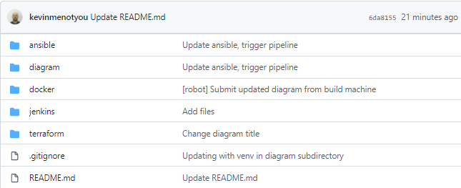
Git Hub Structure
Each technology used is stored in its own folder for clarity

Slide 10
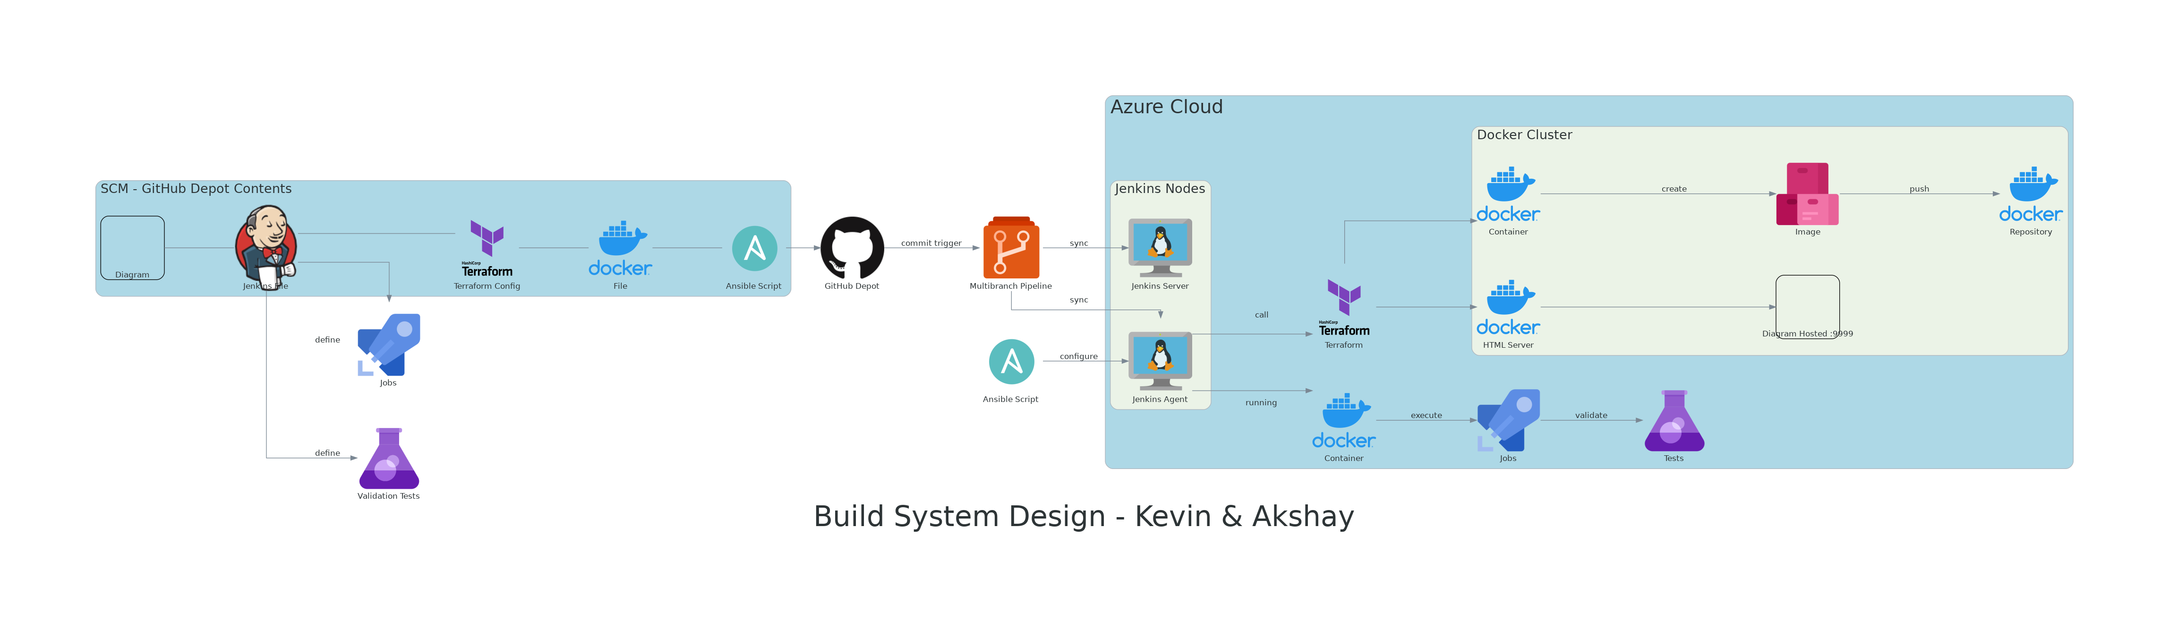
Key Components:
Diagram.py
3 Azure VMs (Ansible, Jenkins Server, Jenkins Agent)
SCM – GitHub
Configuration Management – Ansible
Infrastructure as Code - Terraform
Containerization – Docker
CI/CD – Jenkins Multibranch Pipeline - Diagram Pipeline

Slide 11
Diagram.py
100% Version Controlled
Using python library diagram
Changes are made in code, then image is subsequently generated
Advantages:
Changes are tracked
Coders can design diagram without help of artists
Helps multiple users collaborate

Slide 12
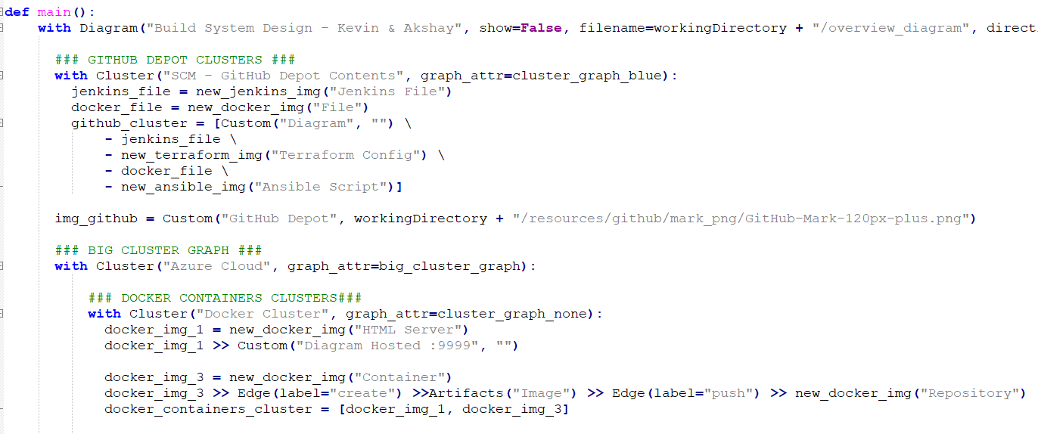
Diagram.py

Slide 13
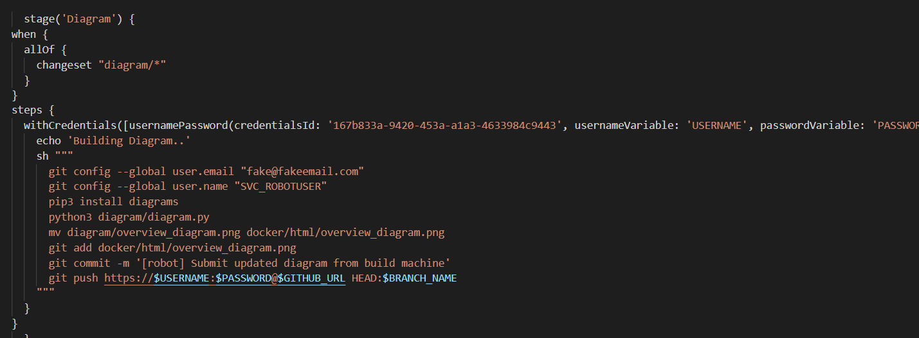
Diagram Generation & Commit to Depot

Slide 14
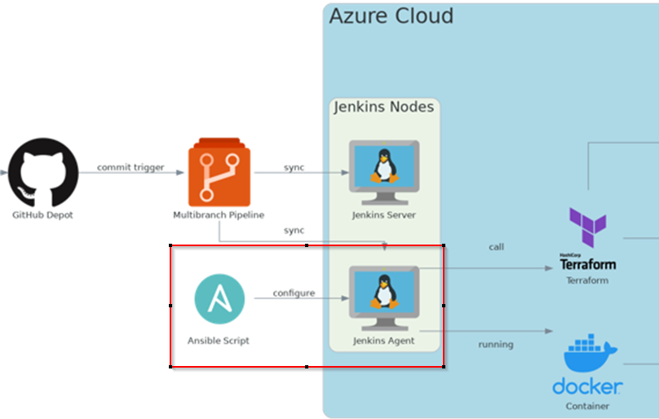
Ansible Overview – Configuration Management

Slide 15
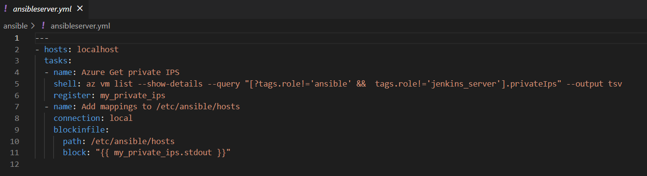
Ansible – ansibleserver.yml
Azure is queried using azure CLI to get the private IPs all active VMs, avoiding those with the tag ansible, or jenkins_server
az vm list –show-details –query …

Slide 16

Ansible – ansibleserver.yml
Job only runs on ansible host to modify the /etc/ansible/hosts files
Puts all available private_ips in ansible-managed block using built-in block_in_file command
In our case, we only have one jenkins build agent we’d like to automate installations for
Since ansible agent is hosted in azure, we can use the private ips for ssh

Slide 17
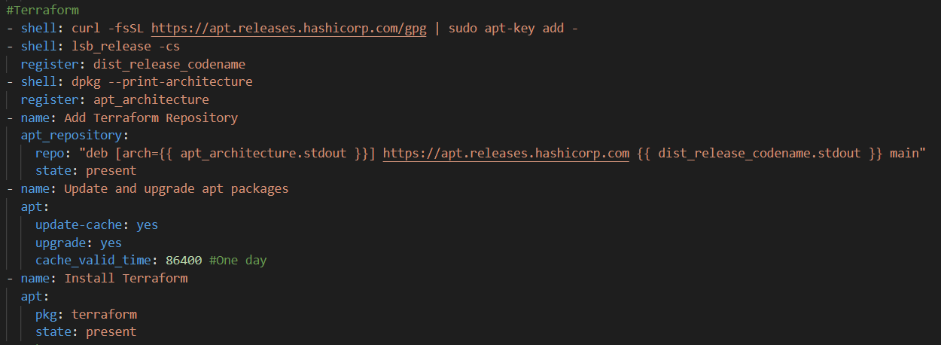
Ansible – main.yml
Automated installation of Terraform, Docker, and Python Packages

Slide 18
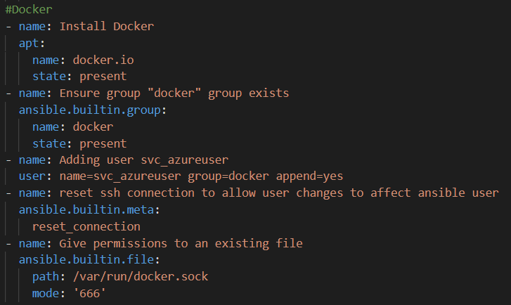
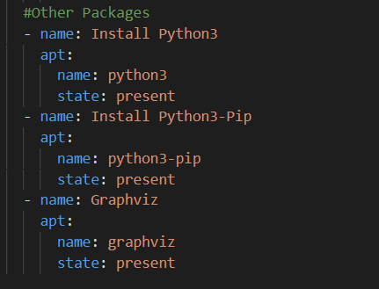
Ansible – main.yml
Automated installation of Terraform, Docker, and Python Packages

Slide 19
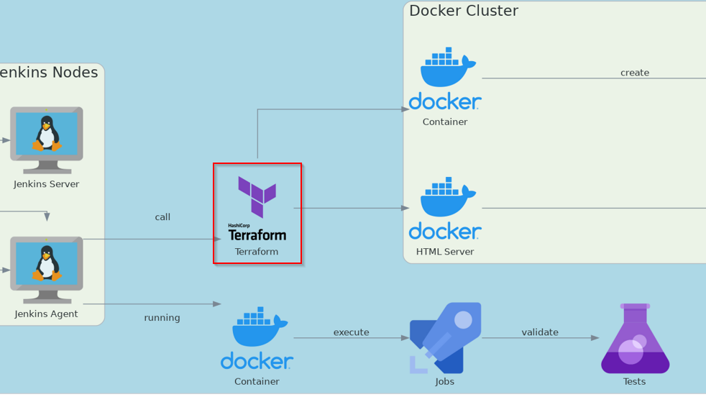
Terraform Overview
Terraform is called directly from the Jenkins Agent to ensure we have the right docker infrastructure available

Slide 20
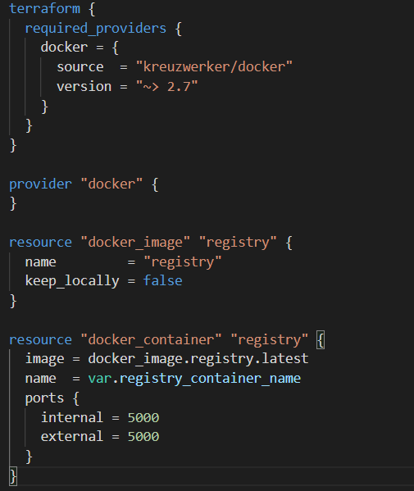
Terraform Overview – Infrastructure as Code
We configured two terraform solutions
The first solution hosts a local docker registry, for us to be able to publish our own images

Slide 21
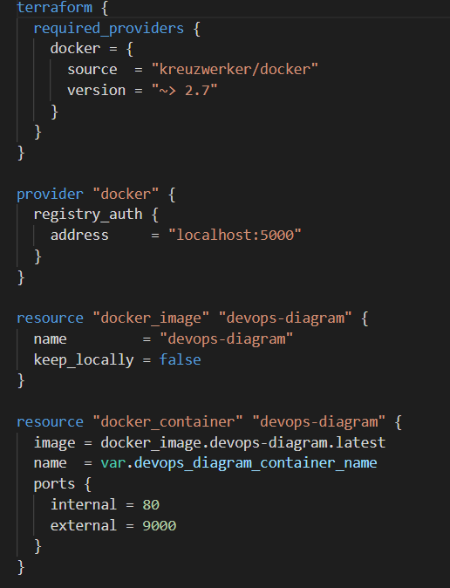
Terraform Overview – Infrastructure as Code
We configured two terraform solutions
The second solution loads our published Devops-Image docker image, based on NGinx, which hosts our Diagram on a web server in simple HTML
It defines a connection to the local registry localhost:5000 where the devops-diagram image is published

Slide 22
Terraform Overview – Infrastructure as Code
Originally we looked into having a single terraform solution for both the registry and the devops-diagram image hosted on the registry
However, the devops-diagram has a hard dependency on the registry both being spawned, and the devops-diagram image being published, which happens later in the pipeline
As a result, we chose to manage two terraform solutions

Slide 23
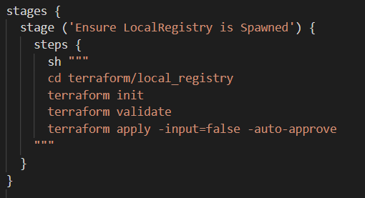
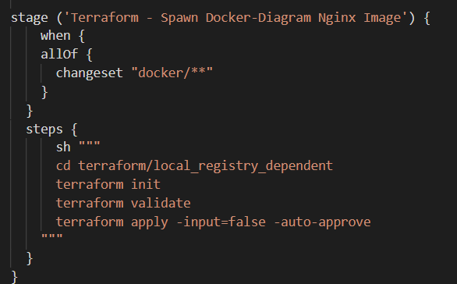
Terraform Pipeline
Ensuring local-registry is spawned
Later… ensuring devops-diagram is spawned

Slide 24
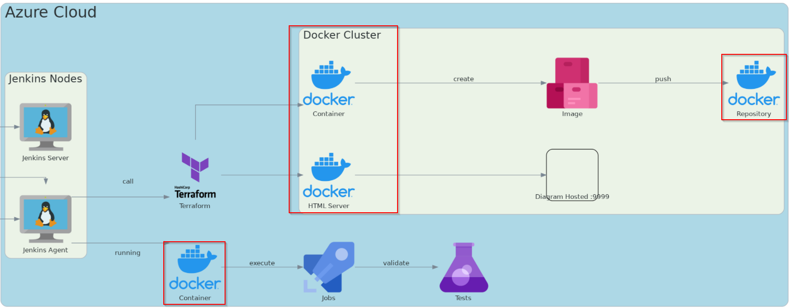
Docker Overview

Slide 25
Docker Overview - Containerization
Both the Jenkins server and Jenkins agent are running as docker containers as seen in assignment 2
The local registry is hosted in a docker container
The Devops Diagram is hosted in a docker container

Slide 26
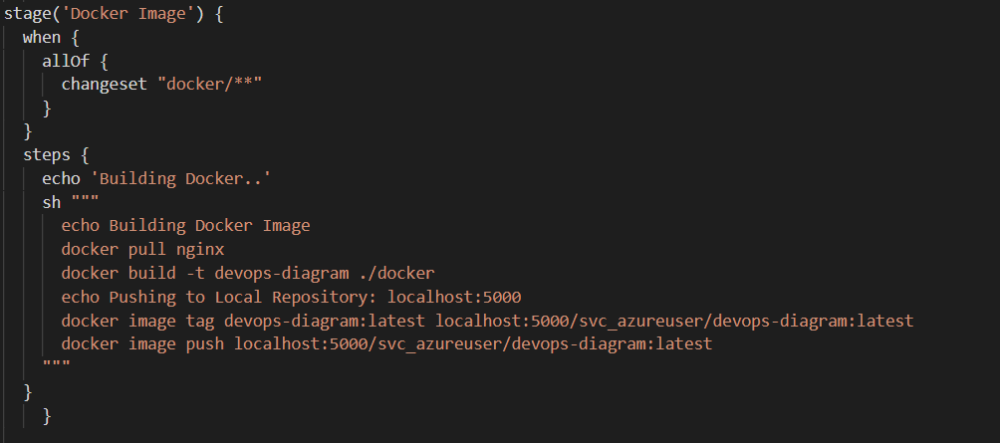

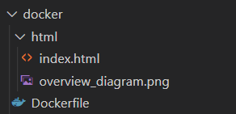
Devops-Diagram - Docker Image Generation Pipeline
Image is submitted to docker/html directory, where it triggers the generation of a new Docker Image for us to host
Dockerfile & Directory Structure

Slide 27
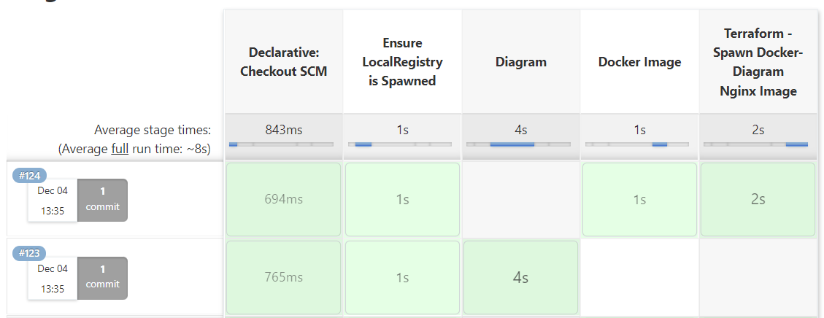
Tying it all together… Jenkins
Multibranch pipeline picks up on pull-requests
Some validation tests are ran as well (e.g. terraform validate)

Slide 28
Jenkins
Per commit path, different jobs are ran
Changes to diagram/ will trigger diagram generation
If successful, the diagram will be submitted under docker/html/
Changes made to docker/ trigger the rebuild of the image, as well as the push to the local registry
Later this is new image is spawned by terraform

Slide 29

DEMO

