Slide 1
CS574
Computer vision and machine learning
(Assignment #2)
Created by:-
( Group 07 )
Aditya(160101010)
Avinash(160101018)
Phool Chandra(160101051)
Savinay(160101062)
Kevin(160101063)

Slide 2
Fusion Network for Face-based Age Estimation

Slide 3
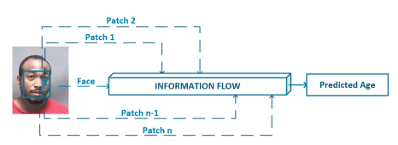
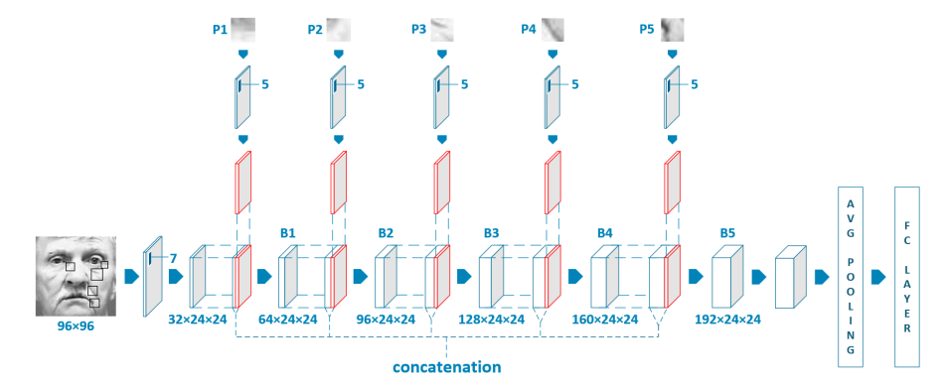
Fusion Network
The method proposed here consists of three components:-
1 The facial patch selection
2 The convolutional network
3 The age regression

Slide 4
Results
Methods | MAE
OR - CNN | 3.27
DEX | 3.25
Ranking - CNN | 2.96
baseline | 3.05
FusionNet + FAttrs + Cls | 3.18
FusionNet + Adap + Cls | 2.95
FusionNet + Adap + Reg | 2.82
There are two common used metrics to evaluate the performance for age estimation models:
Mean Absolute Error(MAE)
Cumulative Score (CS)
Methods | CS(n=1) | CS(n=2) | CS(n=3) | CS(n=4) | CS(n=5) | CS(n=6) | CS(n=7) | CS(n=8)
Baseline | 30.06% | 51.07% | 63.51% | 74.00% | 82.70% | 88.07% | 92.45% | 95.04%
FusionNet + FAttrs + Cls | 29.94% | 50.51% | 63.02% | 73.26% | 82.02% | 87.50% | 91.94% | 94.96%
FusionNet + Adap + Cls | 31.22% | 51.72% | 67.24% | 78.40% | 85.26% | 90.55% | 93.57% | 96.01%
FusionNet + Adap + Reg | 30.96% | 53.07% | 68.35% | 79.59% | 86.16% | 91.00% | 93.97% | 96.37%

Slide 5
Deep Learned Aging Pattern

Slide 6
Previous Work
Earlier used Anthropometric measurement
Problem- Can only be used for classify in age group ( Baby, Adult, Senior Adult).
Used feature map in different layer instead of only top layer like other.

Slide 7
Approach
Deep Neural Network of 6 layers.
Input - 2D grey scale image of size 60x60.
L1 layer - Kernel size = 5 x5 . result 56 x 56 matrix.
L2 layer - input 56 x 56 at end activation function applied obtained feature map.
L3 layer - Obtained by pooling to FM from L2, used 2 x 2 sub sampling for each FM.
L4 layer - kernel size = 7x7 on L3 FM.
L5 layer- Pooling on each FM of L4.
L6 layer - consist 80 FM of size 1x1.
Output layer (Softmax Classifier) - fully connected to L6.

Slide 8
Feature Maps obtained in layers are constructed to extract low level features like edge, texture.
After training CNN extract feature from different layers.’
To reduce dimensionality principal component analysis (PCA) used.
Feature extracted from different layers concatenated to obtained aging pattern. Here L2 to L5.
Manifold learning applied for good performance.

Slide 9
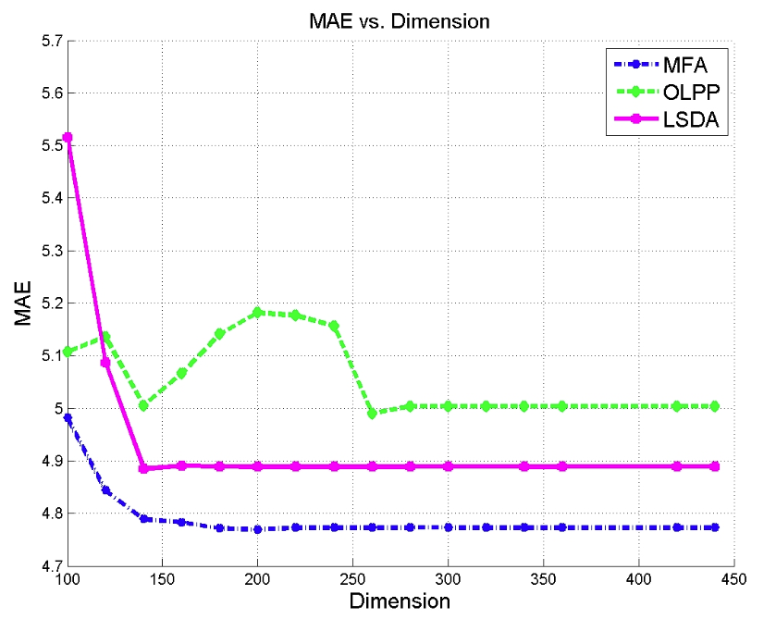

Slide 10
Deep Regression Forests for Age estimation
The contribution of this paper is two folds:
1) It proposes Deep Regression Forests (DRFs), an end-to-end model, to deal with heterogeneous data by jointly learning input-dependant data partition at split nodes and data abstraction at leaf nodes.
2) We apply DRFs on two standard age estimation benchmarks, and achieve state-of-the-art results e.g. MORPH, FG-NET
Previous work- 1. kernel-based global non-linear mapping -> biased heterogeneous data
2.; Divide-and-conquer method makes hard partitions according to ages-> by any heuristic or greedy algorithms

Slide 11
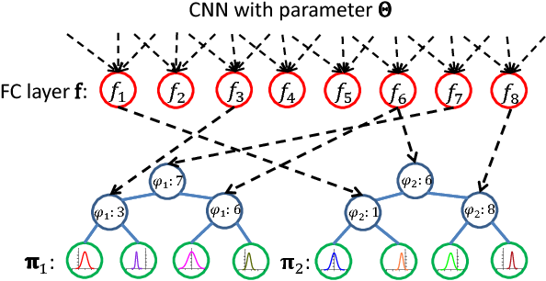
Deep Regression Forests for Age estimation
It’s structure:-

Slide 12
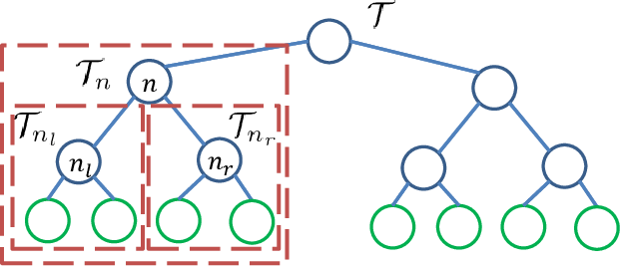
. The subtree rooted at node n: T_{n} and its left and right subtrees: T_{nl} and T_{nr} .
Each leaf node l ∈ L contains a probability density distribution π(y) over Y

Slide 13
Deep Regression Forests for Age estimation
It uses CNN
Layers of CNN involved in it:- A. Convolution Layer B. ReLu layer, C. Pooling layer. D. Fully-connected layer
2. Regression Trees based on different algorithms
SVM B. Naive Bayes C. Logistic regression D. Linear Regression.
Deep Regression Forests (DRFs), an end-to-end model, for age estimation. DRFs connect the split nodes to a fully connected layer of a convolutional neural network (CNN) and deal with heterogeneous data by jointly learning input-dependant data partitions at the split nodes and data abstractions at the leaf nodes. This joint learning follows an alternating strategy: First, by fixing the leaf nodes, the split nodes as well as the CNN parameters are optimized by Back-propagation; Then, by fixing the split nodes, the leaf nodes are optimized by iterating a step-size free and fast converging update rule derived from Variational Bounding. We verify the proposed DRFs on three standard age estimation benchmarks and achieve state-of-the-art results on all of them.
A function of bounded variation, also known as BV function, is a real-valued function whose total variation is bounded (finite)

Slide 14
Logistic regression is used when the dependent variable is binary in nature. In contrast, Linear regression is used when the dependent variable is continuous and nature of the regression line is linear.
Name of dataset | MAE | CS
MORPH | 2.17 | 91.3
FG-NET | 3.85 | 80.6

Slide 15
Ordinal Regression with Multiple Output CNN for Age Estimation

Slide 16
Approaches Before This Paper
multi-class classification
In a multi-class classification problem, the class labels are assumed to be independent to one another.
Problem: But the age labels have a strong ordinal relationship since they form a well-ordered set, which is not exploited in these multi-class classification methods.
metric regression problem
This approach treat the age labels as numerical values to utilize such ordinal information for age estimation.
Problem: But due to non-stationary property of aging patterns. learning non-stationary kernels for a regression problem is usually difficult since it will easily cause over-fitting in the training process

Slide 17
Approach
Use relative order among the age labels in addition to their exact values. And hence the age estimation is cast as a ordinal regression problem.
transform ordinal regression as a series of binary classification sub-problems.
Convolutional Neural Network (CNN) is used to solve those binary classification sub-problems.
our CNN has multiple output layers where each output layer corresponds to a binary classification task, called Multiple Output CNN.
an ordinal regression problem with K ranks is transformed into K − 1 simpler binary classification sub-problems. For each rank r_{k} ∈ {r₁, r₂, · · · , r_{K−1}}, a binary classifier is constructed to predict whether the rank of a sample y_{i} is larger than r_{k}.
rank of an unseen sample is predicted based on the classification results of the K − 1 binary classifiers on this sample.

Slide 18
Three Steps In Approach
Convert original training data D = {x_{i}, y_{i}}^{N}_{i=1} to for kth binary classification sub problem D^{k} = {x_{i}, y^{k}_{i}} where y^{k}_{i}∈ {0,1} y^{k}_{i} = 1, if(y_{i} > r_{k}) , y^{k}_{i} = 0 , otherwise
the K − 1 binary classifiers are trained with their corresponding training data. It is noticed that we adopt one CNN to collectively implement these binary classifiers in our approach. In particular, our CNN has a multiple-output structure where each output corresponds to a binary classifier.
rank for an unseen sample x’ is predicted as follows
h(x’) = r_{q}
q = 1+ ∑^{k-1}_{k= 1}f(x’)
Where f_{k}(x’) ∈ {0, 1} is the classification result of the k-th binary classifier for the sample x’.

Slide 19
Benefits
either the metric regression based or the ordinal regression based approaches, the processes of extracting features and learning a regression model is separated and optimized independently.
But we conduct an End-to-End learning with CNN for age estimation, which could simultaneously optimize feature learning and regression modeling.
So we learn Automatically learn better features from facial images, and avoid directly designing hand-crafted features.

Slide 20
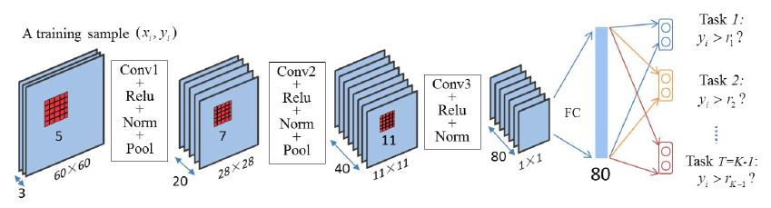
Architecture of the Multiple Output CNN
a

