Slide 1
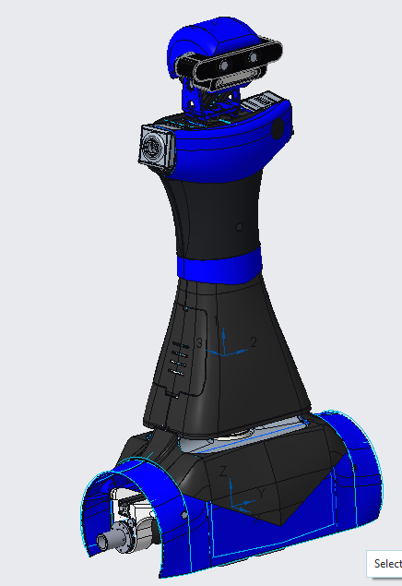
VOLUME = 9.7698795e+06 MM^3
SURFACE AREA = 4.5454505e+06 MM^2
AVERAGE DENSITY = 2.1672039e-06 KILOGRAM / MM^3
MASS = 2.1173321e+01 KILOGRAM
CENTER OF GRAVITY with respect to BODY_SYS coordinate frame:
X Y Z -2.4530316e-01 1.1726402e+00 2.6549449e+02 MM
INERTIA with respect to BODY_SYS coordinate frame: (KILOGRAM * MM^2)
INERTIA TENSOR:
Ixx Ixy Ixz 3.3546678e+06 -5.5712339e+02 -1.3427256e+04
Iyx Iyy Iyz -5.5712339e+02 3.1933458e+06 -2.2806672e+03
Izx Izy Izz -1.3427256e+04 -2.2806672e+03 2.1998895e+05
INERTIA at CENTER OF GRAVITY with respect to BODY_SYS coordinate frame: (KILOGRAM * MM^2)
INERTIA TENSOR:
Ixx Ixy Ixz 1.8621879e+06 -5.6321395e+02 -1.4806203e+04
Iyx Iyy Iyz -5.6321395e+02 1.7008938e+06 4.3112127e+03
Izx Izy Izz -1.4806203e+04 4.3112127e+03 2.1995856e+05
PRINCIPAL MOMENTS OF INERTIA: (KILOGRAM * MM^2)
I1 I2 I3 2.1981256e+05 1.7009040e+06 1.8623236e+06
ROTATION MATRIX from BODY_SYS orientation to PRINCIPAL AXES:
0.00901 0.00376 -0.99995
-0.00291 0.99999 0.00373
0.99996 0.00287 0.00902
ROTATION ANGLES from BODY_SYS orientation to PRINCIPAL AXES (degrees):
angles about x y z -22.455 -89.441 -22.620
RADII OF GYRATION with respect to PRINCIPAL AXES:
R1 R2 R3 1.0189005e+02 2.8342974e+02 2.9657400e+02 MM
---------------------------------------------
MASS PROPERTIES OF COMPONENTS OF THE ASSEMBLY
(in assembly units and the BODY_SYS coordinate frame)
DENSITY MASS C.G.: X Y Z
EGO2_MBASE MATERIAL: UNKNOWN
1.88027e-06 1.42456e+01 -1.32698e+00 1.71417e+00 8.25453e+01
MTEG100_TORSO MATERIAL: UNKNOWN
3.15826e-06 6.92772e+00 1.97897e+00 5.90742e-02 6.41696e+02

Slide 2
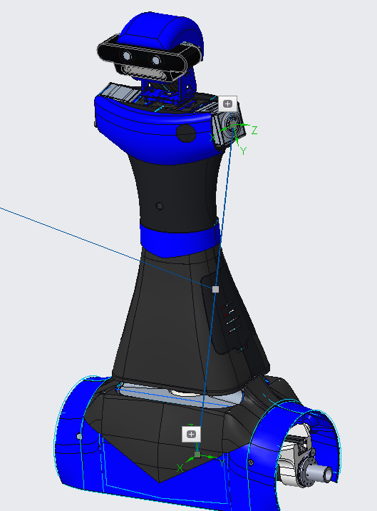
Advanced Measure Results
========================================
BODY_SYS:F5(CSYS)
----------------------------------------
X = 0.0000000000
Y = 0.0000000000
Z = 0.0000000000
ARM_L_SYS:F9(CSYS)
----------------------------------------
X = -145.290
Y = 668.027
Z = -15.2252
All References
----------------------------------------
Distance = 683.814 mm
Transformation matrix =
0.984808 0.000000 0.173648 15.225205
-0.171010 0.173648 0.969846 145.290291
-0.030154 -0.984808 0.171010 668.026953

Slide 3
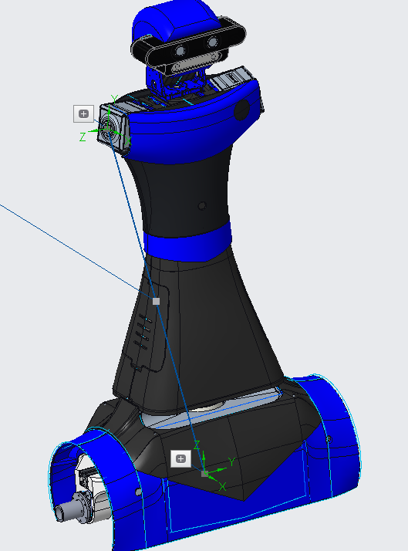
Advanced Measure Results
========================================
BODY_SYS:F5(CSYS)
----------------------------------------
X = 0.0000000000
Y = 0.0000000000
Z = 0.0000000000
ARM_R_SYS:F10(CSYS)
----------------------------------------
X = 145.290
Y = 668.027
Z = -15.2252
All References
----------------------------------------
Distance = 683.814 mm
Transformation matrix =
0.984808 -0.000000 0.173648 15.225205
0.171010 0.173648 -0.969846 -145.290291
-0.030154 0.984808 0.171010 668.026953

Slide 4
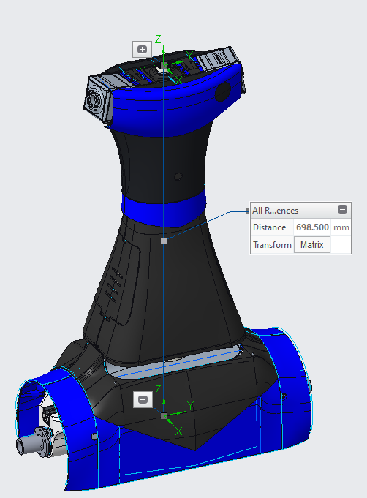
Advanced Measure Results
========================================
BODY_SYS:F5(CSYS)
----------------------------------------
X = 0.0000000000
Y = 0.0000000000
Z = 0.0000000000
HEAD_INTERFACE:F11(CSYS)
----------------------------------------
X = 0.0000000000
Y = 698.500
Z = 0.0000000000
All References
----------------------------------------
Distance = 698.500 mm
Transformation matrix =
1.000000 0.000000 0.000000 0.000000
0.000000 1.000000 0.000000 0.000000
0.000000 0.000000 1.000000 698.500000

Slide 5
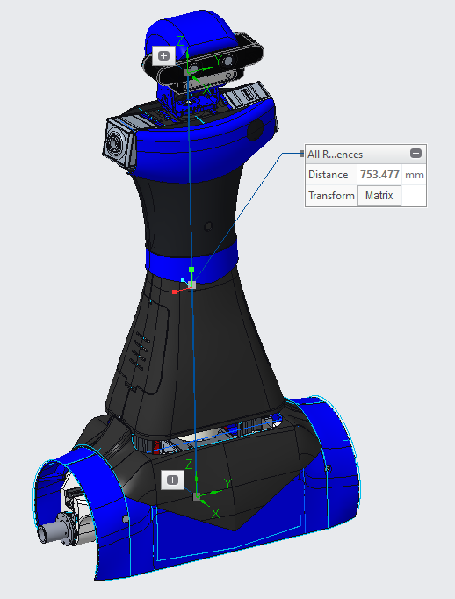
Advanced Measure Results
========================================
BODY_SYS:F5(CSYS)
----------------------------------------
X = 0.0000000000
Y = 0.0000000000
Z = 0.0000000000
HEAD_INTERFACE:F43(CSYS):MTEG102_HEAD
----------------------------------------
X = 0.0000000000
Y = 753.477
Z = 0.0000000000
All References
----------------------------------------
Distance = 753.477 mm
Transformation matrix =
1.000000 0.000000 -0.000000 -0.000000
-0.000000 1.000000 -0.000000 0.000000
-0.000000 0.000000 1.000000 753.476858

Slide 6
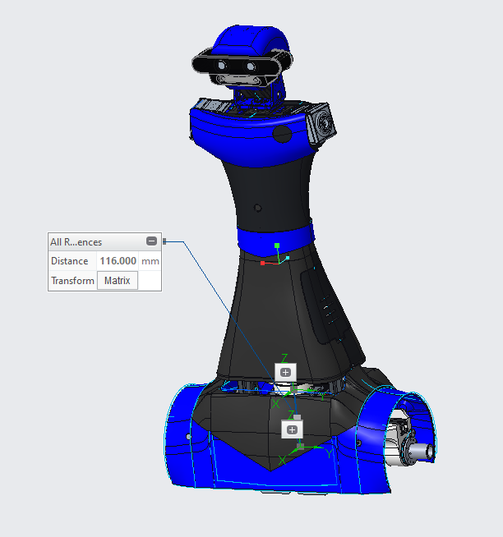
῁ˊ
========================================
BODY_SYS:F5(CSYS)
----------------------------------------
X = 0.0000000000
Y = 0.0000000000
Z = 0.0000000000
LIDAR_INTERFACE:F7(CSYS):RPLIDAR_A2_SLAMTEC
----------------------------------------
X = 0.0000000000
Y = 116.000
Z = 0.0000000000
All References
----------------------------------------
Distance = 116.000 mm
Transformation matrix =
1.000000 0.000000 0.000000 -0.000000
0.000000 1.000000 0.000000 -0.000000
0.000000 0.000000 1.000000 116.000000

