Slide 1


Design and Implementation of a Modular Architecture for a Welcoming Robot
Master Thesis in Artificial Intelligence & Robotics
Candidate: Kevin Munda
ID Number: 1905663
Dipartimento di Ingegneria Informatica, Automatica e Gestionale “Antonio Ruberti”
Advisors:
Prof. Daniele Nardi
Ing. Vincenzo Suriani

Slide 2
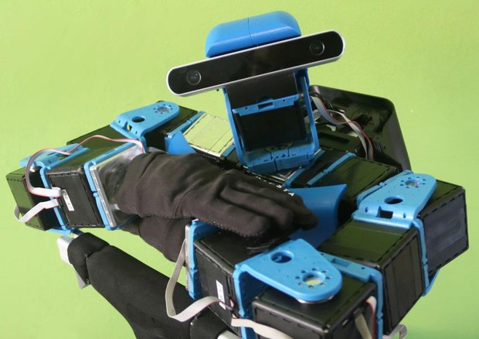
Outline
Thesis Goal
Tools
Architecture
Interactions
Results
Conclusions
Design and Implementation of a Modular Architecture for a Welcoming Robot
31/01/2023
Page 1

Slide 3
Thesis Goal
Design of architecture for an autonomous robot
employed in the Hadrian’s Temple for welcoming guests
Human-Robot Interaction
Capabilities
Speech comprehension
Verbal interaction
Gestures generation
Safe autonomous movements
Level of autonomy (LoA)
Hardware
ALTER-EGO robot
  Developed by IIT
  Designed for tele-operations
  Low level of autonomy
Architecture
Design of an architecture for
autonomous behaviours
Modular
Easy to use by non-experts
Design and Implementation of a Modular Architecture for a Welcoming Robot
31/01/2023
Page 2

Slide 4


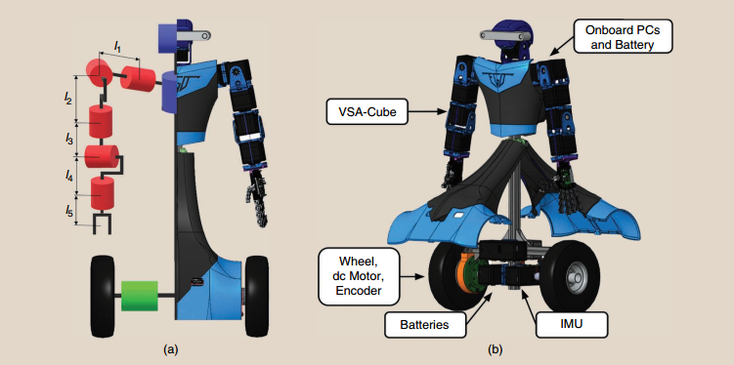

Tools
Robot Operating System (ROS)
  Software framework for the development of robotic applications
SpaCy
  NLP library
Gazebo
  3D Simulation Environment
ALTER-EGO
  5 DoF for each arm and 2 DoF for the neck
  Dimension: 500 mm x 260 mm x 1 m
  Weight: 21 Kg
  Average speed: 0.25 m/s
  Control: Inv. Kin. with damped pseudoinv. (arms) / LQR (base)
  Sensors: RGB-D camera, IMU, LIDAR scanner
Design and Implementation of a Modular Architecture for a Welcoming Robot
31/01/2023
Page 3

Slide 5
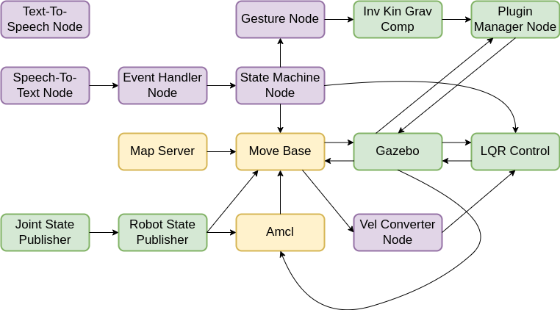
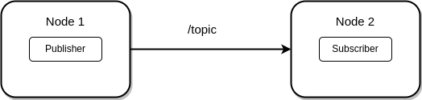
Architecture - Structure
Pre-existing nodes
Developed nodes
New nodes from
standard packages
The architecture manages the operations to execute in each possible case, handling speech interactions, navigation in the environment, obstacle avoidance
Design and Implementation of a Modular Architecture for a Welcoming Robot
31/01/2023
Page 4

Slide 6
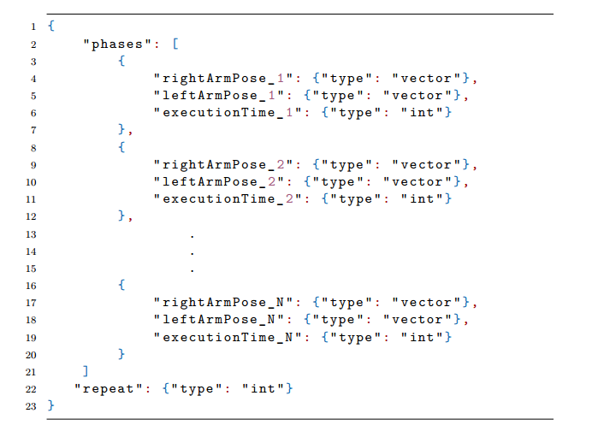
Architecture – Formalisms 1
New gesture formalism
  JSON templates to create a gesture
  N number of single phases executed repeat times
  No need to know the underlying mechanism, just define the file
Phase:
  Single portion of the whole movement
  rightArmPose / leftArmPose: arms poses to reach in the phase
  executionTime: time to reach the poses
Design and Implementation of a Modular Architecture for a Welcoming Robot
31/01/2023
Page 5

Slide 7
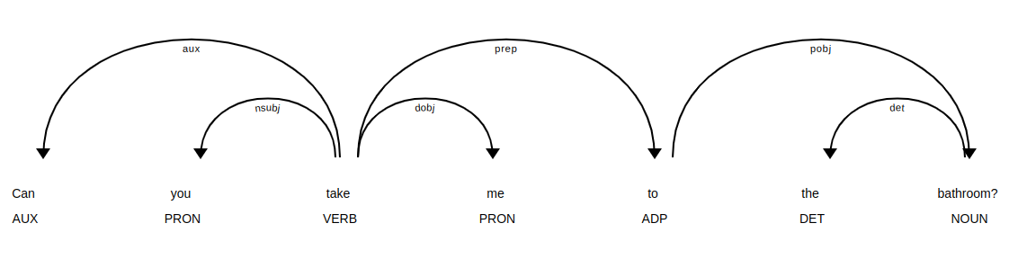
Architecture – Formalisms 2
Patterns
  Set of specific patterns to be matched to trigger an event
Form-Filling
  Form-filling approach used for interaction regarding information requests
Matcher
Design and Implementation of a Modular Architecture for a Welcoming Robot
31/01/2023
Page 6

Slide 8
Architecture – Nodes pipelines
Gesture Node
State Machine Node
- Sends the message with the
name of the gesture to execute
Gesture Node
- Receives the request
- Loads data from JSON file
- Executes the movement
Text-To-Speech Node
State Machine Node
- Calls the tts service passing
a specific Request
Text-To-Speech Node
- Receives the Request
- Selects the text response
- Converts the response and
reproduces the audio
Speech-To-Text Node
Speech-To-Text Node
- Listens for audio input
- Converts the audio into text
- Analyzes text with
spaCy’s NLP pipeline
- Searches for matches
Triggers the event found
Event Handler Node
Forwards the event info
State Machine Node
- Transitions to the states designed
to handle the event
Design and Implementation of a Modular Architecture for a Welcoming Robot
31/01/2023
Page 7

Slide 9
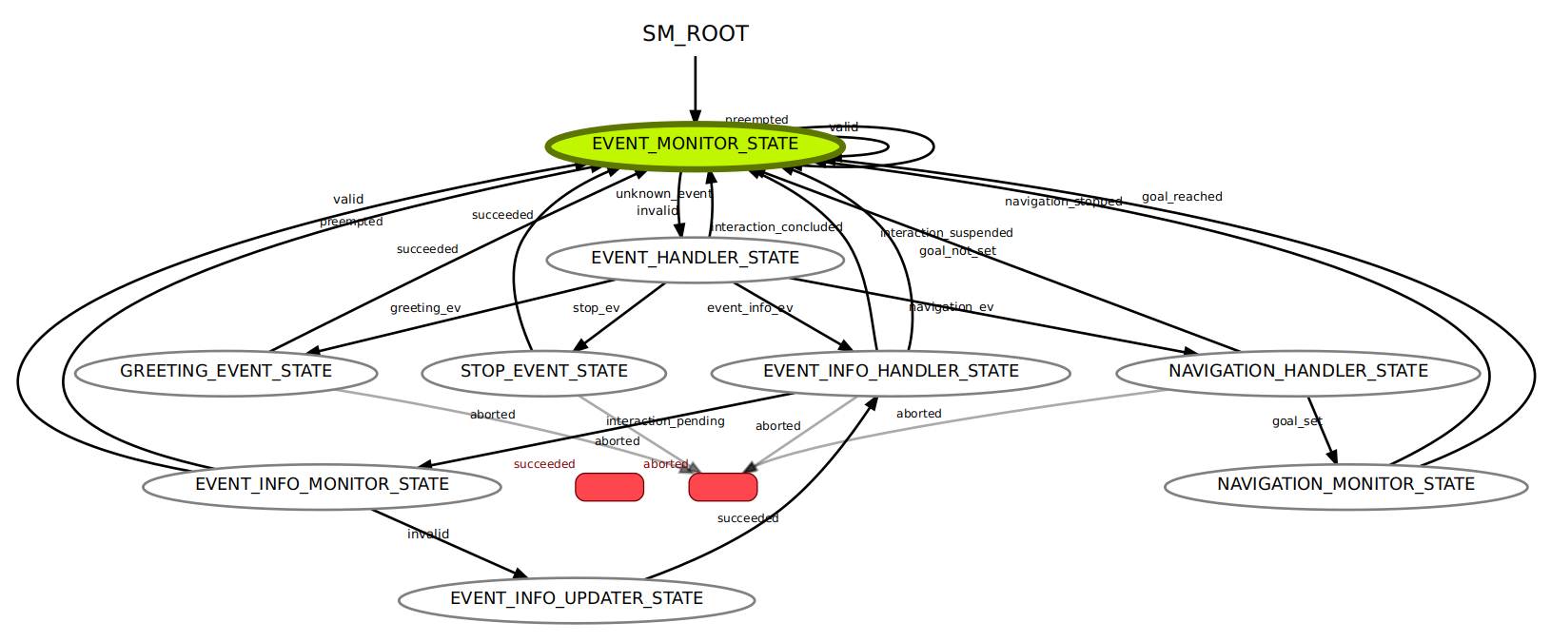
Architecture – State Machine Node
State Machine
  Callback states
  Event-Info states
  Navigation states
Design and Implementation of a Modular Architecture for a Welcoming Robot
31/01/2023
Page 8

Slide 10
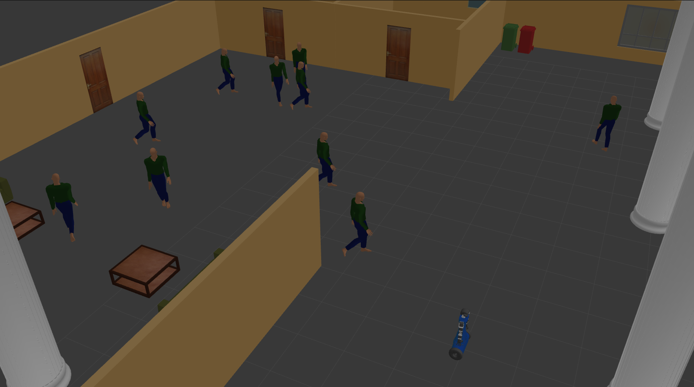
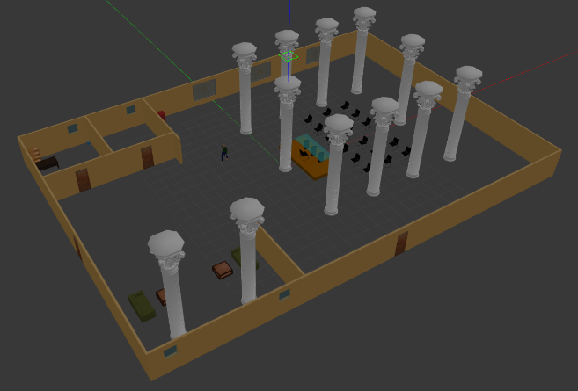
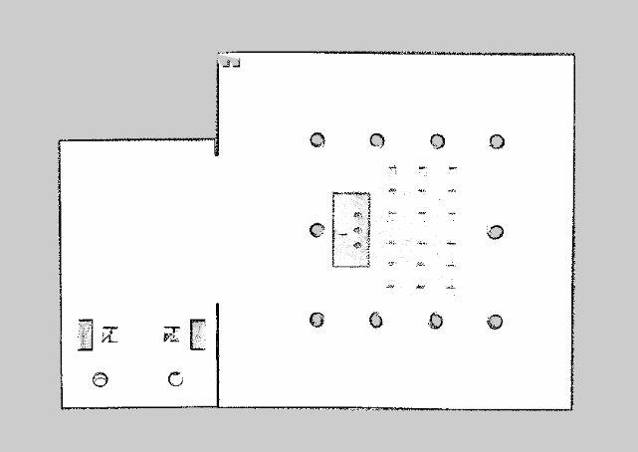
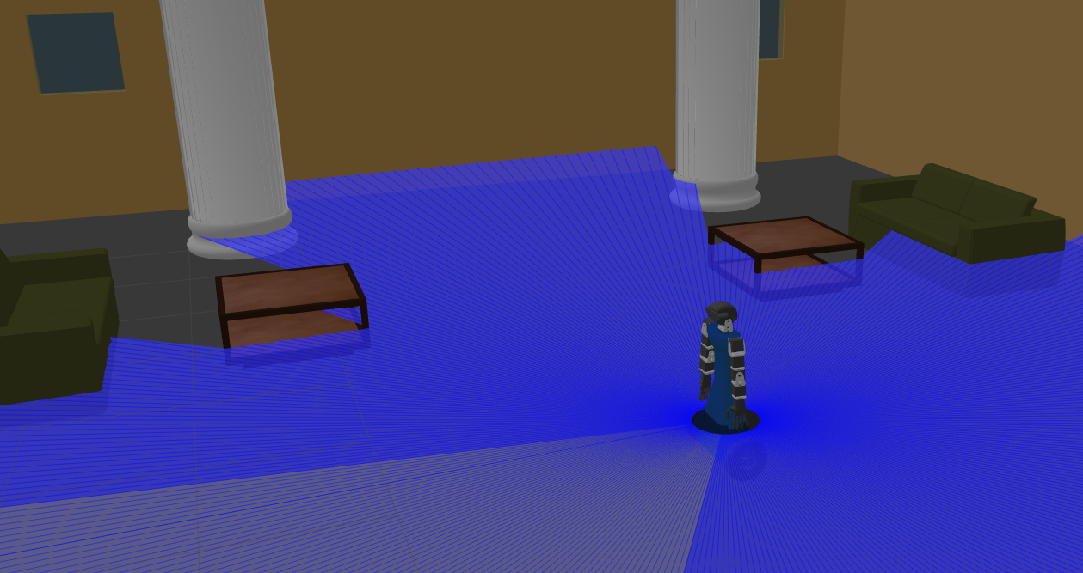
Simulation Environment
Design and Implementation of a Modular Architecture for a Welcoming Robot
31/01/2023
Page 9

Slide 11
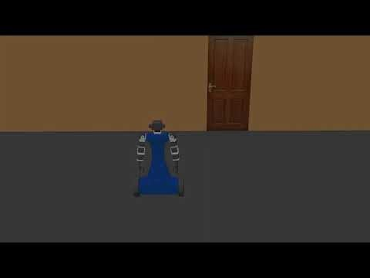
Interactions - 1
Case: Request Complete & Correct
  User: “What is today’s/tomorrow’s next event?”
  Robot: “Today’s/Tomorrow’s next event is...”
Case: Request Complete & Wrong
  User: “What is Sunday’s next event?”
  Robot: “I’m sorry, I have no info for this date. Please, ask again specifying if you want to know about today’s or tomorrow’s event”
Design and Implementation of a Modular Architecture for a Welcoming Robot
31/01/2023
Page 10

Slide 12
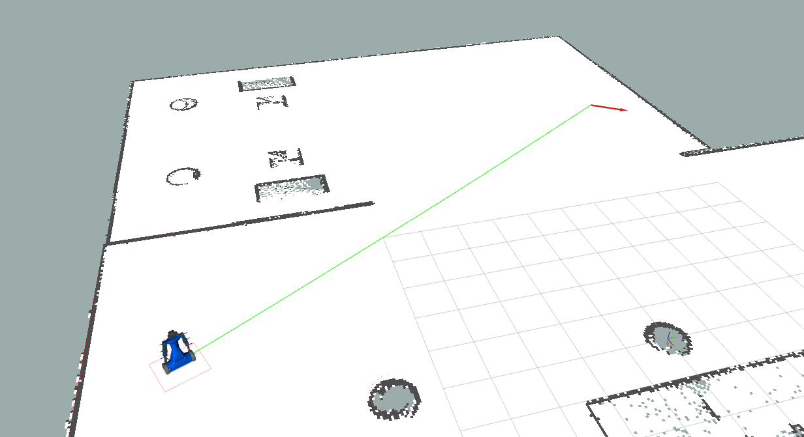
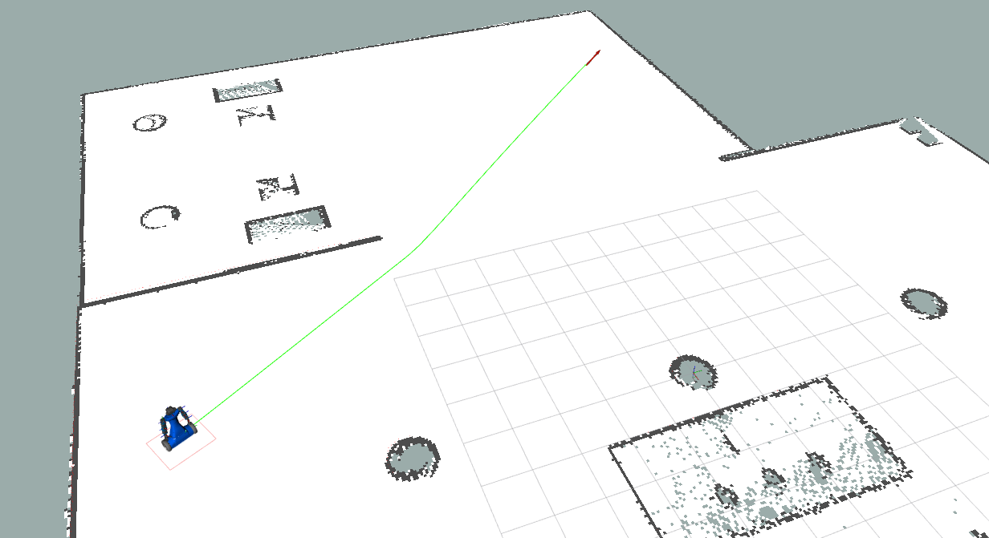
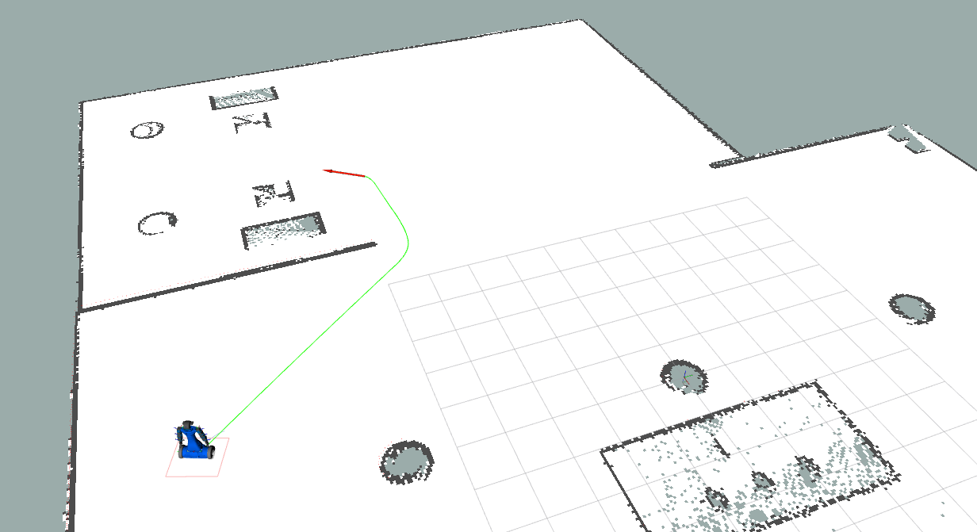
Interactions - 2
Navigation Interaction
Obstacle avoidance through the laser scanner
Possibility to stop the navigation with a voice command
Design and Implementation of a Modular Architecture for a Welcoming Robot
31/01/2023
Page 11

Slide 13
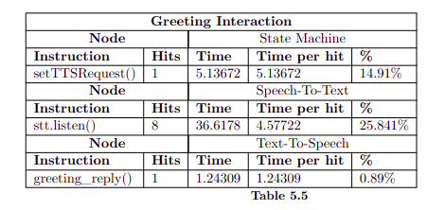
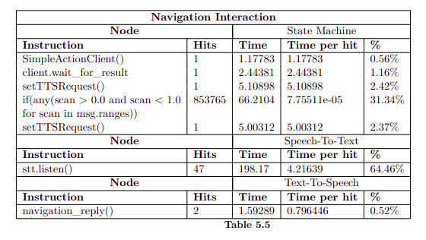
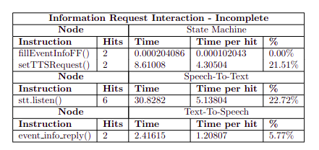
Results
Limited the number of steps during interactions with the use of Form-Filling
Obtained good execution times for the main functions of the nodes
Good result considering that all the computations should be executed on-board
Design and Implementation of a Modular Architecture for a Welcoming Robot
31/01/2023
Page 12

Slide 14
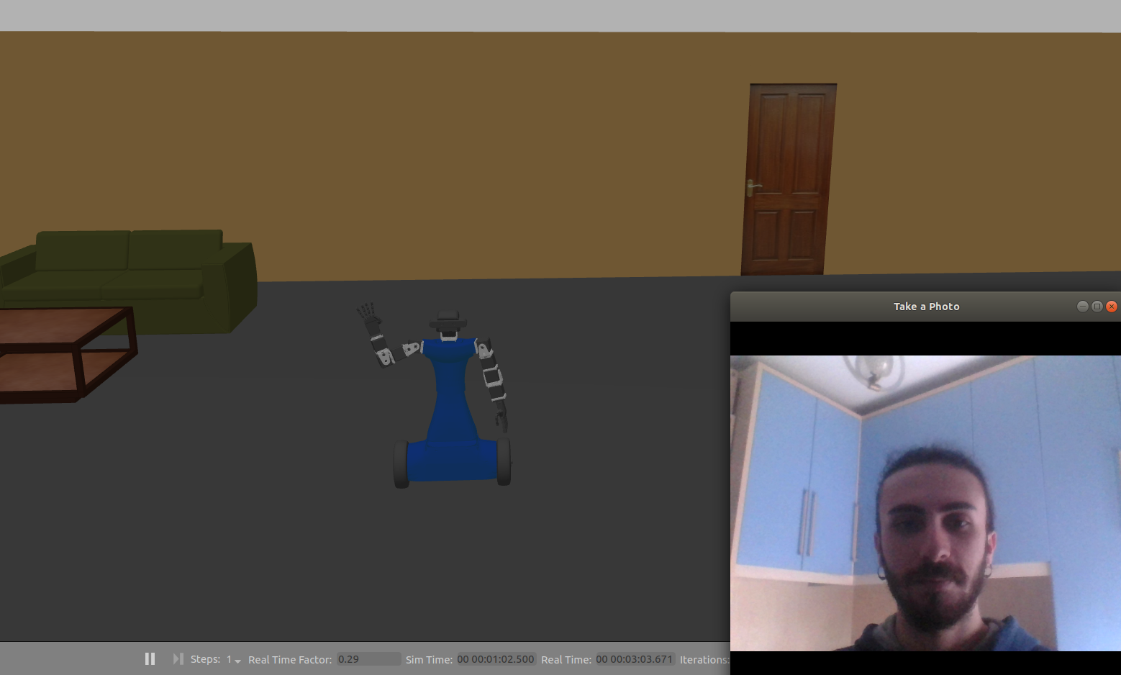
Conclusions
Successfully converted a robot from tele-operated to autonomous
Developed capabilities: execute simple gestures, reply to requests, navigate safely in the environment
Highly modular architecture
Definition of new formalism that facilitates the creation of gestures
New speech interactions can be added by just defining the relative pattern and states
Low number of steps to successfully conclude interaction
Future Works:
  Implement a control strategy that can compare the current pose with the desired one for the Gesture Node
  Instead of patterns, use of a more sophisticated information extraction system, like neural networks
  Optimize the most time-consuming functions
Design and Implementation of a Modular Architecture for a Welcoming Robot
31/01/2023
Page 13

Slide 15
Design and Implementation of a Modular Architecture for a Welcoming Robot
Thanks for you attention!
Candidate: Kevin Munda
ID Number: 1905663
Dipartimento di Ingegneria Informatica, Automatica e Gestionale “Antonio Ruberti”
Advisors:
Prof. Daniele Nardi
Ing. Vincenzo Suriani

