Slide 1
Security Headers
What they are and why you need them
By Kevin Wilder

Slide 2
Table of Contents
OWASP Top 10
HTTP Strict Transport Security
Overview
Preload
Demo
X-XSS-Protection
X-Frame-Options
Content Security Policy
Overview
Directives
Keywords
Demo
Q&A

Slide 3
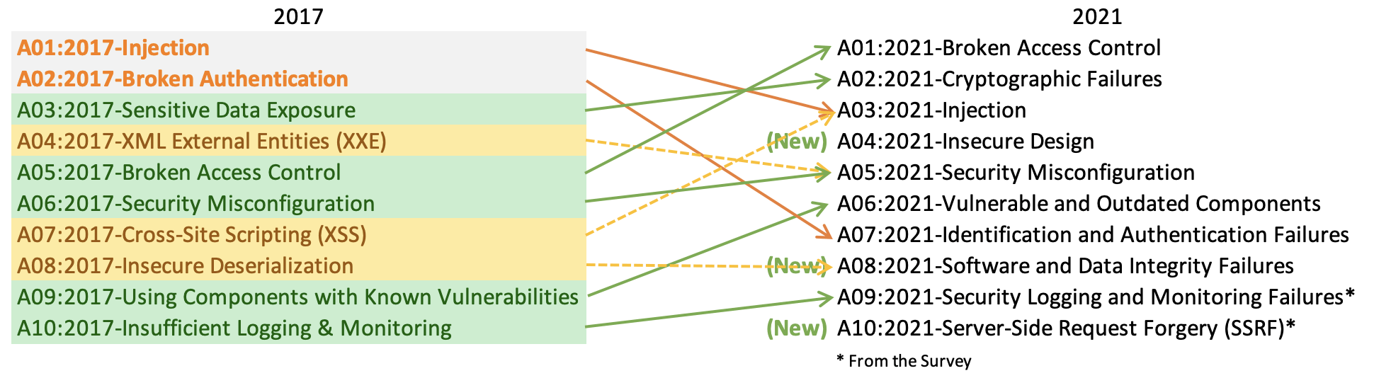
OWASP Top 10
Notes:
Updated every 3-4 years

Slide 4

http://twitterclone.com

Slide 5
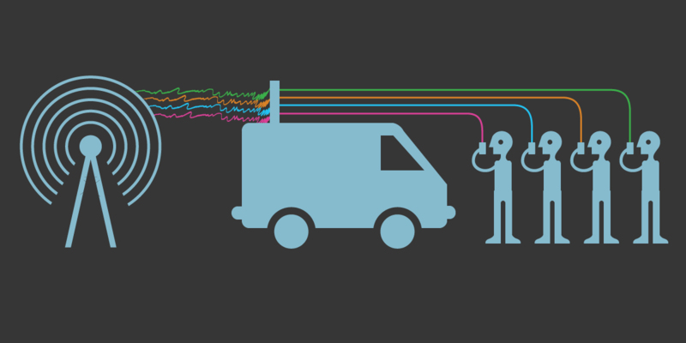
Man-in-the-Middle

Slide 6
HTTP Strict Transport Security (HSTS)
Helps prevent the use of HTTP – forces HTTPS
Defends against man-in-the-middle attacks!!!!
Notes:
Sliding expiration
Not affected by certificate expiration
Has to be loaded to apply
HSTS Preload List Submission

Slide 7
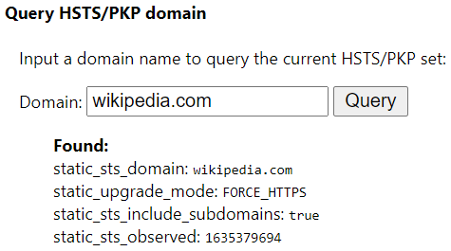
HSTS Demo
chrome://net-internals/#hsts

Slide 8
HSTS Sample Headers
Header with 1 year expiration:
Strict-Transport-Security: max-age=31536000
Header covering subdomains:
Strict-Transport-Security: max-age=31536000; includeSubDomains
Header with preload:
Strict-Transport-Security: max-age=31536000; includeSubDomains; preload
This is the one you want!

Slide 9
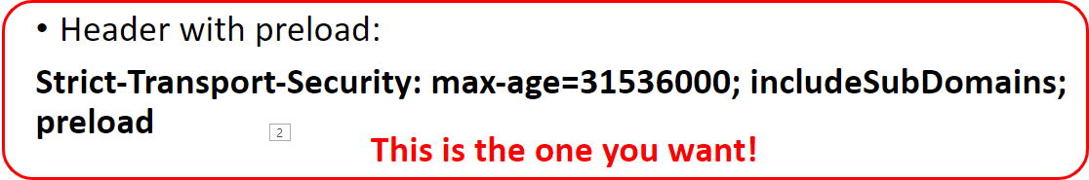
HSTS Limitations
Does not apply on first use or after expiration
At least when not in preload list
Browsers have a list of sites to 'preload' HSTS
Valid TLS/SSL certificate is required
Does not change the behavior or expired certs that are otherwise valid

Slide 10
Myspace
Sammy is my hero

Slide 11

Content Security Policy (CSP)
Swiss army knife of security headers
Various directives that protect against different avenues of attack
Defense in depth
CSP level 2 is currently a W3C Recommendation
CSP level 3 is W3C Working Draft

Slide 12
CSP Directives script-src
Used to prevent cross site scripting attacks (XSS)
Replaces the X-XSS-Protection header
Restricts where a script can be executed from
Prevent inline script by default
Prevents the usage of eval by default

Slide 13
CSP Directives frame-ancestors
Used to prevent framing based attacks (e.g. clickjacking)
Replaces the X-Frame-Options header
Restricts where the protected resource can be embedded
Doesn't fallback to default-src

Slide 14
CSP Directives report-uri
Used to report violations to specified locations
Content-Security-Policy-Report-Only variant header can be set to send reports without enforcing restrictions
Useful for detecting potential issues with the header configuration

Slide 15
CSP Directives default-src
Fallback directive
Does not apply to any directive specified in the header
Applies to all -src directives

Slide 16
Other CSP Directives
style-src: Restricts where stylesheets can be applied from
object-src: Restricts where plugins can be loaded from
img-src: Restricts where images can be loaded from
form-action: Restricts where forms can be submitted to

Slide 17
CSP Directive Sources and Keywords
URLs (https://example.com)
URLs w/subdomains (https://*example.com)
'none': Allows nothing
'self': Allows the origin site with the same scheme and port number
'unsafe-inline': Allows the usage of inline scripts or styles
'unsafe-eval': Allows the usage of eval in scripts
Hashes: Allows specific inline script with corresponding hash
Nonces: Allows specific inline script with corresponding nonce

Slide 18
CSP Demo
Report URI: Generate your Content Security Policy (report-uri.com)

Slide 19
References
OWASP Top Ten Web Application Security Risks | OWASP
HTTP Strict Transport Security - OWASP Cheat Sheet Series
HSTS Preload List Submission
Content Security Policy - OWASP Cheat Sheet Series
Content Security Policy Level 2 (w3.org)
Content-Security-Policy Header ⟶ CSP Reference & Examples
CSP Cheat Sheet (scotthelme.co.uk)
Report URI: Welcome to report-uri.com

