Slide 1



Tuberculosis_California_Dashboard
View in Power BI
Last data refresh:
7/18/2025 5:37:18 PM UTC
Downloaded at:
7/18/2025 5:39:46 PM UTC

Slide 2
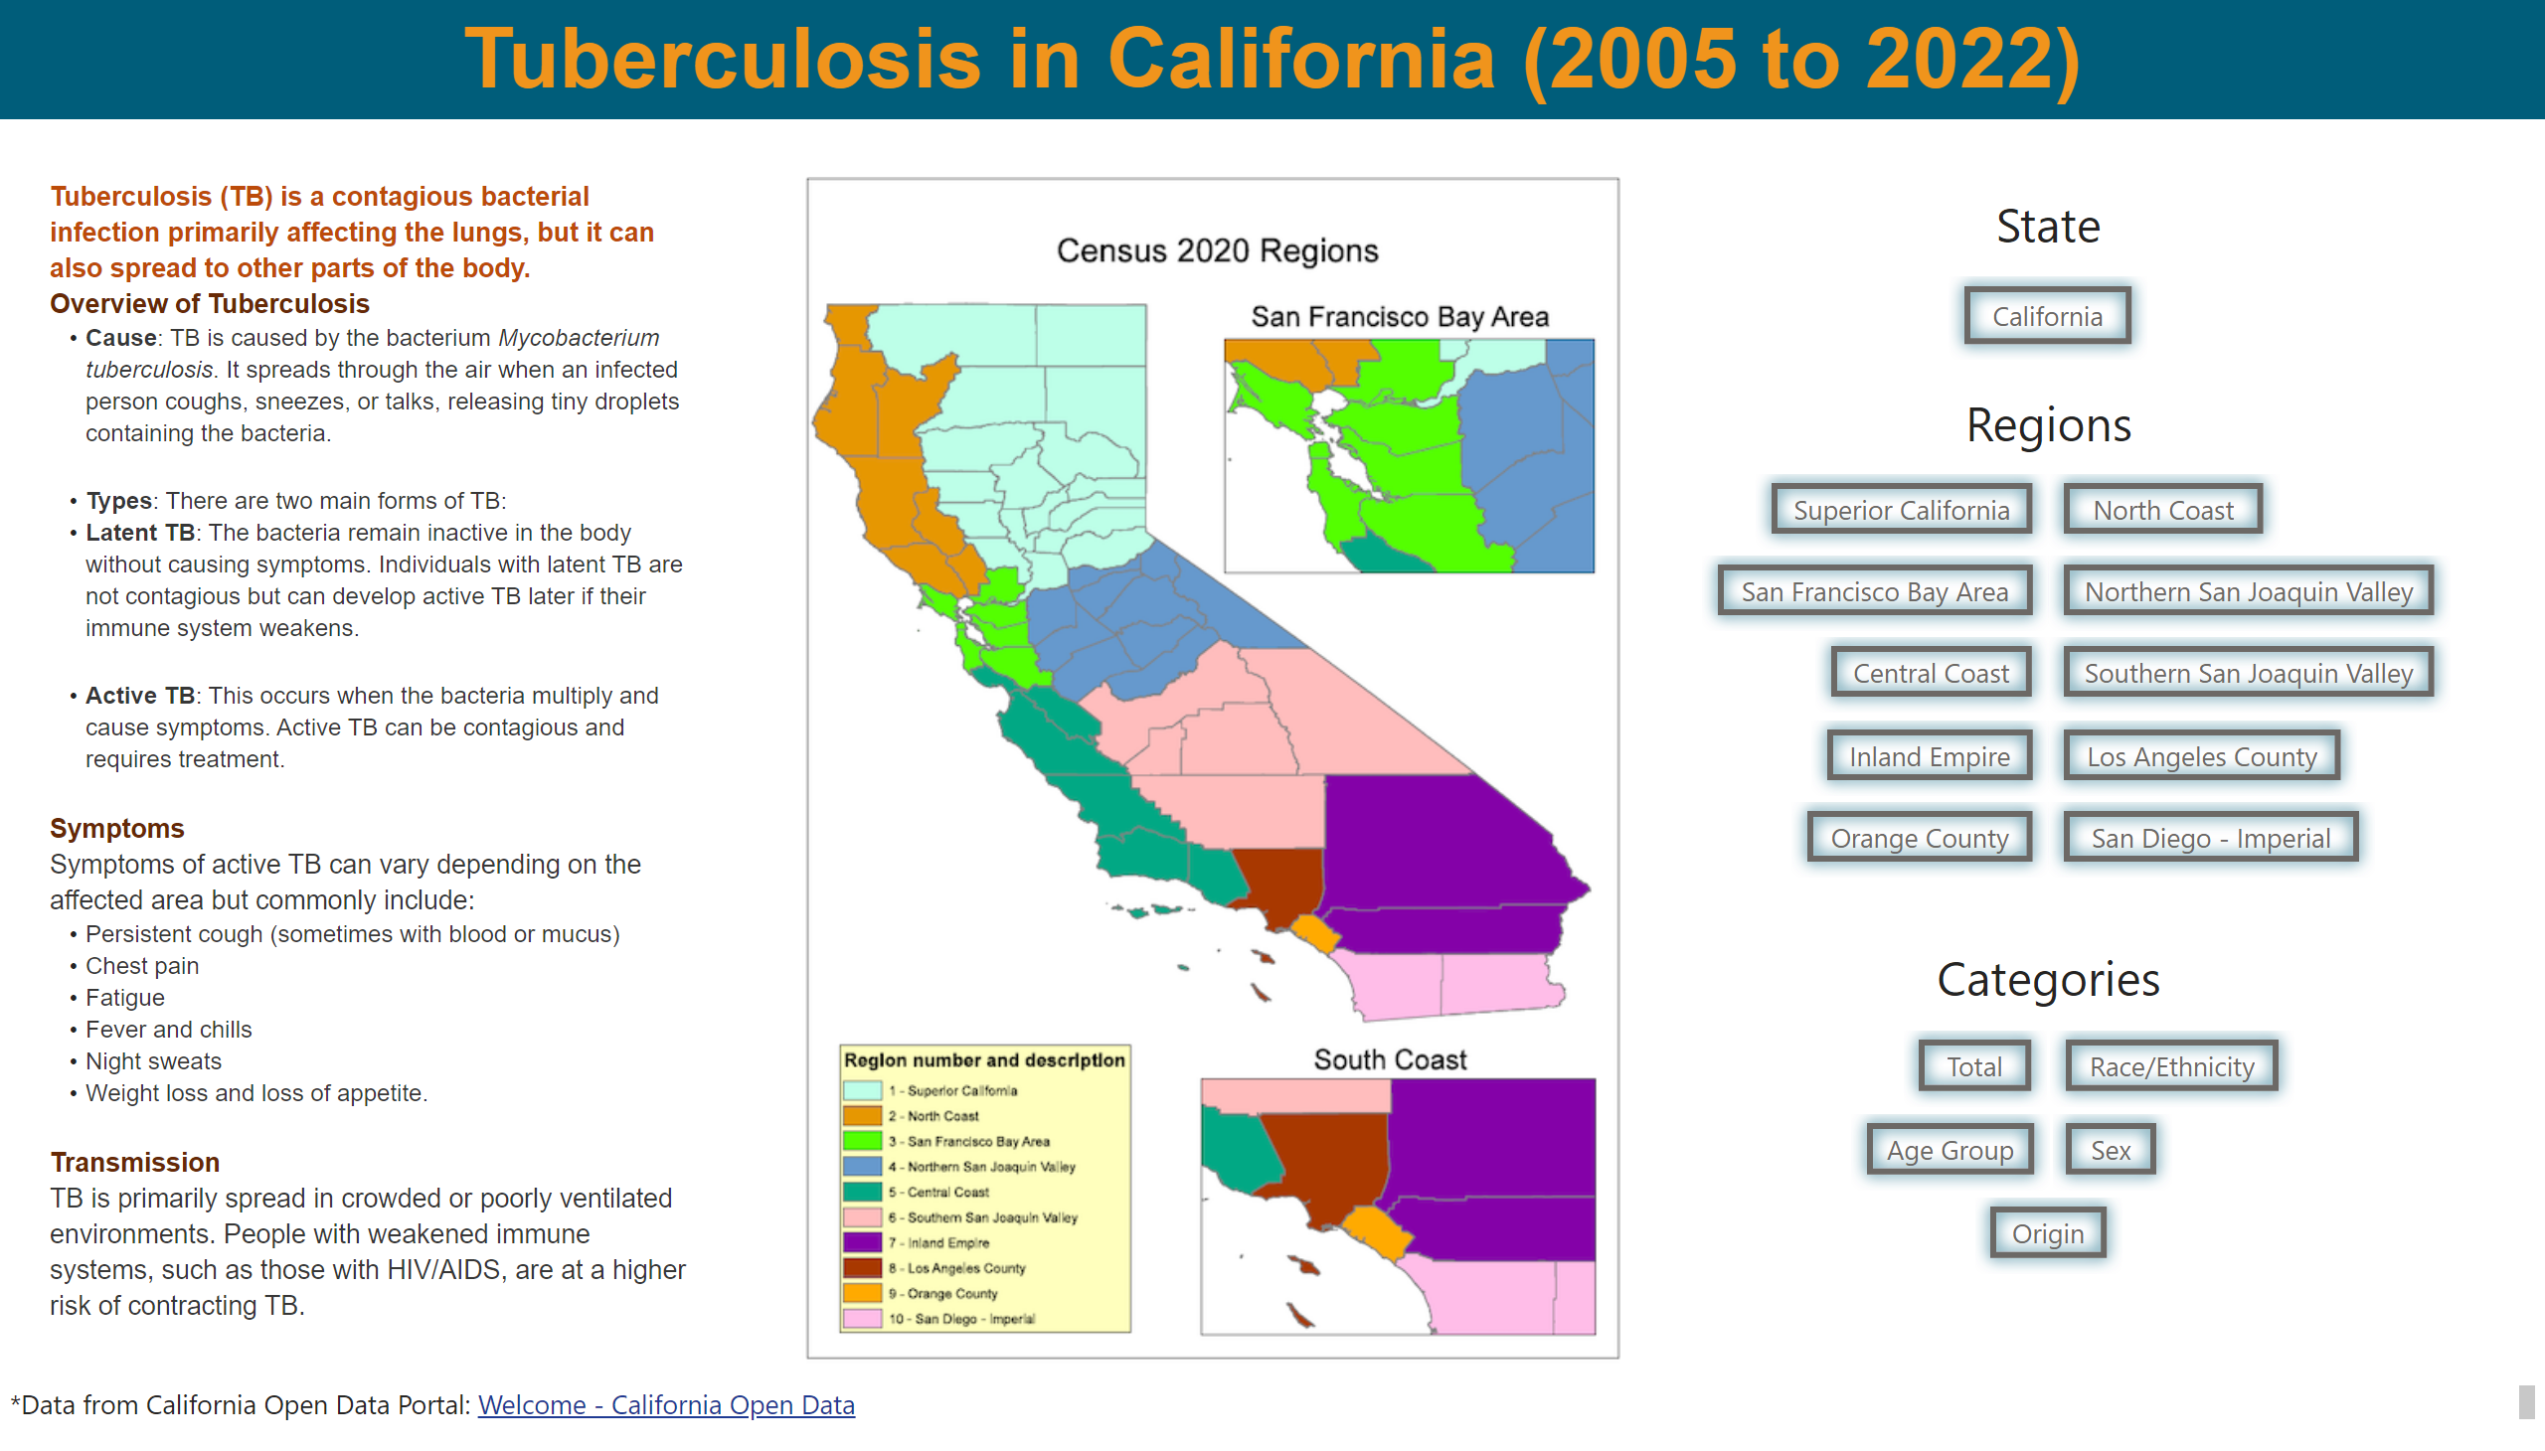
TB in California
Notes:
textbox
No alt text provided
California
No alt text provided
Superior California
No alt text provided
Superior California
No alt text provided
Superior California
No alt text provided
Superior California
No alt text provided
Superior California
No alt text provided
Superior California
No alt text provided
Superior California
No alt text provided
Superior California
No alt text provided
Superior California
No alt text provided
Superior California
No alt text provided
textbox
No alt text provided
textbox
No alt text provided
image
No alt text provided
textbox
No alt text provided
Superior California
No alt text provided
Superior California
No alt text provided
Superior California
No alt text provided
Superior California
No alt text provided
Superior California
No alt text provided
textbox
No alt text provided
textbox
No alt text provided

Slide 3
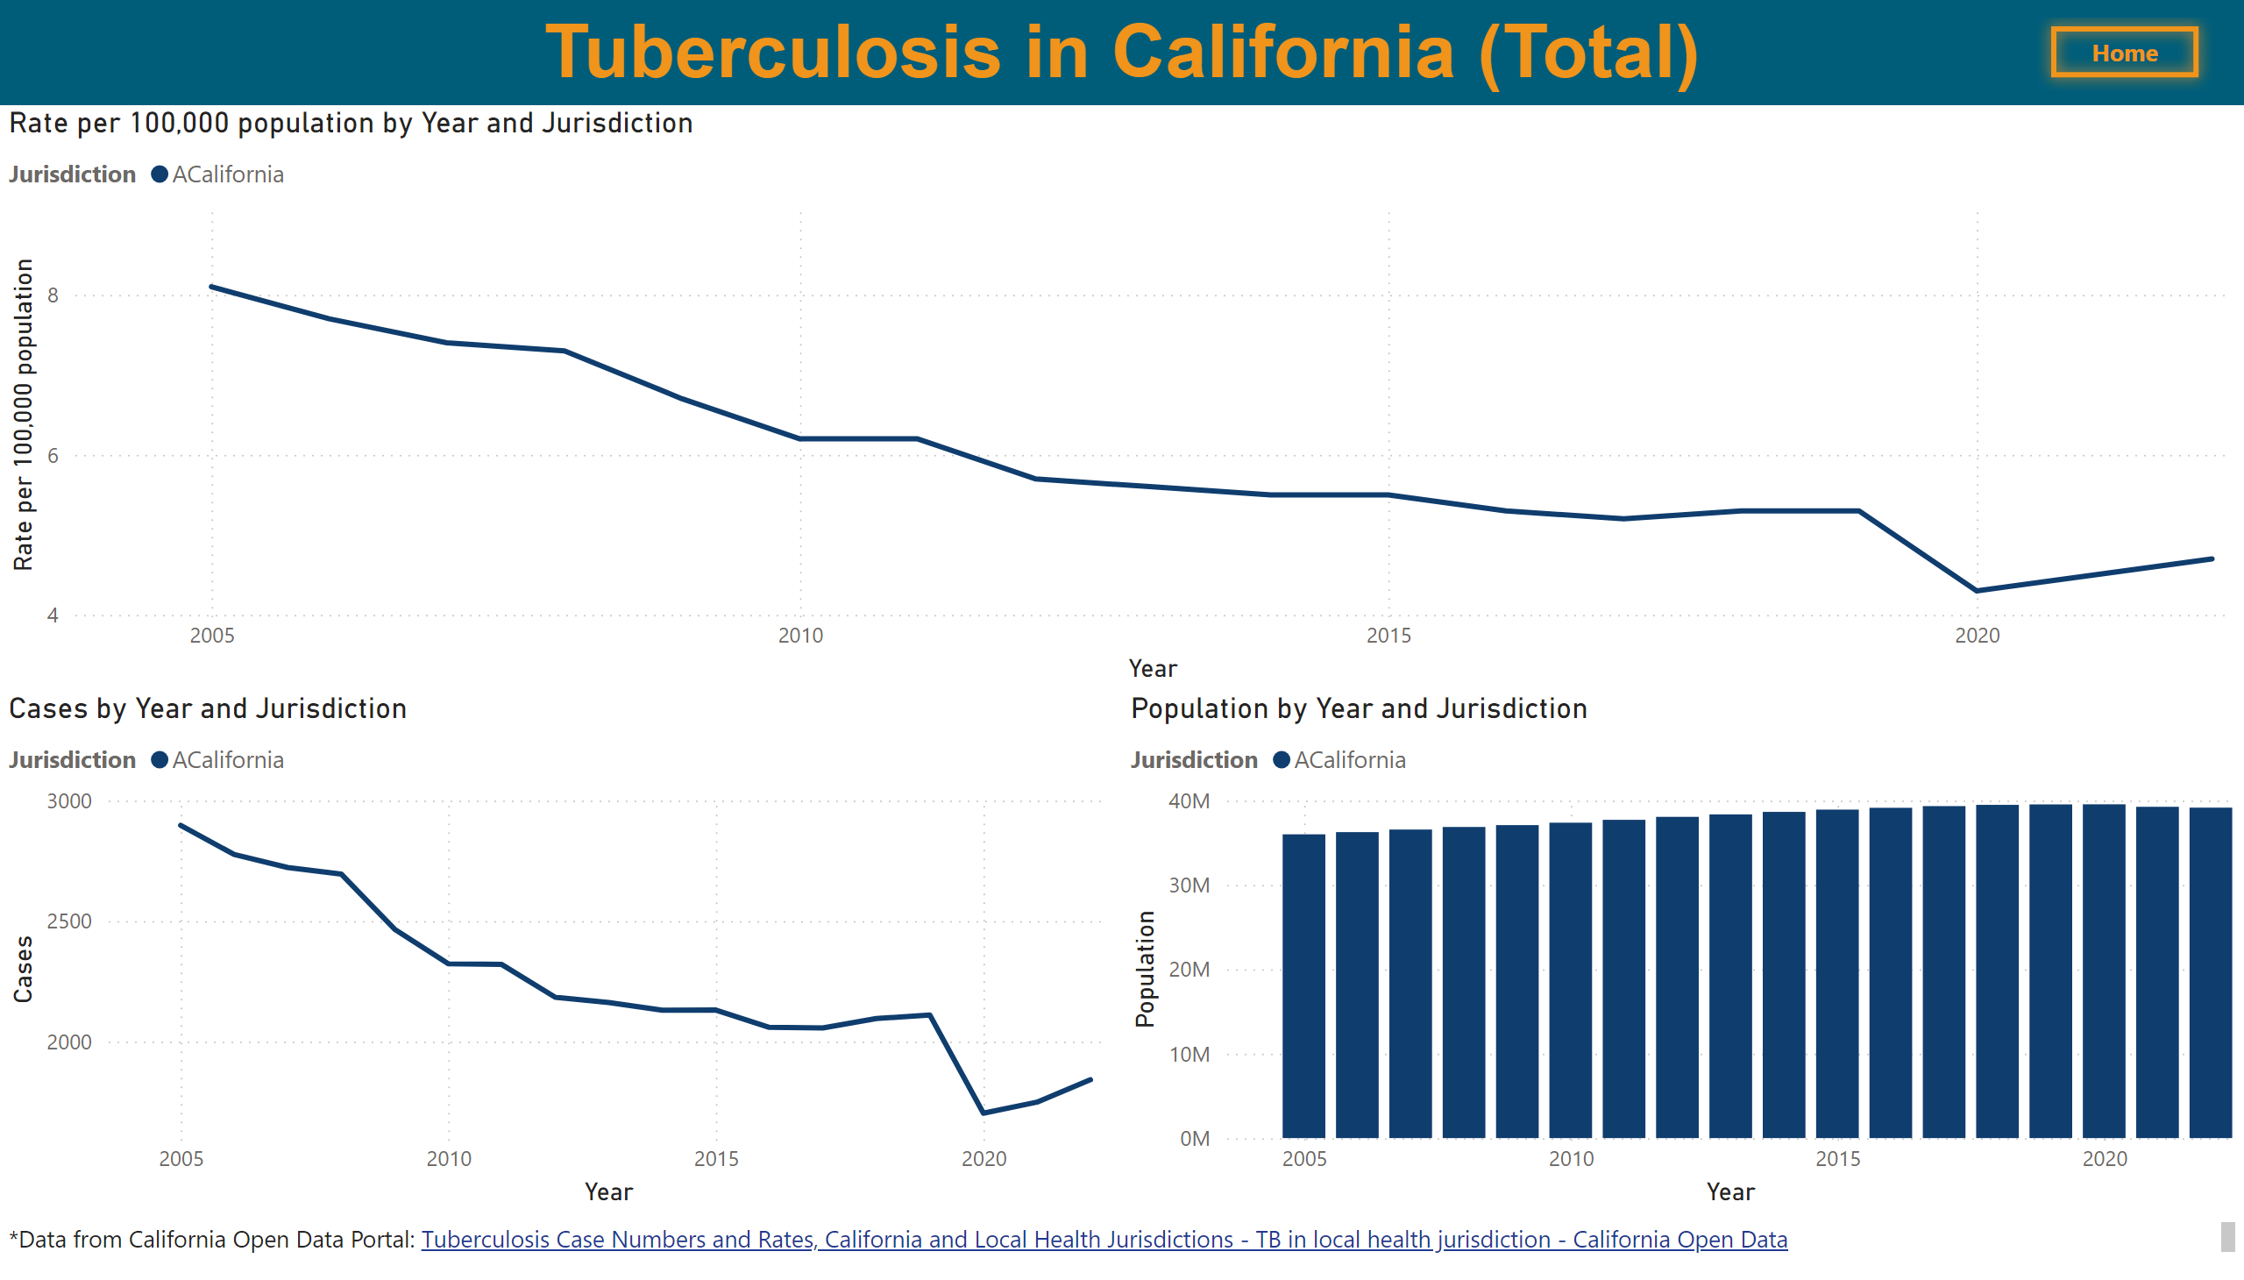
California
Notes:
textbox
No alt text provided
Rate per 100,000 population by Year and Jurisdiction
No alt text provided
Cases by Year and Jurisdiction
No alt text provided
Population by Year and Jurisdiction
No alt text provided
textbox
No alt text provided
California
No alt text provided

Slide 4
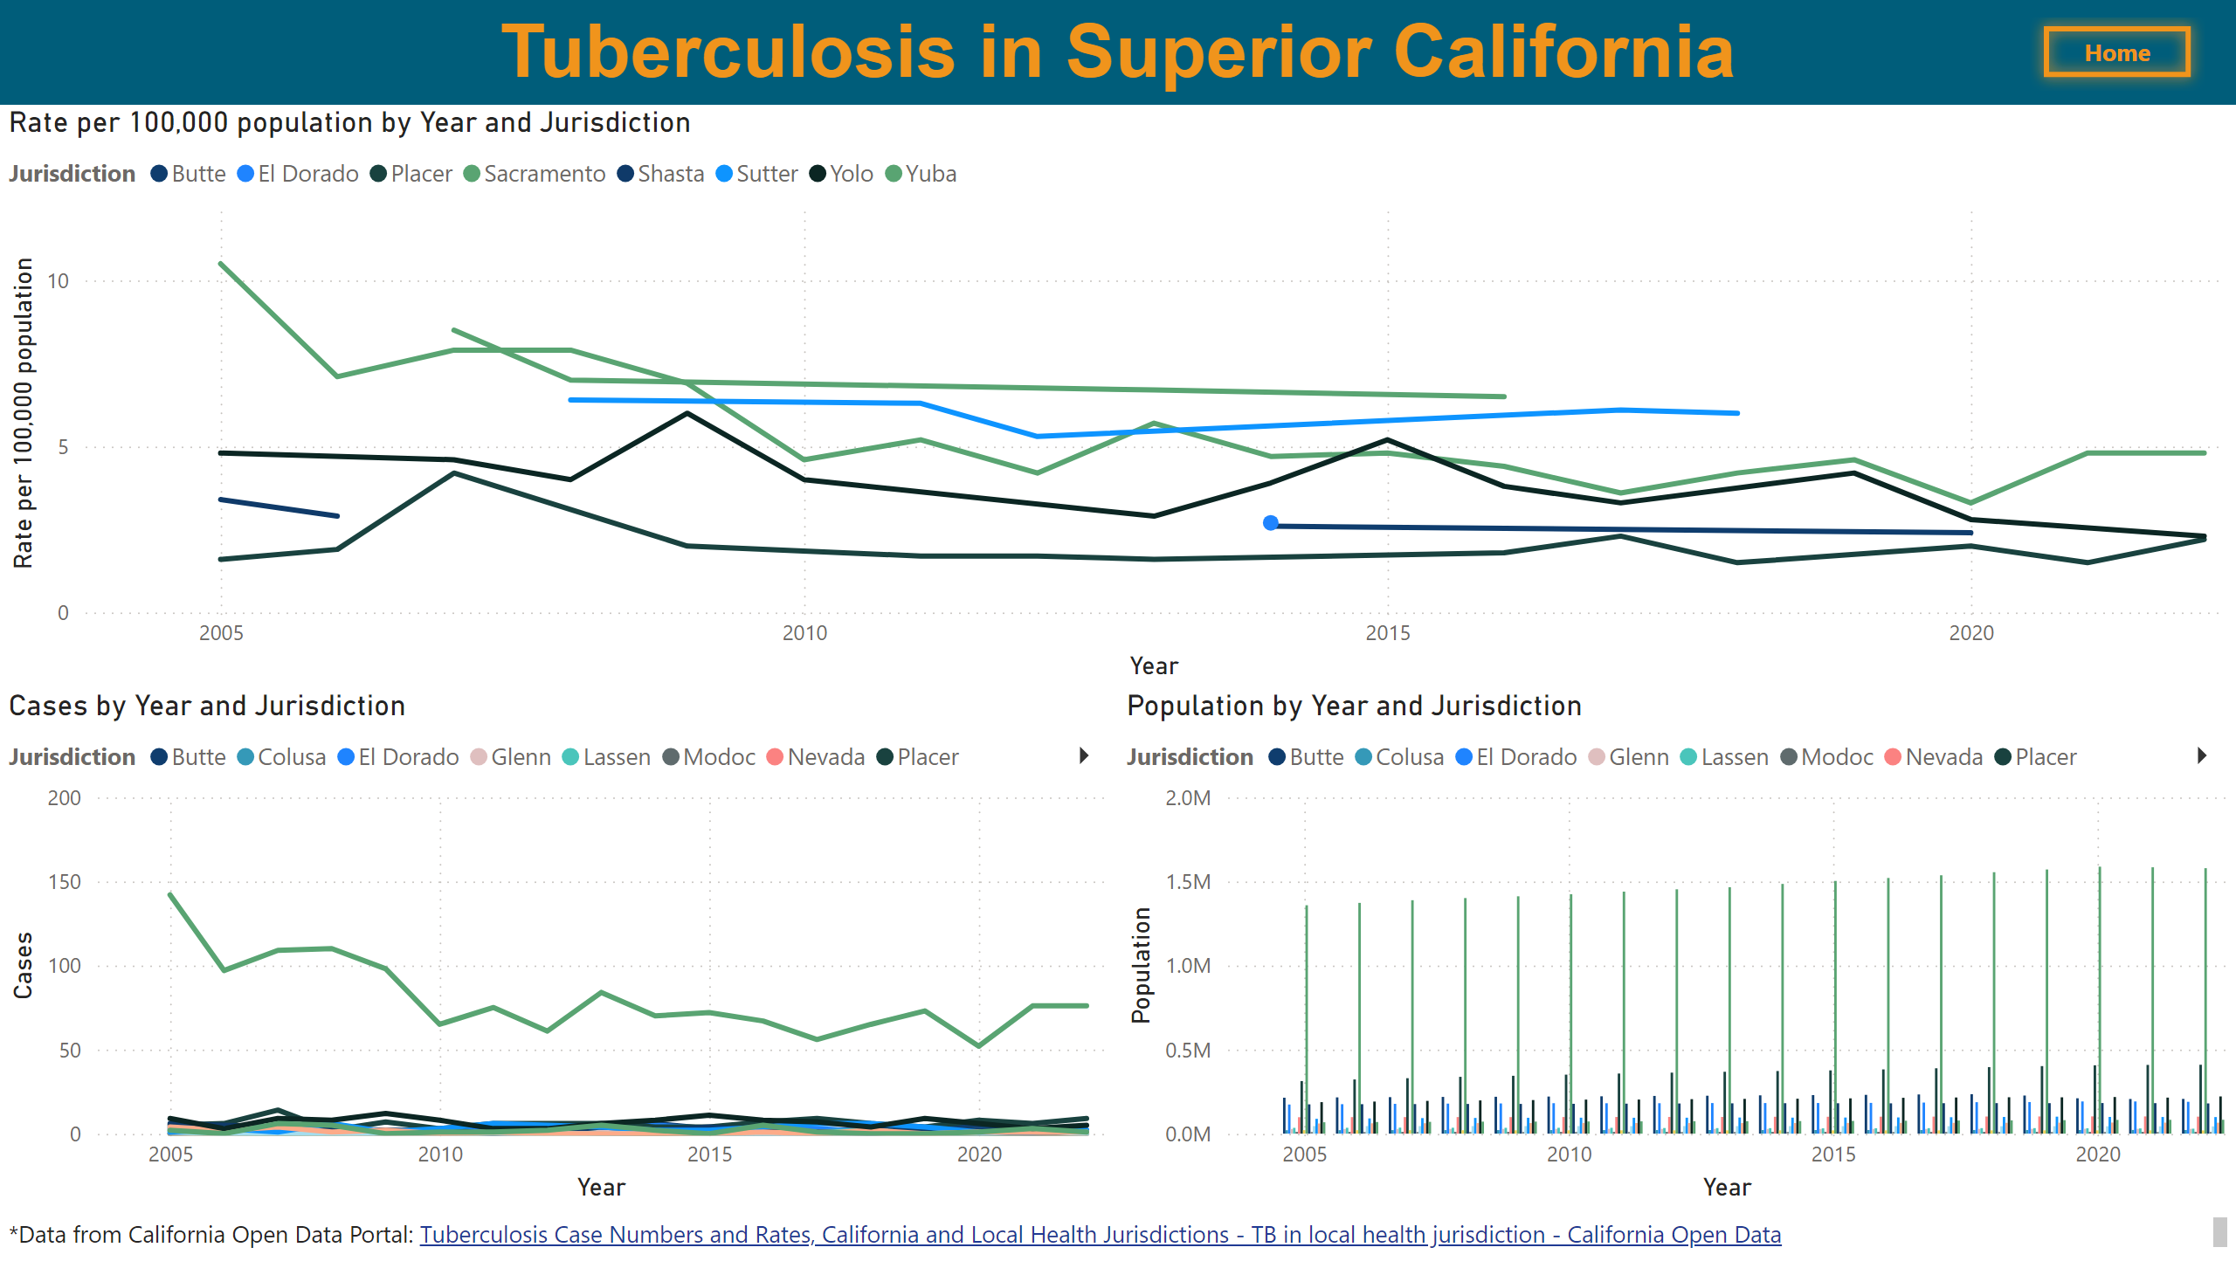
Superior California
Notes:
Rate per 100,000 population by Year and Jurisdiction
No alt text provided
textbox
No alt text provided
Cases by Year and Jurisdiction
No alt text provided
Population by Year and Jurisdiction
No alt text provided
textbox
No alt text provided
California
No alt text provided

Slide 5
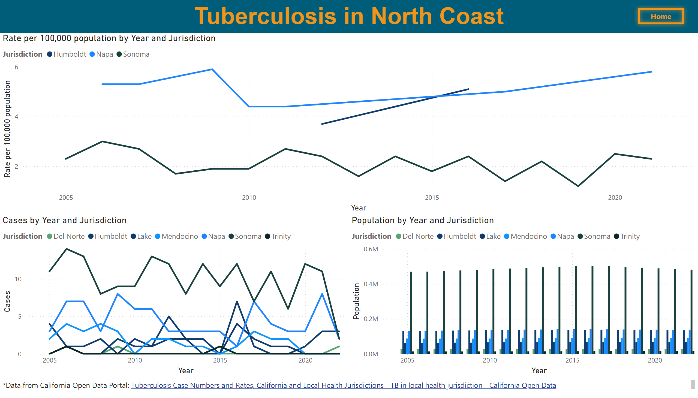
North Coast
Notes:
textbox
No alt text provided
Rate per 100,000 population by Year and Jurisdiction
No alt text provided
Cases by Year and Jurisdiction
No alt text provided
Population by Year and Jurisdiction
No alt text provided
textbox
No alt text provided
California
No alt text provided

Slide 6
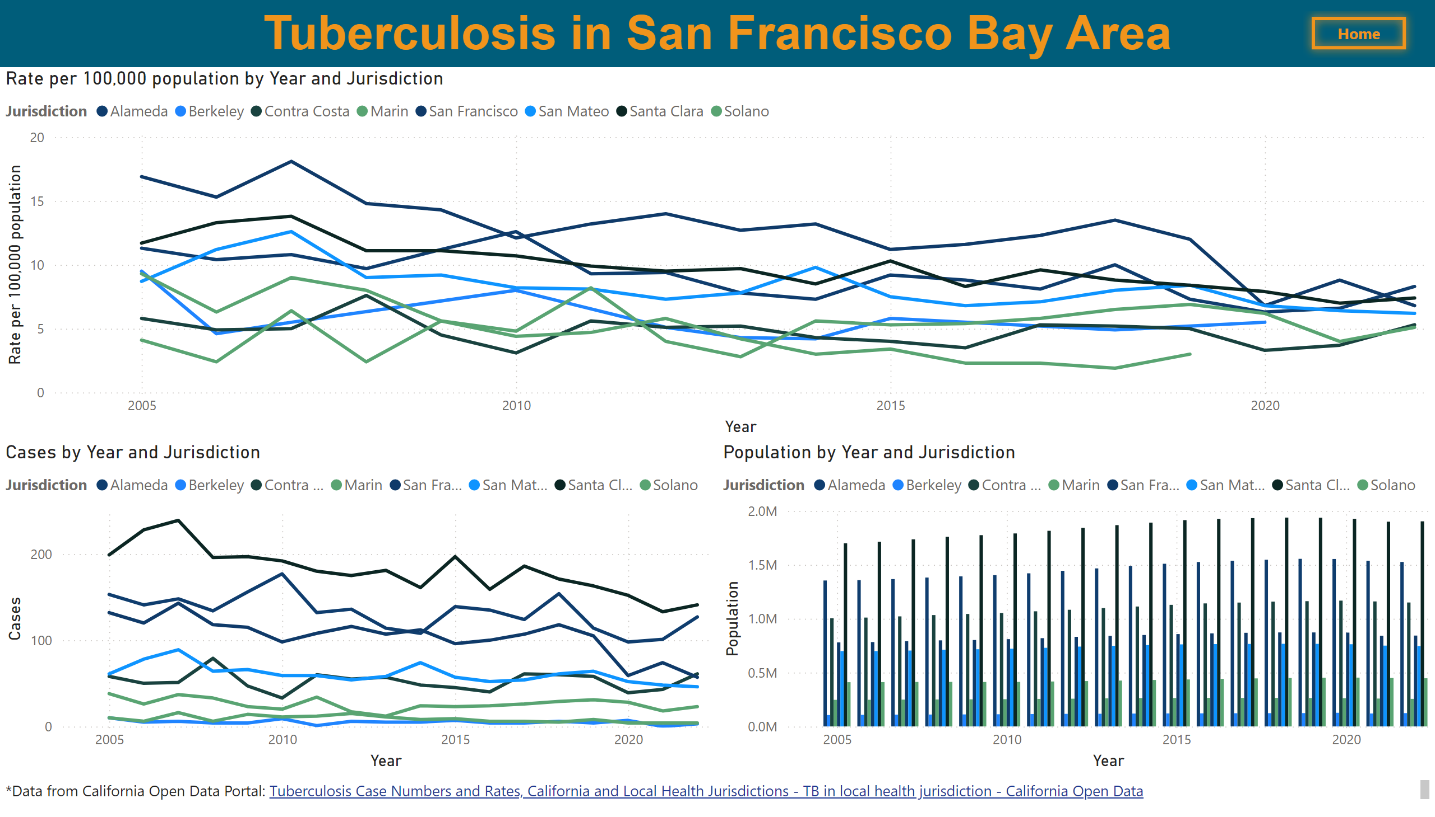
San Francisco Bay Area
Notes:
textbox
No alt text provided
Rate per 100,000 population by Year and Jurisdiction
No alt text provided
Cases by Year and Jurisdiction
No alt text provided
Population by Year and Jurisdiction
No alt text provided
textbox
No alt text provided
California
No alt text provided

Slide 7
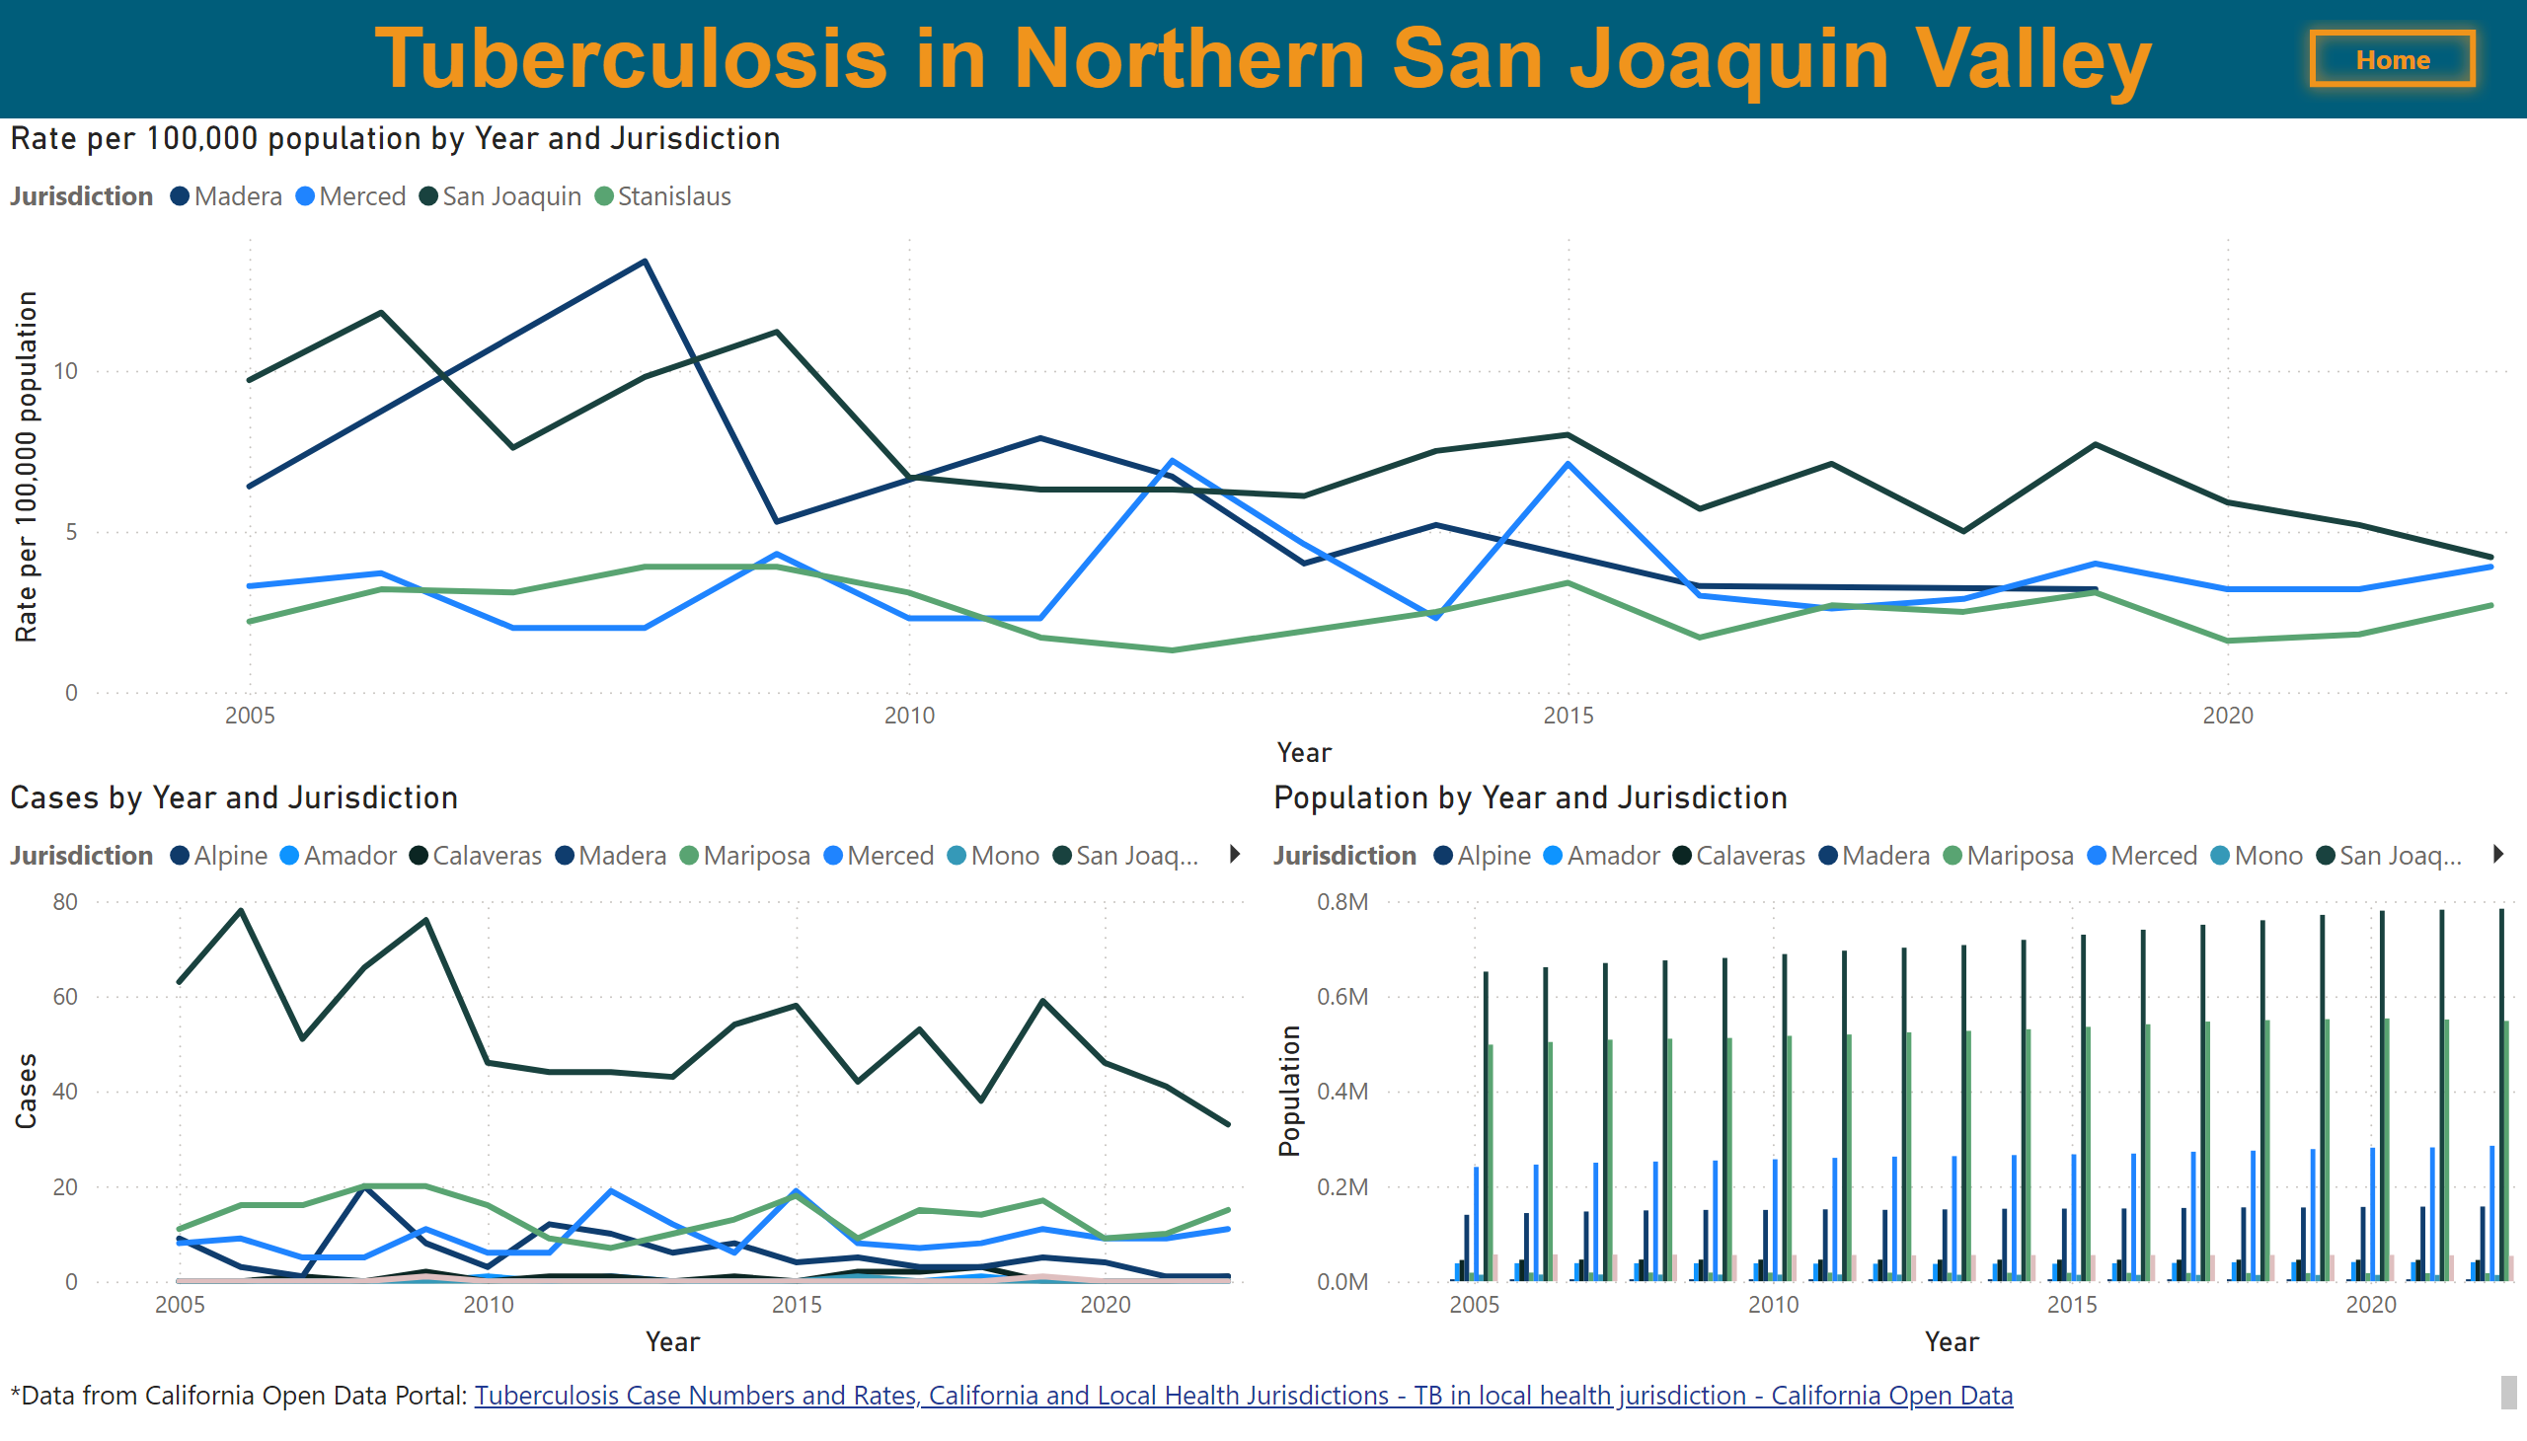
Northern San Joaquin Valley
Notes:
textbox
No alt text provided
Rate per 100,000 population by Year and Jurisdiction
No alt text provided
Cases by Year and Jurisdiction
No alt text provided
Population by Year and Jurisdiction
No alt text provided
textbox
No alt text provided
California
No alt text provided

Slide 8
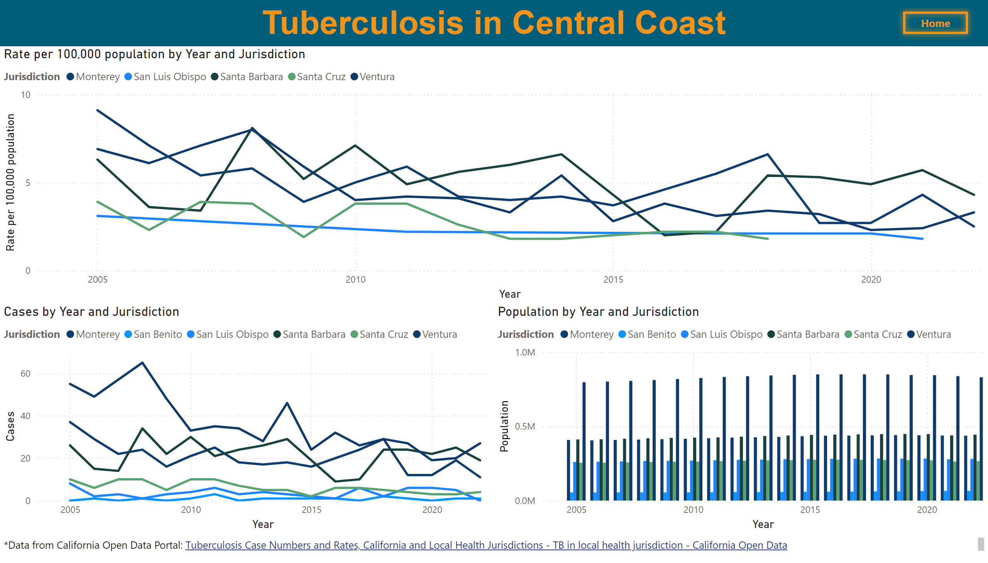
Central Coast
Notes:
textbox
No alt text provided
Rate per 100,000 population by Year and Jurisdiction
No alt text provided
Cases by Year and Jurisdiction
No alt text provided
Population by Year and Jurisdiction
No alt text provided
textbox
No alt text provided
California
No alt text provided

Slide 9
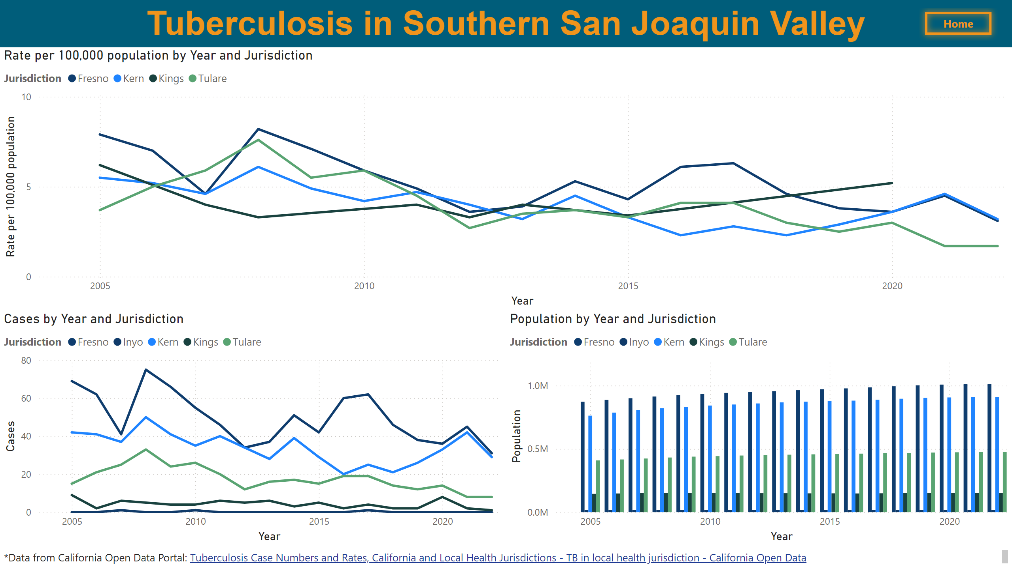
Southern San Joaquin Valley
Notes:
textbox
No alt text provided
Rate per 100,000 population by Year and Jurisdiction
No alt text provided
Cases by Year and Jurisdiction
No alt text provided
Population by Year and Jurisdiction
No alt text provided
textbox
No alt text provided
California
No alt text provided

Slide 10
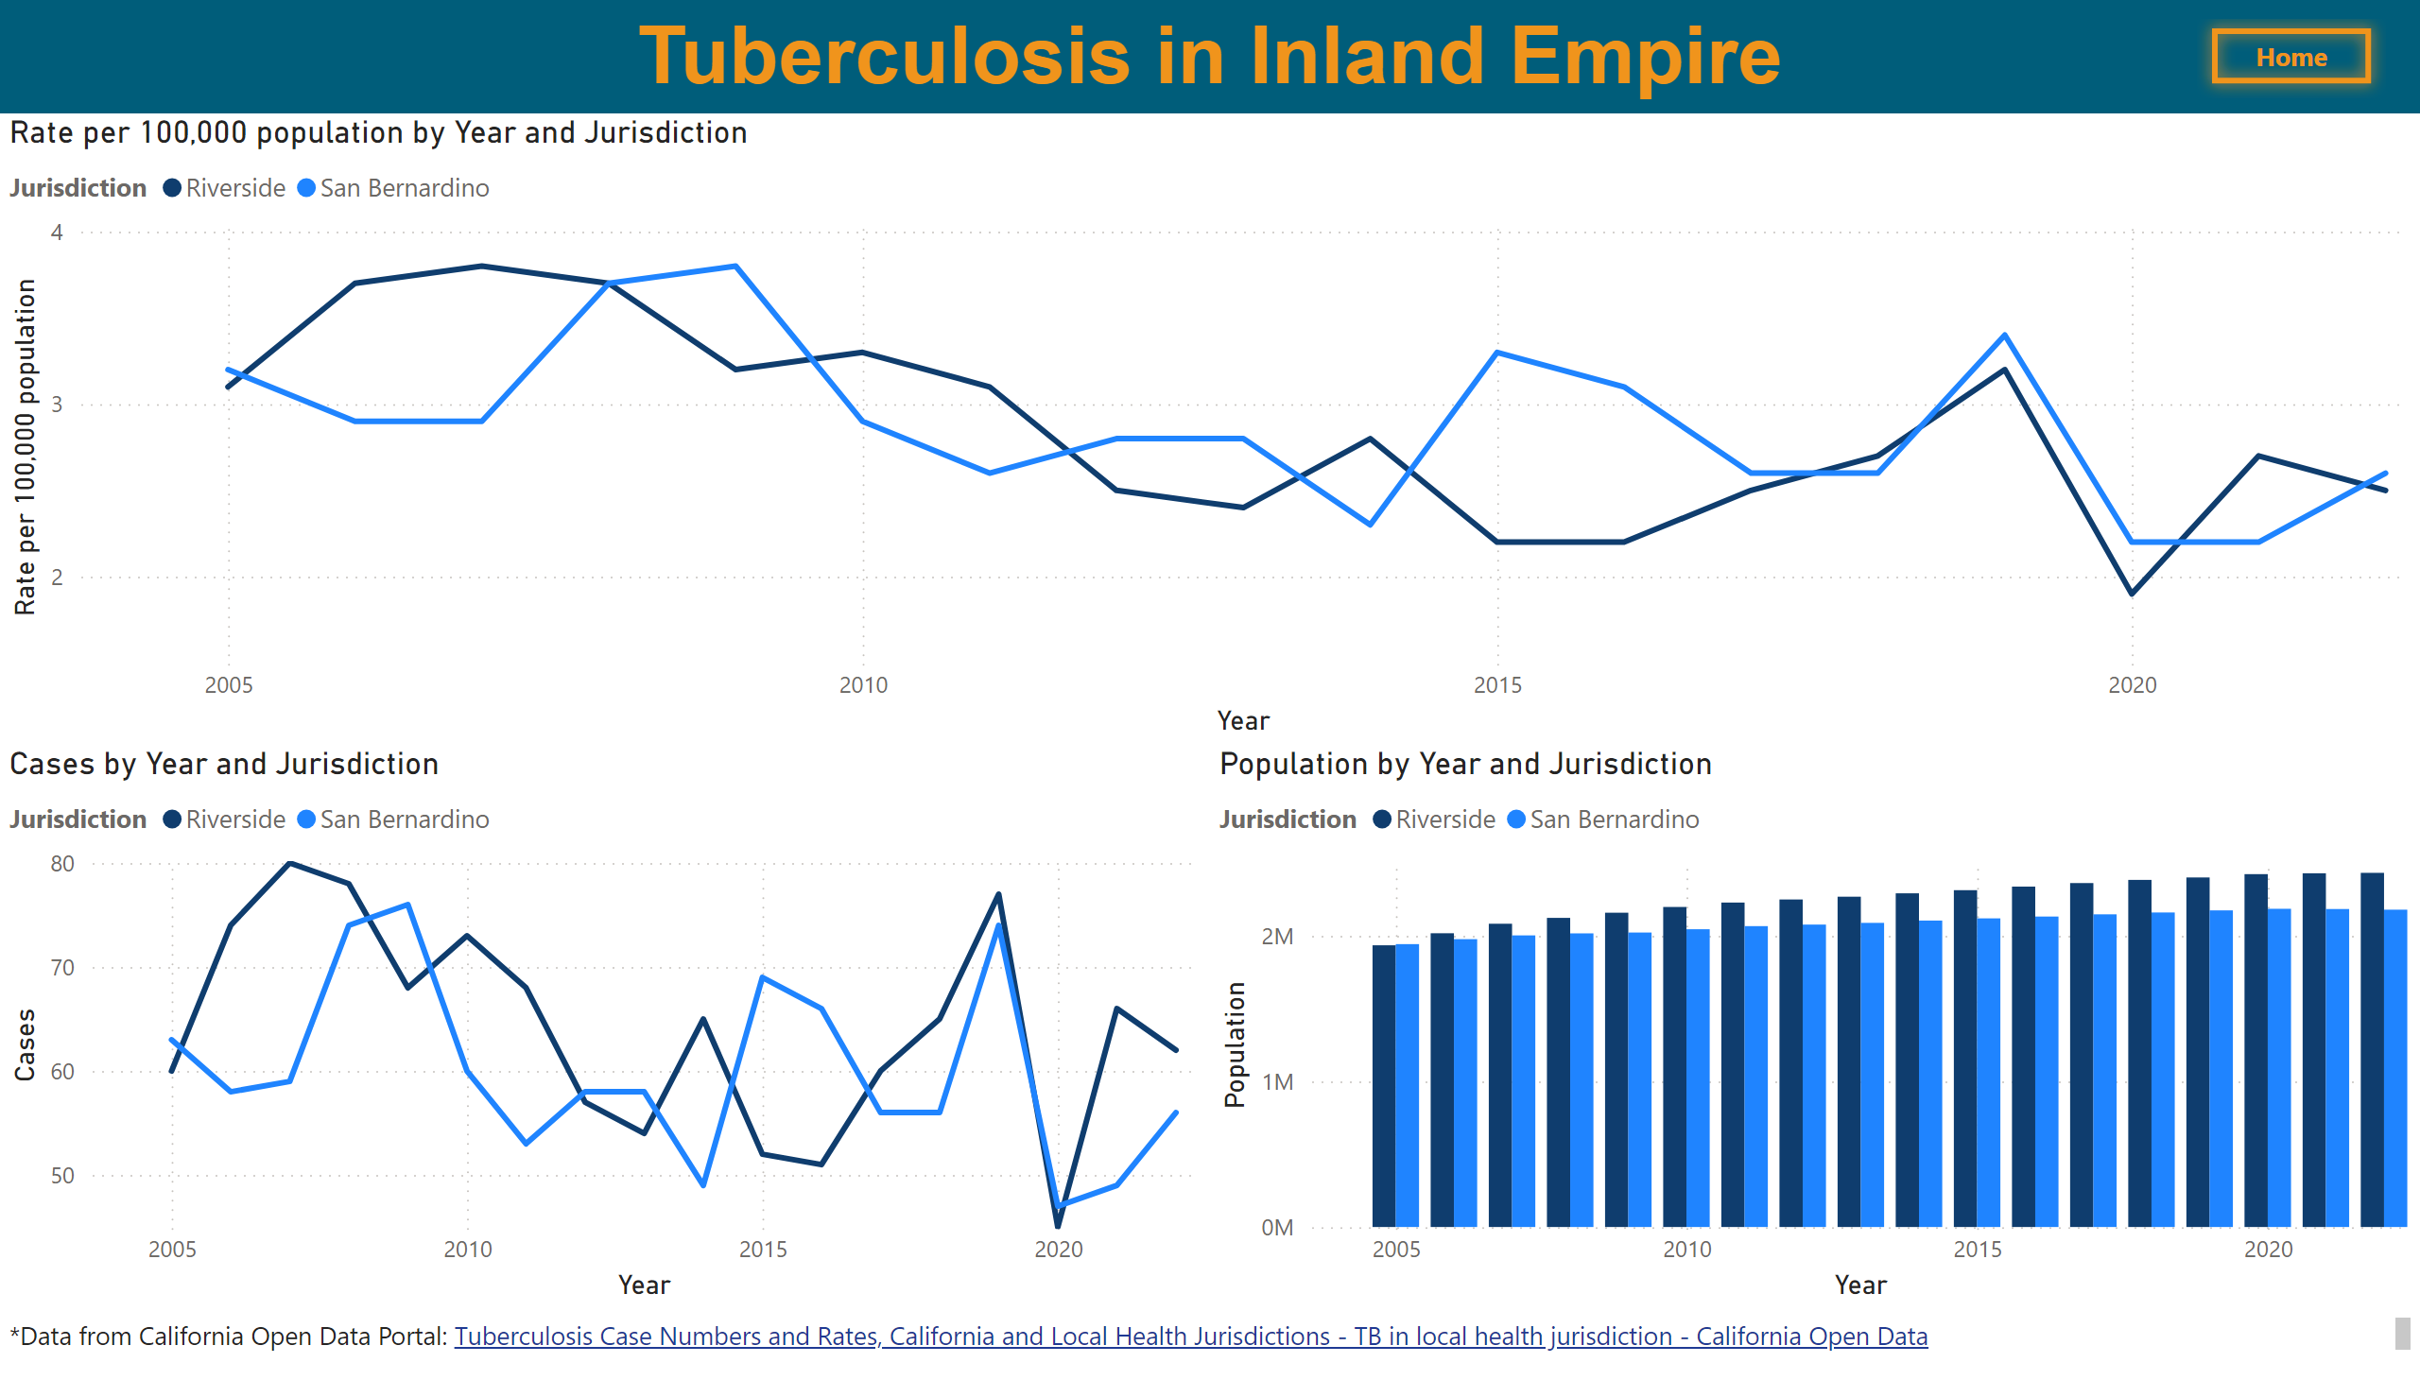
Inland Empire
Notes:
textbox
No alt text provided
Rate per 100,000 population by Year and Jurisdiction
No alt text provided
Cases by Year and Jurisdiction
No alt text provided
Population by Year and Jurisdiction
No alt text provided
textbox
No alt text provided
California
No alt text provided

Slide 11
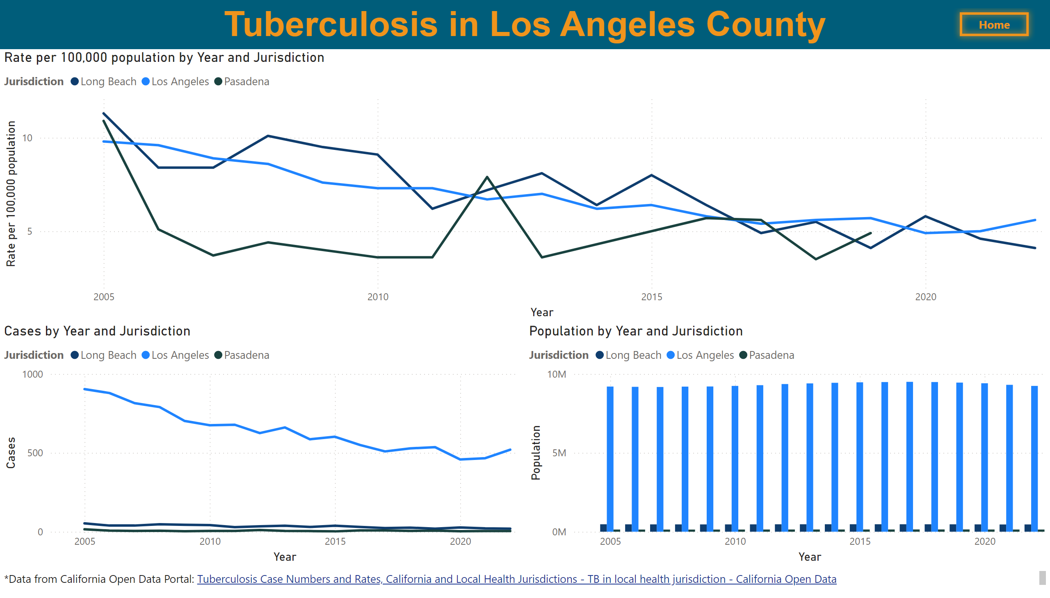
Los Angeles County
Notes:
textbox
No alt text provided
Rate per 100,000 population by Year and Jurisdiction
No alt text provided
Cases by Year and Jurisdiction
No alt text provided
Population by Year and Jurisdiction
No alt text provided
textbox
No alt text provided
California
No alt text provided

Slide 12
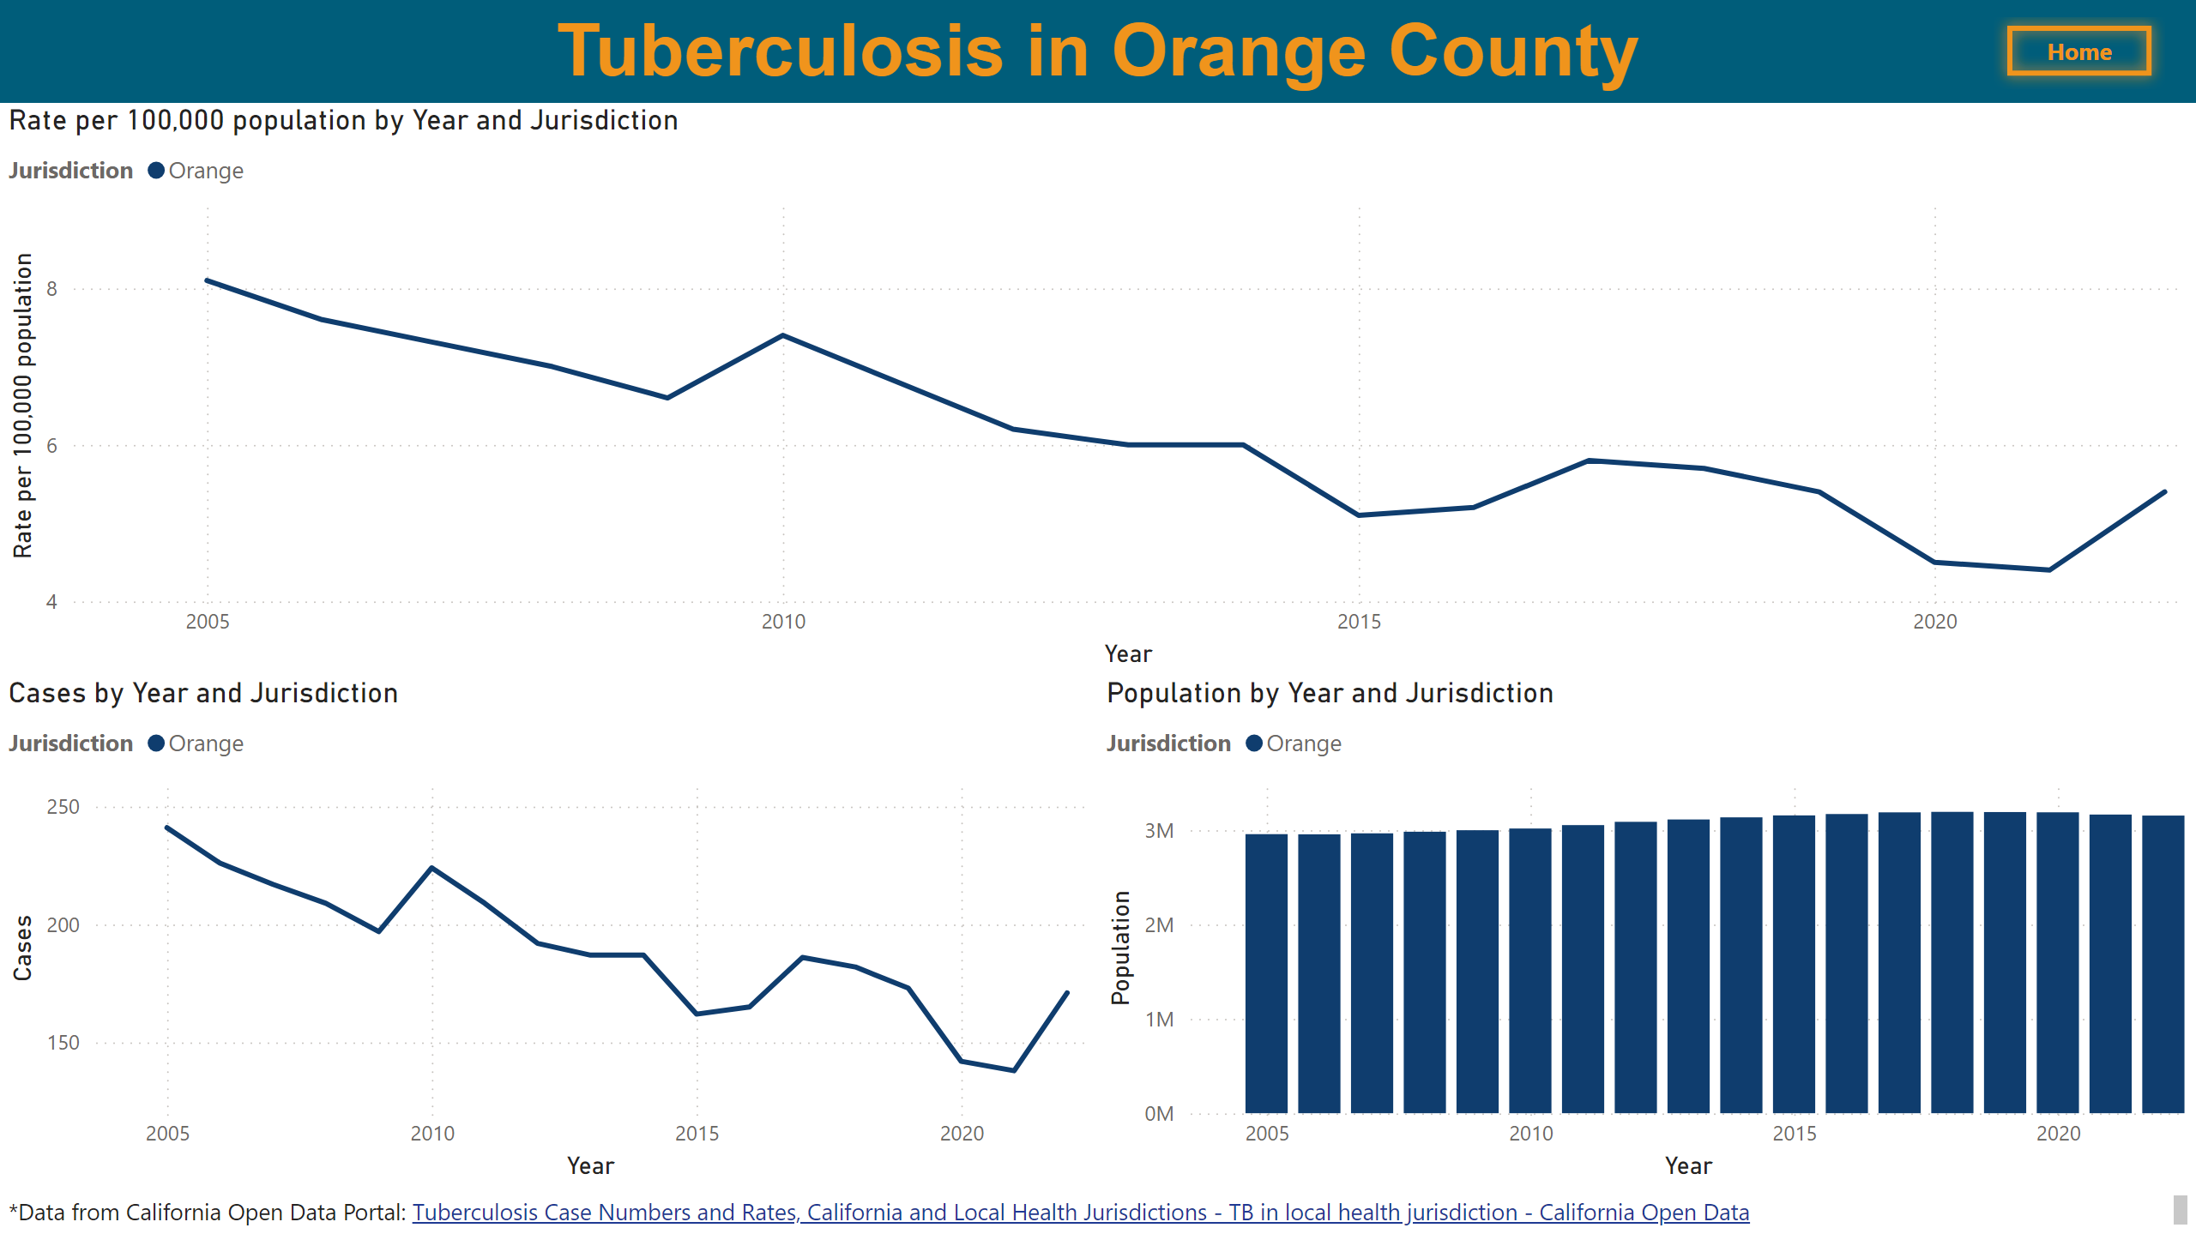
Orange County
Notes:
textbox
No alt text provided
Rate per 100,000 population by Year and Jurisdiction
No alt text provided
Cases by Year and Jurisdiction
No alt text provided
Population by Year and Jurisdiction
No alt text provided
textbox
No alt text provided
California
No alt text provided

Slide 13
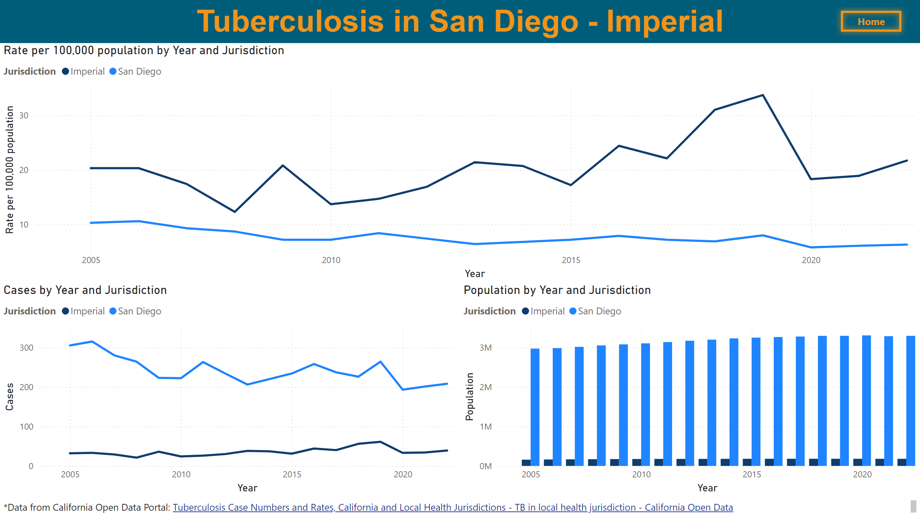
San Diego - Imperial
Notes:
textbox
No alt text provided
Rate per 100,000 population by Year and Jurisdiction
No alt text provided
Cases by Year and Jurisdiction
No alt text provided
Population by Year and Jurisdiction
No alt text provided
textbox
No alt text provided
California
No alt text provided

Slide 14
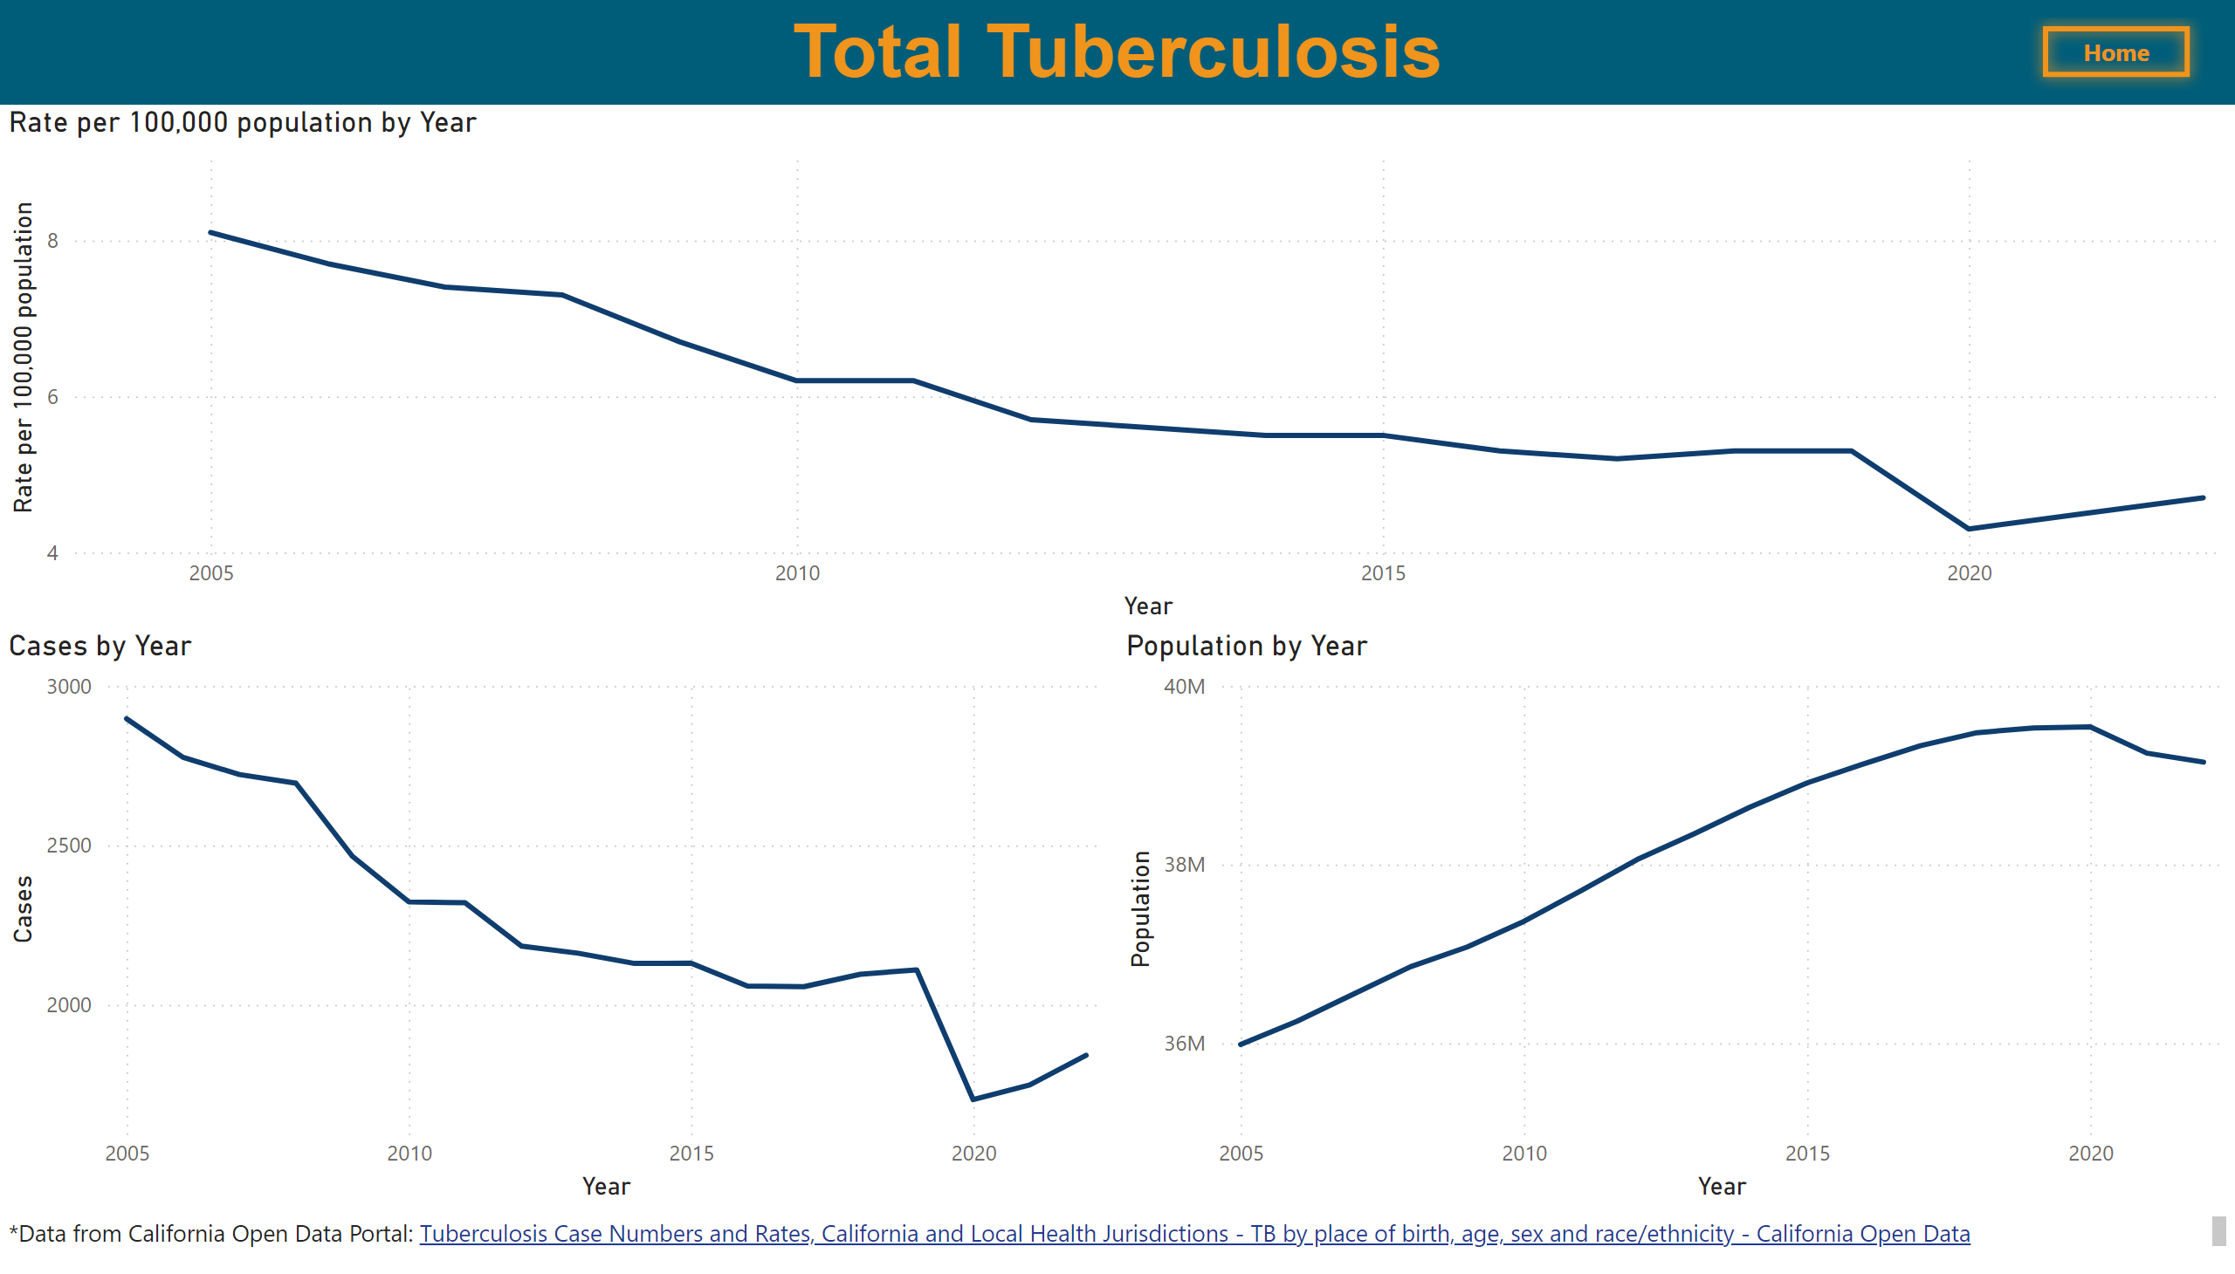
Total
Notes:
Cases by Year
No alt text provided
textbox
No alt text provided
Population by Year
No alt text provided
Rate per 100,000 population by Year
No alt text provided
textbox
No alt text provided
California
No alt text provided

Slide 15
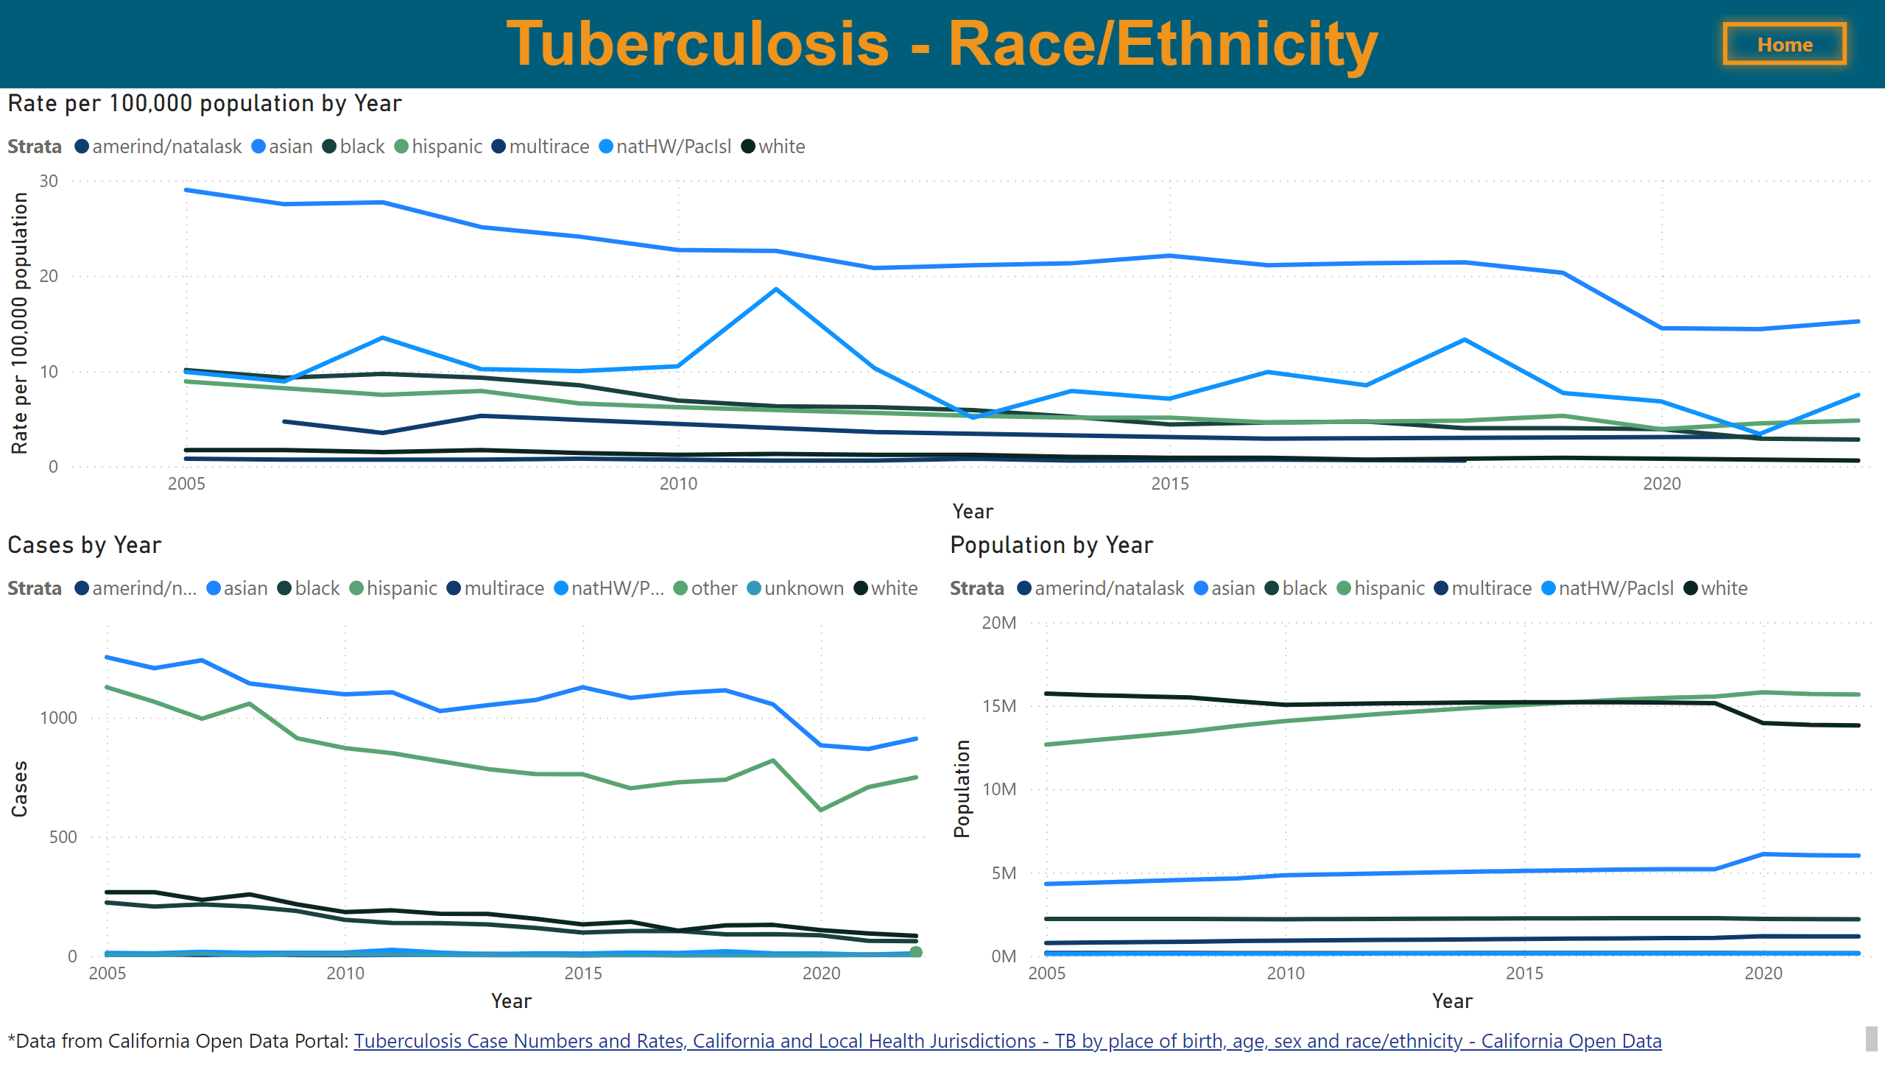
Race/Ethnicity
Notes:
Rate per 100,000 population by Year
No alt text provided
Cases by Year
No alt text provided
Population by Year
No alt text provided
textbox
No alt text provided
textbox
No alt text provided
California
No alt text provided

Slide 16
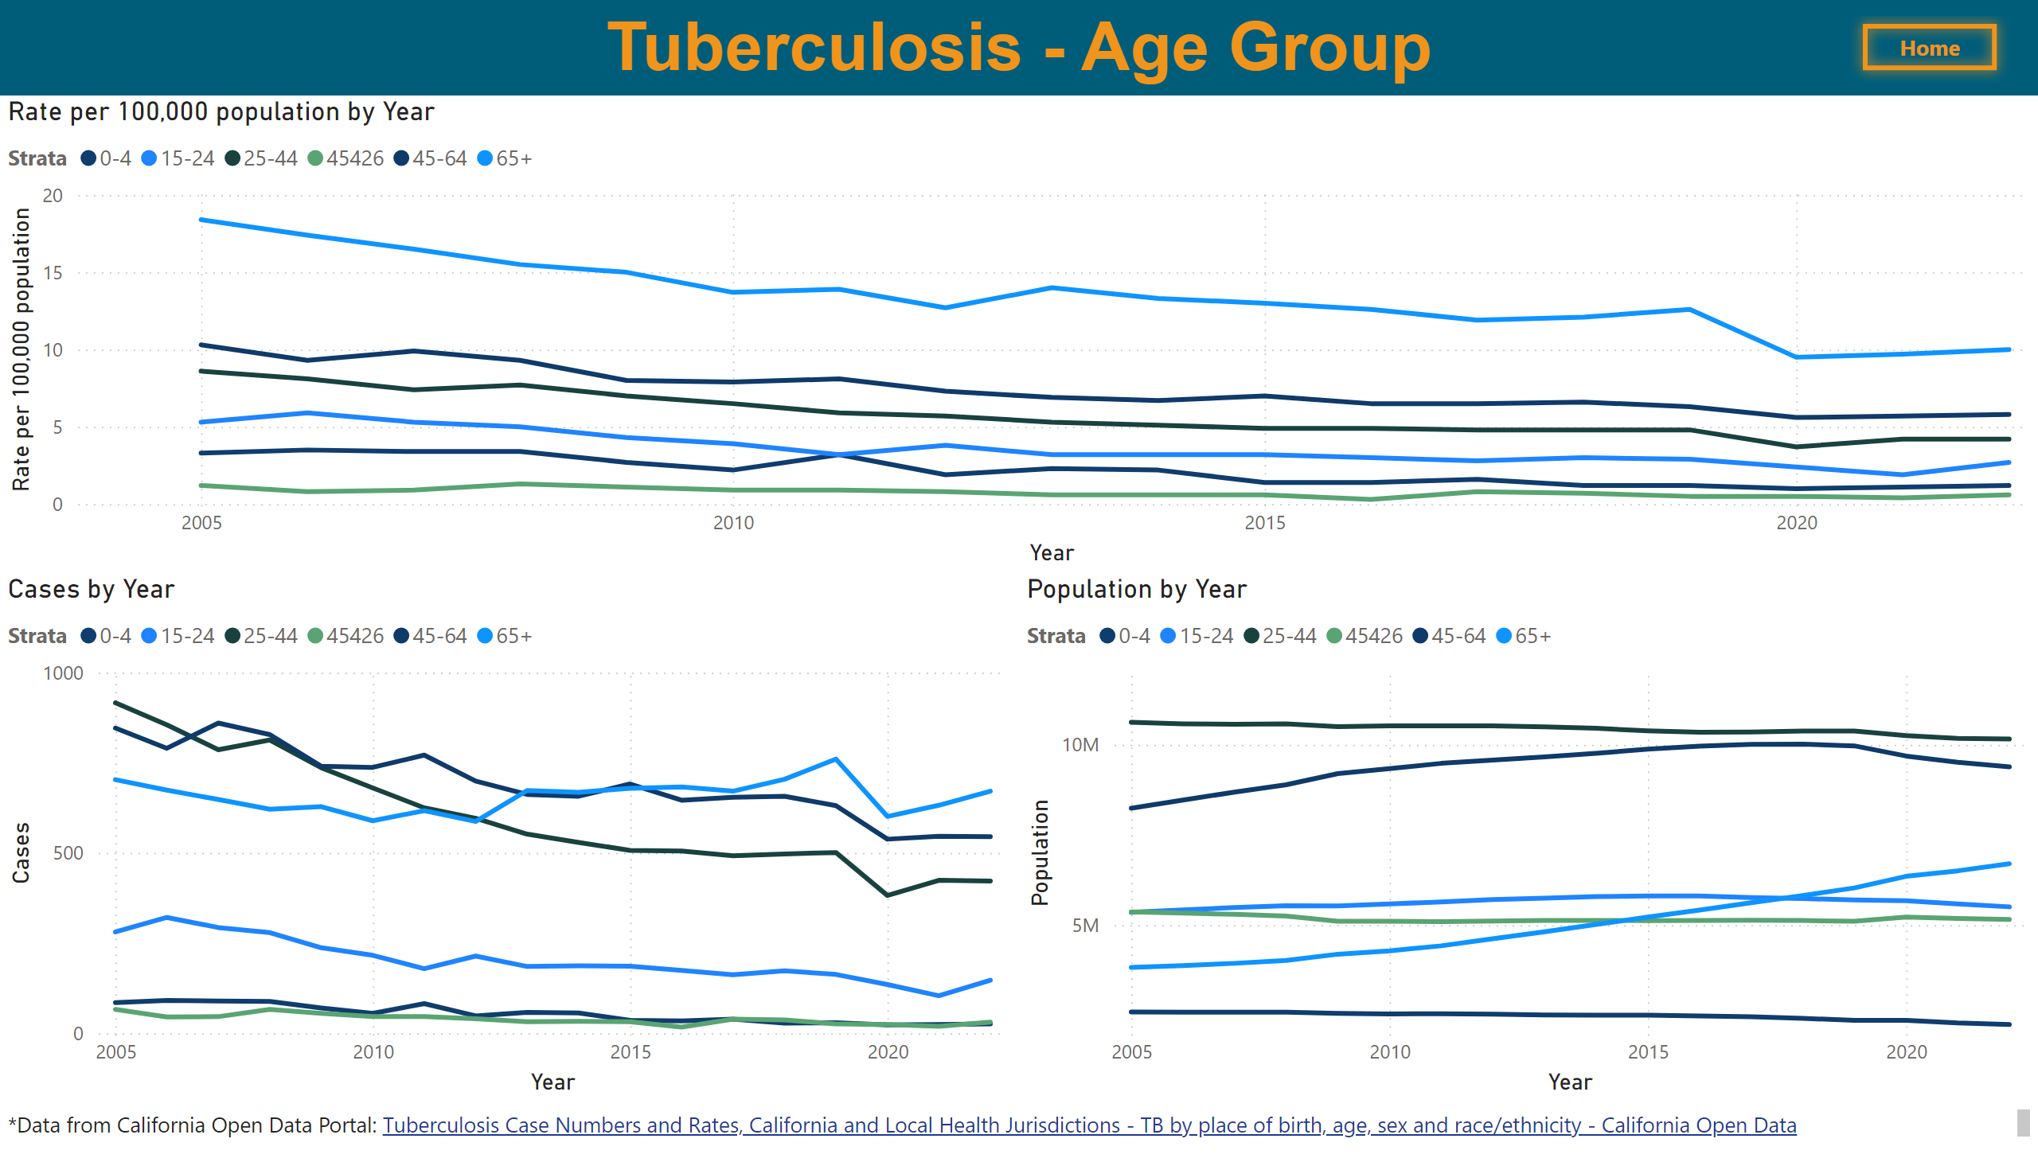
Age Group
Notes:
Rate per 100,000 population by Year
No alt text provided
Cases by Year
No alt text provided
Population by Year
No alt text provided
textbox
No alt text provided
textbox
No alt text provided
California
No alt text provided

Slide 17
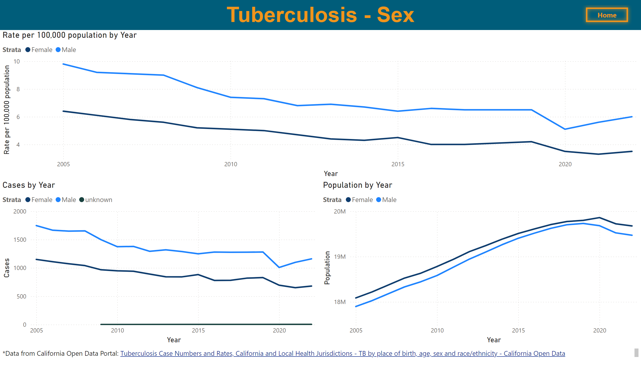
Sex
Notes:
Rate per 100,000 population by Year
No alt text provided
Cases by Year
No alt text provided
Population by Year
No alt text provided
textbox
No alt text provided
textbox
No alt text provided
California
No alt text provided

Slide 18
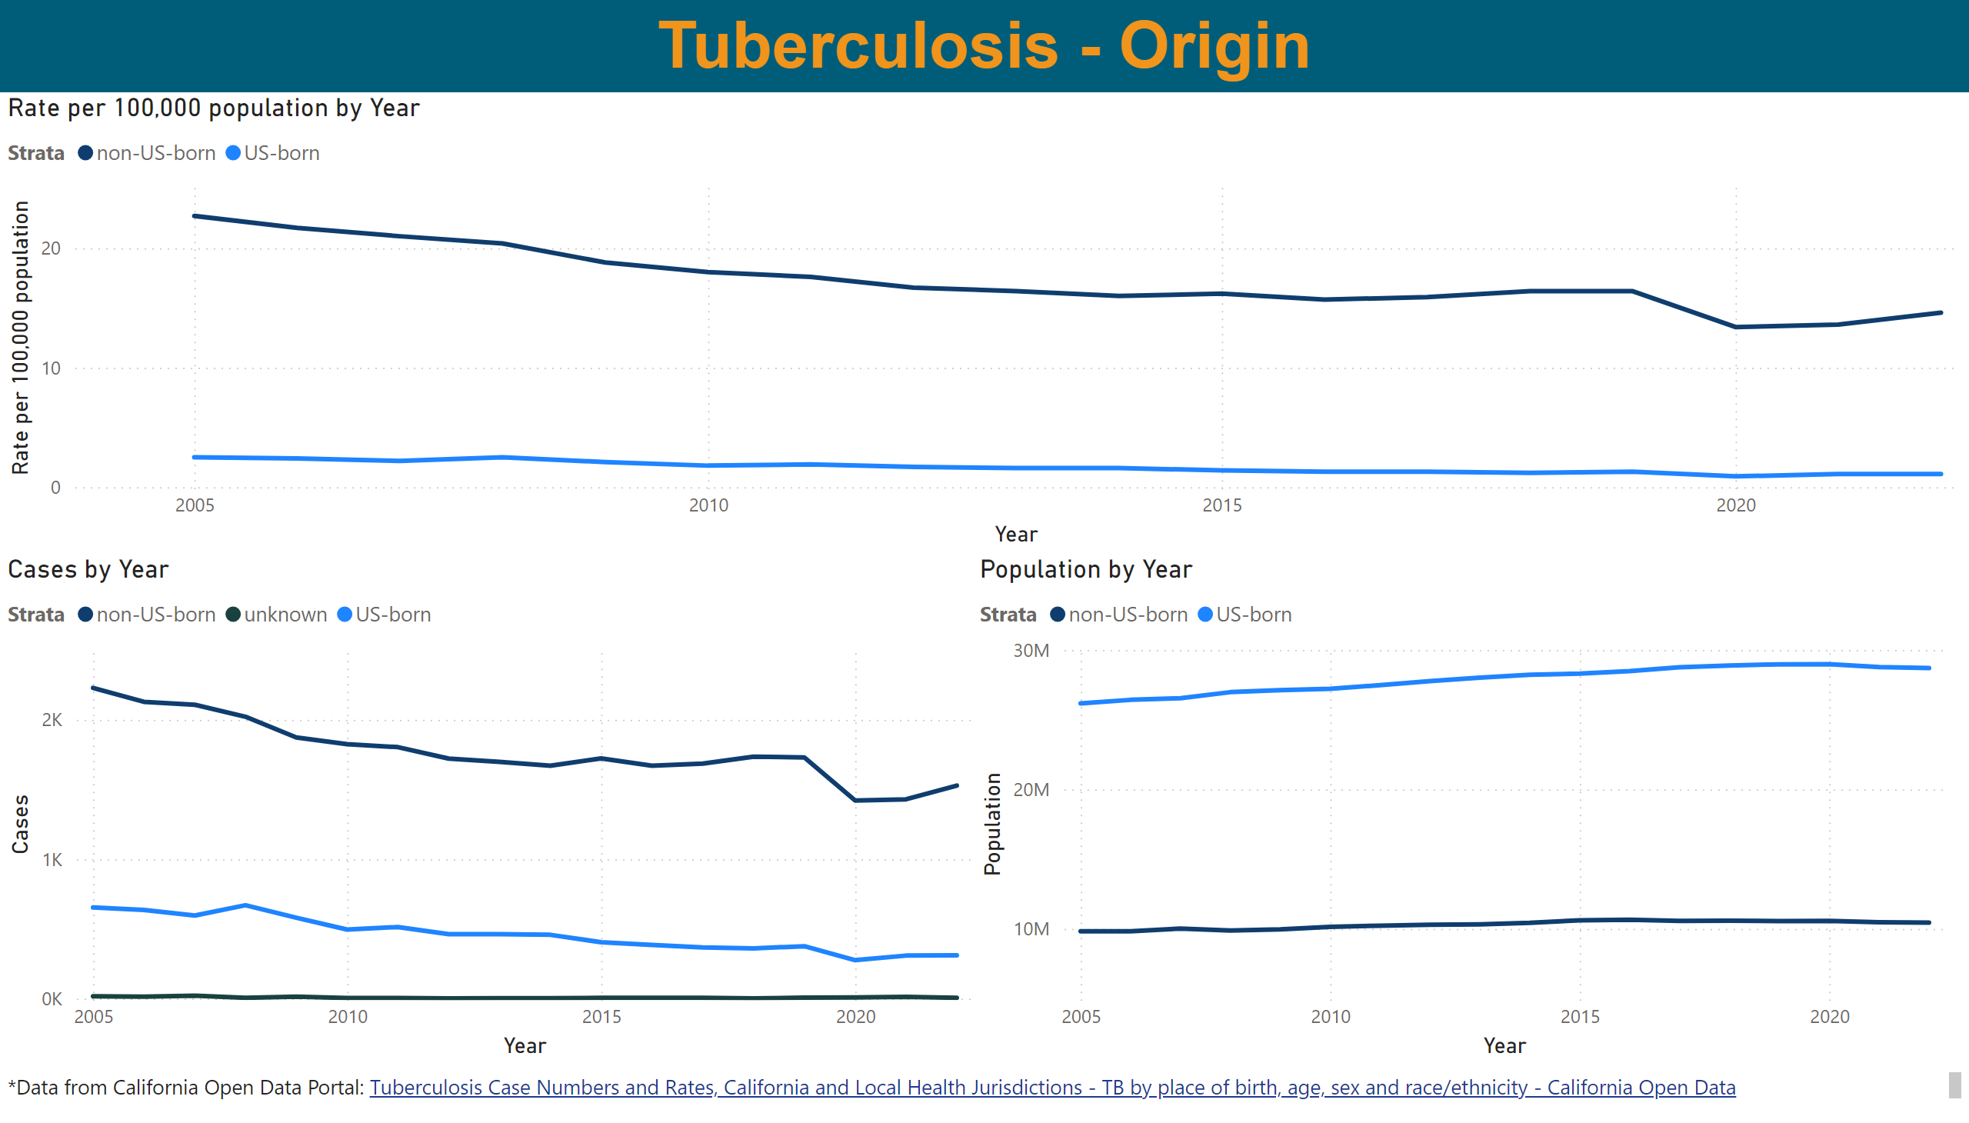
Origin
Notes:
Rate per 100,000 population by Year
No alt text provided
Cases by Year
No alt text provided
Population by Year
No alt text provided
textbox
No alt text provided
textbox
No alt text provided

