Slide 2
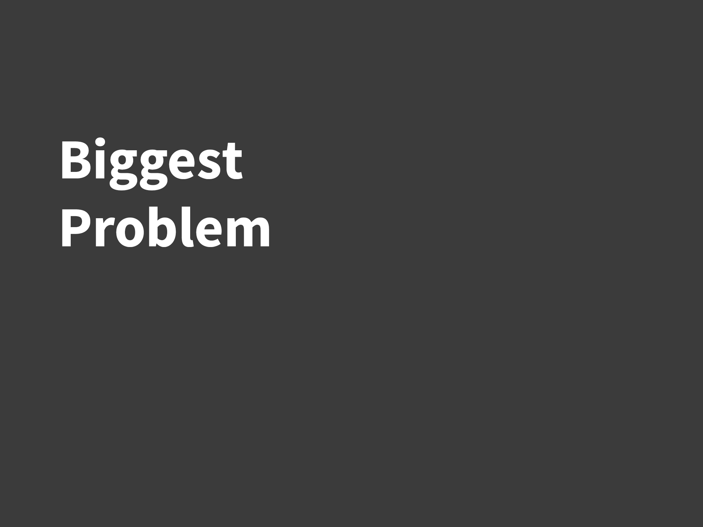
Notes:
A powerful technology is one that solves a big user problem.

Slide 3
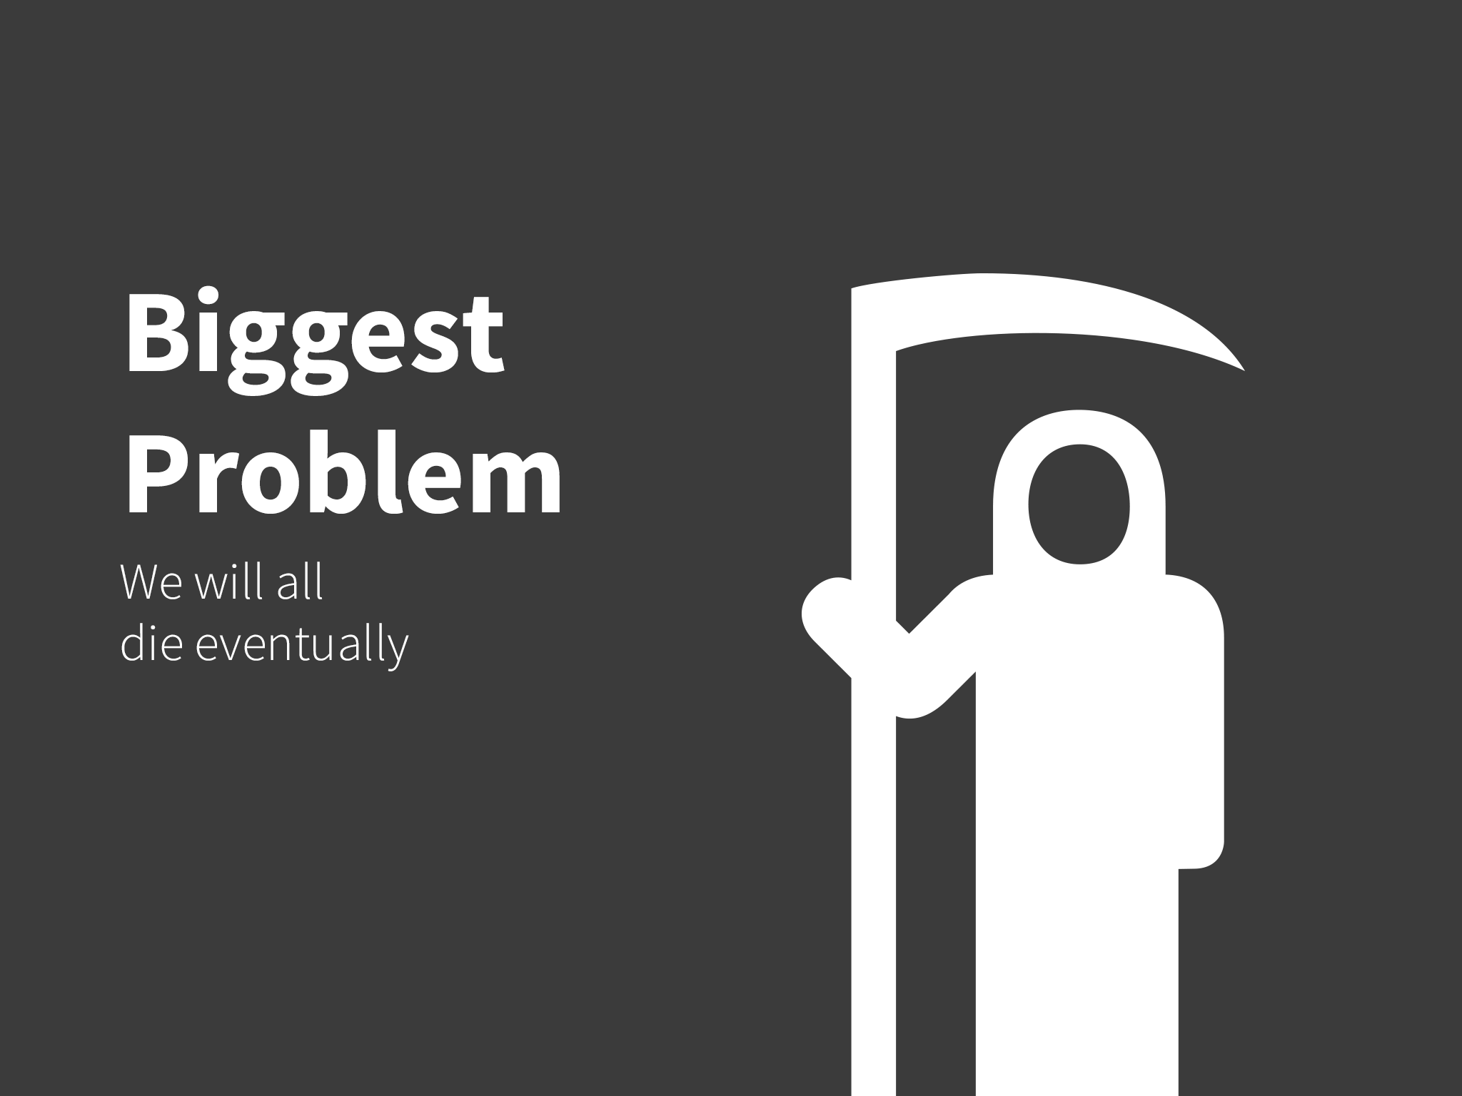
Notes:
And the biggest user problem is death. We have heart attacks, car crashes, and shark attacks. We are constantly bombarded by information about what can kill us. So what do we do? We do what’s normal

Slide 4
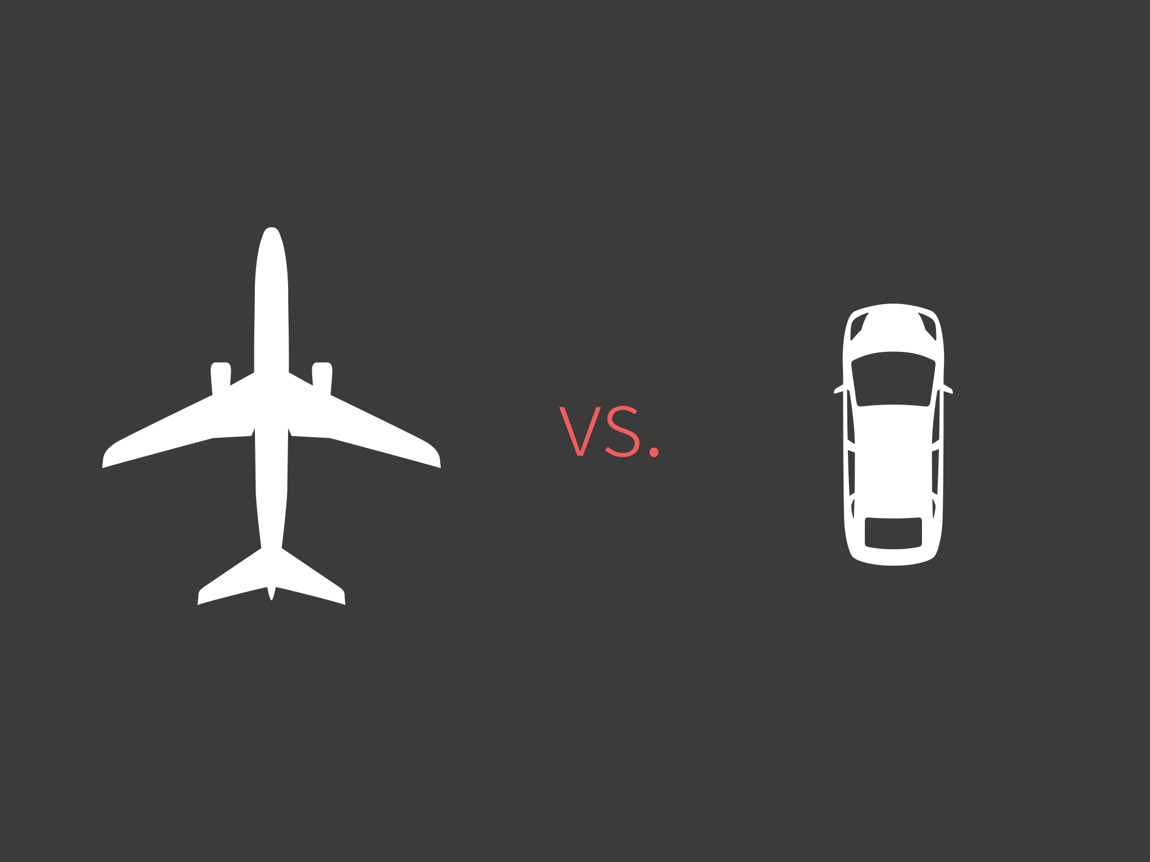
Notes:
Nothing. We’re so overwhelmed with death information we don’t make any informed decisions.

Slide 5
Relative Risk
Notes:
What we need is a way to measure not only risk, but relative risk so we can make better day to day decisions.

Slide 6
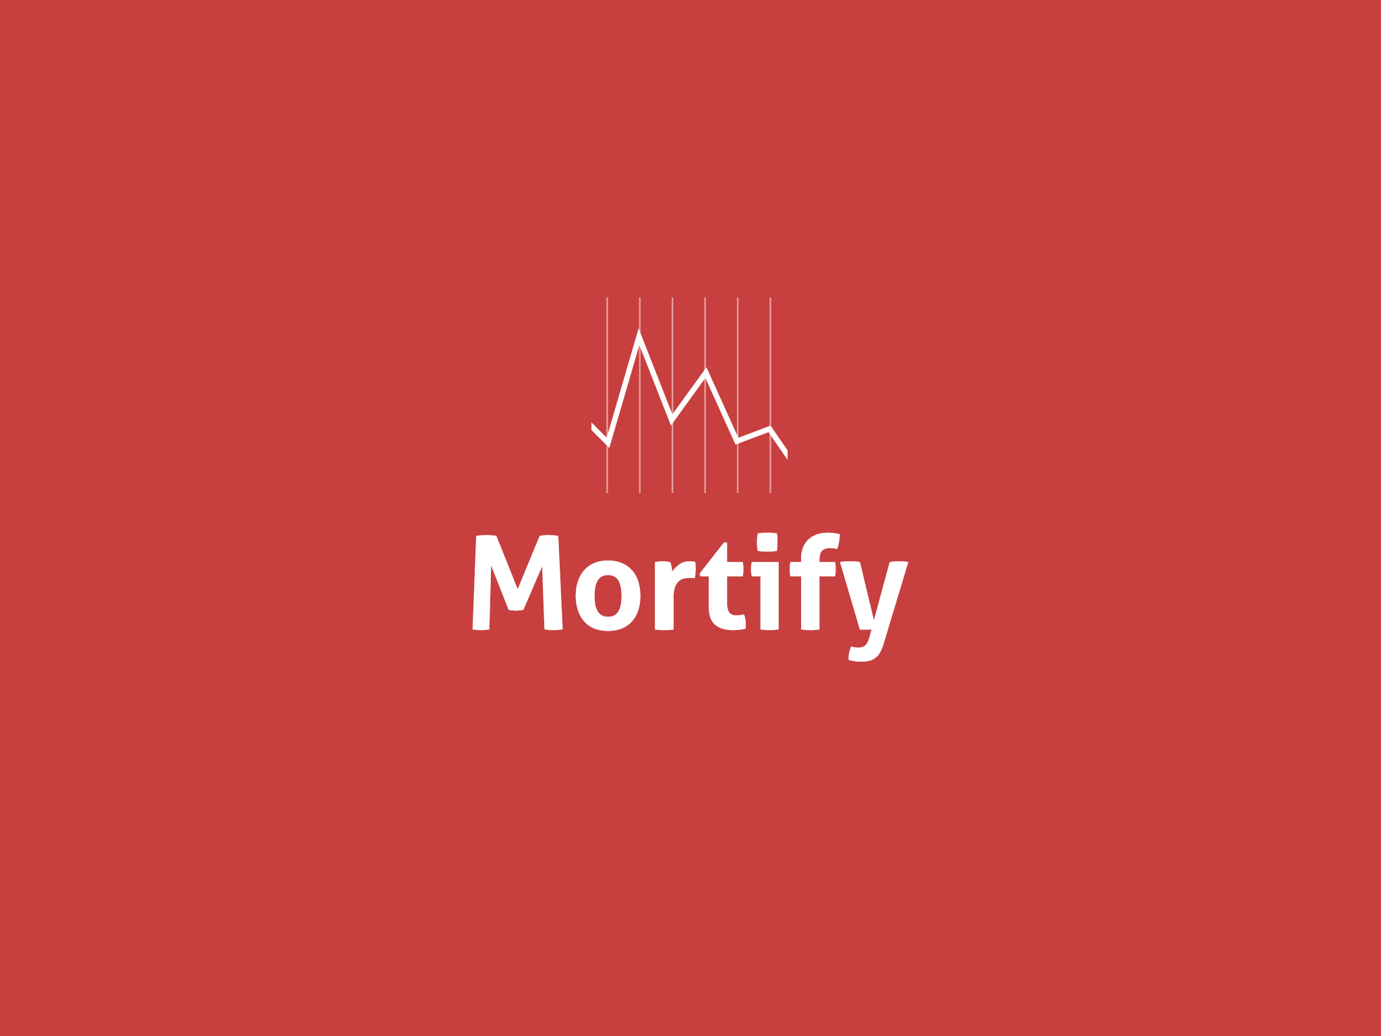
Notes:
Meet Mortify, the app that gamifies death. How? By using a unit called a micromort, and universal unit of the risk of death.

Slide 7
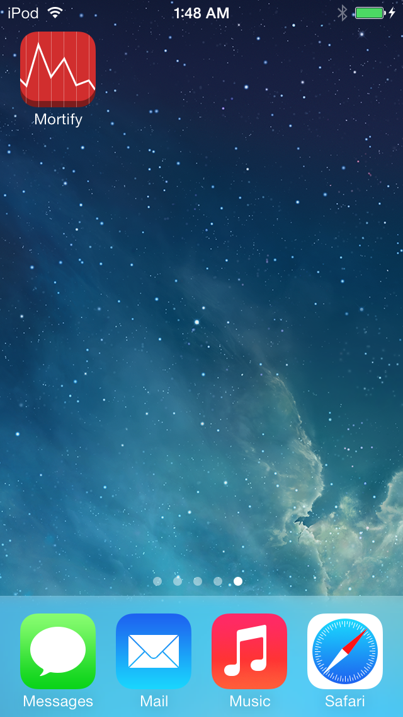
Notes:
In mortify you not only can look up activities to compare relative risk, but you can log them to optimize an increase or decrease in your life expectancy. For example:

Slide 8
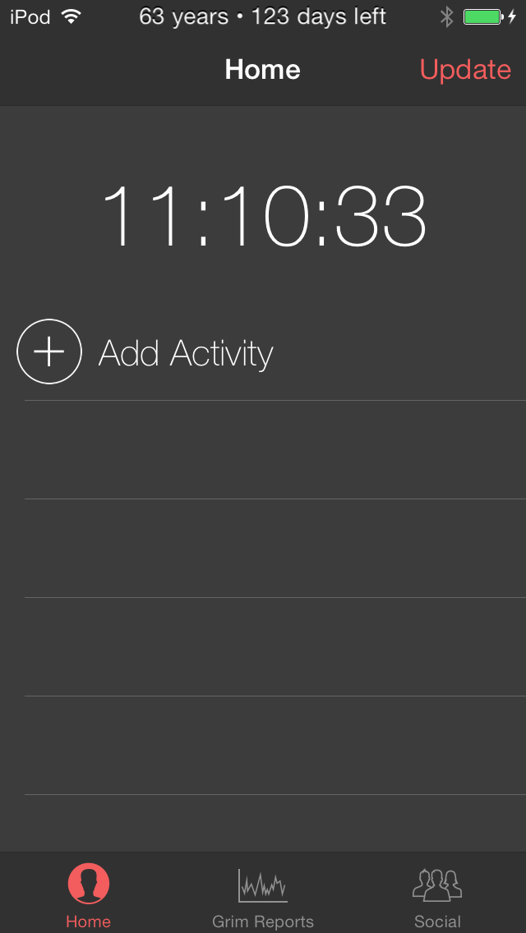
Notes:
lets add a few activities driving, sitting and biking. Notice we have metrics for any activity, the relative weights of such

Slide 9
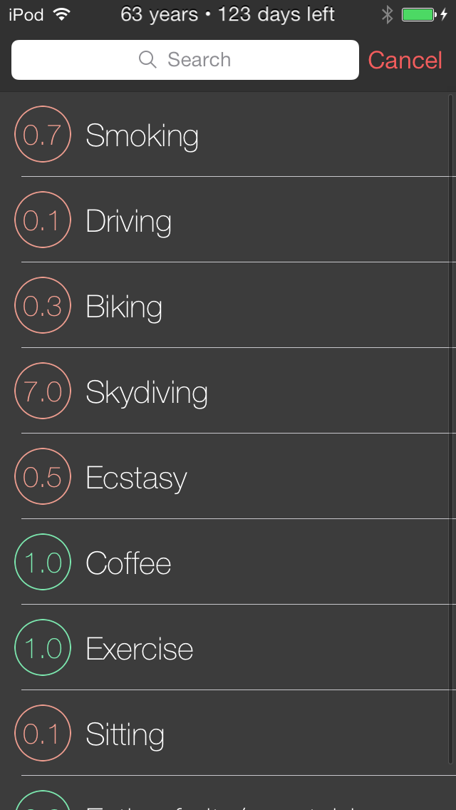
Notes:
And now lets update their life expectancy.

Slide 10
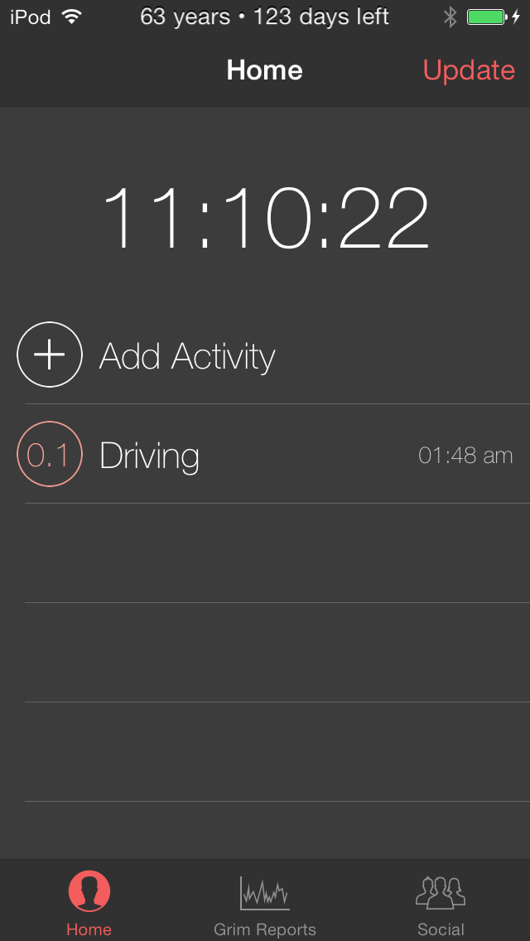
Notes:
We look to moneytize this application in one of two ways. We will put the best long term anaylsis tools behind a paywall. Also the unique data that we will receive puts us in a very good position in terms of targetted marketing

Slide 11
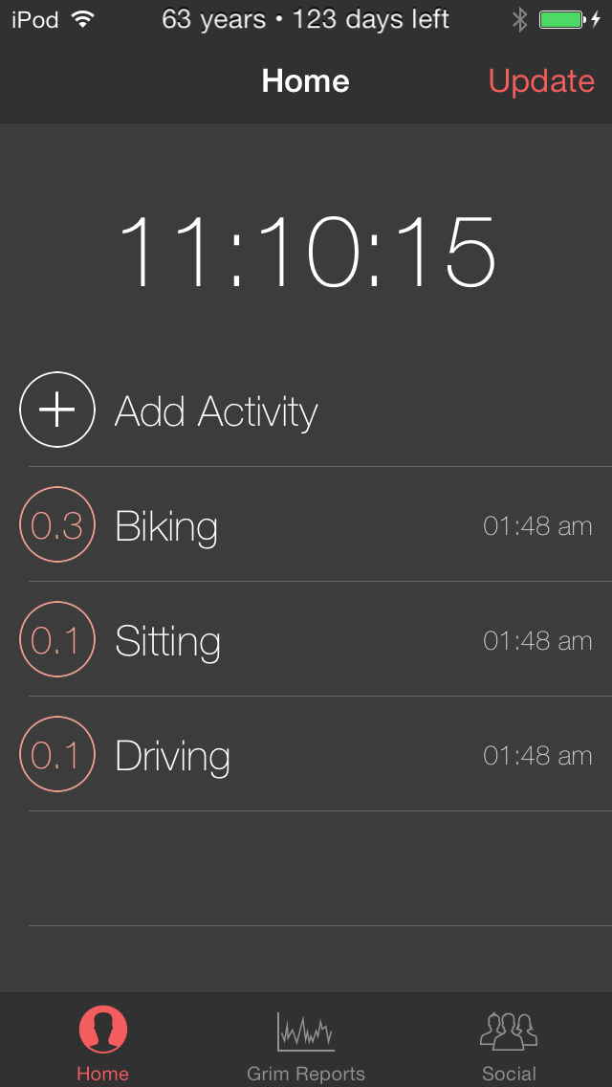
Notes:
We look to moneytize this application in one of two ways. We will put the best long term anaylsis tools behind a paywall. Also the unique data that we will receive puts us in a very good position in terms of targetted marketing

Slide 12
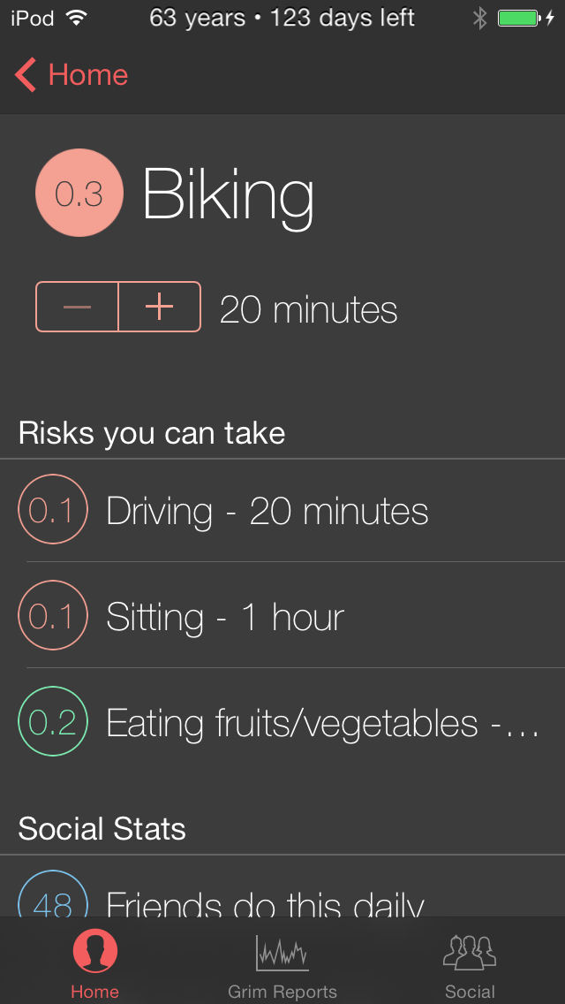
Notes:
We look to moneytize this application in one of two ways. We will put the best long term anaylsis tools behind a paywall. Also the unique data that we will receive puts us in a very good position in terms of targetted marketing

Slide 13
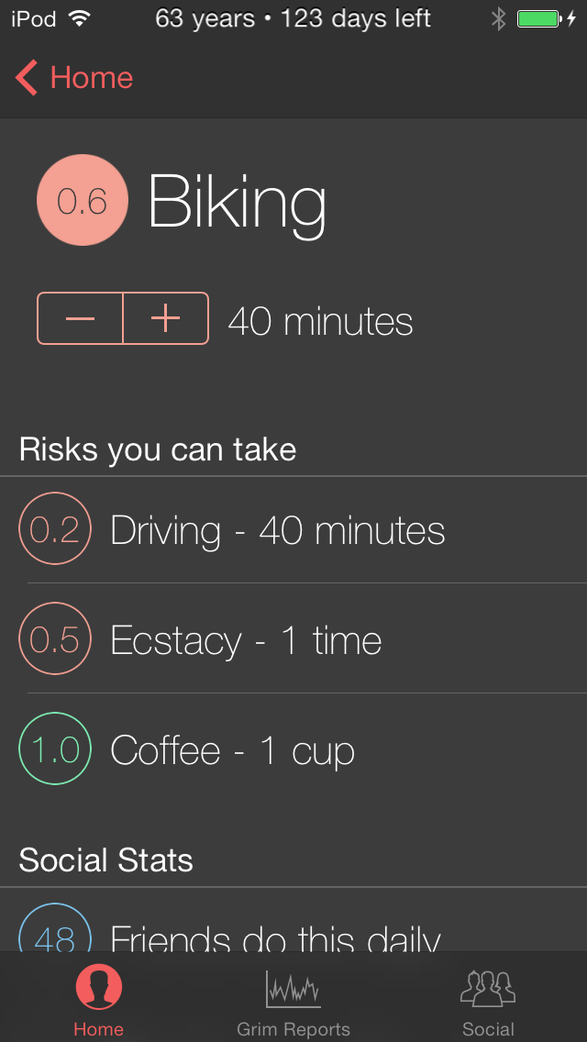
Notes:
We look to moneytize this application in one of two ways. We will put the best long term anaylsis tools behind a paywall. Also the unique data that we will receive puts us in a very good position in terms of targetted marketing

Slide 14
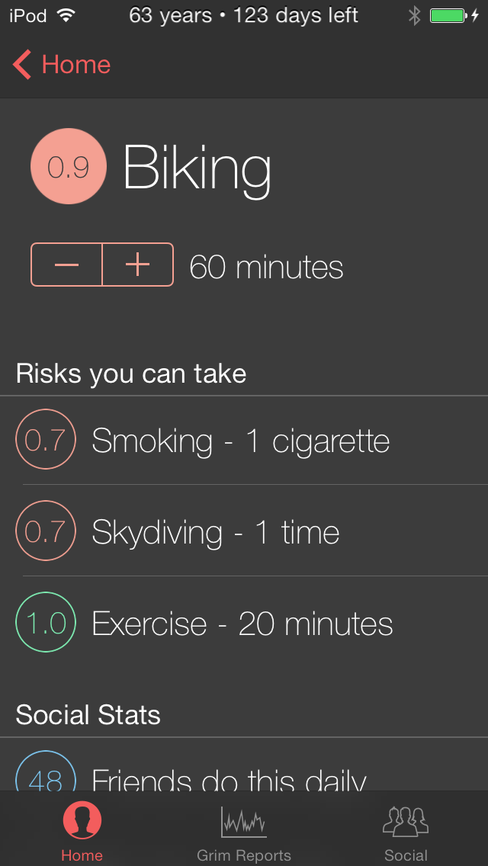
Notes:
We look to moneytize this application in one of two ways. We will put the best long term anaylsis tools behind a paywall. Also the unique data that we will receive puts us in a very good position in terms of targetted marketing

Slide 15

Notes:
We look to moneytize this application in one of two ways. We will put the best long term anaylsis tools behind a paywall. Also the unique data that we will receive puts us in a very good position in terms of targetted marketing

Slide 16
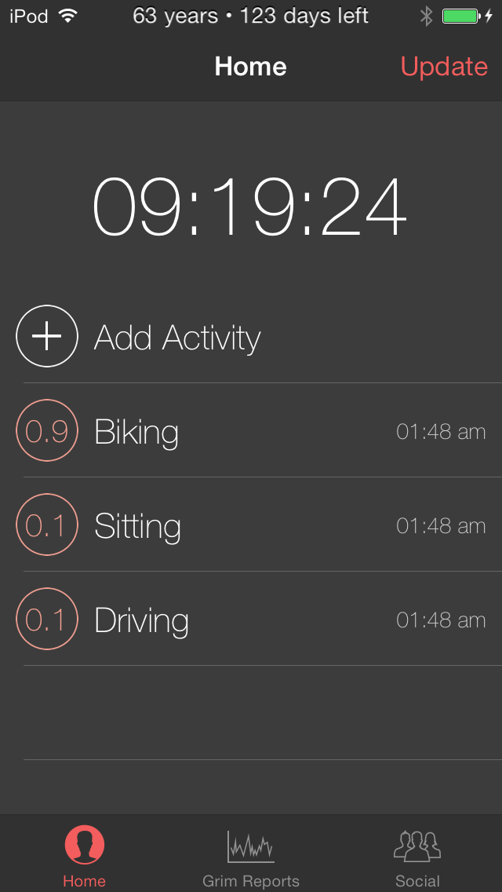
Notes:
We look to moneytize this application in one of two ways. We will put the best long term anaylsis tools behind a paywall. Also the unique data that we will receive puts us in a very good position in terms of targetted marketing

Slide 17
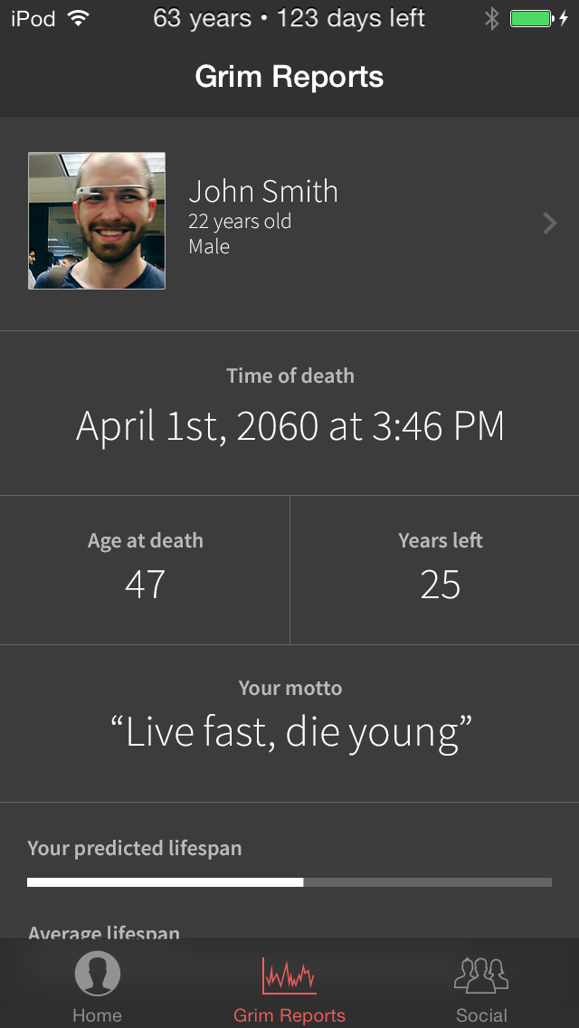
Notes:
We look to moneytize this application in one of two ways. We will put the best long term anaylsis tools behind a paywall. Also the unique data that we will receive puts us in a very good position in terms of targetted marketing

Slide 18
Notes:
We look to moneytize this application in one of two ways. We will put the best long term anaylsis tools behind a paywall. Also the unique data that we will receive puts us in a very good position in terms of targetted marketing

