Slide 1
Gradient Boosted Machines

Slide 2
Agenda

Slide 3
Today’s Talk
1
GBM Algorithm
3
Best Practices
2
GBM in H2O
2
GBM Demo

Slide 4
GBM Algorithm

Slide 5
What is a Decision Tree?
1
Separate the data into a left and right bucket by splitting on a feature.
2
Choose the point and feature as the one that causes the greatest reduction in the error function.
Example: Squared error (predicted – actual)²
Advantage
Disadvantage
Robust
Intuitive
Non-linear
Poor Accuracy

Slide 6
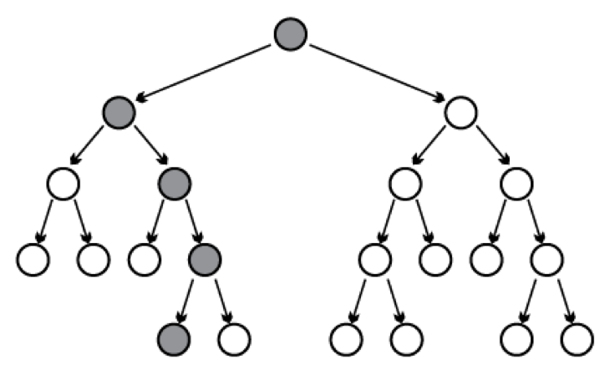
What is GBM?
1
Make Initial Prediction
f₀ = 0
2
Calculate Residuals
r = y – f₀
3
Build Regression Tree on Residuals
h =
Fits consecutive trees where each solves for the net loss of the prior trees.
f₁ = f₀ + learn_rate * h
Results of new tree are partially applied to the entire solution.
4
Update

Slide 7
When to use GBM?
Advantages
Disadvantages
Often the best model
Nonlinear models
Robust to correlated features
Robust to feature distribution
Robust to missing values
Tends to overfit on the training set
Sensitive to noise and outliers
Several hyper-parameters

Slide 8
H2O Implementation of GBM

Slide 9
Scalable Implementation in H2O
1
Parallel Data Ingest
2
Distributed Tree Building via Fine-Grain Map/Reduce to find optimal split points of data layer by layer
Start with root node and build layers of tree nodes [ILLUSTRATION BELOW]
For each layer, repeat the following:
For a set of features, split the data at every possible split point
Find the split that leads to best model improvement
Use discretization to limit the number of potential splits
To find the split, local histograms are calculated on each node and then aggregated into a global histogram
From the global histogram, the best split column is chosen
Data is stored in-memory on all cluster compute nodes
Rows are evenly distributed across the cluster
Columns are stored separately and compressed
Basis for fine-grain Map/Reduce for histogram calculation
For each layer, iterate

Slide 10
Scalable Distributed Histogram Calculation
Parallel Parse into Distributed Rows
Fine Grain Map Reduce Illustration: Scalable Distributed Histogram Calculation for GBM

Slide 11
GBM Functionalities in H2O
Regression and Classification Models Exponential distributions including Poisson, Gamma, and Tweedie are available in addition to Bernoulli, multinomial, and gaussian distributions.
Fast and CPU Efficient Parallel and distributed computation across multiple nodes and many cores.
Grid Search Hyperparameter optimization allows the user to run through many parameters before selecting the best models.
Early Stopping The user can specify the metric and the incremental change in the metric as convergence. If additional trees no longer provide an increase in AUC prune the tree early.
Stochastic User can specify the sample rate that the algorithm will sample the column and row by for better generalization.
Model Output The model is exportable as Java code and if you find the model overfitted after a certain number of trees, it is easy to reduce the number of trees in a POJO before putting it in production without rerunning model build.

Slide 12
GBM: Best Practices

Slide 13
Establish a Validation Schema
Training Data | Model Tuning
Validation Data | Parameter Tuning
Testing Data | Final estimate of generalization error

Slide 14
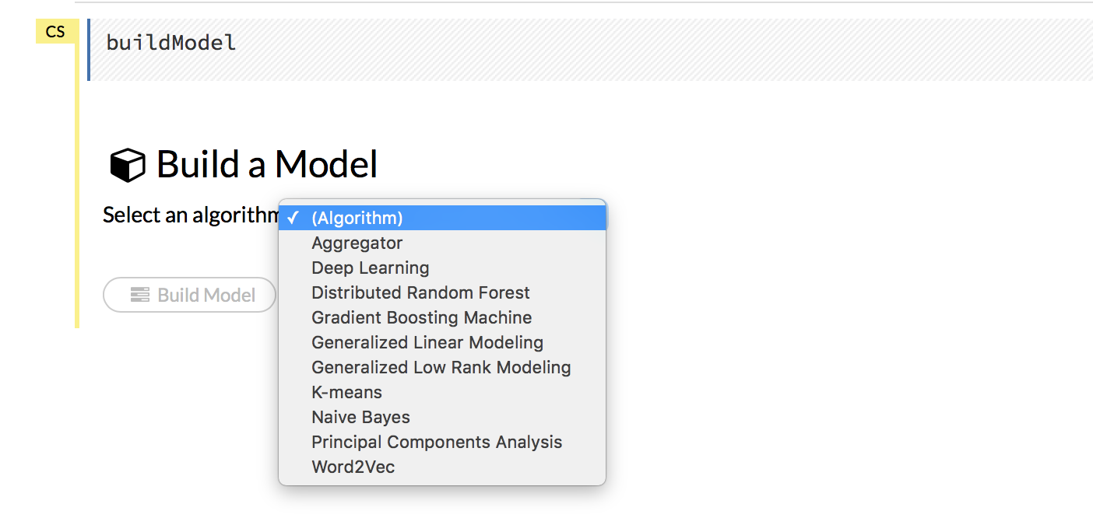
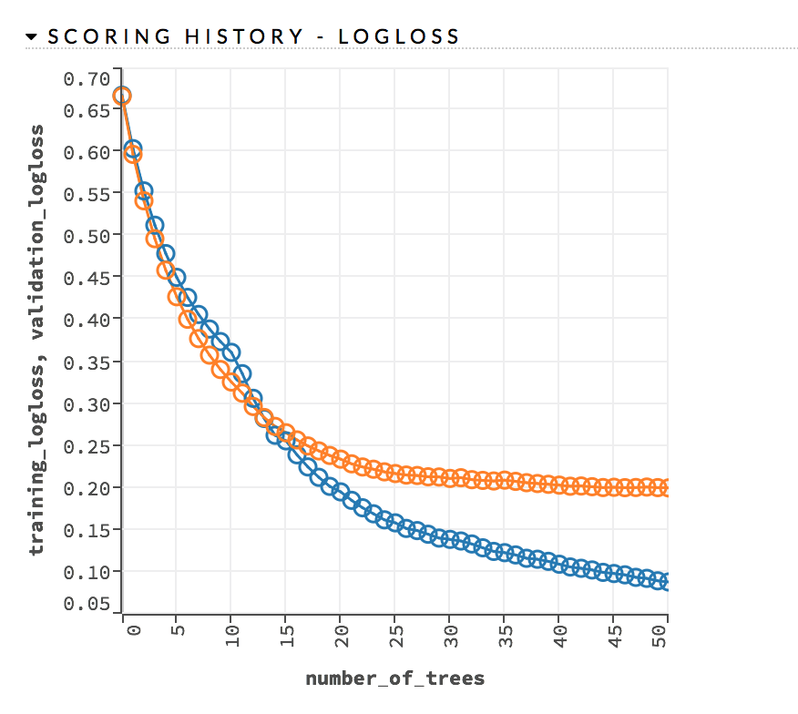
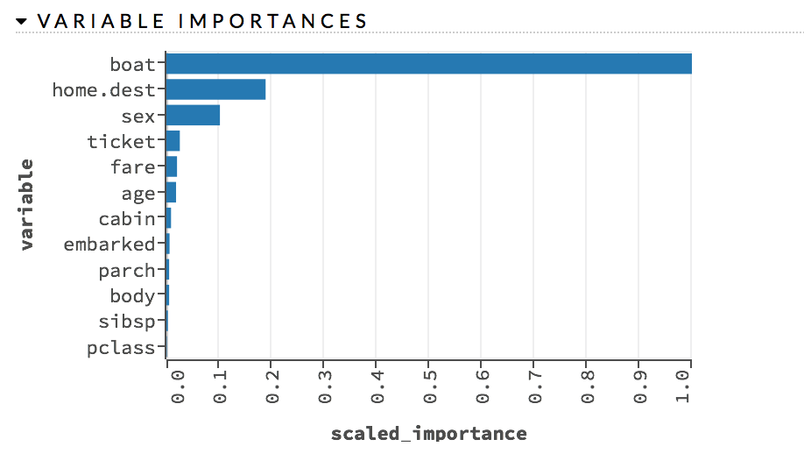
Establish a Baseline
Train multiple models using different supervised learning algorithms with the default parameters.
Inspect models in Flow

Slide 15
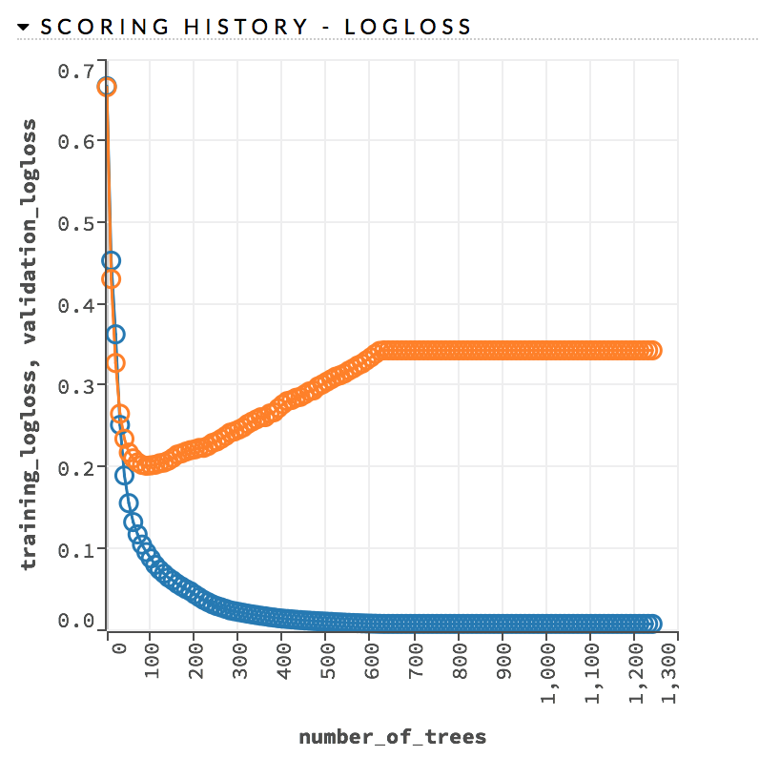
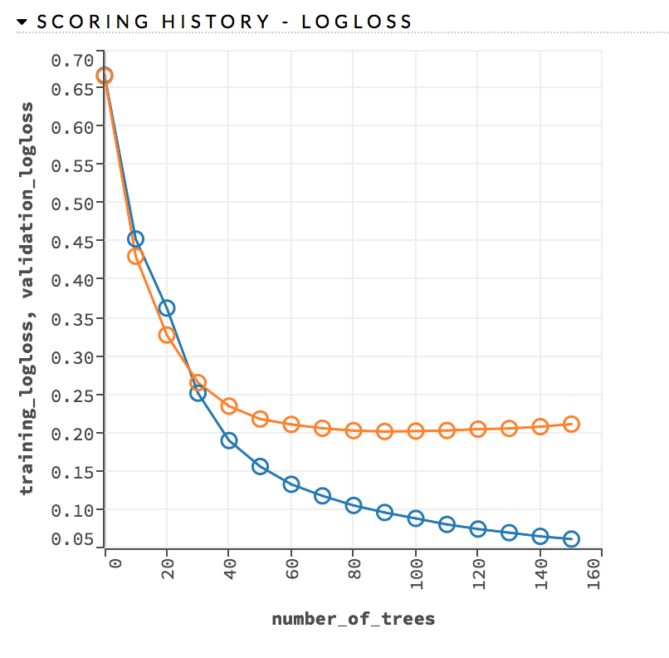
Use Early Stopping
Early stopping once the moving average (window length = 5) of the validation AUC doesn’t improve by at least 0.1% for 5 consecutive scoring events
stopping_rounds = 5
stopping_tolerance = 0.001
stopping_metric = “AUC”
Overfitting
Early Stopping

Slide 16
Choose the Correct Distribution Function
Distribution | Details
Gaussian | Squared error loss - sensitive to outliers
Laplace | Absolute loss - very robust to outliers
Huber | Combination of squared error and absolute loss - Robust to outliers
Poisson | Used for estimating counts
Gamma | Used for estimating total values
Tweedie | Used for estimating densities
Quantile | Used for estimating a specified percentile

Slide 17
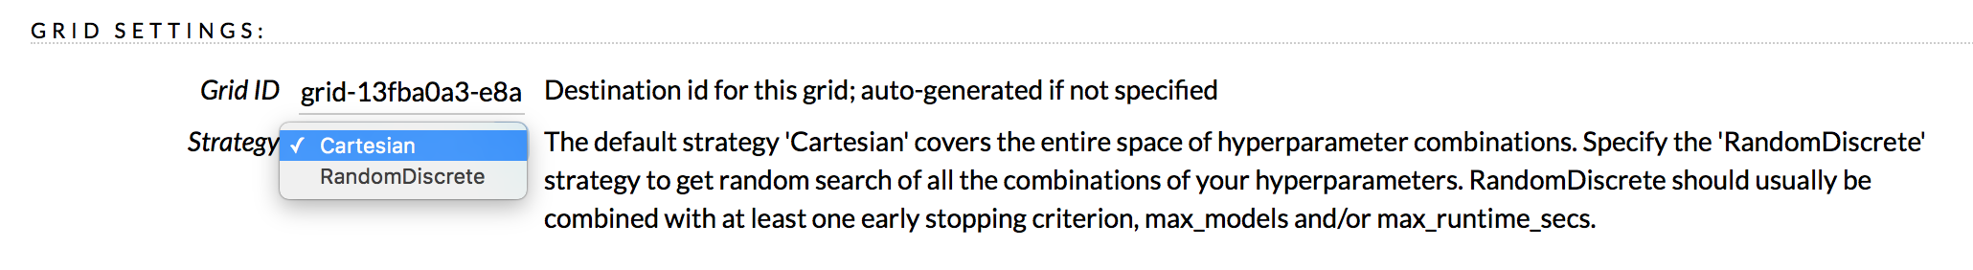
Perform Hyperparameter Search
In R:
grid <- h2o.grid(hyper_params = list(max_depth = c(1:20)),
search_criteria = list(strategy = "RandomDiscrete", max_runtime_secs = 3600),
algorithm = "gbm“, ..)
In Flow:

Slide 18
Perform Hyperparameter Search
Parameter | Definition | Typical Values
max_depth | Maximum tree depth | 1 to 25
learn_rate | The rate at which the GBM learns while building the model Typically lower levels are better but require more trees | 0.01 to 0.1
sample_rate | Row sampling rate per tree | 0.2 to 1
col_sample_rate | Column sampling rate per split | 0.2 to 1
min_rows | The minimum number of observations for a leaf in order to split | 1 to 20
nbin_cats | Number of bins to be included in the histogram Ex: {A, B, C, D, E, F, G} splits to {A, B}, {C, D}, {E, F}, {G} when nbin_cats = 4 | 10, 100, 1000, 10000
histogram_type | What type of histogram to use for finding the optimal split point. | “UniformAdaptive”, “QuantilesGlobal”

Slide 19
GBM Demo

Slide 20
Resources
Data: data/titanic.csv
R Script: gbmTuning.R
Python Script: gbmTuning.ipynb

Slide 21
Questions?

