Slide 1
Machine Learning 101 and H2O

Slide 2
Tips on Predictive Modeling
Solve the right problem!
A good answer yesterday beats a great answer tomorrow
Simplify everything
Model
Data Size
Data Types
Counting and averages are great analytics!
Be mindful of “productionizing” your model
Input and Output

Slide 3
Outline
Introduction to Machine Learning
Shared concepts
Feature creation
Algorithm Basics
Unsupervised Methods
Supervised Methods
Using ML models in practice
Scoring code and production
Getting Started with ML

Slide 4
What is Machine Learning?
Set of statistical and optimization tools to best predict outcomes
Focus on “production analytics”
Reducing need for
Sampling
Periodic revision of models
Subjective priors
Hand coding models in a production language

Slide 5
Vocabulary
Concept | Statistics\Econometrics | Machine Learning
“Computation” | Fit\Estimate | Train
“Left-hand side” | Dependent variable | Target
“Right-hand side” | Regressor\Predictor\Class | Feature\Factor\Enum
“Goal” | Estimation\Explanation | Prediction

Slide 6
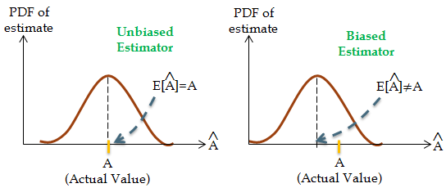
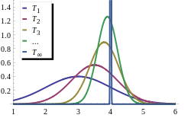
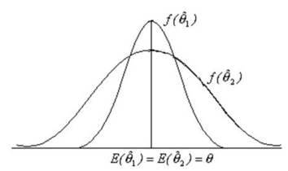
Statistics vs. Machine Learning
Statistics: Good estimators are….
Unbiased in small samples
Consistent if not unbiased
Efficient
Machine Learning: Good models….
Predict well.

Slide 7

Train vs Test Data Sets
Training Set vs.
Test Set
Partition the original data (randomly or stratified) into a training set and a test set. (e.g. 70/30)
Training Error vs.
Test Error
It can be useful to evaluate the training error, but you should not look at training error alone.
Training error is not an estimate of generalization error (on a test set or cross-validated), which is what you should care more about.
Training error vs test error over time is an useful thing to calculate. It can tell you when you start to overfit your model, so it is a useful metric in supervised machine learning.

Slide 8
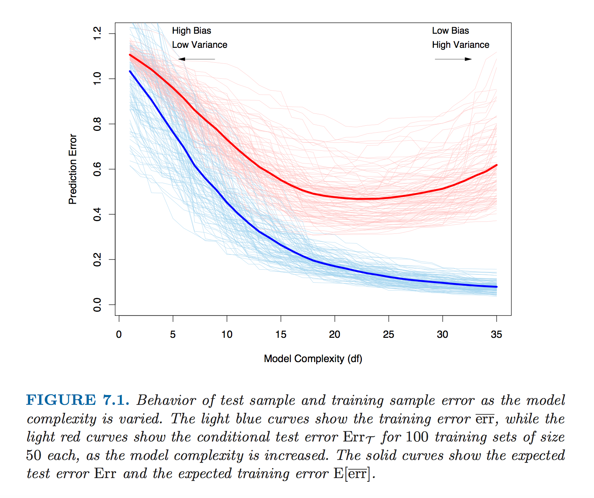
Train, Test and Validation
Source: Elements of Statistical Learning

Slide 9
Feature Creation
Features=Predictors (Factors, Regressors)
Yes you need domain knowledge
Example: If I give you a date/time stamp for a past transactions, what would you do with it?

Slide 10
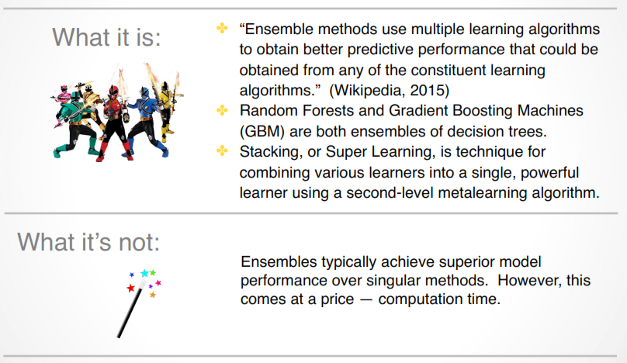
Ensembles

Slide 11
Machine Learning Methods
Supervised Learning Methods
Regression (GLM)
Decision tree
Unsupervised Learning Methods
Clustering
Lasso
Ridge
Elastic net
Random Forest
Gradient Boosted Models
Neural Network
Deep Learning
Support Vector Machine
Kmeans
Hierarchical
Principal Components Analysis
Autoencoders
Non-negative matrix factorization
Generalized Low Rank Models
Know Y
Don’t know Y
When do I use what tool?

Slide 12
Generalized Linear Model
Supervised Learning:

Slide 13
What is the Generalized Linear Model (GLM)?
Class of models that relate X (inputs) to Y (output)
Allows for a unification of models that have errors of the following form:
Normal (Gaussian)
Gamma
Poisson
Binomial (Logistic)
Multinomial
MLE is found by iteratively reweighted least squares

Slide 14
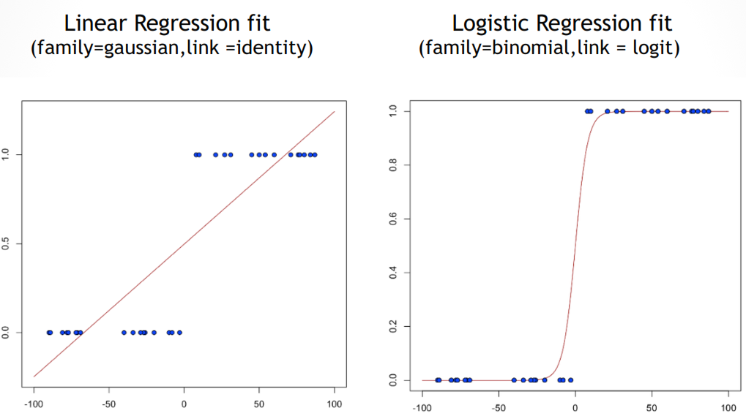
Same predictors, different family and link functions

Slide 15
Pros and Cons of GLM’s
Pros
Fast to fit
Easy to interpret
Well understood statistical properties
Continuous, categorical, count and classification problems
Transparent scoring functions
Cons
Possibility of overfitting
Difficult to account for non-linearities
Issues of multicollinearity
Non-unique solutions
Difficult to fully account for interaction effects

Slide 16
Penalized Generalized Linear Model(LASSO, Ridge, Elastic Net)
Supervised Learning:

Slide 17



Regularized Regression
Want to build a parsimonious but interpretable model
Shrink the number of predictors and/or size by imposing penalties on the estimated coefficients (L1, L2)
LASSO:
picks one correlated variable, others discarded. Sparse.
Ridge:
correlated variables coefficients are pushed to the same value
Elastic Net:
sparse solution, correlated variables grouped, enter/ leave the model together

Slide 18
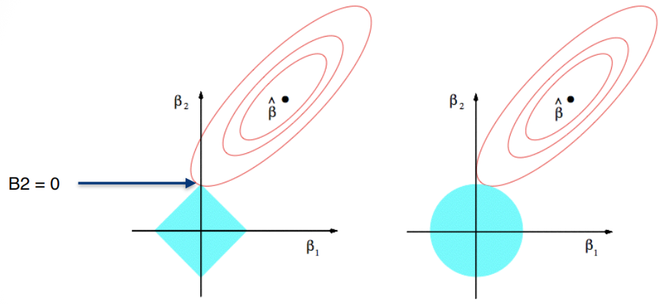
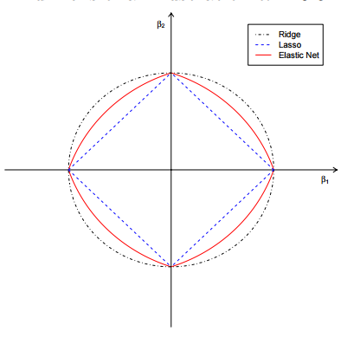
Constraints for L1, L2 and L1&L2
LASSO Regression vs. Ridge Regression

Slide 19
Decision Trees (Recursive Partitioning)
Supervised Learning:

Slide 20
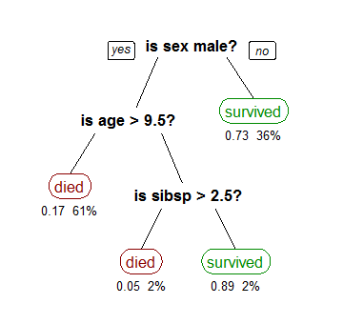
Basics of Decision Trees
Break sample data into homogenous pieces
Sample means
Categorical and Continuous data
Splits identify interaction effects and important variables
ID3
C4.5
CHAID
Wikipedia: Titanic Survivors

Slide 21
More info on trees
Depth
min rows
Number of bins in histogram
Number of categories from a enum (“binning”)
Stopping criteria

Slide 22
Pros and Cons of Decision Trees
Pros
Easy to compute
Easy to interpret
Robust to correlated features
Robust to missing values
Easy scoring functions
Handles non-linearities in data
Cons
Overfit data
Will eliminate collinear variables
Finds nonlinearities with linear relationships

Slide 23
Random Forests
Supervised Learning:

Slide 24
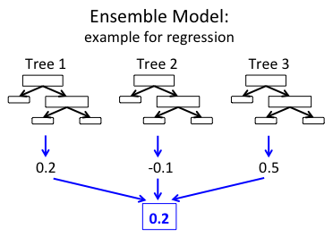
What are Random Forests?
Average a bunch of decision trees
Different trees on different samples and average
Different rows, different columns
Reduce variance with minimal bias increase
Bootstrap aggregation➔ “Bagging”

Slide 25
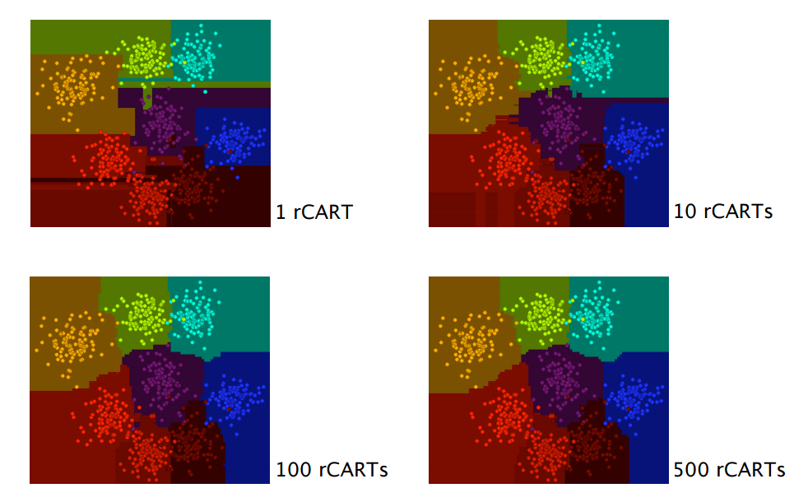
Pros and Cons of Random Forests
Strengths
Easy to compute
Easy to parallelize
Robust to outliers
Variable importance
Weaknesses
Slow to score
Not transparent

Slide 26
Deep Learning
Supervised Learning:

Slide 27
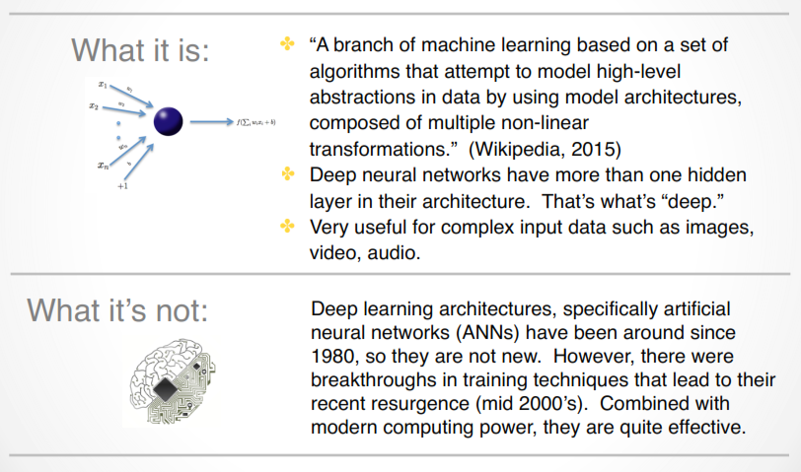
What is Deep Learning?

Slide 28
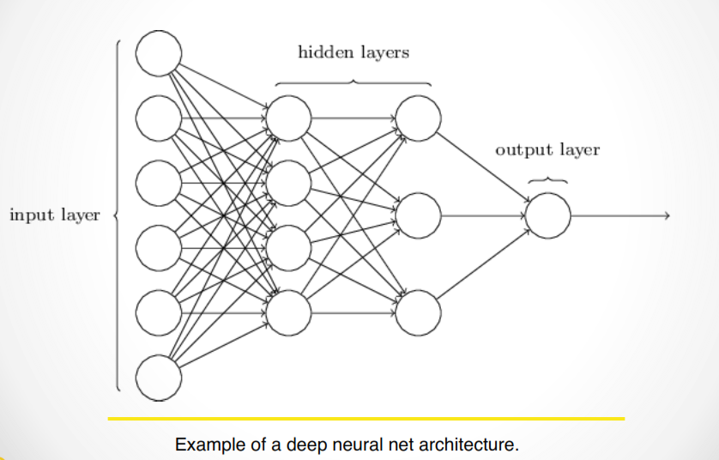
An example “Deep” Neural Network

Slide 29
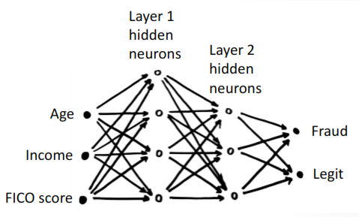
VALUE OF DEEP LEARNING
Deep Learning learns a hierarchy of non-linear transformations
Neurons transform their input in a non-linear way
Black-box, brute-force method, really good at pattern recognition
Deep Learning got a boost in the last decade due to faster hardware and algorithmic advances

Slide 30
STRENGTHS AND WEAKNESSES
Strengths
non linear
robust to correlated features
learned features can be extracted
can stop training at any time
can be fine-tuned with more data
great ensemble member
efficient for multi-class problems
world-class at pattern recognition
Weaknesses
slow to train
slow to score
not interpretable
results not fully reproducible
theory not well understood
overfits, needs regularization
many hyper-parameters
expands categorical variables
must impute missing values

Slide 31
Unsupervised Learning Models

Slide 32
Unsupervised Learning Models
No target!
Ways to characterize or simplify data
Uses
Clustering (Put rows together)
Variable reduction (Put columns together)
Anomaly detection

Slide 33
K-means Clustering
Unsupervised Learning:

Slide 34
Clustering
We are going to try and “bundle” customers/companies/transactions based on “likeness” of certain features.
These “clusters” will help us simplify and potentially “segment” observations.
Segment customers
Categorize events

Slide 35
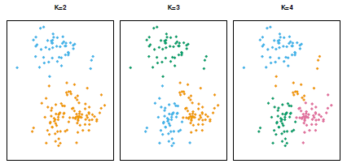
Clustering
Objective: Minimize the within cluster variation for a given k
How to choose k?
Choose several and evaluate performance
Often business rules determine feasible k

Slide 36
Principal Components Analysis (PCA)
Unsupervised Learning:

Slide 37
What is Principal Components Analysis
Another method of data simplification
Can I reduce the width (dimensionality) of the dataset by creating one or more new PCA variables that do a “good job” of representing the original signal in the data?
Uses:
Variable reduction=> Fewer predictors
Feature extraction=>Anomaly detection

Slide 38
Scoring and Scoring Code
Operationalizing Machine Learning:

Slide 39
Score code
Operationalizing your model means handing off “Score Code”
Scoring within compute engine
PMML
Low level representations
Java Object
C

Slide 40
Tips on Getting Started
Operationalizing Machine Learning:

Slide 41
Balancing Accuracy and Interpretability
Let’s you try different regression techniques
Train a “black box model” but use it as a benchmark
Train explainable model on predictions from the black box
Use the black box model as backup
Use variable importance and partial dependency plots for explanation
Use complicated model for feature creation
https://www.oreilly.com/ideas/predictive-modeling-striking-a-balance-between-accuracy-and-interpretability

Slide 42

Robust, Tested and Supported Platform for Predictive Analytics
H₂O.ai Machine Intelligence

Slide 43
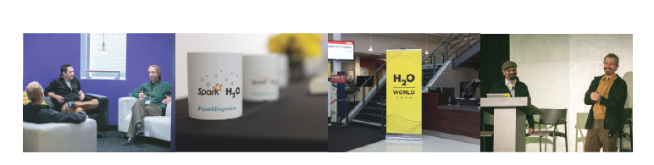
H2O.ai Overview
Founded: 2011: Version 3 released in 2015
Product: H2O open source in-memory prediction engine
Team: 50+ Core developers and data scientists
HQ: Mountain View, CA. Sales: U.S., U.K. & Canada
H₂O.ai Machine Intelligence

Slide 44


Slide 45
What is H2O?
Platform
Open source in-memory prediction engine
Parallelized and distributed algorithms making the most use out of multithreaded systems and grids
Access
Data, Platform and Client Agnostic
Runs anywhere
Scale
Same code. Different Environments
Use all of your data without sub setting
GLM, Random Forest, GBM, Deep Learning(ANN), GLRM, PCA, K-means etc.
REST API– drives H2O from R, Python, Web UI, Excel, Tableau
No code changes to go from development to production
Score code for all models
Single source of truth for R and Python users

Slide 46
Algorithms on H2O
Supervised Learning
Generalized Linear Models (LASSO, Elastic Net, Ridge)
Binomial, Gaussian, Gamma, Poisson and Tweedie
Naïve Bayes
Statistical Analysis
Distributed Random Forest: Classification or regression models
Gradient Boosting Machine: Produces an ensemble of decision trees with increasing refined approximations
Ensembles
Deep learning: Create multi-layer feed forward neural networks starting with an input layer followed by multiple layers of nonlinear transformations
Deep Neural Networks

Slide 47
Algorithms on H2O
Unsupervised Learning
Clustering
K-means: Partitions observations into k clusters/groups of the same spatial size
Principal Component Analysis: Linearly transforms correlated variables to independent components
Generalized Low Rank Models: extend the idea of PCA to handle arbitrary data consisting of numerical, Boolean, categorical, and missing data
Dimensionality Reduction
Anomaly Detection
Autoencoders: Find outliers using a nonlinear dimensionality reduction using deep learning

Slide 48



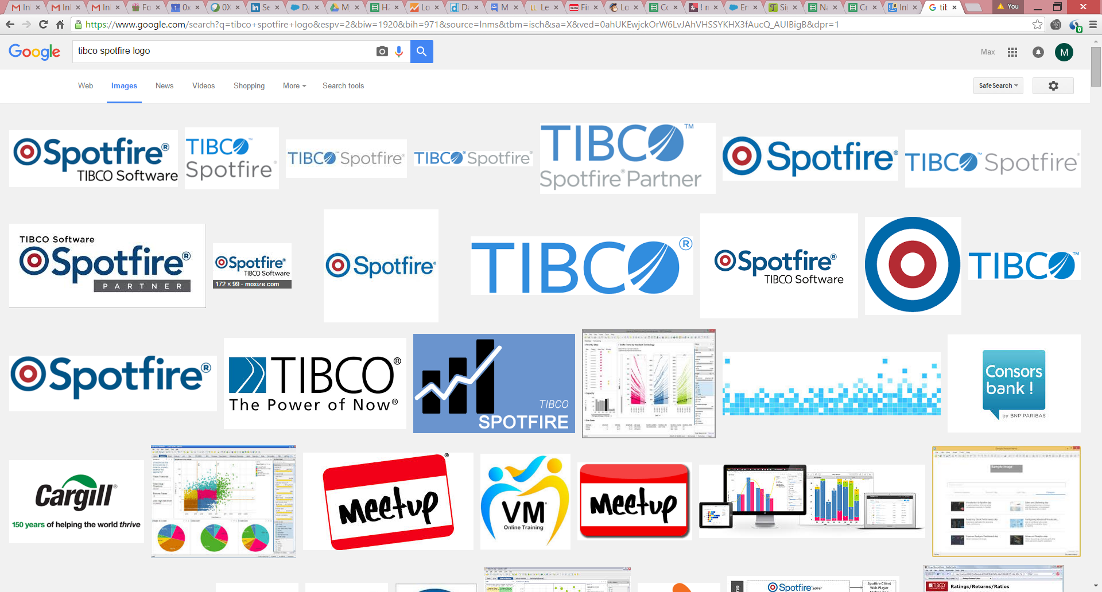
Data and Client Agnostic
HDFS
H2O Compute Engine
In-Memory
Feature Engineering
Deep Learning
Matrix Factorization
S3
Clustering
Map Reduce/Fork Join
PCA, GLM, K-means
Munging
Classification
Regression
Columnar Compression
Random Forest / GBM Ensembles
SQL
Streaming
Java Score Code
NoSQL

Slide 49
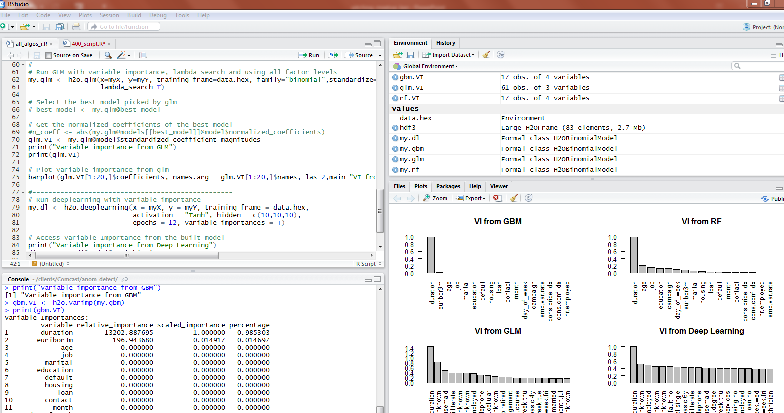
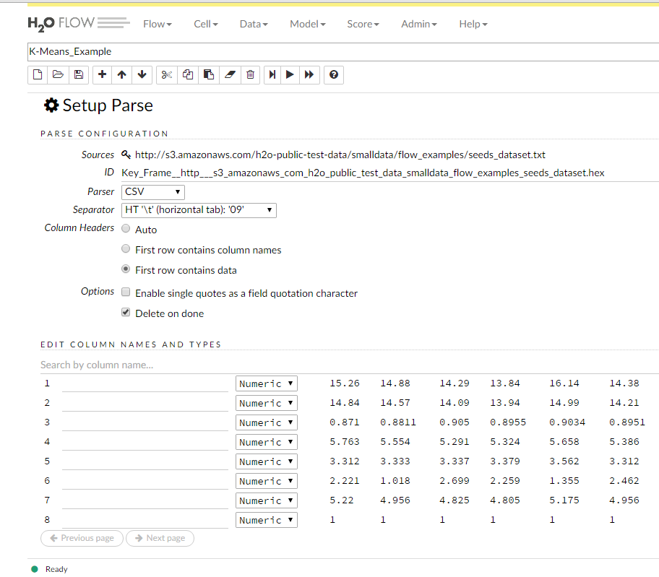
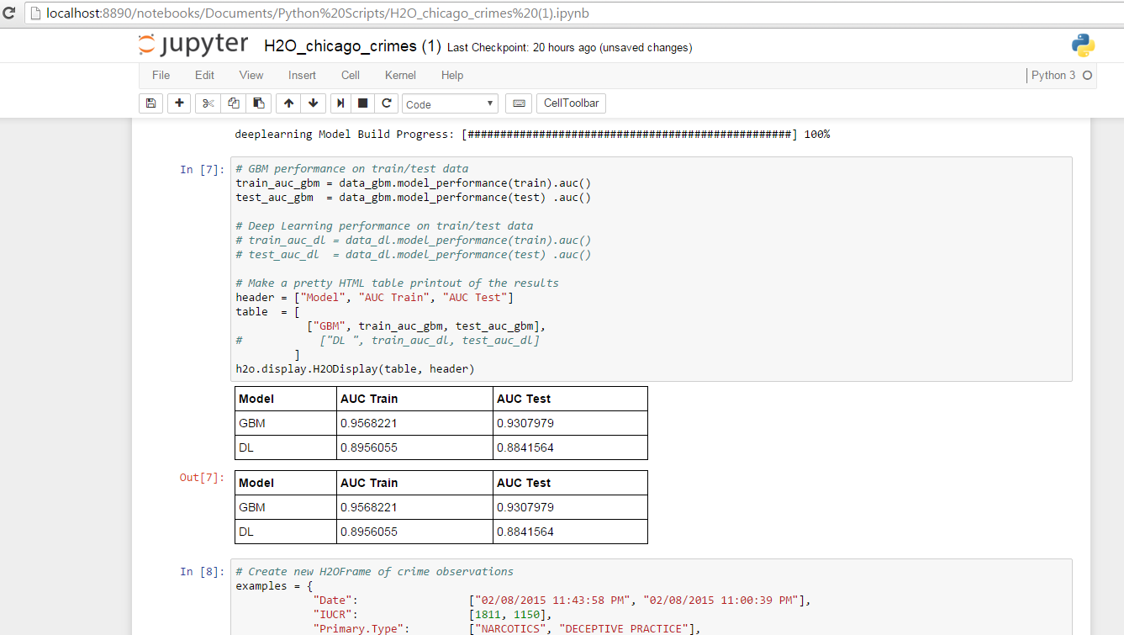
R, Python and Flow

