Slide 1
Hands on Introduction to Sparkling Water

Slide 2
Agenda

Slide 3
Today’s Talk
Sparkling Water Installation
Hands on Demo
Installing Sparkling Water
Installing PySparkling
Our Use Case
Importing data into H2O
Converting Spark Dataframe to H2O Frame and vice versa
Data Cleaning and Feature Engineering
Using Flow with Sparkling Water
Introduction to Sparkling Water
Typical Uses
How it Works?

Slide 4
Sparkling Water Installation

Slide 5
Sparkling Water Prerequisites
To Launch Sparkling Water the prerequisites are:
Java 7+
Spark 1.6+

Slide 6
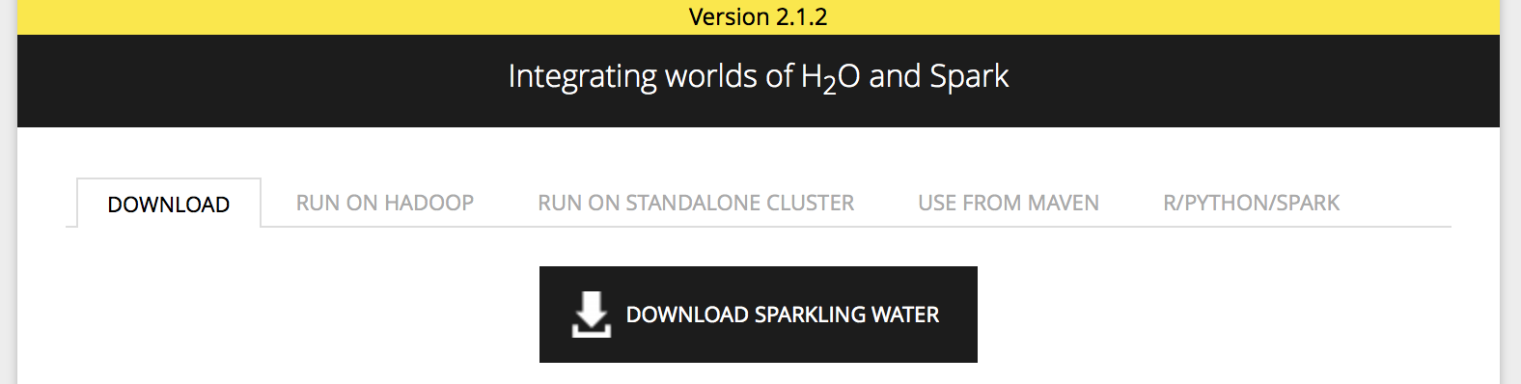
Installing Sparkling Water
Download Sparkling Water
Export Environment Variables
export SPARK_HOME="/path/to/spark/installation"
# To launch a local Spark cluster with 3 worker nodes with 2 cores and 1g per node.
export MASTER="local[*]"
Start Sparkling Water
cd ~/Downloads
unzip sparkling-water-2.3.5.zip
cd sparkling-water-2.3.5
bin/sparkling-shell --conf "spark.executor.memory=1g"

Slide 7
Installing PySparkling
Prerequisite: Python 2.7
Install Dependencies
pip install requests
pip install tabulate
pip install six
pip install future
Start PySparkling
cd ~/Downloads
unzip sparkling-water-2.3.5.zip
cd sparkling-water-2.3.5
# Run PySparkling
bin/pysparkling
# Run Ipython Notebook
PYSPARK_DRIVER_PYTHON=“ipython” PYSPARK_DRIVER_PYTHON_OPTS=“notebook” bin/pysparkling

Slide 8
Introduction to Sparkling Water

Slide 9
What is Sparkling Water?
Provides
Transparent integration of H2O with Spark ecosystem
Transparent use of H2O data structures and algorithms with Spark API
Seamlessly toggle between Spark Dataframes and H2O Frames
Prediction
Processing
Data Munging
Modeling
Data
Source

Slide 10
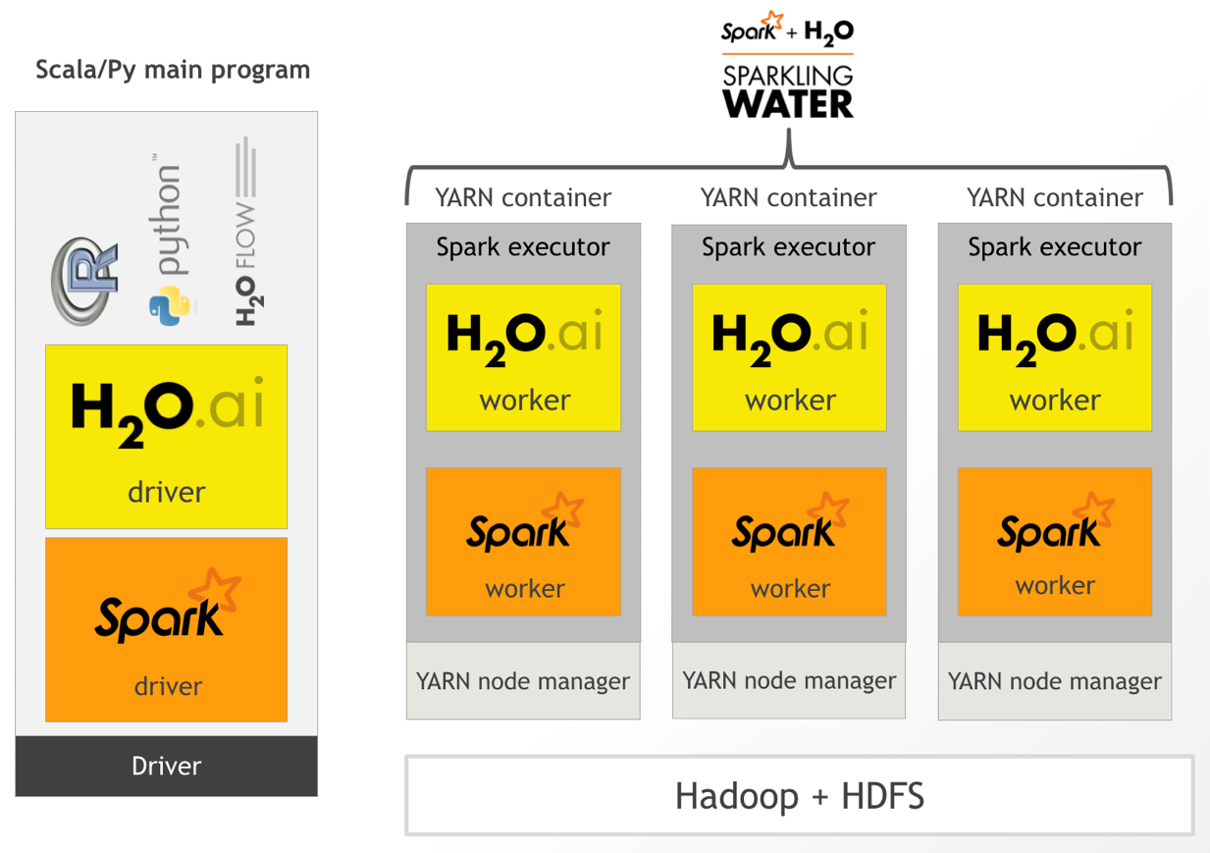
How Does it Work?

Slide 11
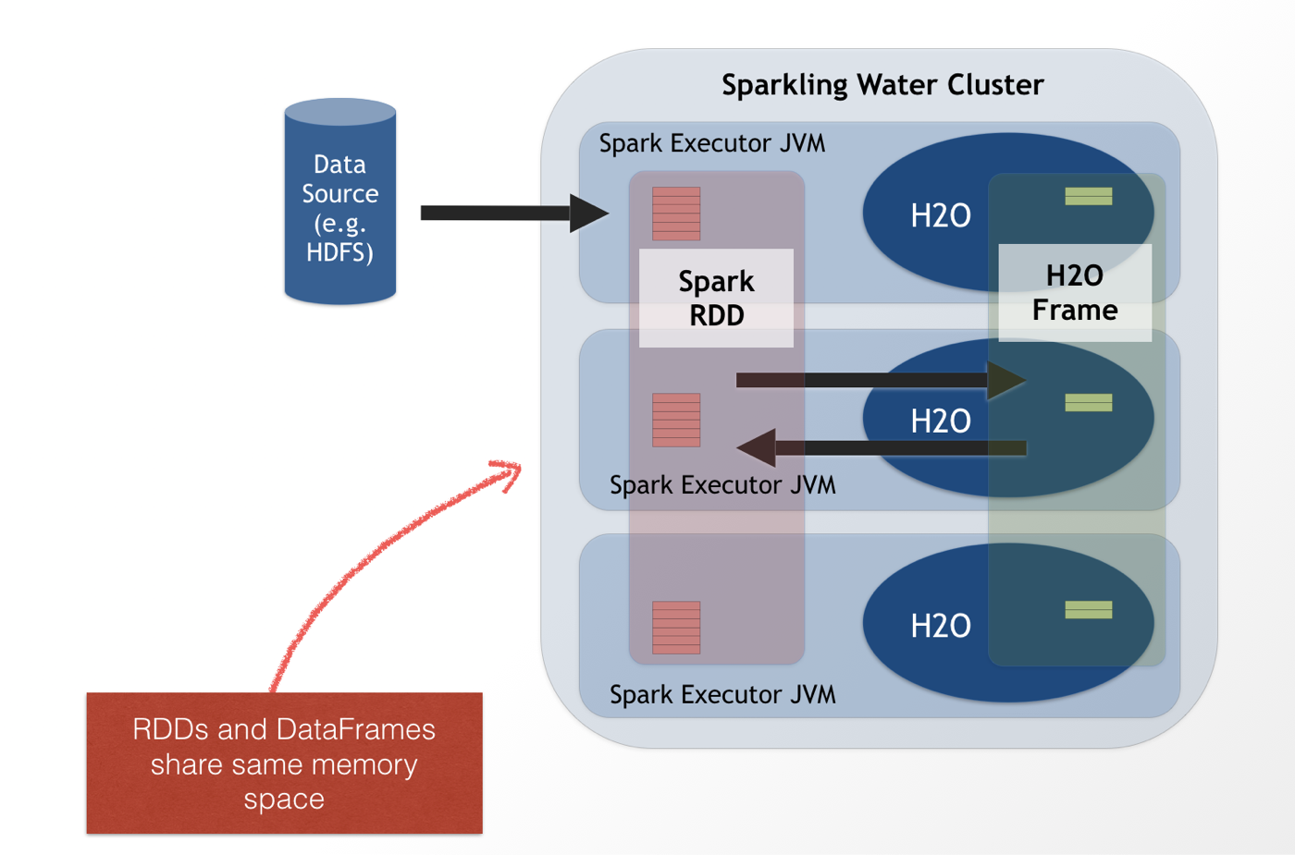
How Does it Work?

Slide 12
Demo

Slide 13
Use Case
End Goal
Predict whether an arrest will be made for a given crime.
Why?
We can use this model to improve public safety by predicting whether an arrest will be made and also by analyzing the factors that contribute to a high probability of arrest.
How?
Join crime data with external data like weather and socioeconomic factors to train a model that will predict arrest.

Slide 14
Use Case
Weather
Census
Crimes
Data Munging
Spark SQL Join
Split Table
Train
Deep Learning
Evaluate Models
Train
GBM
Score New Crimes

Slide 15
Resources
Data: sparkling-water-2.3.5/examples/smalldata
Scala Script: ChicagoCrimeDemo.scala
Python Script: ChicagoCrimeDemo.ipynb

Slide 16
Questions?

