Slide 1
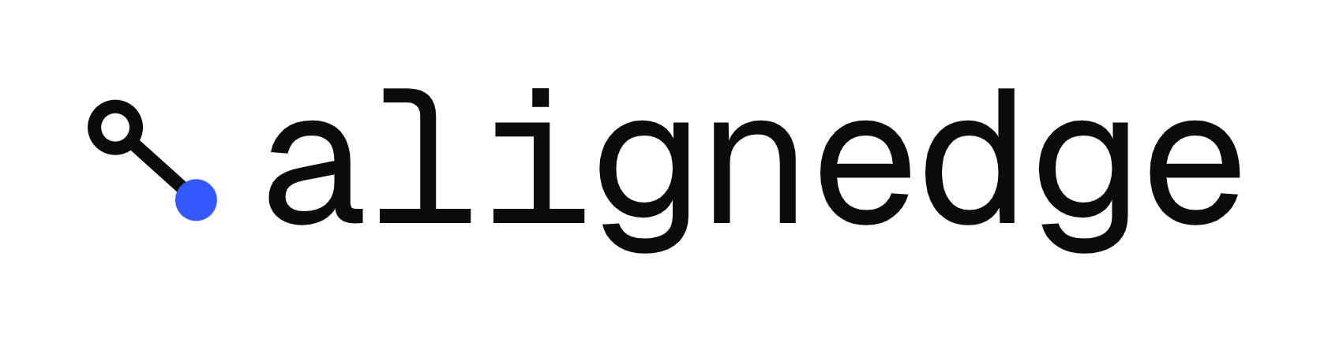
RUNTIME MAINTENANCE LAYER FOR EDGE AI
The right-sized AI model, on the right chip, at the right time
The Haiku-not-Opus moment for industrial AI
Kevin Omede· Politecnico di Torino × UIC Barcelona · Visiting Researcher, Beihang University
Notes:
AlignEdge — runtime maintenance layer for edge AI. The right-sized AI model, on the right chip, at the right time. The Haiku-not-Opus moment for industrial AI.

Slide 2
PROBLEM
$2.3M
per hour It’s the cost of automotive downtime when AI misses the alarm.
3–6 months
Invisible
Unmeasured
average delay before silent degradation is detected
the cloud never sees SLA-violating requests, so missed alarms never reach monitoring
nobody checks the model actually runs in time on the real chip
02
Aberdeen Research · Siemens True Cost of Downtime 2024
Notes:
AI models deployed on factory hardware silently degrade — too slow for the SLA, sensor drift, chip-model mismatch. Nobody notices until a machine fails. $2.3M per hour in automotive downtime. 3 to 6 months average detection delay. Missed alarms are invisible to cloud-side monitoring because the cloud never sees SLA-violating requests.

Slide 3
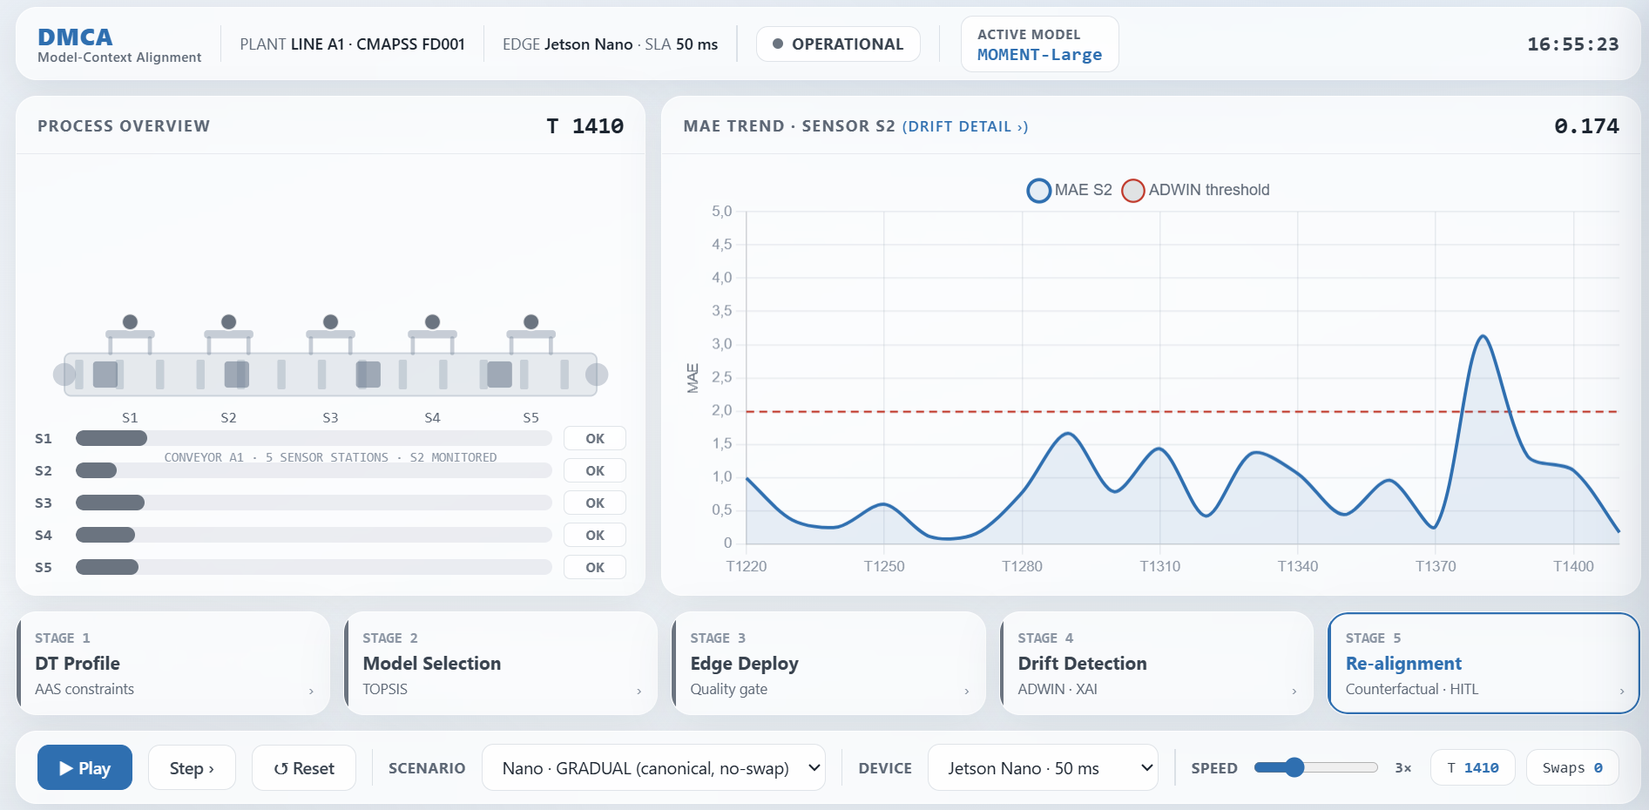
SOLUTION
We test your models on real edge hardware — then keep them working
01
You send
02
We test
03
You get
Your model, a data sample, hardware spec, SLA budget.
Real-hardware profiling, drift injection, coverage against your SLA and TOPSIS vs 8 foundation models.
Full report telling you which models fit, which don’t and how to manage them.
4 WEEKS · MODEL IN → VERDICT OUT
03
Notes:
You send: model in any format, data sample, hardware spec with SLA budget. We test: real-hardware profiling on Jetson Nano, Raspberry Pi 4, Jetson Orin NX; drift injection across 5 failure modes; coverage analysis; multi-criteria comparison against 8 benchmarked foundation models. You know: 15-page report — keep, optimize, or swap — with AI Act-aligned audit trail.

Slide 4
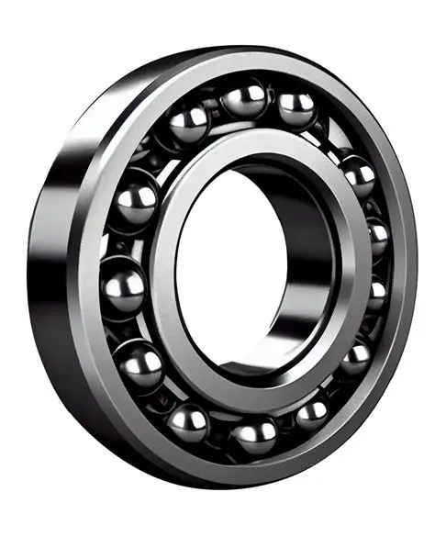
Everyone measures accuracy.
Nobody measures coverage.
SLA COVERAGE — BEARING 3_2
10×
PatchTST
85%
gap in SLA coverage
same task, same hardware, same SLA
Lag-Llama
64%
Moirai-S
9.3%
Real bearing data · PHM 2012 Challenge · Public dataset
04
Notes:
Accuracy times coverage equals events actually caught. Same task, same hardware, same SLA — 10x gap in SLA coverage between the right model and the wrong one: 85% vs 9.3%. Warning time on this bearing: 290s / 240s / 80s. 8 months of hardware-real benchmarks, PHM 2012 + IMS Center.

Slide 5
WHY NOW
Three converging shifts open a 24-month window
REGULATORY
FOUNDATION MODEL EXPLOSION
CLOSED ECOSYSTEMS
3%
2.4M+
LOCK-IN
of global turnover.
EU AI Act fines hit August 2, 2026.
models on HuggingFace.
Manual selection is now impossible.
Every chip vendor locks you in. No vendor has incentive to build the agnostic decision layer.
Regulation demands it. Complexity requires it. No one is building it.
05
Notes:
EU AI Act high-risk enforcement August 2, 2026 — penalties up to 3% of global turnover or €15M, Article 99. HuggingFace grew to 2.4M+ models — the second million took only 335 days; manual selection is combinatorially impossible. OctoAI (formerly OctoML), the only cross-vendor optimizer, was acquired by NVIDIA in September 2024 — $900M peak valuation, sold at $165M, cross-vendor endpoints sunset. The decision-system side is empty.

Slide 6
BUSINESS MODEL
One wedge, one core, one platform
DEEPEN
Optimization
EXPAND
Runtime
LAND
Fleet-wide cross-vendor orchestration
Platform scale integration
Audit
Continuous drift detection + automatic swap.
Enterprise subscription.
On-hardware validation.
First market entry.
Same costumer, growing footprint over time.
06
Notes:
Three products in sequence. LAND: Audit — one-shot on-hardware test, 15-page report in 4 weeks, broad entry across automotive, robotics, energy, defense edge. EXPAND: Runtime — continuous drift detection, automatic re-selection, audit trail; enterprise subscription, automotive tier-1 focus. DEEPEN: Optimization — fleet-wide cross-vendor orchestration; the platform space OctoML left open.

Slide 7
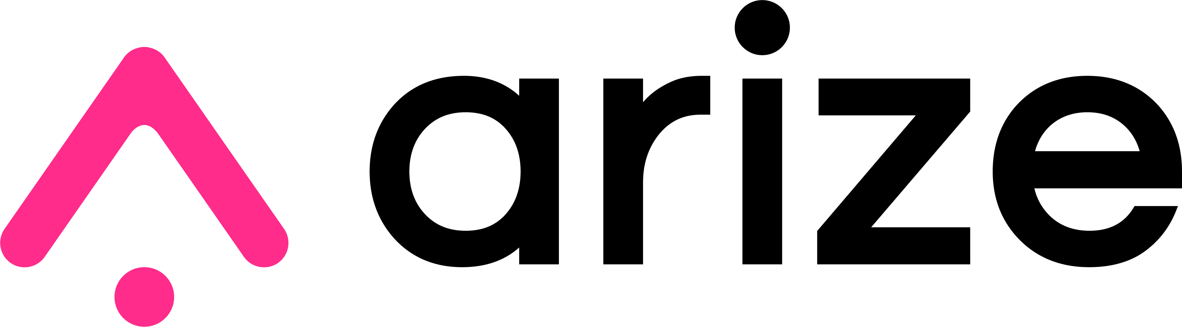


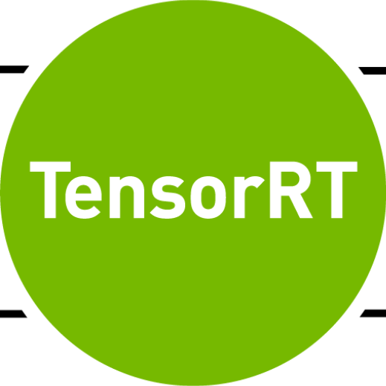

COMPETITION
Three reasons no one else can catch up
Coverage / drift aware
1
Productized audit measuring SLA coverage on your hardware, with your data.
Server-side observability, no on-device runtime
2
Cross-vendor by design. No chip vendor will cannibalize their own lock-in.
Hardware-aware
Consulting audits
manual, one-off, not scalable
Big 4, boutique consultancies
.
3
A dataset that compounds — every audit adds one customer × model × hardware × drift × outcome record no competitor can replicate
ONNX Runtime
HW-optimized, no drift
07
Notes:
Only audit measuring SLA coverage on real edge hardware with customer data. Cross-vendor by design — no incumbent has structural incentive; the OctoML precedent proves it. Every audit will feed a proprietary customer × model × hardware × drift × outcome dataset.

Slide 8
CHINA · 中国
75%
of the world’s EVs are produced in China
Chaoyang, Beijing
$318B
43.6%
Startup Alliance
global automotive electronics market (2026)
Asia Pacific share
The largest edge AI deployment testbed on Earth.
IEA Global EV Outlook 2026 · Fortune Business Insights 2026
08
Notes:
Chaoyang HQ, Wangjing automotive AI cluster. 75% of the world's EVs are produced in China — the largest edge AI deployment testbed on Earth.

Slide 9




TEAM + TRACTION
One founder, three institutions, validated technology
92%
drift classifier accuracy, held-out
Kevin Omede
0%
false alarms
FOUNDER
MSc, Politecnico di Torino × Universitat Internacional de Catalunya
$0.30
canonical cost — 8 models on real GPU
Visiting Researcher,
Beihang University
10×
coverage gap — PHM 2012 + IMS Center
Beijing Founder Program 2026 · Selected
09
Notes:
One founder, three institutions, validated technology. MSc Politecnico di Torino × UIC Barcelona, Visiting Researcher at Beihang. Thesis: Dynamic Model-Context Alignment in Industry 4.0. Drift classifier 92% held-out accuracy, 0% false alarms. 8 foundation models benchmarked on real GPU at $0.30 canonical cost. PHM 2012 + IMS Center validation, 10× coverage gap demonstrated.

Slide 10
Every industrial AI model, always in its optimal deployment state
AI-on-edge becomes a maintained asset, not a one-shot deployment. By 2030: millions of models continuously maintained. Hundreds of billions of dollars in industrial downtime prevented.
The Haiku-not-Opus moment for industrial AI.
AlignEdge
Notes:
AI-on-edge becomes a maintained asset, not a one-shot deployment. By 2030: millions of models continuously maintained, hundreds of billions in industrial downtime prevented. The Haiku-not-Opus moment for industrial AI.

