Slide 1
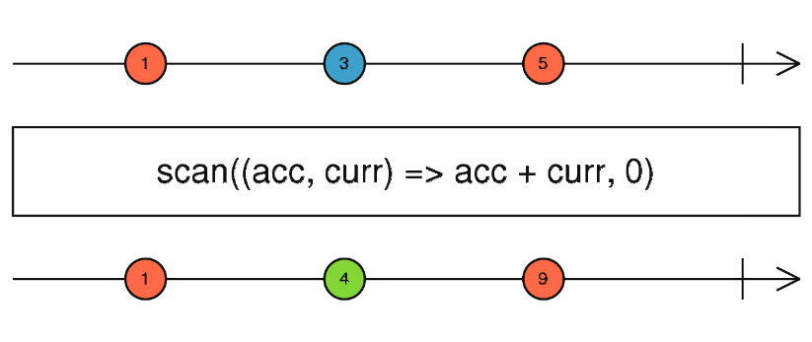
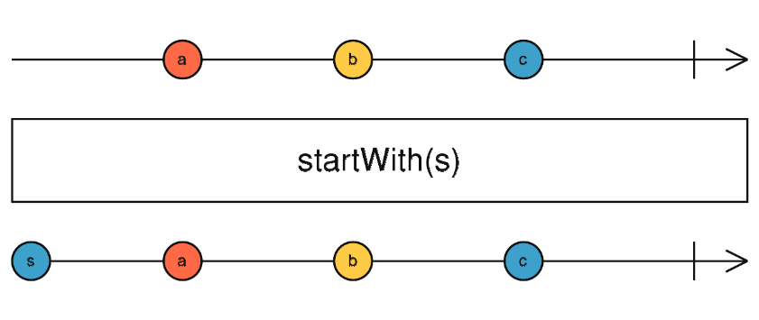
scan
Applies an accumulator fn over the source Observable, and returns each intermediate result, with an optional seed value.
It’s like reduce, but emits the current accumulation whenever the source emits a value.
startWith
Returns an Observable that emits the items in a specified iterable before it begins to emitted by the source Observable.

Slide 2
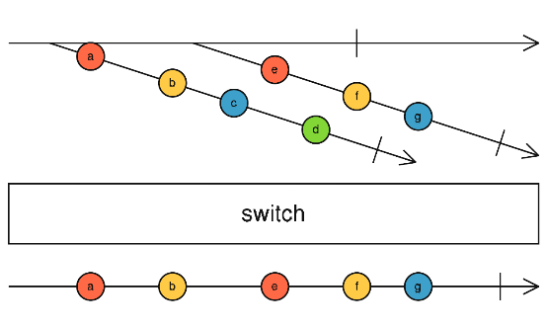
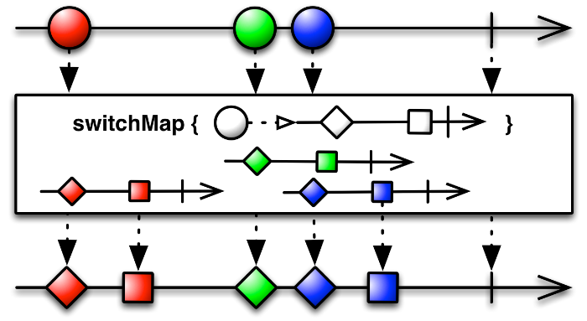
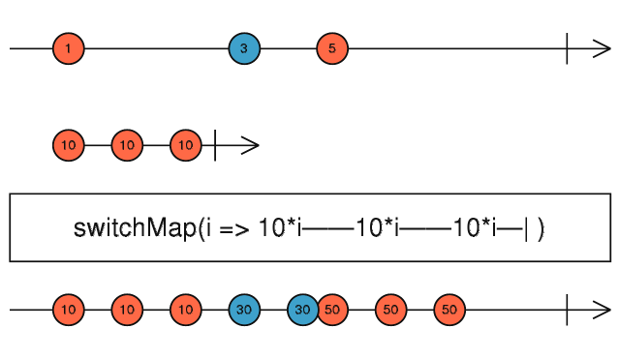
switch
Converts a higher-order Observable into a first-order Observable by subscribing to only the most recently emitted of those inner Observables.
Flattens an Observable-of-Observables by dropping the previous inner Observable once a new one appears.
Switch subscribes to an Observable that emits Observables, also known as a higher-order Observable. Each time it observes one of these emitted inner Observables,
the output Observable subscribes to the inner Observable and begins emitting the items emitted by that. So far, it behaves like mergeAll. However, when a new inner
Observable is emitted, switch unsubscribes from the earlier-emitted inner Observable and subscribes to the new inner Observable and begins emitting items from it.
It continues to behave like this for subsequent inner Observables.
switchMap
Projects each source value to an Observable which is merged in the output Observable, emitting values only from the most recently
projected Observable.
Returns an Observable that emits items based on applying a function that you supply to each item emitted by the source Observable, where that function return an
(so-called “inner”) Observable. Each time it observes one of these inner Observables, the output Observable begins emitting the items emitted by that inner Observable.
When a new inner Observable is emitted, switchMap stops emitting items from the earlier-emitted inner Observable and begins emitting items from the new one.
It continues to behave like this for subsequent inner Observables.

Slide 3
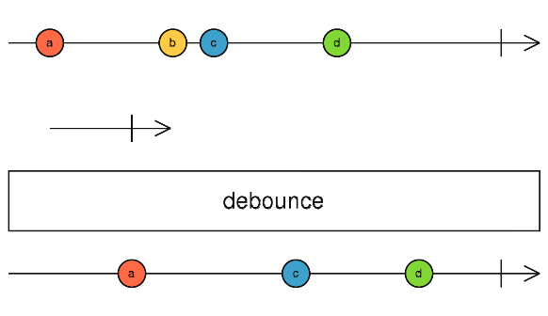
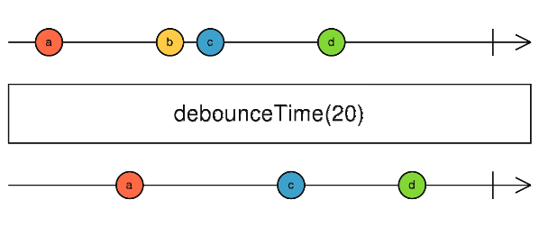
debounce
Emits a value from the source Observable only after a particular time span determined by another Observable has passed without another
Source emission.
It’s like debouceTime, but the time span of emission silence is determined by a second Observable.
debounce delays values emitted by the source Observable, but drops previous pending delayed emissions if a new value arrives on the source Observable.
This operator keeps track of the most recent value from the source Observable, and spawns a duration Observable by calling durationSelector function. The value is emitted
only when the duration Observable emits a value or completes, and if no other value was emitted on the source Observable since the duration Observable was spawned.
If a new value appears before the duration Observable emits, the previous value will be dropped and will not be emitted on the output Observable.
Like debounceTime, this is a rate-limiting operator, and also a delay-like operator since output emissions do not necessarily occur at the same time as they did on the source
Observable.
debounceTime
Emits a value from the source Observable only after a particular time span has passed without another Source emission.
It’s like delay, but passes only the most recent value from each burst of emissions.
debounceTime delays values emitted by the source Observable, but drops previous pending delayed emissions if a new value arrives on the source Observable.
This operator keeps track of the most recent value from the source Observable, and emits that only when dueTime enough time hass passed without any other value
appearing on the source Observable. If a new value appears before dueTime silence occurs, the previous value will be dropped and will not be emitted
on the output Observable.
This is a rate-limiting operator, because it is impossible for more than one value to be emitted in any time window of duration dueTime, but it is also a delay-like operator
since output emissions do not occur at the same time as they did on the source Observable. Optionally take a Scheduler for managing timers.

Slide 4
Setup angular2 with webpack : https://semaphoreci.com/community/tutorials/setting-up-angular-2-with-webpack

