Slide 1


Medinteract
Final Project Review
Adv. Topics in Software Development, CSCI 5308
Developer: Group 27
Client: Group 17
April 2023
https://www.vmware.com/uk/solutions/industry/healthcare-it-solutions.html

Slide 2

Group-27
Faizal Maulvi
Kevin Panchal
Mohammad Ramezani
Shubham Chauhan
Tapan Patel

Slide 3
Project Summary
What we were supposed to do:
To design and implement a healthcare web application used by typical hospital patients and doctors
To check doctors’ licenses and certifications (Approved/Rejected)
To book an appointment to visit a doctor using the calendar
To provide a list of patients and doctors
To provide prescriptions for patients
To use a chatbot to address the most common questions and concerns
To make it possible for doctors to post articles for patient

Slide 4
Meeting Statistics
Meeting | Number | Comments
Internal Meeting | 12 | Discussing the idea and Features Delegating the task Initializing the project on Git Updating the GitLab board Discussing the progress and problems Presentation
Meeting with Client | Every Week | Sharing the updates Feature and design approvement
Meeting With TA | Every Week | Sharing the updates Discussing the errors and problems

Slide 5
Smells Removed
Smells | Existing | Removed
Architecture Smell | 25 | 4
Design Smell | 34 | 14
Implementation Smell | 99 | 39
Test Smell | 82 | 60

Slide 6
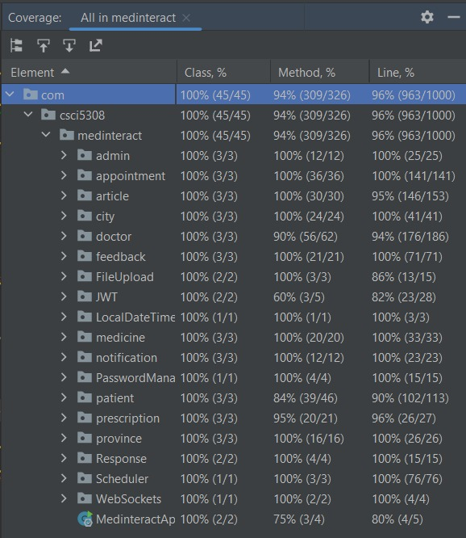
Code Coverage

Slide 7
Goals and Individual Contributions
Milestone | Achieved/Not Achieved | Contributor
Patient/Doctor/Admin Authentication Module | Achieved | Tapan & Faizal
Dashboard Module | Achieved | Shubham
Patient/Doctor Profile Module | Achieved | Mohammad & Faizal
Scheduling Appointment and Handling Calendar module | Achieved | Faizal
Admin: doctor Verification Module | Achieved | Kevin
Article Module | Achieved | Mohammad & Faizal
Feedback and Rating Module | Achieved | Shuham
Chatbot Module | Achieved | Tapan
Prescription Module | Achieved | Kevin
Notification Module | Achieved | Faizal
Code Smell Analysis and Refactoring | Achieved | All
CI/CD | Achieved | Faizal
Documentation | Achieved | All
Midterm

Slide 8
We Learned …
Client-Developer interaction
Spring-boot architecture
TDD approach
Web Sockets
CI/CD
Use of Rest APIs

Slide 9
Demo Application Presentation

