Slide 1

Pokémon Data Science
Bellevue University
DSC 530
Final Project
By Kevin Paulovici

Slide 2
Overview
Introduction
Statistical Questions
Conclusion
Resources
Dataset – pokemon.csv
https://www.kaggle.com/rounakbanik/pokemon
GitHub: https://github.com/kevinpau/Bellevue_University_DSC_530/tree/master/Final_Project
DSC530_Paulovici_Final_Project.ipynb
Bellevue University – DSC 530

Slide 3
Introduction
This project performs data analysis on a dataset of Pokémon (pokemon.csv)
The goal of this project was the following:
Answer the proposed questions
Proof the results through analysis or simulated battle
Summarize results, including any bad assumptions
Determine what can be improved for future analysis
See DSC530_Paulovici_Final_Project.ipynb at the GitHub link for full details
Bellevue University – DSC 530

Slide 4
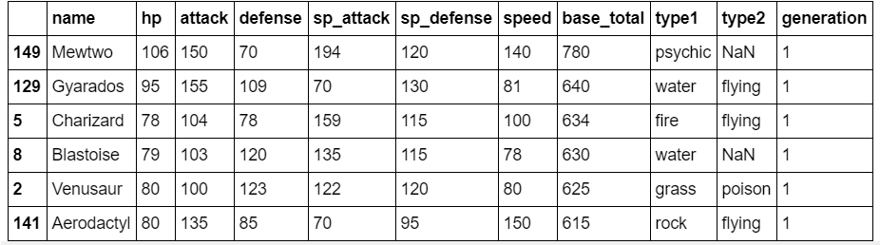
Statistical questions
Is the strongest lineup the perfect lineup? The lineup would be against the elite four trainer’s Pokémon from generation 1. The strongest lineup was determined to be the 6 strongest Pokémon based on a variable called base_total which is a summation of other variables (e.g., attack, hp, defense, etc.). While this lineup was strong against the elite four, this could also be a coincidence. The battle simulation did not take into all variables of base_total. Additionally, there could be other combinations that could defeat my lineup based on other variables not taken into account. For example, the strength/weakness of types was not accounted for.
My lineup
Bellevue University – DSC 530

Slide 5
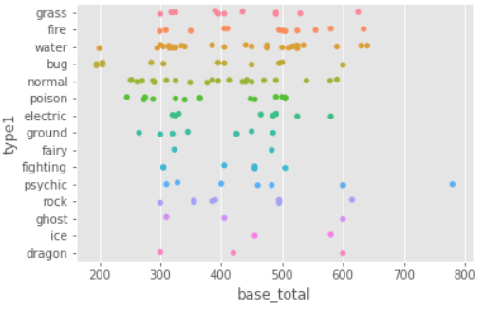
Statistical questions
Is one type of Pokémon clearly stronger than others? Through EDA, it was determined that no one particular Pokémon stood out as over powered. This ensures that a fair battle system was accounted for in the various types of Pokémon.
Reasonably even spread of overall strength (base_total) for different types of Pokémon
Bellevue University – DSC 530

Slide 6
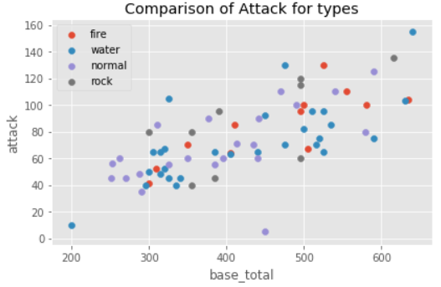
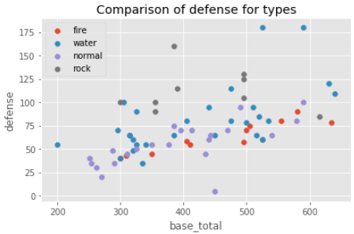
Statistical questions
What stat is most important when considering overall strength? No singular variable appeared more important when considering overall strength (base_total). However, the variables that were accounted for in the battle simulation would be more relevant in determining results.
Bellevue University – DSC 530

Slide 7
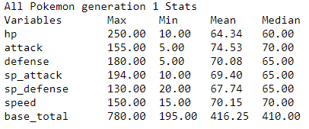
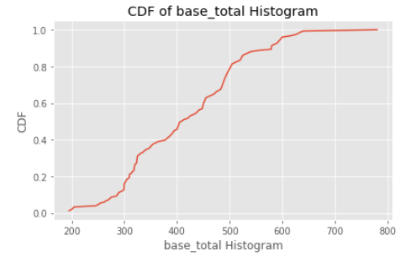
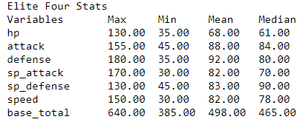
Statistical questions
Where do the elite four Pokémon stand against other Pokémon? As you’d expect, the elite four Pokémon tended to be at the high end of strength (base_total). When considering the mean to max values of various parameters (e.g., hp, attack, defense, etc.) they were in the ~80-95 percentile range.
Bellevue University – DSC 530

Slide 8

Statistical questions
Can you simulate a mock battle to determine outcome? PokeBattle.py was created to simulate a battle. However, this was simplistic and doesn’t give true realistic sense of how the Pokémon would fair when considering additional variables.
What limitations are there? Limitations were found based on the battle implementation and how they relate to analysis performed. Additional consideration should of went into how the analysis and battle would impact each other.
Example fight between two Pokémon
Mewtwo has a higher overall strength than Gyarados and should have won based on my hypothesis
Mewtwo has a slightly higher hp
Gyarados has a stronger attack and defense compared to Mewtwo’s defense, based on the battle mechanics, this was enough of a difference
Bellevue University – DSC 530

Slide 9
Conclusion
A single overall strength variable doesn’t necessarily reflect a Pokémon's capability to win.
Overall strength should have aligned better with the battle mechanics, otherwise it is not a true representation.
Additional variables can further impact the outcome of a fight that were not accounted for (e.g., weakness against certain types).
Measure of a Pokémon's strength should be adjusted, which could lead to a different outcome of the perfect lineup.
When taking addition variables into account, a lineup can be found to defeat them, so the “perfect” lineup is relative not absolute.
Bellevue University – DSC 530

