Slide 1

Hassle-free collaborative travel journal app

Slide 2
Frontend
Technology: ReactNative (JavaScript)
5 screens
Login
Signup
Map
Journey Management
Details

Slide 3
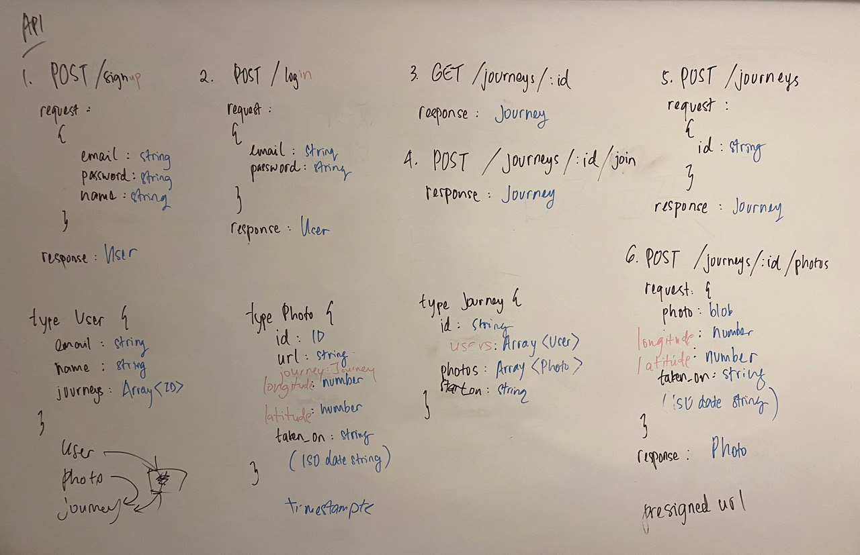
Backend Server
Application-tier: Flask (Python) with API calls fully done
Database: SQLAlchemy, SQLite

Slide 4
Future exploration/development
Reviews
Automatic slideshow maker for a given Journey

