Slide 1
The Technology Value Stream
Lead Time, DevOps Challenges, and Solutions
Kevin Ramirez
March 22, 2025
CSD 380

Slide 2
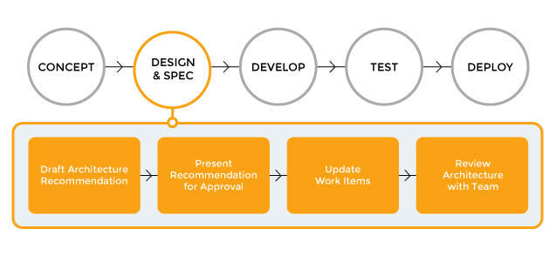
What is the Technology Value Stream?
A sequence of activities, processes, and tools that are needed to convert a business idea into a technology-enabled solution.

Slide 3

Lead Time vs. Processing Time
Lead Time: Total time from request to delivery
Processing Time: Time actively spent working on a task
Example: 10 days lead time, 2 days actual work = 8 days waiting

Slide 4
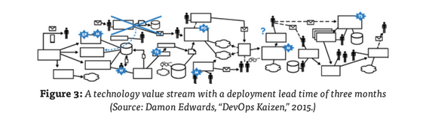
The Common Problem: Long Lead Times
In many traditional monolithic organizations:
Code is written quickly, and it’s hard to distinguish accountability
Investigations can take several weeks
A resolution causes many delays and results in poor customer outcomes.

Slide 5

The DevOps Ideal: Deployment in Minutes
The DevOps approach aims for taking minutes between writing code and deploying it
Uses automation, CI/CD pipelines, and cross-team collaboration
Enables faster, safer, smaller changes

Slide 6
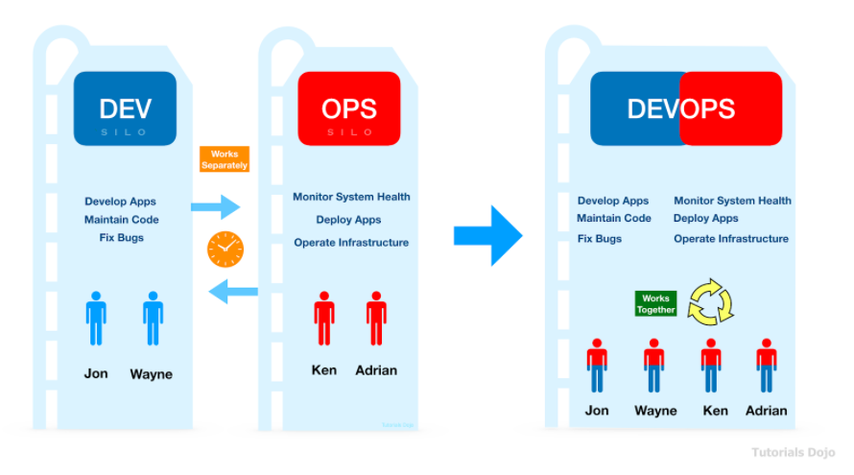
DevOps Deployment

Slide 7
Key Ideas
Shorter lead time improves delivery speed and feedback
DevOps helps eliminate waste and delays
Technology value stream helps visualize and optimize flow

Slide 8
References
Kim, G., Humble, J., Debois, P., & Willis, J. (2016). The DevOps handbook: How to create world-class agility, reliability, & security in technology organizations. IT Revolution Press.
Onyekwelu, P. (2023, September 3). DevOps vs Traditional: Key differences in software development and delivery. Dev.to. https://dev.to/princemaxi/devops-vs-traditional-key-differences-in-software-development-and-delivery-2j0g

